Slide 1
Opportunity Cost
What you lose

Slide 2
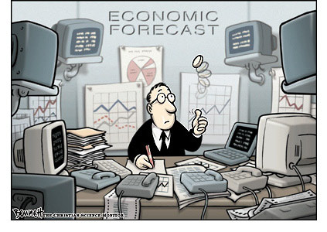
Effective and Efficient
As you will see economic decisions need to be both effective and efficient.
That means we often need to make 1 choice over another.

Slide 3
Desired Results
If we consume a given among of resources and achieve our goals then our use of the resources is effective.
If we use a bare minimum of resources to achieve our goal, our use of the resources is efficient.
Economic Imperative: To achieve the right goals (effectiveness) in the right way (efficiently)

Slide 4
Opportunity Cost
When we choose to use resources for one thing, we cannot use them for another. Therefore we lose something by allocating resources.
Life as we see is about choice. That choice often will cost us something.
For example you choose to go to Venue over doing your homework. What is the cost to you here?
Opportunity Cost is what you lose from making one given choice over another, thus eliminating the other choices.

Slide 5
Ceteris paribus
“With other things the same," or “All other things being equal or held constant."
Purpose: to acknowledge, and to rule out, the possibility of other factors that could override the relationship between the previous and the subsequent condition.
For example: Venue isn’t giving away test answers for being the best dancer. ☺

Slide 6
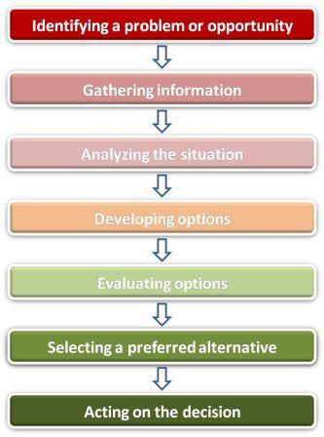
Decision Making:
Economists, like you, take have to evaluate problems using a set of criteria to make the best decision and minimize opportunity cost.

Slide 7
What do you choose and Why?
You have 2000 dollars.
1. Take a trip to Europe for 1 week.
2. Buy a new Bike.
3. Go to build schools in Africa for a summer.
The opportunity cost of your vacation is the satisfaction lost from your next best choice. I.e.. How unhappy you are for not having that vacation.

Slide 8
Your Choices
Whichever Choice you Make it depends on your values and the facts that you have been presented or determined to affect the choice you made.

Slide 9
Economists are NO Different
Analytical Economics: Branch of economics that deals with facts and direct observations about the world around you.
Descriptive Statements: Portrays things as they are in the present or as they have been in the past.
Conditional Statements: Uses analysis to determine what will happen in the future based on past facts and patterns. i.e. “If x happens then y will follow”

Slide 10
Normative Economics
Deals with policy and statements that primarily contain judgments. These are value based statements (i.e. if you believe climate change is destroying our planet, you might make a statement containing that value)
Governments, firms, institutions and interest groups often provide these types of statements.

Slide 11
Judge the Following Statements
Are the following statements normative or analytical (descriptive or conditional)?
a) If a minimum wage is introduced in Haiti, prices paid by consumers will have to increase
b) Government should provide affordable day care for the benefit of working parents
c) If people buy a lot of teddy bears, the price of teddy bears will increase.
d) Students who complete tertiary education are 45% more likely to make more than CAD40, 000 per year.

