Slide 1
Influences in Canadian law

Slide 2
Part 1:primary sources OF Canadian law
Parts of the legal system that have the longest historical development and represent the system’s cumulative values, beliefs and principles.
Religion and Morality
Historical Influences
Customs and Conventions

Slide 3
1. Religion and MORALITY - Christianity
Missionaries came to Canada in 16th and 17th Centuries brought with them their beliefs and practices.
You swear (or affirm) that the evidence to be given by you touching the matters in question between the parties to this proceeding shall be the truth, the whole truth, and nothing but the truth. (you do not need a bible in Ontario for this)
10 Commandments and Canadian Law
Excepts from the 10 Commandments | Excerpts from Canada’s Criminal Code
#5 Thou shalt not kill | s.235(1) Every one who commits first degree murder or second degree murder is gulty of an indictable offence and shall be sentenced to imprisonment for life.
#7 Thou shalt not steal | s. 344 Every person who commits robbery is guilty of an indictable offence and liable…to imprisonment for life
#8 Thou Shalt not bear false witness against thy neighbour | s. 132 Every one who commits perjury is guilty of an indictable offence and liable to imprisonment for a term not exceeding fourteen years.

Slide 4
Lord’s Day act
The Lord’s Day act was challenged and abolished in 1982 after the Charter of Rights and Freedoms came into affect. Clearly if you were not a Christian and were forbade from doing business based on Religion on Sundays, your rights were being violated under Section 2a of The Charter.
- As Canada has become more diverse, laws have changed.

Slide 5
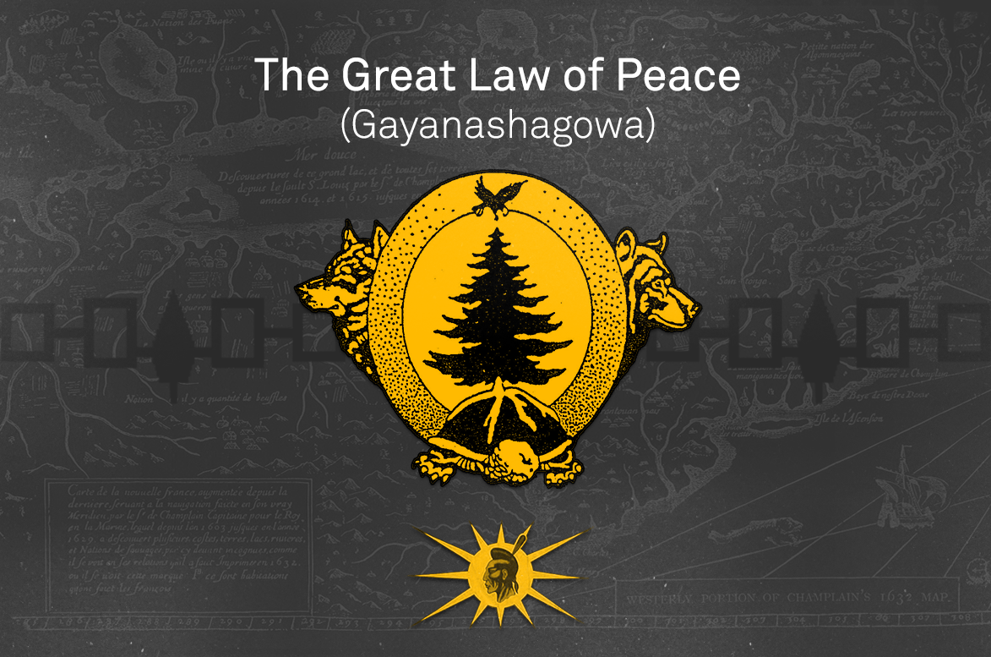
#2. historical -Indigenous Peoples and LEGAL INFLUENCE
Legal tradition in Indigenous communities is passed down by elders through stories.
However, they often did not write these laws down the same way Europeans did, but this did not make them any less important.
1142 CE The Confederacy was established by the Mohawk, Seneca, Onondaga, and Cayuga. It took 40 years to create. The union bout together the tribes in a formal constitution called Gayanashagowa or “great binding law”. It provided checks and balances giving everyone a voice in tribal affairs and made it so if a chief wasn’t acting in the best interests of the people they could be removed. This was referenced by bot the US Constitution and the Charter of the United Nations.

Slide 6
Some Legal Highlights
Under the Indian Act (awful name)
The Indian Act of 1876 dismantled traditional systems of governance and imposed external controls — in the form of local Indian agents and the federal bureaucracy of the Department of Indian Affairs on individuals and communities.
Indigenous peoples saw their rights to self-government affirmed in the​Constitution Act, 1982
First Nations have made successful sectoral arrangements allowing for greater governance powers not provided under the Indian Act. Some examples include: First Nations Land Management Act (1999), First Nations Fiscal Management Act (2005), First Nations Oil and Gas and Moneys Management Act (2005), First Nations Commercial and Industrial Development Act (2006), and First Nation Property Ownership Act (2009)
In 2011, Parliament passed the Gender Equity in Indian Registration Act, also known as Bill C-3 which grants status to grandchildren of women who regained status in 1985.
One part of Bill S-3 came into effect on 22 December 2017. Among other provisions, the amendment enables more people to pass down their status to their descendants and reinstate status to those who lost it before 1985.

Slide 7
#2. Historical - ANCIENT influences
Read the excerpt you have been given that discusses the theory of Justice.
What was justice for Plato?
What is the role of the individual?
What is justice for Aristotle?
Which do you agree with? Why?
Epicurus thinks happiness is at the core of justice, do you agree? Why or why not?
What is justice for you? Write this down and see if it changes by the end of the course (hint: Final Exam Question)

Slide 8
#3. Culture and Customs
Customs are long – established ways of doing something that overtime has acquired the force of law. (Can you think of one?)
Conventions are a way of doing something that has been accepted for so long it amounts to an unwritten rule (Can you think of one?)
As you can see so far cultures and customs permeate throughout our legal system. As our society changes and evolves so does our laws. That is why I feel Indigenous Peoples should be included not only in History, but in Culture and Customs as well.
Go to our website and together we will explore more indigenous influence on Canadian Law and Society. Then read the case posted there and answer the questions.

Slide 9
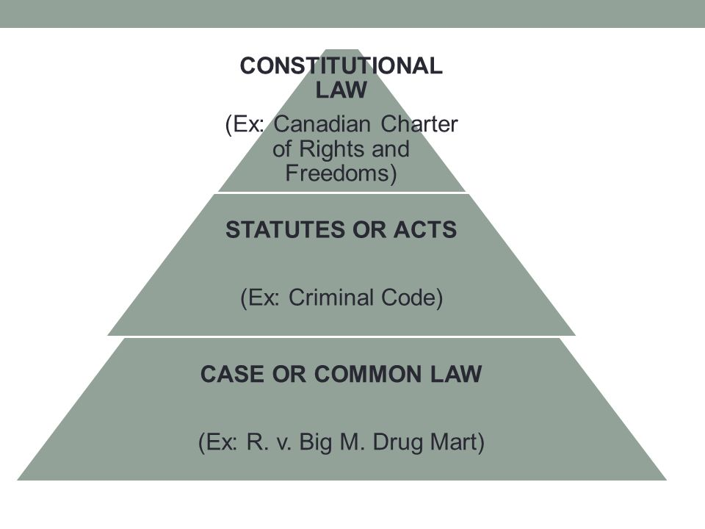
Part 2: Secondary sources of Canadian law
Current laws that enshrine a society’s values in written rules and regulations that have been formulated by legislators and judges.
The Constitution
Statute Law
Case Law
They Pyramid: If a statute (a written law passed by a legislative body) is found in contradiction with it then the statute must be revised or repealed. Statute law takes precedence over case law or decisions made by lower courts, except when statues are found unconstitutional.

Slide 10
1. The constitution
Constitutional Law: the body of written and unwritten laws that set out how the country will be governed. It sets out the distribution of powers between the federal government and the provinces.
1867 the British North American Act is the first of these documents that founded Canada as a Dominion. “Constitution similar in Principle to that of the United Kingdom.”
The Canadian Legal & Government was created in the image of Britain

Slide 11
Judicial Independence & Parliamentary Supremacy
The Principle of Judicial Independence asserts that judges function independently of the government.
The Principle of Parliamentary Supremacy asserts that Parliament has the supreme power of making Canadian Laws.

Slide 12
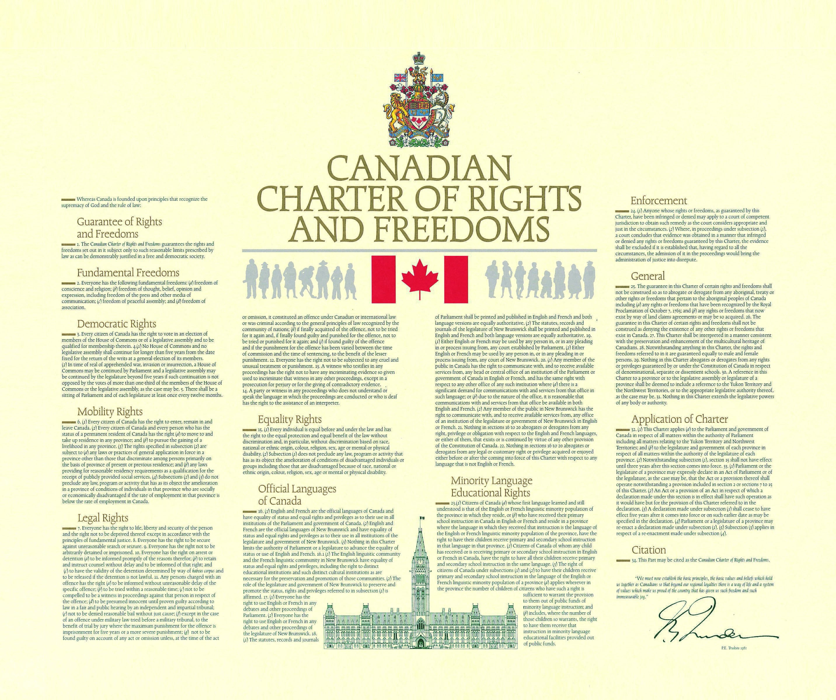
Amendments to the Constitution
1982 the constitution was patriated, which means that Canada has the right to amend its own constitution, without British approval.
The Charter of Rights and Freedoms was entrenched in 1982 with the Constitution Act as well. (Link to this Document is on our website) More on this in Unit 2
Many of the Rights & Freedoms we take for granted today were introduced then.

Slide 13
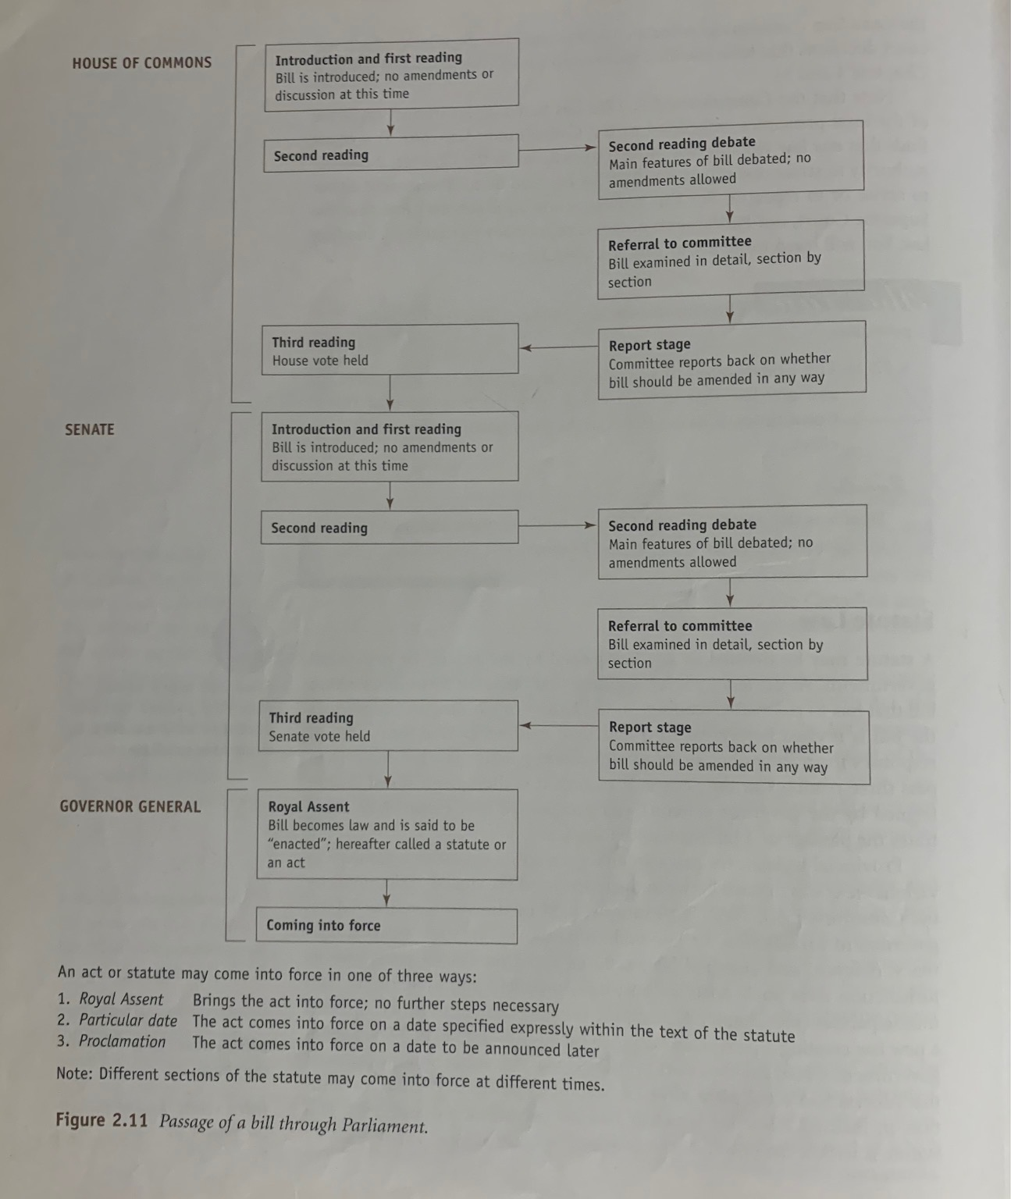
Statue Law
These are Laws passed by federal and provincial governments.

Slide 14
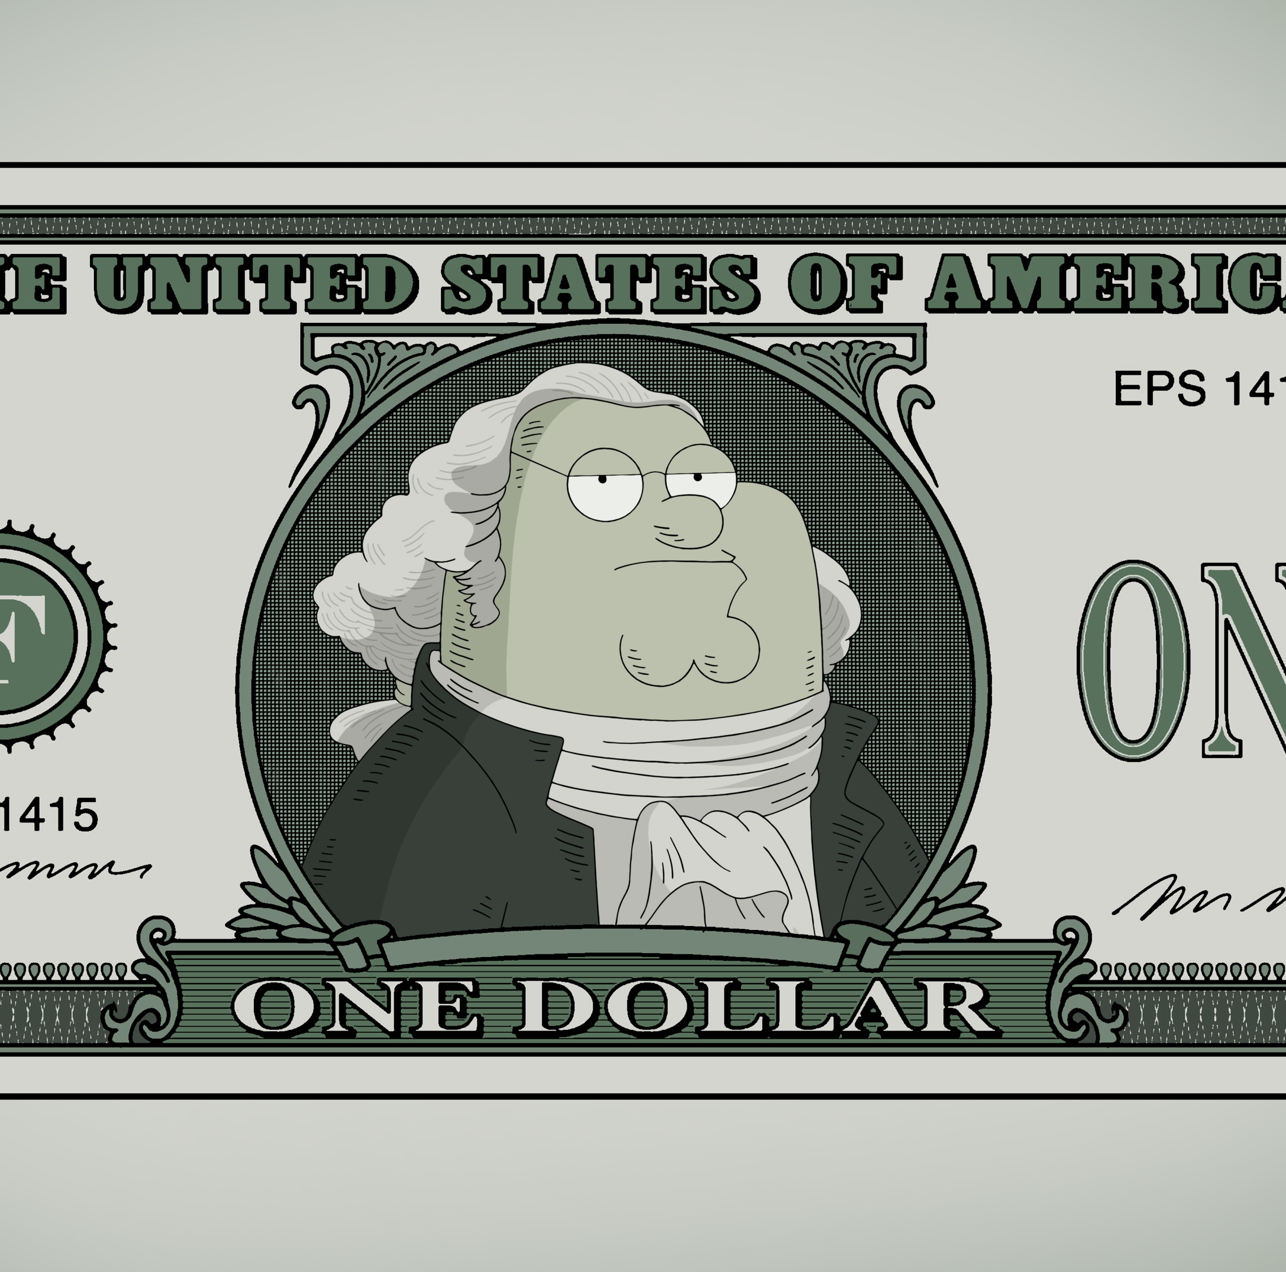
Ultra & Intra Vires
If a province passes a law that exceeds the powers like a province creating its own currency for example the federal government can say they have ultra vires or exceeded their power.
If a statute is within the province’s power it is intra vires.

Slide 15
Case Law
In most cases judges have to render a written decision or explanation of their ruling and it is these decisions that form the basis of case law.
Case Law is distinct from statute law.
Stare decisis: to stand by the decision. This means previous decisions are taken into account when making rulings on current ones. The precent must be followed if it was set by a higher court. Sometimes precedents do not apply if it was from another province or the case circumstances were too different.
Lawyers and Judges prepare for cases by reading through prior case law.
Statutory Interpretation is how judges interpret laws through cases that are referred to them.

Slide 16
Part 3: Categories of Law
Substantive Law: A law that identifies the rights and duties of a person or level of government.
Procedural Law: A law that outlines the methods or procedures that must be followed in enforcing substantive laws.

Slide 17
Domestic & International Law
Domestic Law: A law that governs activities within a particular country. Ex. Firearms Act. It has no application outside of Canada.
International Law: A law that has jurisdiction in more than one country. Ex. Extradition Treaty.
Go to our website and visit the link to the countries with and without extradition treaties.

Slide 18
categories OF law
Public Law: Area of Law that regulates activities between a state and its citizens.
Administrative Law
Criminal Law
Private Law: Area of Law that regulates disputes between individuals, businesses, or organizations sometimes referred to as Civil Law
Family Law
Contract Law
Tort Law
Go to our website to examine your Categories of Law Presentation Assignments.

