Slide 1
Poverty
How Economics tackles market failures

Slide 2
Defining Poverty
Most agree that poverty involves: substandard housing, poor nutrition, limited social opportunities, difficulties in financing post secondary education, and problems providing for children.
Absolute Poverty – a state of utter destitution (what you often see on TV)

Slide 3
Wealth Gap
The gap between the haves and have not's is growing. Look at our website to see how much.

Slide 4
Poverty Lines or Relative Poverty
Relative Poverty means that one is poor in relationship to the conditions of material life that most other people have in Canada.
Low – income cut off (LICO) – identifies income levels below what a household statistically classified as being in a relatively limited income situation.

Slide 5
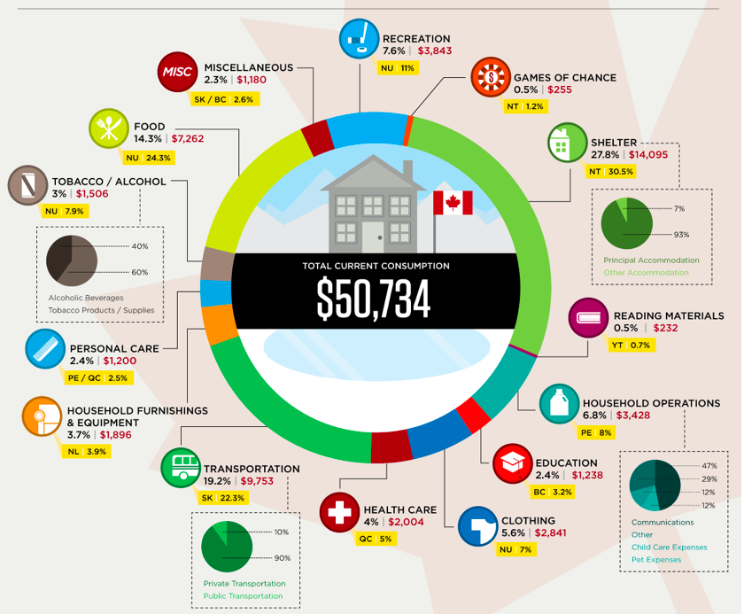
Graphic from Stats Can.

Slide 6
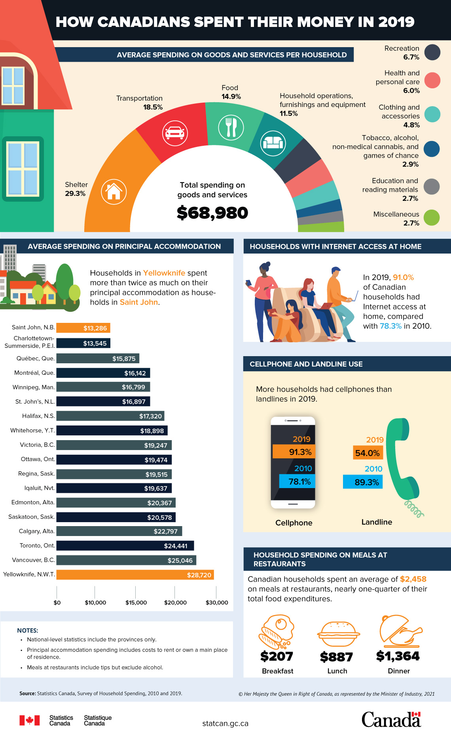
Another

Slide 7
Low Income Cut Offs
How much does it cost to live in Toronto?
How much does it cost to live in Vancouver?
How much does it cost to live in Ottawa?
How much doe it cost to live in Halifax?
Find the answers to the above and then look at the Low Income Cut Offs.
IF you work at Walmart making 16$ (minimum wage) per hour can you afford to live in these cities? What is the relationship between LICOs and minimum wage? Does this change your stance on minimum wage?

