Slide 1
Political Satire
Cartoons and Commentary

Slide 2
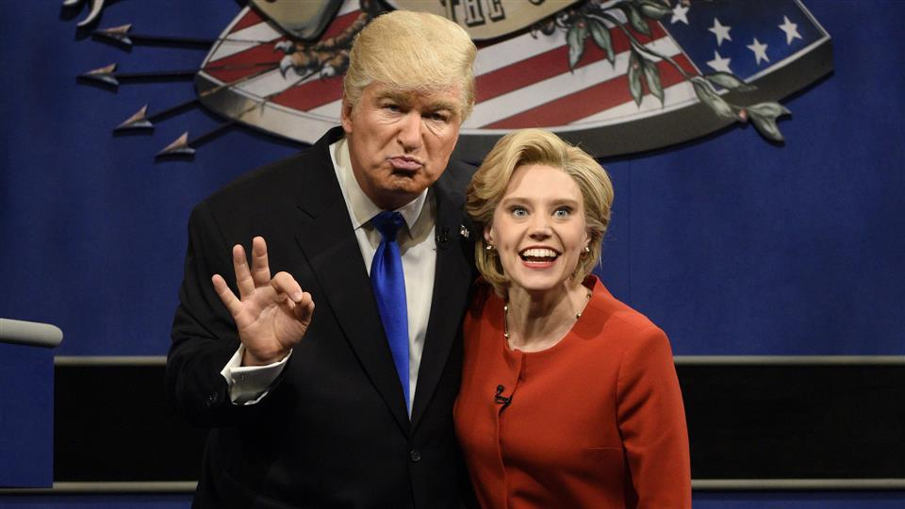
Political Satire
Political commentary covers the spectrum of political views.

Slide 3
Examples in Media
Political satire takes many forms: television programs like The Daily Show, cartoons like South Park and The Simpsons, and Internet channels like The Beaverton and Youtube's Autotune the News are notable examples in different mediums.
Recent memorable examples include Jon Stewart's and Stephen Colbert's 2010 'Rally to Restore Sanity and/or Fear', Tina Fey's impression of Sarah Palin on Saturday Night Live (2008), and the 2015 Charlie Hebdo controversy in Paris, France.

Slide 4
What it Does…
​These satires succeed when mixing the realities of political debate with a grain of humor.
Whether in an illustration or television comedy show, political satirists enlighten our understanding of a debate by warping the reality ever so slightly.
They can reveal the insanity underlying a political controversy and show us the banality of political discourse.

Slide 5
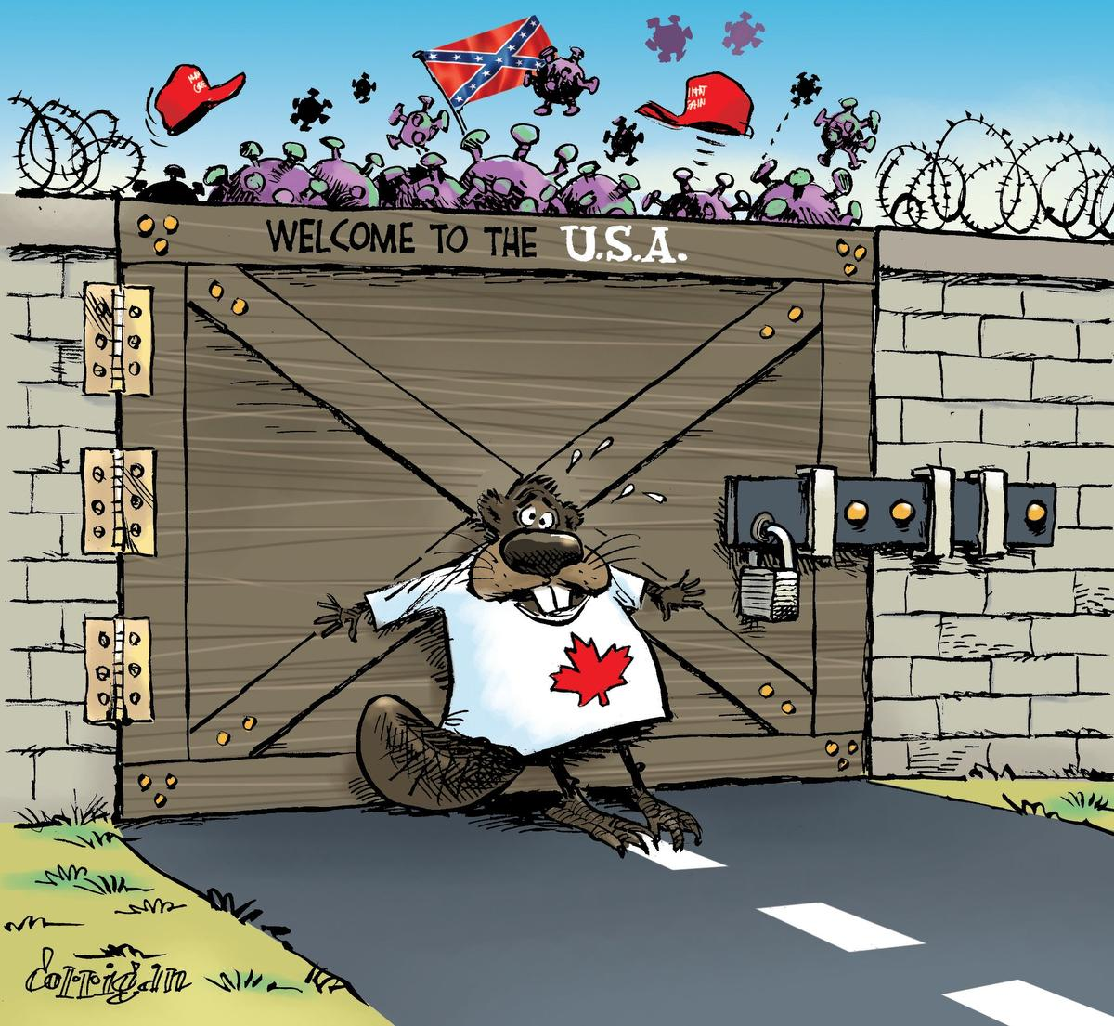
Political Cartoons
Political cartoons allow us to examine the many persuasive techniques cartoonists use to change people’s minds.
The most used persuasive techniques are symbolism, exaggeration, labeling, analogy, and irony

Slide 6
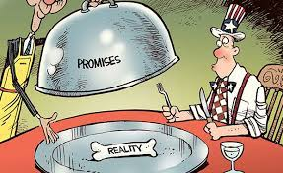
Symbolism
Simple objects, or symbols, can stand for larger concepts or ideas.
Identify any symbols and what they are intended to represent.

Slide 7
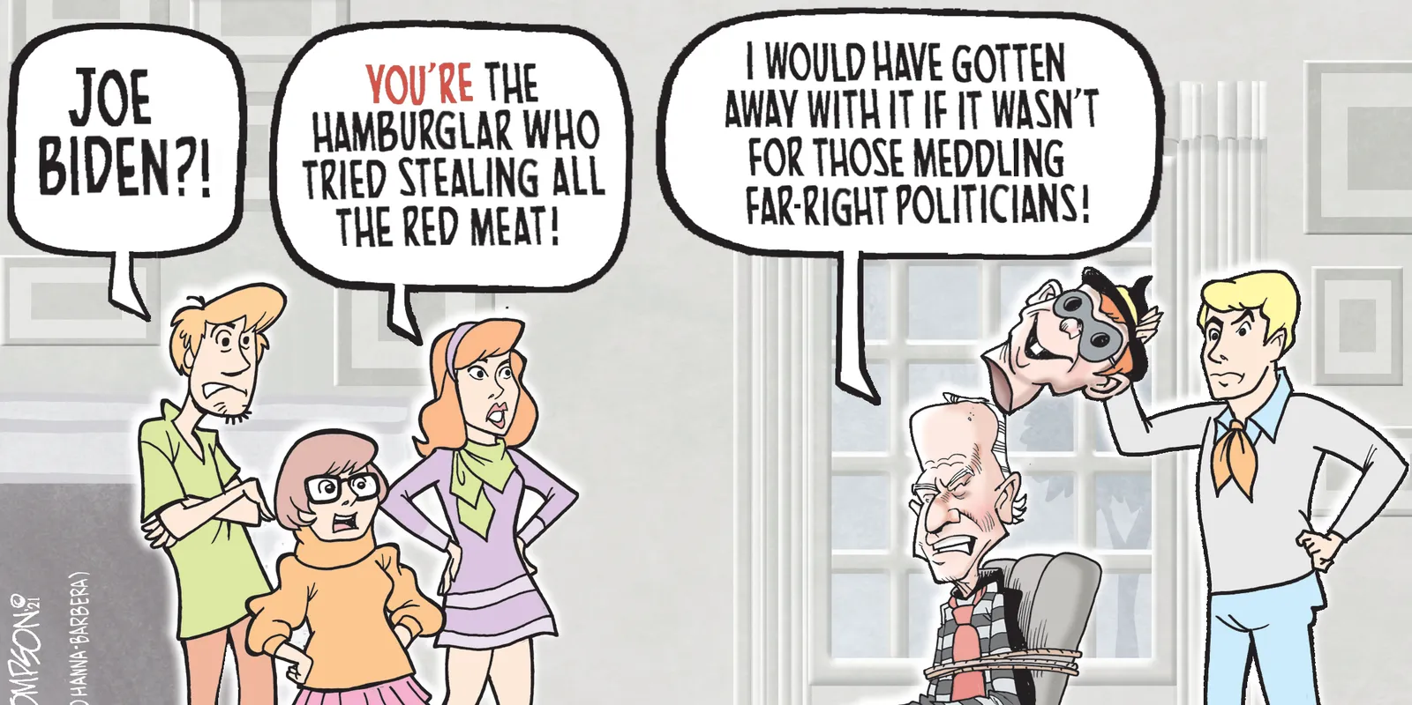
Exaggeration
Physical characteristics of people or things may be exaggerated to make a point.
What are the exaggerations and why the artist chose to exaggerate these features?

Slide 8
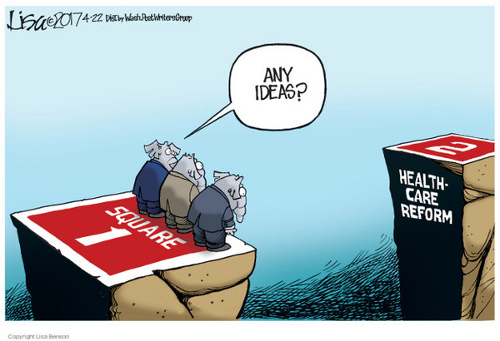
Labelling
Sometimes objects or people are labeled to make it obvious what they stand for.
Why the artist decided to add a label?

Slide 9
Analogy
By comparing two different things, cartoonists can help their readers see a different point of view.
What the analogy is comparing and what is the point the comparison makes?
How does the first cartoon demonstrate a comparison?

Slide 10
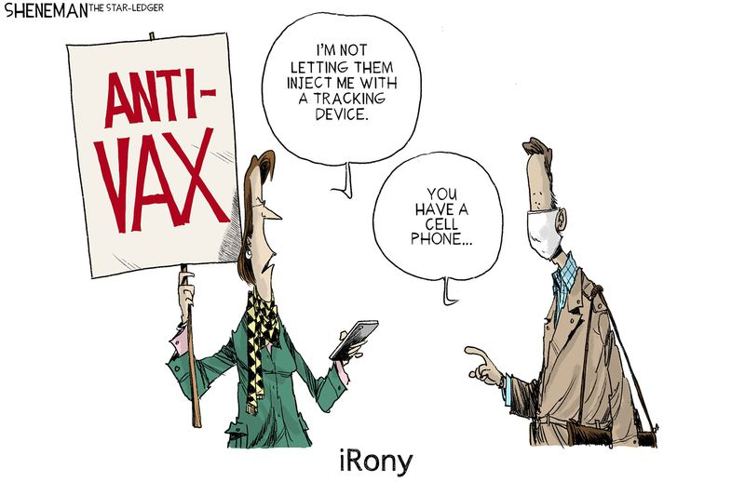
Irony
Irony is the difference between the ways things are and the way things should be or are expected to be. Students should decide if the irony expresses an opinion on the issue.
We can now take a look at some political cartoons surrounding the Reasonable Limits Clause and Notwithstanding Clause.

