Slide 1
Canadian Politics
A Brief History and Explanation

Slide 2
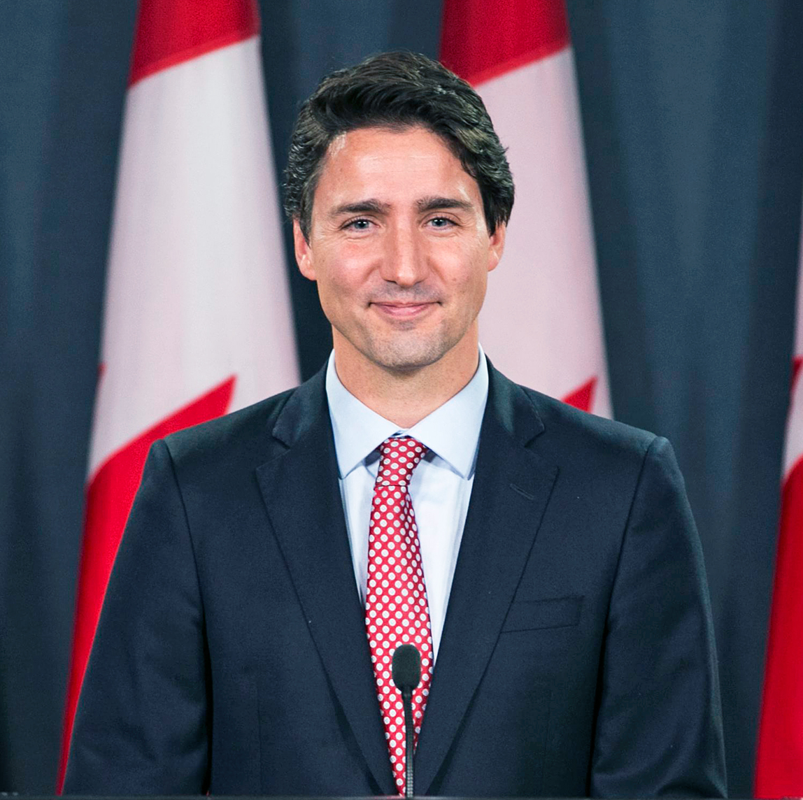
Prime Minister
The prime minister of Canada is an official who serves as the primary minister of the Crown, chair of the Cabinet, and thus head of government of Canada.
Officially, the prime minister is appointed by the Governor General of Canada, but by constitutional convention, the prime minister must have the confidence of the elected House of Commons.
Normally, this is the leader of the party caucus with the greatest number of seats in the house.

Slide 3
Parliament
The federal legislature of Canada, seated at Parliament Hill in Ottawa, and is composed of three parts: the Monarch, the Senate, and the House of Commons.
By constitutional convention, the House of Commons is dominant, with the Senate rarely opposing its will.
338 members of the House of Commons—called members of Parliament (MPs)—each represent an electoral district, commonly referred to as a riding, and are elected by Canadian voters residing in the riding.

Slide 4
Some History
1867
Post 1867 The Liberal and (Progressive) Conservative parties dominated Canadian politics.
1961
The New Democratic Party became stable in 1961.
1993
the Conservative Party broke and created the Reform Party (later the Canadian Alliance) and the Bloc Quebeccis
2003
Two ”right wing” parties aligned to create the Conservative Party of Canada (what we have now)

Slide 5
What is a Political Party?
#1. An organization or group that nominates candidates and contests elections in order to influence the personnel and policy of government.
#2. Are broad in scope to appeal to many different interests or demands.
#3. Parties reduce these demands to manageable quantity called “issues”.
#4. Political parties are tied to formal institutions of government including the electoral system and Parliament, based on territorial representation.
#5. Parties recruit decision makers usually from within their own parties.

Slide 6
Political Parties
Parties develop distinct election platforms that seek to formulate public policy around issues they and society feel are important
The successful party seeks to implement their platform while other parties oppose it providing ‘policy alternatives’.
6 Main Political Parties in Canada. On your assignment is a link to others as well.

Slide 7
Two Types of Parties
Catch All Parties – focus on winning elections and getting the most votes from the population
Liberal / Conservative
Programmatic Parties – retain an ideologic identity
Bloc, NDP, Green, PCP
Broker Theory – Parties function to maximize their appeal and mediate the differences between various parts of Canadian society (regions, religions, linguistic groups, ethnicities, gender, classes, age and urban/rural locations) Interests / issues they are concerned with are those that most voters are concerned with
Do Liberals and Conservatives have and ideology that they hide or have one at all?

Slide 8
Party Ideologies – Complex Stuff!!
Some argue that Liberals and Conservatives do not have an ideology and that they respond pragmatically to public opinion (Provincial Example: Doug Ford on vaccines, opening and closing economy etc.)
Fragment Theory suggests there is a basic ideology of liberalism (more details next unit!) in Canada but that traces of socialism and conservatism also exist.
Canadian liberalism seeks to liberate the induvial and maximize each individual’s freedom (most Canadians support this). Differences occur when we discuss who should be liberated, when, and how to do so.

Slide 9
Ideologies in Canada
Conservativism (the right) seeks to liberate the individual from restrictions of the state, allowing private markets to flourish that determine wealth and power or individualism. Minimizing taxes, little government regulation, “some people are better because they work harder.”
Social democracy (the left) seeks to liberate the individual from inequalities and exploitation of capitalism. Egalitarianism (all people are equal) and government intervention (planning, regulation, ownership of some major industries, progressive taxation and redistribution of wealth) or collectivism to achieve equality and liberation from constraints.

Slide 10
Critical Approaches
Rational choice arguments feature prominently in the study of political parties. They say that the relationship between political parties and voters is similar to that of business and consumers. Do you agree or disagree? Discuss.

