Slide 1
Approaches to Studying Politics
5 Brief Approaches

Slide 2
Why Approaches?
Illuminating aspects of the Canadian (and other nation’s) political systems.
They focus on questions such:
#1 How widely power an influence are shared?
#2 Which political actors in society are most important?
#3 Which government institutions are most powerful?
#4 How politicians seek and maintain power?
#5 How much government actions are affected by external factors?

Slide 3
#1 Institutional Approach Characteristics
The Oldest.
Sees constitutions and law as the main substance of politics and government as the proper object of political analysis.
Government is understood to be essentially constituted by a set of rules, and rules governed by overarching constitutions, written and unwritten.
Power is more concentrated in Canada.
Who makes decisions?
How are decision makers chosen?
How are their decisions made?
Example: Universal HealthCare in Canada vs. US Private. Parliament power is constituted in such as a way that small groups cannot so easily block legislation.

Slide 4
#2 State-based Approaches
State actors using the powers of the state to shape economic and social circumstances of their country.
Emphasizes the autonomy of state actors who seek to increase their own power.
State actors are translate their preferences into public policies by using support from like minded individuals, changing preferences of opponents, or imposing their will on society.
Nordlinger, “individuals who occupy offices that authorize them, and them alone, to make and apply decisions that are binding upon any and all segments of society.”

Slide 5
Political Economy
The study of the state and its interaction with the economy.
States steer the economic actions of their country directions that favor state actors. E.g. Oil investment in pipelines in Alberta.

Slide 6
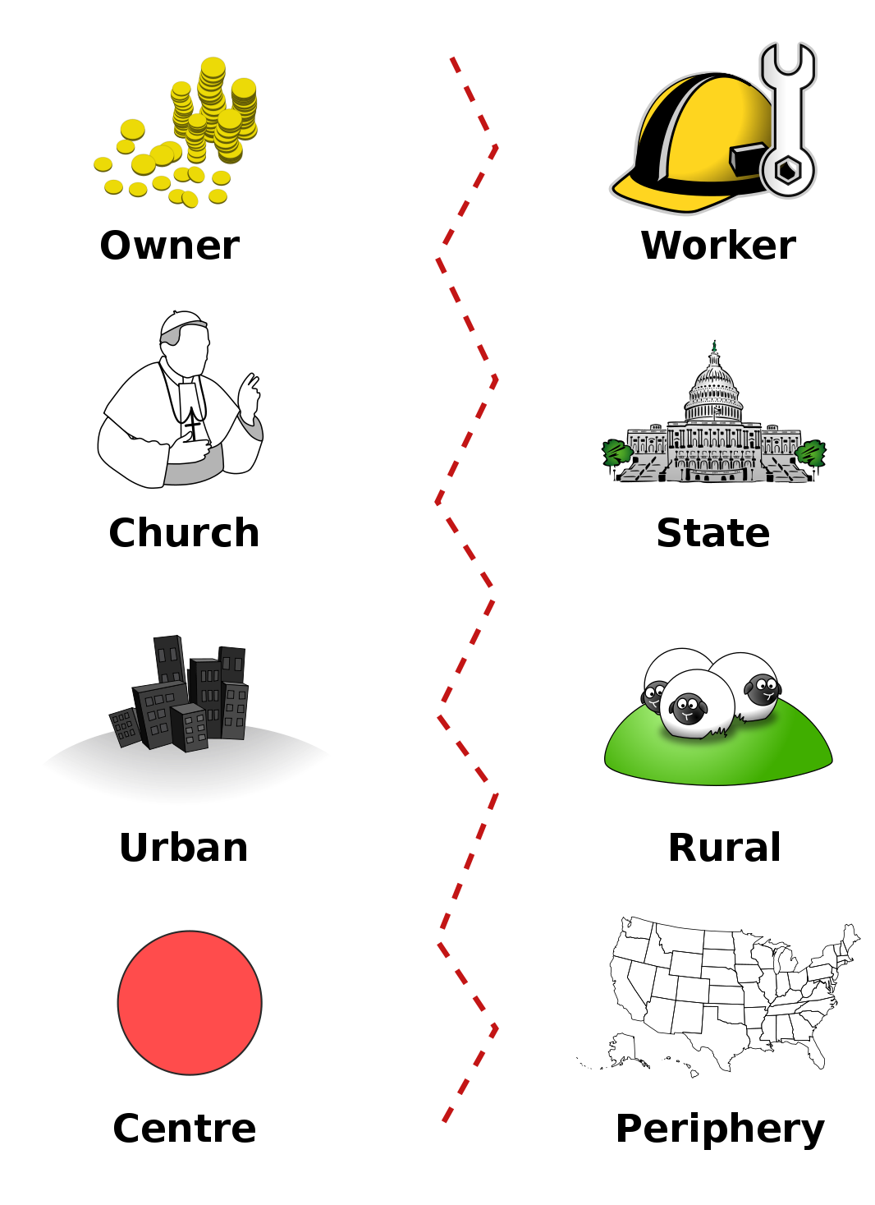
#3 Political Sociology Approach
Study government in the context of the broader social and economic environments of which it is a part.
Focus on groups and social forces.
Looks at division in terms of religion, ethnic backgrounds, language, regional division, and economic class system division.

Slide 7
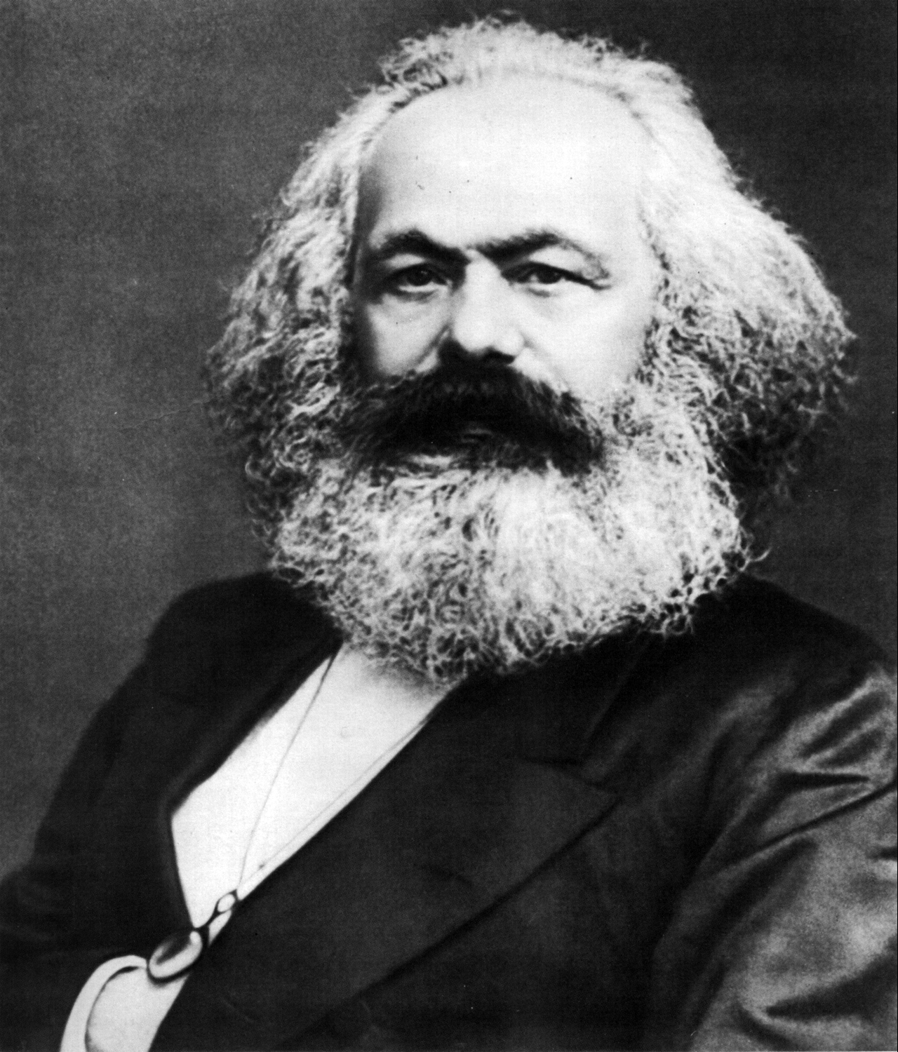
Marxist Approach
Focuses on social class and economic groupings. Marx predicted the conflict between capitalist halves and have-not's.
The political elite normally take orders from the capitalist elite (corporations) and thus the state is dominated by these elites.
Lobbyists are modern examples of this.
From this perspective politics is first and foremost a class conflict and about how power groups from the economy are transferred into patterns in government.
Lets have a look at wealth distribution in Canada

Slide 8
Working in Canada

Slide 9
#4 Political Psychology and Behavior Approach
Seeks to understand why people think the way they do about politics.
Examines politically related attitudes, opinions, beliefs, perceptions , expectations, motivations, and behaviors.
Politics about the individuals and the importance of individuals.
Focus on surveys and statistical analysis of the opinions of people.
Use of observation and scientific method.

Slide 10
#5 Rational Choice Approach
Individuals seek to maximize their utility as efficiently as possible.
Utility is what people are seeking (money, happiness whatever)
Focus on how individuals and groups pursue their motivations (desires)
Assumes behaviors are goal orientated.

Slide 11
Thinking Questions
How might different approaches to studying politics demonstrate different political motivations?
How can young people (YOU) increase their influence on the Canadian pollical system?

