Slide 1
Monetary Policy
The Role of The Government

Slide 2
Banks
As you have seen in the video, banks and by extension the federal bank, have a great influence over the economy.
Governments use the banks to direct monetary policy. - Controls the supply of money, often targeting an inflation rate or interest rate to ensure price stability and general trust in the currency.

Slide 3
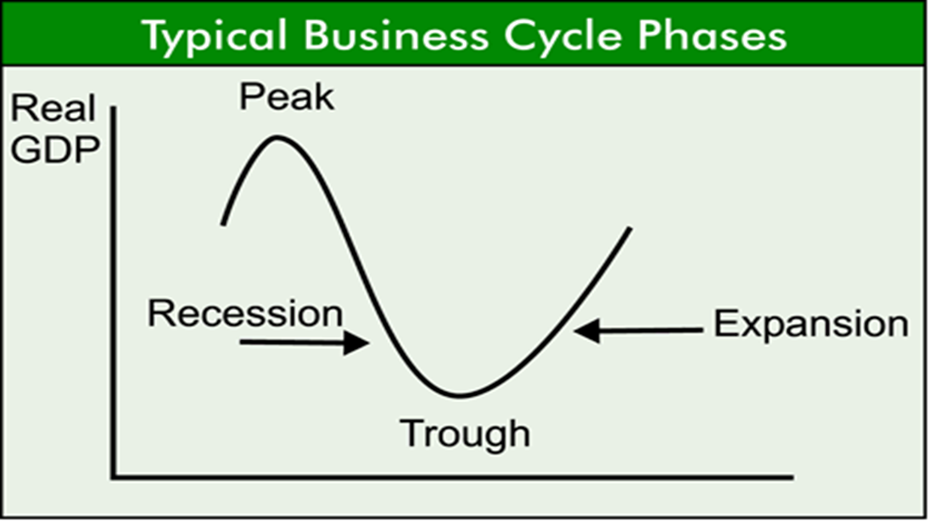
Tight Money to Reduce inflation
Easy Money to help stimulate the Economy

Slide 4
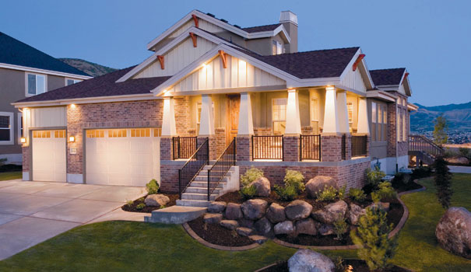
Easy Money
Central Bank/Treasury shifts money to Chartered Banks and increases their Reserves making it easier for them to lend money with a lower interest rate
Low Interest Rate encourages consumers to borrow for large purchases (Big Ticket Items).
Businesses respond by borrowing to increase inventories, and equipment

Slide 5
EASY MONEY POLICY
New borrowing increases Money Supply growth through increased bank deposits allowing the increased output to be purchased through the economy.
Increased spending by consumers shifts AD to the right, Increasing GDP and thereby ending recession.
D
S
S₁
Interest Rate (%)
Quantity of Loanable Funds
AS
D
D₁
Price Level
Real GDP
FE

Slide 6
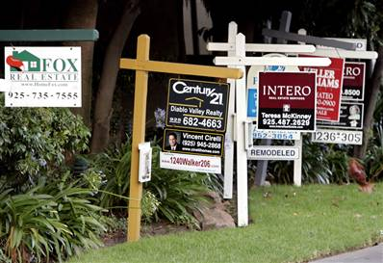
Tight Money Policy
Central Bank/Treasury shifts money from Chartered Banks and decreases their Reserves thereby making it more difficult for them to lend money with a higher interest rate.
High Interest Rate discourages consumers to borrow for large purchases (Big Ticket Items). Businesses respond by cutting investment in inventories, and equipment

Slide 7
TIGHT MONEY POLICY
Less borrowing decreases Money Supply growth as banks find it difficult to lend money based on reserves. Leads to decreased spending.
Decreased spending by consumers shifts AD to the left, Decreasing GDP and thereby ending inflation.
D
S₁
S
Interest Rate (%)
Quantity of Loanable Funds
D
AS
D₁
Price Level
Real GDP
FE

Slide 8
MONETARY POLICIES AND THE BUSINESS CYCLE
ITEM | EASY MONEY | TIGHT MONEY
Consumer Spending | Increase | Decrease
Business Investment | Increase | Decrease
Interest Rates | Decrease | Increase
Bank Lending | Increase | Decrease
Money Supply Growth | Increase | Decrease
Inflation | Increase | Decrease
Unemployment | Decrease | Increase

Slide 9
Fiscal Policy
This is Fiscal Policy: something used by the government to alter the size of the circular flow of income in the economy so as to bring about consumer demand more employment inflationary restraint or other economic goals (in America’s case to reduce deficit)

Slide 10
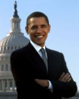
Discretionary Fiscal Policy
What Obama is doing: when the government takes deliberate actions through legislation to alter spending or taxations policies in order to influence spending and employment levels.

Slide 11
Expansionary Policy
Republicans: the government may want to increase aggregate demand through a tax cut, increase in government spending or both.
Republicans want the tax cut to have the government cut medicade and privatize it.
Obama: wants a tax increase for the rich, cut for the middle and poor and to increase government spending on infrastructure.

Slide 12
EXPANSIONARY POLICY
AD₁
AS
AD
Price Level
Recessionary Gap
FE
Real GDP (Output)

Slide 13
Contractionary Policy
If the government was doing well: A tax increase across the board and decrease to government spending or both would move the aggregate demand to the left and stem growth.

Slide 14
CONTRACTIONARY POLICY
AD
AD₁
AS
Price Level
Inflationary Gap
FE
Real GDP (Output)

Slide 15
Obama’s Argument
If we raise tax for the rich they will pay a higher percentage and therefore contribute more to the ‘pot’
If we spend in sectors that will help the ‘middle class’ get jobs they will also pay tax and boost the economy as per the circular flow of income.

Slide 16
Tools of Fiscal Policy
We already mention taxation and spending on infrastructure (new roads, railways, hospitals, education, est..)
Automatic Stabilizers: Employment insurance and welfare automatically stabilize the economies during periods of recession. These slow the leftward shift of the AD or begin to increase it.

