Slide 1
Modern Political Theory
Contemporary Theories Dealing With Modern Issues

Slide 2
Previous Classical & ‘Modern’ Theorists
Political philosophy is also known as political theory but it must also be understood that Plato (Republic), Hobbes (Leviathan), and Marx (in the entire body of his work), are example of political philosophers
Machiavelli, James Madison, and Isaiah Berlin are examples of political theorists.

Slide 3
Philosophy vs. Theory
Traditional theory (philosophy) or approach in political science is a normative or an imaginative approach to politics. It emphasis on “what ought to be” rather than “what is”
The modern political approach on the other hand, is scientific or behavioral approach to political issues that are happening now.
“To put it crudely: a political philosopher is much more likely to appeal to a higher level of abstraction (to general ethical theory, then to metaethics, then to epistemology...) while a political theorist is much more likely to appeal to a lower level of abstraction (empirical findings, history).” (Levy) https://profs-polisci.mcgill.ca/levy/theory-philosophy.html

Slide 4
Contemporary Political Theory
1. It is philosophical, i.e. it is concerned with the normative and conceptual framework.
2. It is empirical, i.e., it is concerned with the problem of understanding and explanation of the concepts.
3. It is historical, i.e., it is concerned with the examination of the key concepts of political theory in historical context;
4. It is strategic, i.e. it is concerned with an assessment of the feasibility of moving from where we are to where we might likely to be. (Dr. George T. Haokip)
In other words its concerned with both what ought to be and the issues that we are experiencing now.\

Slide 5
Purpose
Social Issues need context.
This slide show is designed to give you an overview of some important minds in modern theory and some different ways to examine political theory. It’s the Metaethics of the course (Review – Dealing with how we tackle issues before we tackle issues).

Slide 6
Three Philosophers/ Theorists:
Michel Foucault
Noam Chomsky
G.A. Cohen

Slide 7
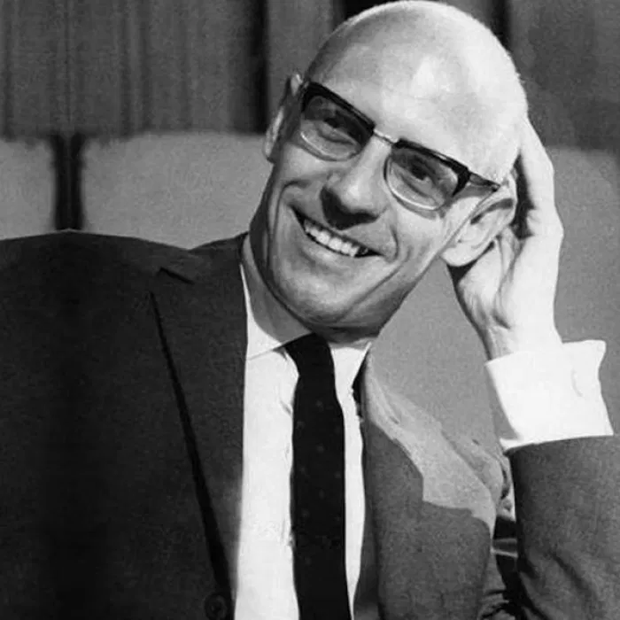
#1 Michel Foucault (1926 - 1984)
The term ‘political philosophy’ has come to be associated with a form of thought that consists on producing prescriptive views about the ways politics ought to work, as an adjunct to reflection about morality.
Tradition of Kant, for whom morals and politics are indissociable.
Foucault’s political philosophy consists of non-normative descriptions of reality.
For Foucault knowledge is formulated as a strategy of a battle between forces.
For Foucault Power relations provide a general grid of analysis for society.
For Foucault, the point of mass political activity is to achieve liberation, hence ultimately it is oriented against leadership.
Kelly, Mark G. E. (2008)

Slide 8
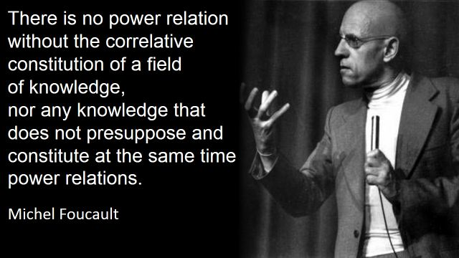
Foucault & Power
Anarchy is a society being freely constituted without authorities or a governing body.
Foucault is not an anarchist. The central political role of the intellectual is to advise as to the possibilities of political action, though an analysis of the strategies of power. Thus, there must be a decision, made by those who resist but informed by a critical analysis
Foucault does not want us ever to accept any power uncritically, we can never be free of power. Thus, we must always question and challenge power, with new problems and new priorities.
Kelly, Mark G. E. (2008)

Slide 9
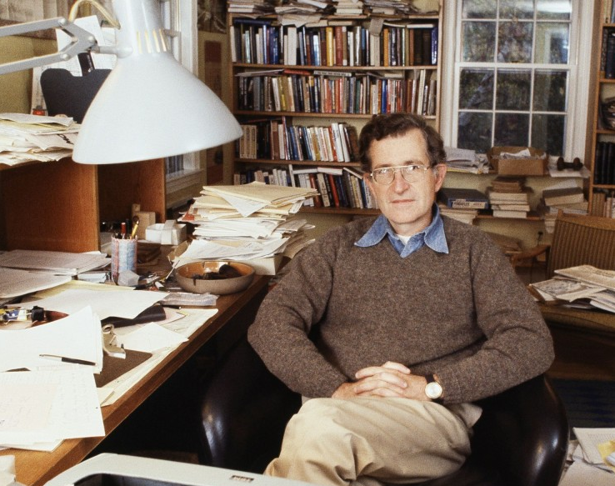
#2 Noam Chomsky (1928 - )
Who? Philosopher, Author, Professor at MIT, Acting Dean of Harvard…
I think its best for Chomsky to explain, what his political beliefs are. Watch the 4 videos on our website (as many times as you need) to gain an understanding (without just trying to Google him) of what his beliefs are. Be prepared to summarize them. If you want to Google them afterwards, you can, but figure out what you an on your own or with those around you, share, then Google.

Slide 10
#3 G.A. Cohen (1941–2009)
Who? Canadian, Oxford Professor
Arguably the leading political philosopher of the left. Wrote Why Not Socialism? (2009)
He argued that they (capitalists) believe that the distribution of property is somehow part of the natural order of things, like weather or death, and that freedom is distributed on top of that. He goes on to say that this unequal distribution in the end destroys, rather than enhances, freedom as its distribution in a capitalist society necessitates halves and halve nots.
He wrote If You're an Egalitarian, How Come You're So Rich? (2000)
Believed that what is needed to bring about equality are changes in individual attitudes and choices – a position
An egalitarian favors equality of some sort: People should get the same, or be treated the same, or be treated as equals, in some respect. An alternative view expands on this last-mentioned option: People should be treated as equals, should treat one another as equals, should relate as equals, or enjoy an equality of social status of some sort. Egalitarian doctrines tend to rest on a background idea that all human persons are equal in fundamental worth or moral status.

Slide 11
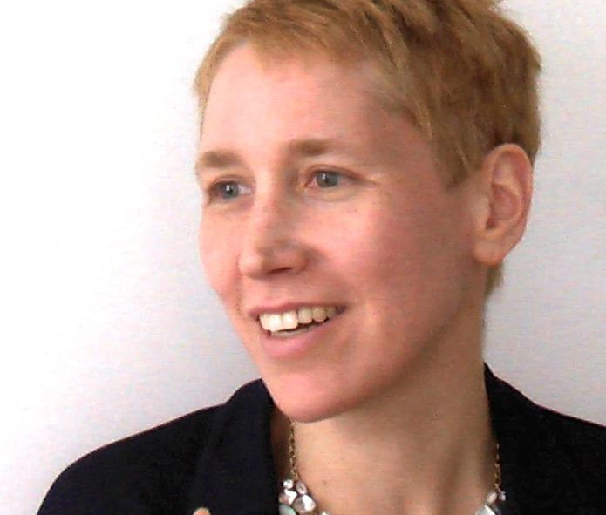
Three Theories: #1 Pluralism
The organizational and institutional articulation of competing individual and group interests (Carla Yumatle)
Robert Dahl, for instance, claimed that power was dispersed among many interest groups that tended to balance their relative bargaining position (Carla Yumatle)
A multitude of groups, not the people as a whole, govern… include among others unions, trade and professional associations, environmentalists, civil rights activists, business and financial lobbies, and formal and informal coalitions of like-minded citizens, influence the making and administration of laws and policy. (University of Delaware)
Some pluralists believe that direct democracy is not only unworkable; it is not even necessarily desirable (University of Delaware)
Nor do pluralists think that representative democracy works as well in practice as in theory. Voting is important, to be sure. But Americans vote for representatives, not for specific policy alternatives. (University of Delaware)
Recent Pluralist Scholars: They acknowledge the relative power leverage of different groups and the unique, commanding position of the state in shaping and inducing preferences among competing groups (Schlosberg 1999; Eisfeld 2006; McFarland 2004, 2007) (Carla Yumatle)

Slide 12
#2 Agonism
Arendt: Action as a mode of human togetherness.
Liberal variants of agonistic democracy that conceive of legal and political institutions as tools for recognizing and mediating citizens’ moral and cultural differences suggest ways to deepen our participation in democratic practices in plural societies.
For example, Mouffe argues that "In a democratic polity, conflicts and confrontations, far from being a sign of imperfection, indicate that democracy is alive and inhabited by pluralism.”
Therefore conflict = individual participation in the democratic process, which is a good thing in terms of self determination
“The polis, properly speaking, is not the city-state in its physical location; it is the organization of the people as it arises out of acting and speaking together, and its true space lies between people living together for this purpose, no matter where they happen to be” (HC, 198).

Slide 13
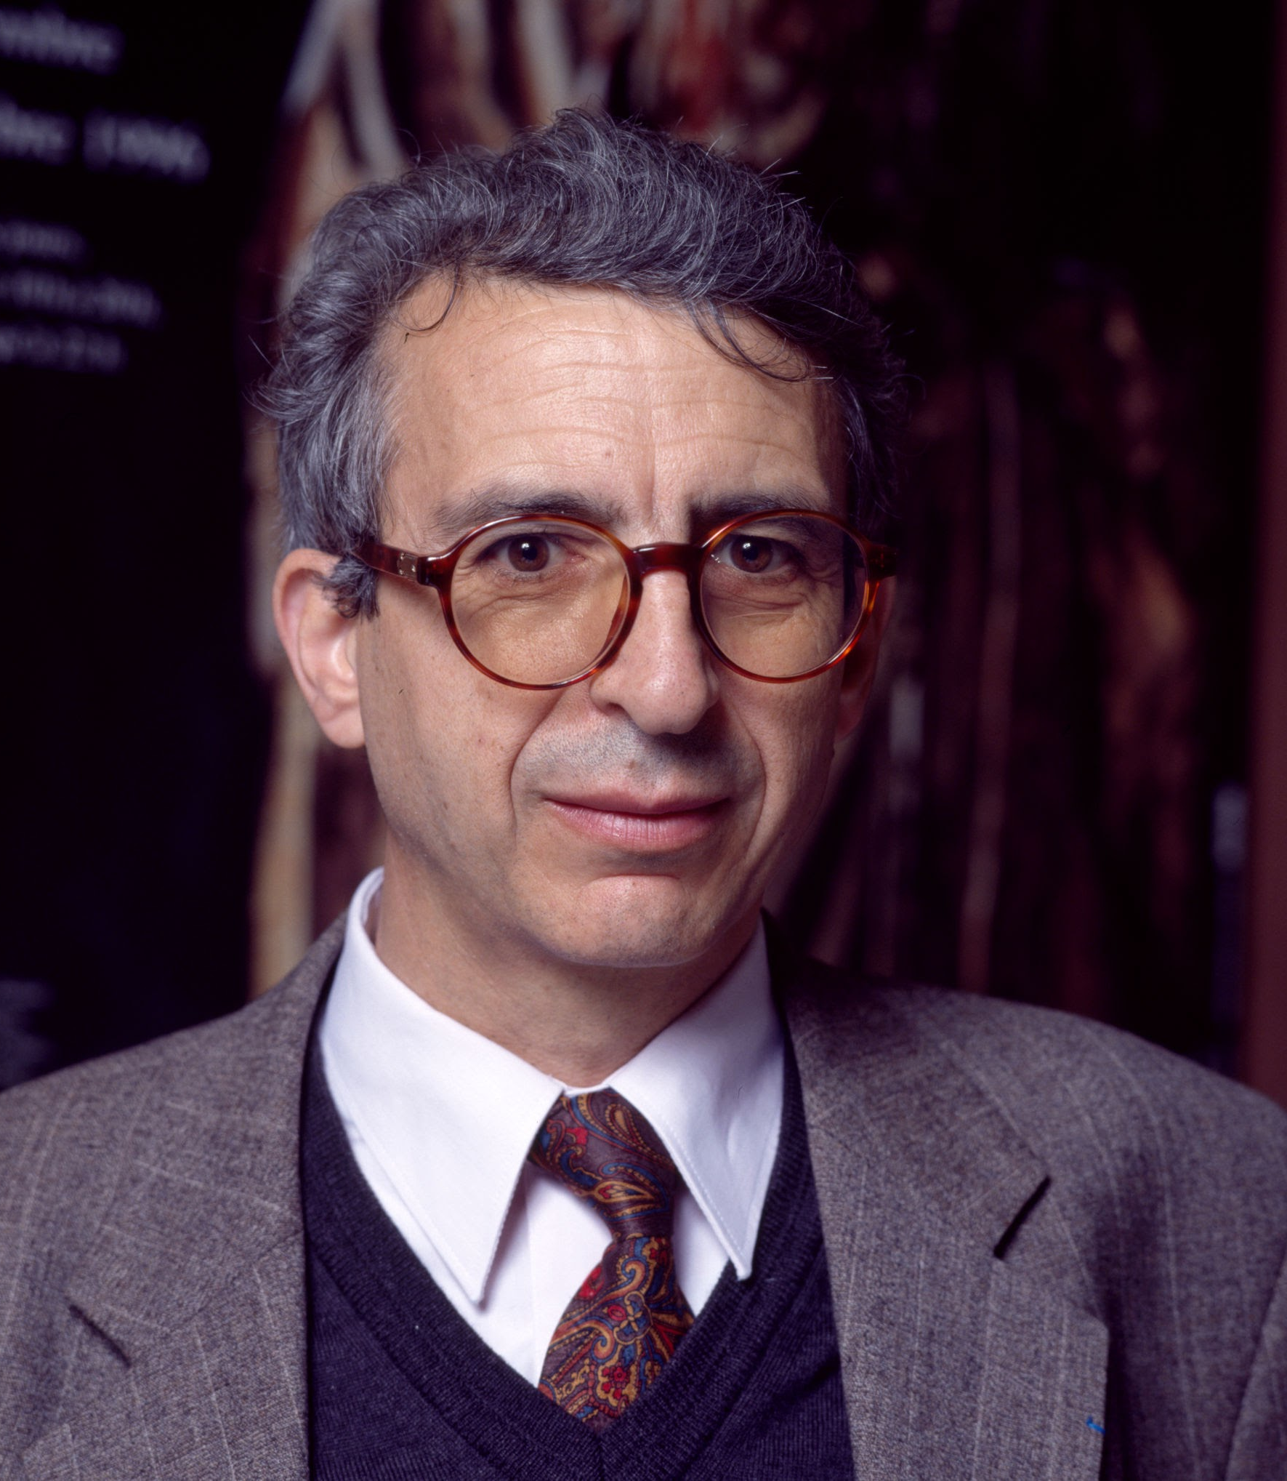
#2 Secularism
French scholar Jean Bauberot. Three essential components to a secular society:
The separation of religious institutions from the institutions of the state;
Freedom of conscience for all individuals, circumscribed only by the need for public order and the respect of the rights of other individuals;
No discrimination by the state against individuals on the basis of their beliefs.
Some scholars argue that its simply another Western imposition on societies that would prefer much more religion in their states.
(Stephen Conn)
“Men never do evil so completely and cheerfully as when they do it from religious conviction.”
(Blaise Pascal)

