Slide 1
Legal Rights
Sections 7 & 8
Case Study Assignment

Slide 2
Legal Rights
Protect personal and privacy rights.
Provide legal safeguards to ensure that proper procedures are followed in the criminal justice system in areas such as searches, arrests, detention and interrogation.
Remedy: the way in which a wrongdoing is fixed by the court or other judicial body.

Slide 3
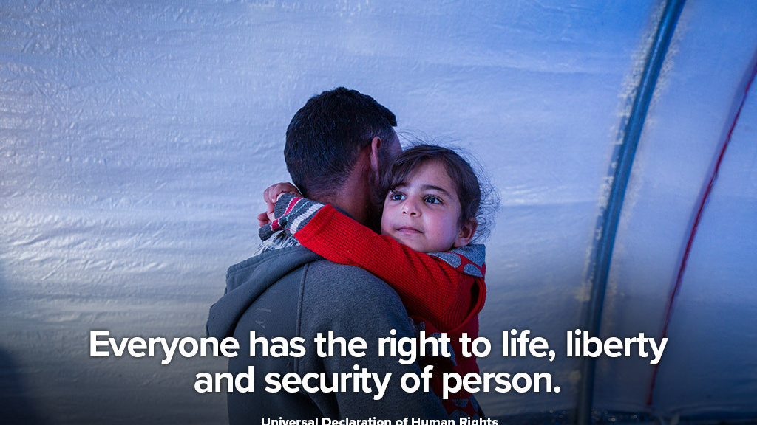
Life, Liberty and Security of Person
7 Everyone has the right to life, liberty and security of the person and the right not to be deprived thereof except in accordance with the principles of fundamental justice.
It is the duty of the Crown to disclose all relevant information it has in its possession before the case goes to trial.
The Crown cannot withhold any information from the defendant.

Slide 4
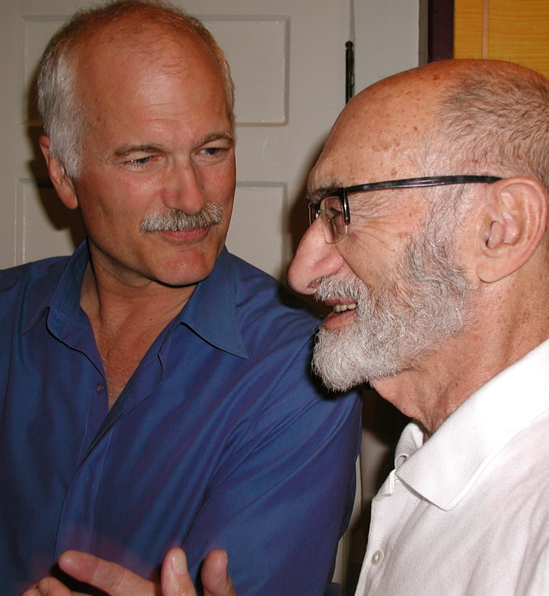
Henry Morgentaler
Morgentaler survived Auschwitz and Dachau, arriving in Canada in 1950.
He completed his medical studies in 1953 at the Université de Montréal and began a general practice in medicine in Montréal in 1955.
This contributed to his decision in 1969 to devote his practice to family planning.
On the advice of the medical establishment, Section 251 of the revised Criminal Code also allowed abortions, but only in restricted circumstances.
Abortions were only legal if performed in hospital, and had to be approved by a hospital therapeutic abortion committee. (Canadian Encyclopedia)
Jack Layton (Left) Dr. Morgentaler (Right)

Slide 5
R. v. Morgentaler, 1988.
Learn a bit about his struggle here.
In 1988 the Supreme Court declared Canada’s abortion Laws unconstitutional. It ruled that they violated Section 7 of the Charter. This guaranteed the security of the person. As a result, Canada’s abortion laws are not longer in effect.
The Supreme Court of Canada decided that the Criminal Code’s restrictions on abortion were unconstitutional because they increased health risks to women, depriving them of the right to security of the person. (Cornell University Law)
Since this decision, no abortion laws have been enacted. Therefore, this decision has had the practical effect of giving women the freedom of choice.(Cornell University Law)

Slide 6
Case Study: Rodriguez v. British Columbia (Attorney General), 1993
Sue Rodriguez was a victim of a terminal disease that would soon leave her helpless. She was told that she had no more than three years to live. Once she was unable to enjoy life, she hoped that someone would be be able to help her end her life. In Canada, it is not illegal to commit suicide,. However, it is illegal for anyone to assist in a suicide.
Rodriguez argued that the law denying assisted suicide violated her right to life, liberty, and security of the person. The Supreme Court disagreed with Rodriguez. It kept the law on assisted suicide in the Criminal Code. The court commented that the objective of the law as to preserve life and protect the vulnerable in society.
On February 12, 1994, Rodriguez committed suicide with the help of an anonymous doctor.
Do you agree with the Supreme Court’s decision in this case?
Do you think assisted suicide law should still be in the Criminal Code? Explain

Slide 7
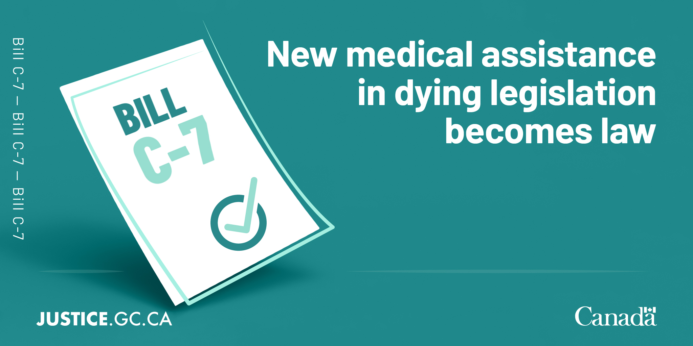
MAID (Government of Canada)
MAID became legal in Canada in June 2016. Canada's Criminal Code now exempts doctors and nurse practitioners who provide, or help to provide, MAID.
"Medical assistance in dying" includes:
the use of medication by a physician or nurse practitioner to directly cause a person's death at their request
the prescription or provision of medication by a physician or nurse practitioner that a person can use to cause their own death

Slide 8
March 17, 2021 MAID Update
Note: The law no longer requires a person’s natural death to be reasonably foreseeable as an eligibility criterion for MAID.
As of March 17, 2021, persons who wish to receive MAID must satisfy the following eligibility criteria:
be 18 years of age or older and have decision-making capacity
be eligible for publicly funded health care services
make a voluntary request that is not the result of external pressure
give informed consent to receive MAID, meaning that the person has consented to receiving MAID after they have received all information needed to make this decision
have a serious and incurable illness, disease or disability (excluding a mental illness until March 17, 2023)
be in an advanced state of irreversible decline in capability
have enduring and intolerable physical or psychological suffering that cannot be alleviated under conditions the person considers acceptable

Slide 9
Search and Seizure
8 Everyone has the right to be secure against unreasonable search or seizure.
Police must have a good reason for searching your person, your home, or your possessions and they must also be able to justify the taking of any evidence from these locations.
The police must have reasonable groups to search your car such as seeing drugs in plain view or receiving a tip that your car is involved in trafficking.

Slide 10
Case Study Assignment Part 1 – Group Cases
In groups of 3 complete the R. v. M. Case posted on our website. Read the case and answer all parts of the case including the Discussion Questions.
Check the Rubric for this portion of the assignment’s evaluation.

