Slide 1
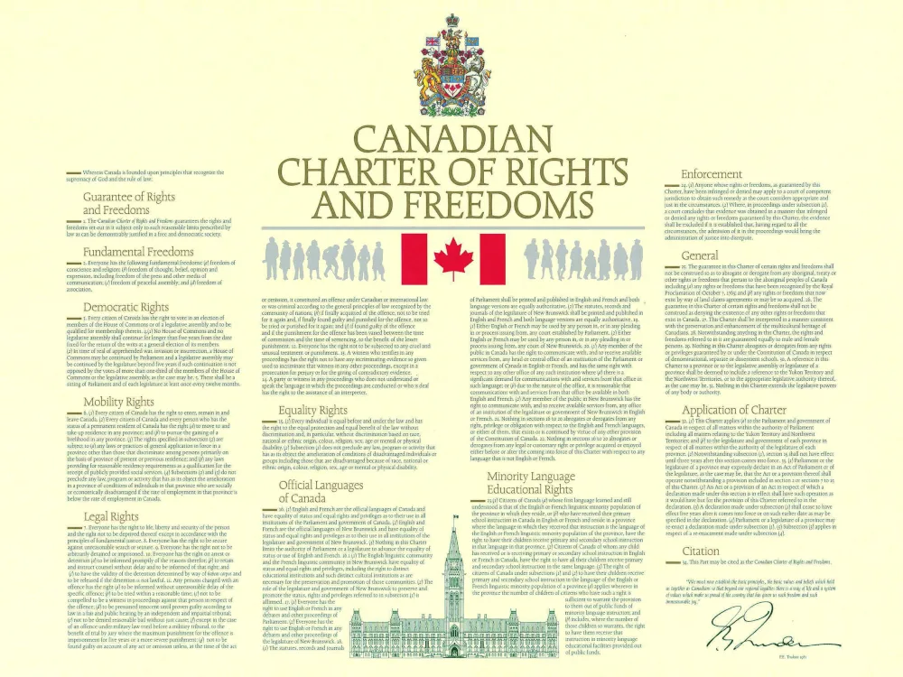
The Charter of Rights and Freedoms
Using the Charter

Slide 2
Analyzing a Charter Case: 4 Step Process
1. Does the Charter Apply?
2. Has a Charter Right or Freedom Been Infringed?
3. Does the Reasonable limits Clause Justify the Infringement?
4. If Not, Is there a Remedy under the Charter?

Slide 3
#1 Does the Charter Apply?
The Charter concerns only matters involving the government.
Can challenge a government law or question a government action (police illegal search & seizure).

Slide 4
#2 Has a Charter Right or Freedom Been Infringed?
Does it violate a specific right or freedom guaranteed under the Charter?
Courts examine facts to determine this.

Slide 5
#3 Does the Reasonable Limits Clause Justify the Infringement?
Charter rights are not absolute they can be limited if it can be justified in our free and democratic society.

Slide 6
Section (1) Reasonable Limits Clause
You can’t say or do anything you want and claim it as a right of Free Speech (Section 2(b) of the Charter).
Section 1 states “(1) The Canadian Charter of Rights and Freedoms guarantees the rights and freedoms set out in it subject only to such reasonable limits prescribed by law as can be demonstrably justified in a free and democratic society.”
Writing racist or sexist comments that promote hate on an Internet blog is not against the law, but if it results in harm, it violates the Charter and you can be taken to court.

Slide 7
“Reasonable Limits”
What are “Reasonable Limits”. This means that your rights and freedoms are limited in certain situations. The Charter does not define ”reasonable” therefore the courts have had to interpret the meaning.
Burden of Proof: the onus of brining forth proof (evidence) to prove someone’s legal argument to the court.
Read the R. v. Oakes Case on our website and answer the questions.

Slide 8
#4 If Not, Is There a Remedy under the Charter?
You may be able to apply to the court for a remedy such as having the evidence excluded under Section 24(2) of the Charter (see link on website).
The court can even see a law as unconstitutional and strike it down.

Slide 9
GraceLife Church
Go to our website and watch the video on what is going on near Edmonton with GraceLife Church.
1. How does the reasonable limits clause apply here?

Slide 10
Provincial Controversy in the Charter
Negotiations over the Constitution Act of 1982 were intense. Several provinces feared that the Constitution would give the federal government power over provincial matters.
They were worried the Charter would allow courts to change provincial laws.
At the last minute the federal government and the provinces agreed to the Notwithstanding Clause (Section 33).

Slide 11
The Notwithstanding Clause (Section 33)
33 (1) Parliament or the legislature of a province may expressly declare in an Act of Parliament or of the legislature, as the case may be, that the Act or a provision thereof shall operate notwithstanding a provision included in section 2 or sections 7 to 15 of this Charter.
The clause applies to Fundamental Freedoms (Section 2), Legal Rights (Sections 7 – 14), and Equality Rights (Section 15).
Allows provincial governments to create certain laws that contradict some Charter Rights.

Slide 12
Quebec and The Notwithstanding Clause
1988: Bill 101 was passed in Quebec that said all public signs must only be in French. This was challenged under the Charter that it violated Section 23 (1)
23 (1) Citizens of Canada
(a) whose first language learned and still understood is that of the English or French linguistic minority population of the province in which they reside, or
(b) who have received their primary school instruction in Canada in English or French and reside in a province where the language in which they received that instruction is the language of the English or French linguistic minority population of the province,
have the right to have their children receive primary and secondary school instruction in that language in that province. ⁽⁹⁴⁾
Paragraph 23(1)(a) is not in force in respect of Quebec. See section 59 of the Constitution Act, 1982.

Slide 13
Bill C-21 Quebec
Bans the wearing of religious symbols such as crosses, hijabs, turbans and yarmulkes by government employees such as police officers, teachers, and lawyers.
Look at the Political Cartoons on our website and be prepared to analyze them explaining their meanings and the various elements within.

