Slide 1
Introduction to Politics
What is important to you?

Slide 2
Quick Top 10
Make a list of the TOP 10 most important things to you. 5 minutes. You will have to share some.

Slide 3
What is Politics?
Politics is the practice of attempting to influence the decisions of a collective to act, or not to act, in a particular manner.
How many of your Top 10 do you think are influenced by politics?

Slide 4
What is Ethics? – Videos on Website!
Consequentialist: One ought perform the action that produces the best consequences. But for who? Themselves (Egoist)? Society (Utilitarian)?
Non – Consequentialist: One should perform the action that is the right action in and of itself (because it is the ‘right’ thing to do) based on criteria. Kant?

Slide 5
Public vs. Private Issues
Virtually every issues is at least in part political. Think of your Top 10, how many can be influenced at least in part by government?
Private issues are resolved in private or voluntary sectors, also known as civil society
Public issues necessitate that governments be involved or that government should take or should not take action on the issue.
Big Question: Which issues should the government service and control, and should should it not?

Slide 6
Beliefs
Normative: How things ought to be.
Empirical: How things are.
Ethical/Election Issue #1: Should the Canadian government limit greenhouse-gas emissions or should regulations be minimized to attract investment and job growth in the petroleum industry?

Slide 7
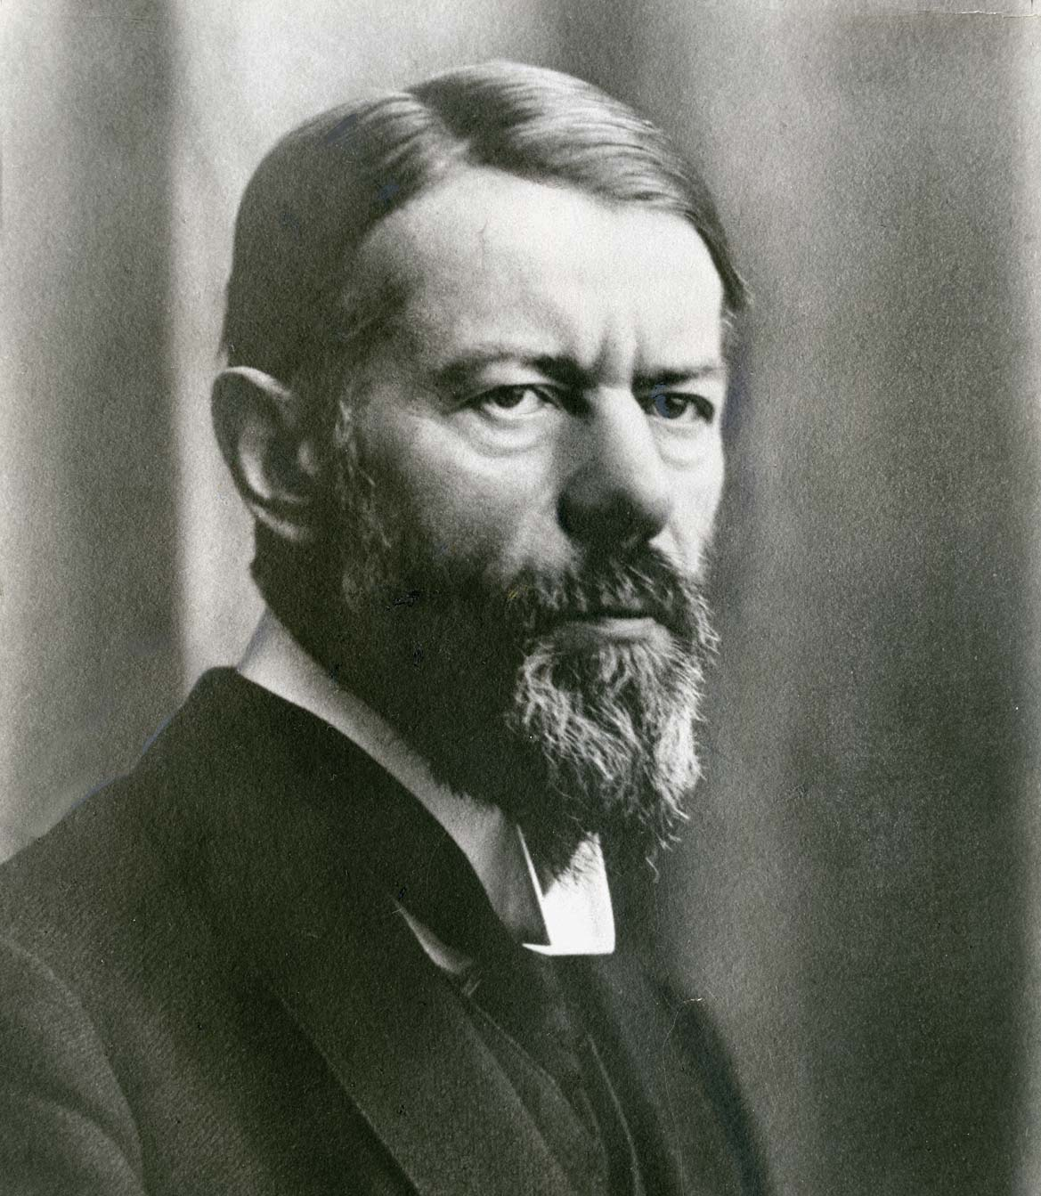
Power
The ability of one actor to impose its will on another, to get its own way, to do or get what it wants.
People are powerless when they have no probability to being able to impost their will (you can’t vote, you have no power for example).
German Sociologist Max Weber defined Power as, “…the probability that one actor within a social relationship will be in a position to carry out his own will despite resistance…”

Slide 8
Two Kinds of Power
Coercion: the agent (person or group of people – agents (basic definition there is major debate on this) are individuals who “have the power to act.” (Sandford Encyclopedia of Philosophy) is able to impose its will on others by using or threatening physical force or other punishment; essentially using fear.
Authority: power based on legitimacy. Agent can impose its will on another because the subject regards the decision – maker as having a right to make such a decision. i.e. your coach tells you to run so you run.

Slide 9
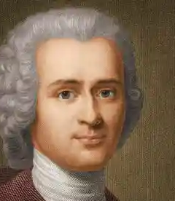
Jean Jacques Rousseau
"man is born free, but he is everywhere in chains,”
What do you think this might mean?

Slide 10
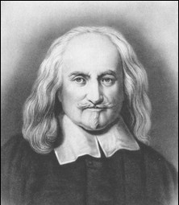
Hobbes
“The difference of Commonwealths consisteth in the difference of the sovereign, or the person representative of all and every one of the multitude . . . When the representative is one man, then is the Commonwealth a monarchy; when an assembly of all that will come together, then it is a democracy, or popular Commonwealth; when an assembly of a part only, then it is called an aristocracy.”

Slide 11
On Hobbes: Read and Be Prepared to Discuss
7. Establishing Sovereign Authority
When people mutually covenant each to the others to obey a common authority, they have established what Hobbes calls “sovereignty by institution”. When, threatened by a conqueror, they covenant for protection by promising obedience, they have established “sovereignty by acquisition”. These are equally legitimate ways of establishing sovereignty, according to Hobbes, and their underlying motivation is the same—namely fear—whether of one’s fellows or of a conqueror. The social covenant involves both the renunciation or transfer of right and the authorization of the sovereign power. Political legitimacy depends not on how a government came to power, but only on whether it can effectively protect those who have consented to obey it; political obligation ends when protection ceases. (Lloyd, Sharon D.)

Slide 12
John Locke
In the Two Treatises of Government, he defended the claim that men are by nature free and equal against claims that God had made all people naturally subject to a monarch. He argued that people have rights, such as the right to life, liberty, and property, that have a foundation independent of the laws of any particular society. (Tuckness, Alex)
Which of these rights do we have now? Which do we not have? Why do you think we don’t have the rights that we don’t have?

Slide 13
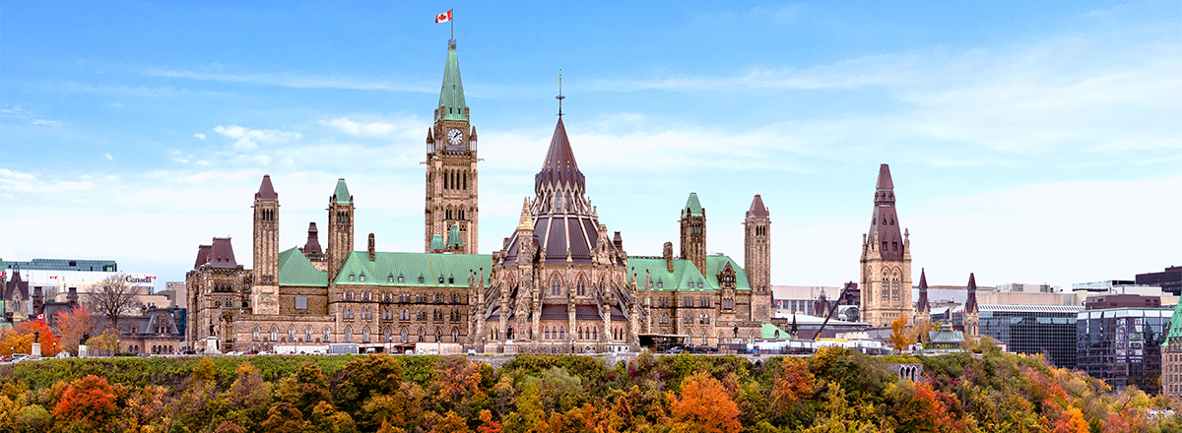
Government
Refers to the set of organizations that make, enforce, and administer collective public decisions for a society.

Slide 14
Types of Government Power
Legislative: Power to create laws and public policies
1
Executive: Power to enforce laws and administer public policies
2
Judicial: Power to interpret the law
3

Slide 15
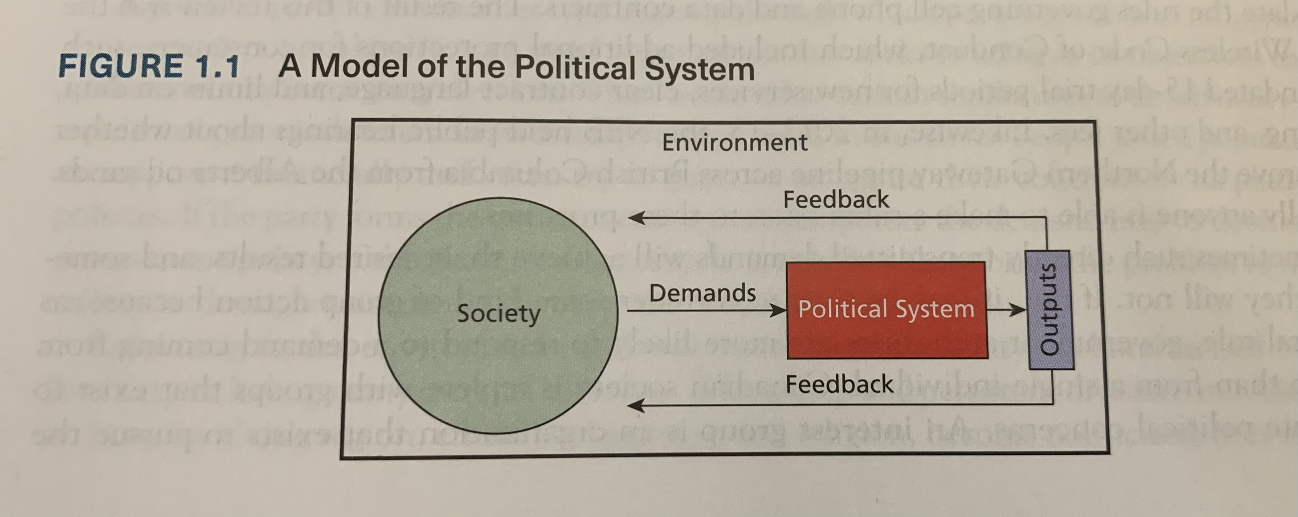
Power & Government
Those who control the government make appointments, spend money, extract taxes, enact regulations and generally impose their will on society.
We are born free (Rousseau)
We submit to the will of the government (Hobbes)
We establish the type of government we have (Hobbes)
We fear our government (Hobbes)
- We are free to disagree with and remove the government (Locke)
- We are afforded rights (Locke)

