Slide 1
Introduction to LAW 12
A Review From 11 + New Stuff

Slide 2
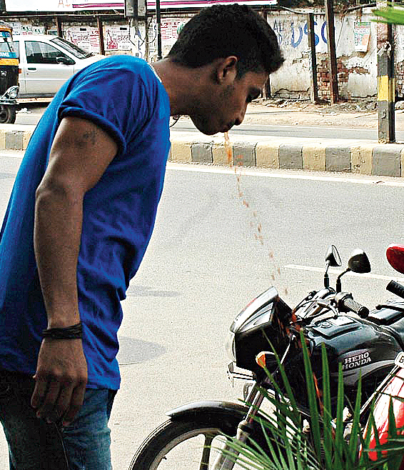
There Should Be A Law For / Against That
Often we hear people say this. What are some examples that you can think of whereby someone might say this (they don’t have to and often are not actual legal matters).

Slide 3
What Actually Causes Laws to Change?
Demographic Change – a change in the make up of society. Demographic analysis is the study of a population-based on factors such as age, race, and sex. Demographic data refers to socioeconomic information expressed statistically, including employment, education, income, marriage rates, birth and death rates, and more. (Investopedia)
Technological Change – A change in available technology. Smart Phones, Surveillance Equipment

Slide 4
Values and National Emergencies
Changes in Values – Society evolves and our feelings change. For example, how we treat, feel about and discuss issues surrounding Indigenous People’s has changed. How society feels about issues changes how the law regulates them. Social attitudes towards the use of marijuana led to its legalization.
National Emergencies – Covid – 19 caused a national emergency and resulted in mandated lockdowns (provincial matters) and airport / boarder restrictions (federal matters).
- Ex: Anti – terrorism Act & Public Safety Act

Slide 5
Who Has Jurisdiction Over What?
Go to our classroom website and visit the link. Look at what the federal government has jurisdiction over and what the provincial government has jurisdiction over. Are there any surprises? We will list some here.
Federal
Provincial

Slide 6
Reflect:
How much power should a government have in the face of crisis? Should individual freedoms be limited and if so, to what degree?
Be prepared to share with the group.

Slide 7
Part 2: Politics and Law
Go to our website and we will watch the Crash Course History on Democracies. Answer the following questions. Not all are answered (almost none actually) in the short video.
What is the modern welfare state?
Agree or Disagree with the following statement: “Human beings, regrettable though it may be, are inherently vicious and have to be restrained from their viciousness.”
What is authoritarian capitalism?
What are the drawbacks to China’s/Singapore’s style of government?
What is a representative democracy?
What is a nation state?

Slide 8
Rule of Law vs. Rule of Man
Democracy (in theory) - Rule of law is a fundamental principal that society is governed by laws applied equally to all persons and that neither any person nor the government is above the law. Laws must be:
Necessary in an orderly society
Applies to everyone equally
A person’s legal rights will not be taken away except in accordance with the law.
Dictatorship - Rule of man is when a single individual or group of people enact laws and are not accountable to the laws they make.

Slide 9
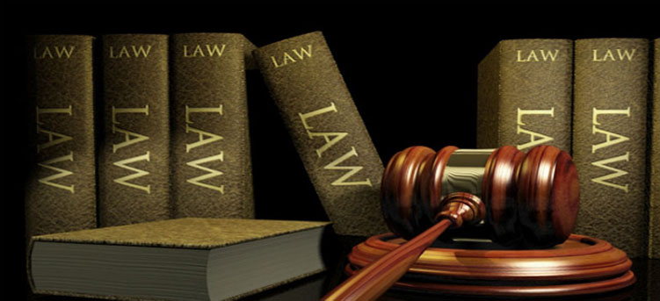
Foundation of a Democratic Legal System
Case Law: A type of law developed in England that is based on following previous judicial decisions and is common to all the people of a country.
Precedents: Legal decisions that serve as guides for future laws
Statute Law: Laws passed by legislatures (governments)
The Crown: Lawyer employed by the state to prosecute a criminal offence

Slide 10
Case Citations

Slide 11
Interest Groups
Interest group, also called special interest group, advocacy group, or pressure group. Visit the link on our website and choose an interest group. Do you think they have the best interests for wider society in mind?

Slide 12
Looking at the Past Differently
Thinking and Reflecting
How do you look at the past differently from your parents? What are some things you feel will change about how we look at the past? How does looking at history determine how we see ourselves in the present?

