Slide 1
Introduction to International Law

Slide 2
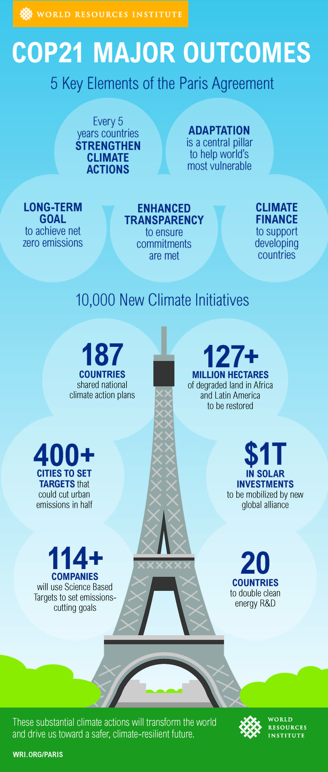
international LAW
Provides rules for conduct, mechanisms for the resolution of disputes, and substantive and procedural law to help guide decisions.
Treaties are agreements between nations and are governed by international law. There is a 5 Step Process To Treaty Implementation:
Treaty Negotiations – bilateral or multilateral negotiations with usually a diplomatic conference. This follows the UN Charter.
Signing – After negotiations a text is produced that everyone agrees to and it is signed by representatives of the country.
Ratification – Done by the government after it has been reviewed by ambassadors. The process varies between countries.
Reservations – Changes that may need to be made or negotiated further.
Implementation – A nation takes steps to make it law. Climate targets in Canada are a result of the Paris Agreement that Canada ratified in 2016 and 2021.

Slide 3
Importance of Treaties
Rulers or officials have entered into a binding mutual agreement.
Create Extradition Laws. The act of returning a person to a jurisdiction in which he or she is charged with a crime and can face trial.

Slide 4
Principles of International Law
Public international law is a combination of rules and customs governing relations between states in different fields, such as armed conflict, human rights, the sea, space, trade, territorial boundaries, and diplomatic relations.
The United Nations Charter sets out the fundamental principles of modern public international law, notably:
Promotion of human rights;
The strict limitation on the right to use force against other states;
The strict prohibition on the acquisition of territory by force.

Slide 5
How International law shapes our everyday life
Check out the link on our website. Choose 3 important ways that international law affects our lives and be prepared to share them.

Slide 6
State sovereignty
The lawful control by a state over its territory, right to govern in that territory, and authority to apply law there to the exclusion of other states.
Isolationism is a political philosophy advocating a national foreign policy that opposes involvement in the political affairs, and especially the wars, of other countries.
What do you think of isolationism? Why would a country want it? Watch the short video on our website and be prepared to discuss.

Slide 7
The paradox of sovereignty
If a state is independent and has its own laws, should other states be in a position to judge it and make laws for it?
International sanctions are political and economic decisions that are part of diplomatic efforts by countries, multilateral or regional organizations against states or organizations either to protect national security interests, or to protect international law, and defend against threats to international peace and security

Slide 8
Types of sanctions
There are several types of sanctions.
Economic sanctions – typically a ban on trade, possibly limited to certain sectors such as armaments, or with certain exceptions (such as food and medicine)
Diplomatic sanctions – the reduction or removal of diplomatic ties, such as embassies.
Military sanctions – military intervention
Sport sanctions – preventing one country's people and teams from competing in international events.
Sanctions on the environment – since the declaration of the United Nations Conference on the Human Environment, international environmental protection efforts have been increased gradually.
Go to our website and view the short video about sanctions on Russia because of the Ukraine War.

Slide 9
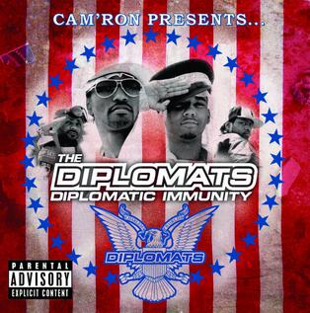
Diplomatic Immunity
Diplomats who represent their country abroad enjoy diplomatic immunity. This protects them against prosecution in the receiving state for the entire period in which they hold their diplomatic post.
In the event of misconduct, however, only the sending state has the authority to take action, for instance by recalling the diplomat or waiving his/her diplomatic immunity.
Diplomatic Asylum is protection sought in embassies of other countries fearing for safety. Visit the link on our website to see why this exists.

