Slide 1
Human Rights
An Introduction

Slide 2
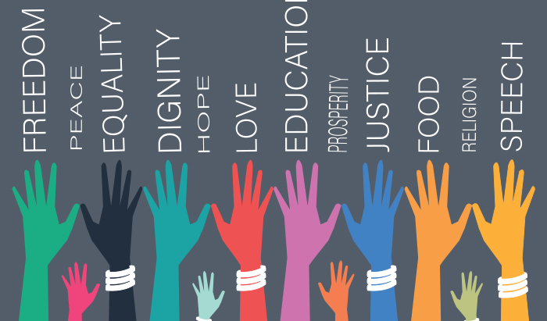
Human Rights
These are rights that protect a person from unfair treatment by other individuals and governments but are not always upheld by a country’s justice system.

Slide 3
Human Rights Laws
Protect people from being treated unfairly by others. They make it illegal for people to treat others unfairly.

Slide 4
Human Rights Vocabulary You Should Know
Discrimination: treating individuals or groups unfairly or differently because of such characteristics as race, sex, religion, age, or disability.
Prejudice: an unfair and unreasonable opinion or feeling, especially formed without enough thought or knowledge.
Stereotyping: judging, or forming an opinion of a group and applying that judgment to all members of the group

Slide 5
Prejudice
A Prejudiced person pre-judges another person based on the fact that he or she belongs to a group. Its not based on actual character, skill, or personality.
Prejudiced opinions are based on ignorance not fact and are often negative.
They influence how a person is treated.

Slide 6
Stereotyping
Putting a label on people within an entire group. It doesn’t matter what an individual is like, they are labeled as a part of a group.
Telling jokes about minority groups for instance is being prejudiced and stereotyping. It also causes harm.
Even if you think you are ‘joking’ people feel hurt,but say nothing.

Slide 7
Discrimination
Prejudice and Stereotyping are not illegal. They are a part of a belief system that leads to discrimination.
Human Rights Laws prohibit discrimination.
Discrimination happens when people act on ta prejudice or stereotype and treat others unfairly.
Complainant: a person who makes an allegation of discrimination.

Slide 8
Types of Discrimination
Intentional Discrimination: treatment of others that is unfair (on the basis of prejudice or stereotype) and on purpose.
Example: Not hiring the most qualified person for the job because of their race, ethnicity, sexual orientation, gender or religion based on a personal belief about that group.
Unintentional Discrimination: actions that appear to be neutral but that have the effect of discriminating against most members of a group.
Example: Firefighters have a fitness test that is impossible for a woman to pass.

Slide 9
Bona Fide occupational Requirement
A legitimate reasonable necessity (requirement) of a job; a possible defense against discrimination in hiring and other employment situations.
Example: Requiring that counsellors be female at a crisis centre for abused women.

Slide 10
Check Your Understanding
1. What is prejudice?
2. How is prejudice different from stereotyping?
3. What are the two types of discrimination? What is the difference between them?
4. Give an example not from the PowerPoint of Bona Fide occupational Requirement.

