Slide 1
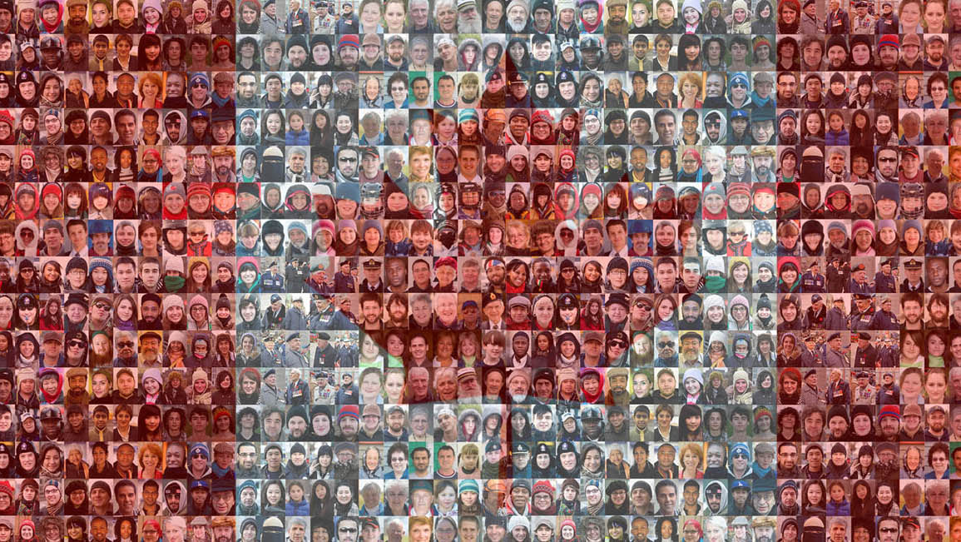
Canada
An Immigrant Society

Slide 2
Some Basic Terminology
Visible minorities - defined as “persons, other than Aboriginal peoples, who are non-Caucasian in race or non-white in colour” (Statistics Canada, 2013, p. 14).
Settler society - a society historically based on colonization through foreign settlement and displacement of Aboriginal inhabitants,
Multiculturalism - the presence of, or support for the presence of, several distinct cultural or ethnic groups within a society.
Racialization - (the social construction of race) certain groups become racialized through a social process that marks them for unequal treatment based on perceived physiological differences.
Ethnicity – a term that describes shared culture — the practices, values, and beliefs of a group. This might include shared language, religion, and traditions, among other commonalities.

Slide 3
Some You May Know Already
Stereotypes are oversimplified ideas about groups of people
Prejudice refers to thoughts and feelings about those groups
Discrimination refers to actions toward them.
Racism is a type of prejudice that involves set beliefs about a specific racial group.

Slide 4
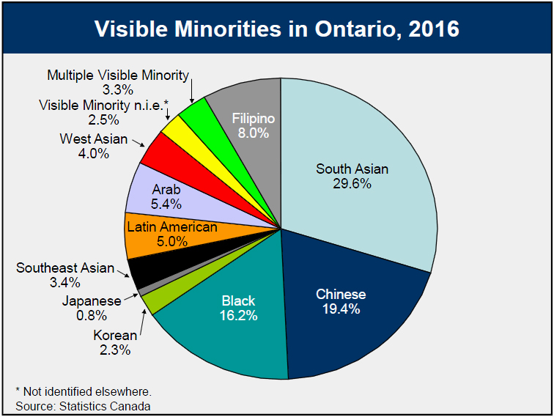
Minority Groups
This term connotes discrimination, and in its sociological use the term subordinate can be used interchangeably with the term minority, while the term dominant is often substituted for the group that’s in the majority.
Visible minorities are defined in the Employment Equity Act as “personas, other than Aboriginal peoples, who are non – Canadian in race or non – white in color.”
A minority group is distinguished by five characteristics:
Unequal treatment and less power over their lives
Distinguishing physical or cultural traits like skin colour or language
Involuntary membership in the group
Awareness of subordination
High rate of in-group marriage (1958).

Slide 5
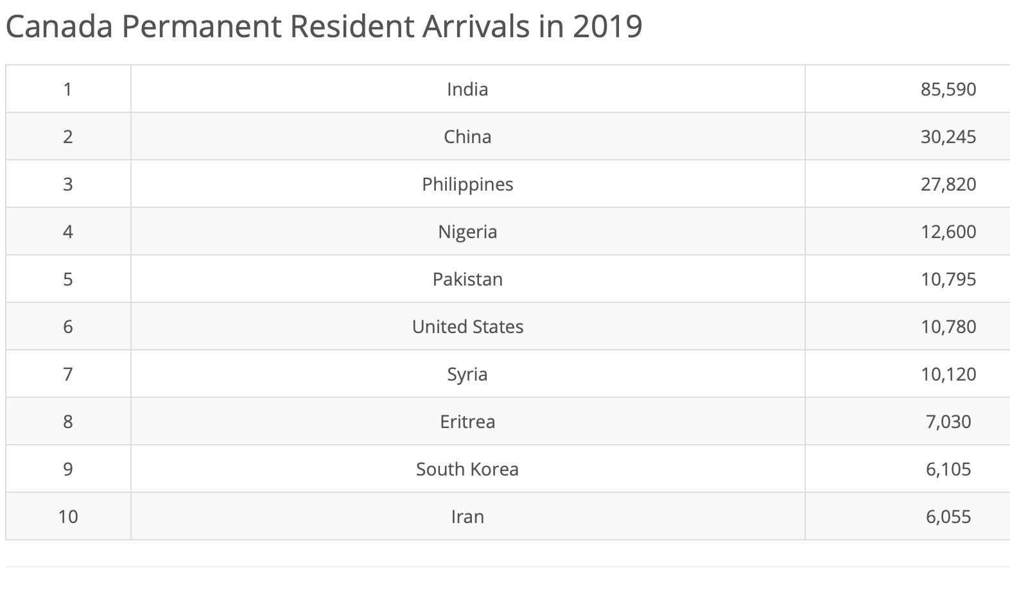
What is An Immigrant Society?
As we have discussed already, every person in Canada who is not of Indigenous decent, has been or their descendants have been an immigrant at some point in their family's history.
CICS is the Centre for Immigrant & Community Services. They are “committed to providing our clients with equal access to services that meet their individual needs.”
Government of Canada https://www.immigration.ca

Slide 6
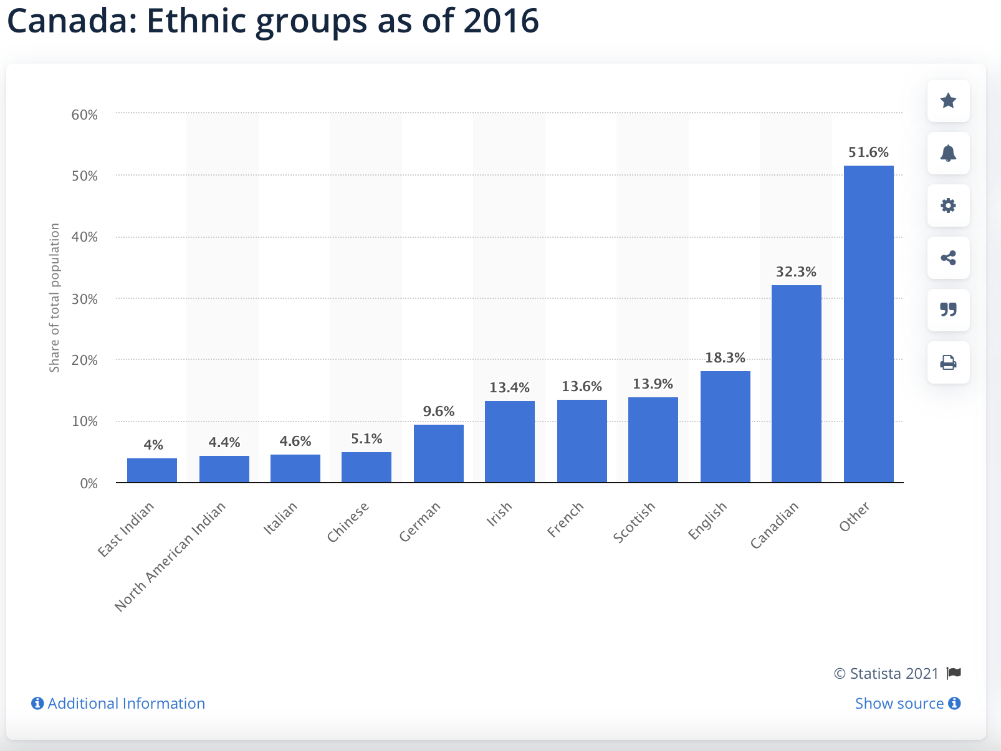
Overview of Diversity in Canada
2016 – over 250 different ethnic identities in Canada
66% of visible minorities live in the Toronto, Vancouver and Montreal.

Slide 7
Cultural Pluralism
A societal condition in which minority groups within a society can maintain their distinctive cultural identities, values, and practices provided that they are consistent with the laws and values of the wider society.
Canada as a society prides itself on its ability to do this, the degree to which this exists in reality is debatable. Do you think Canada is culturally pluralistic?

Slide 8
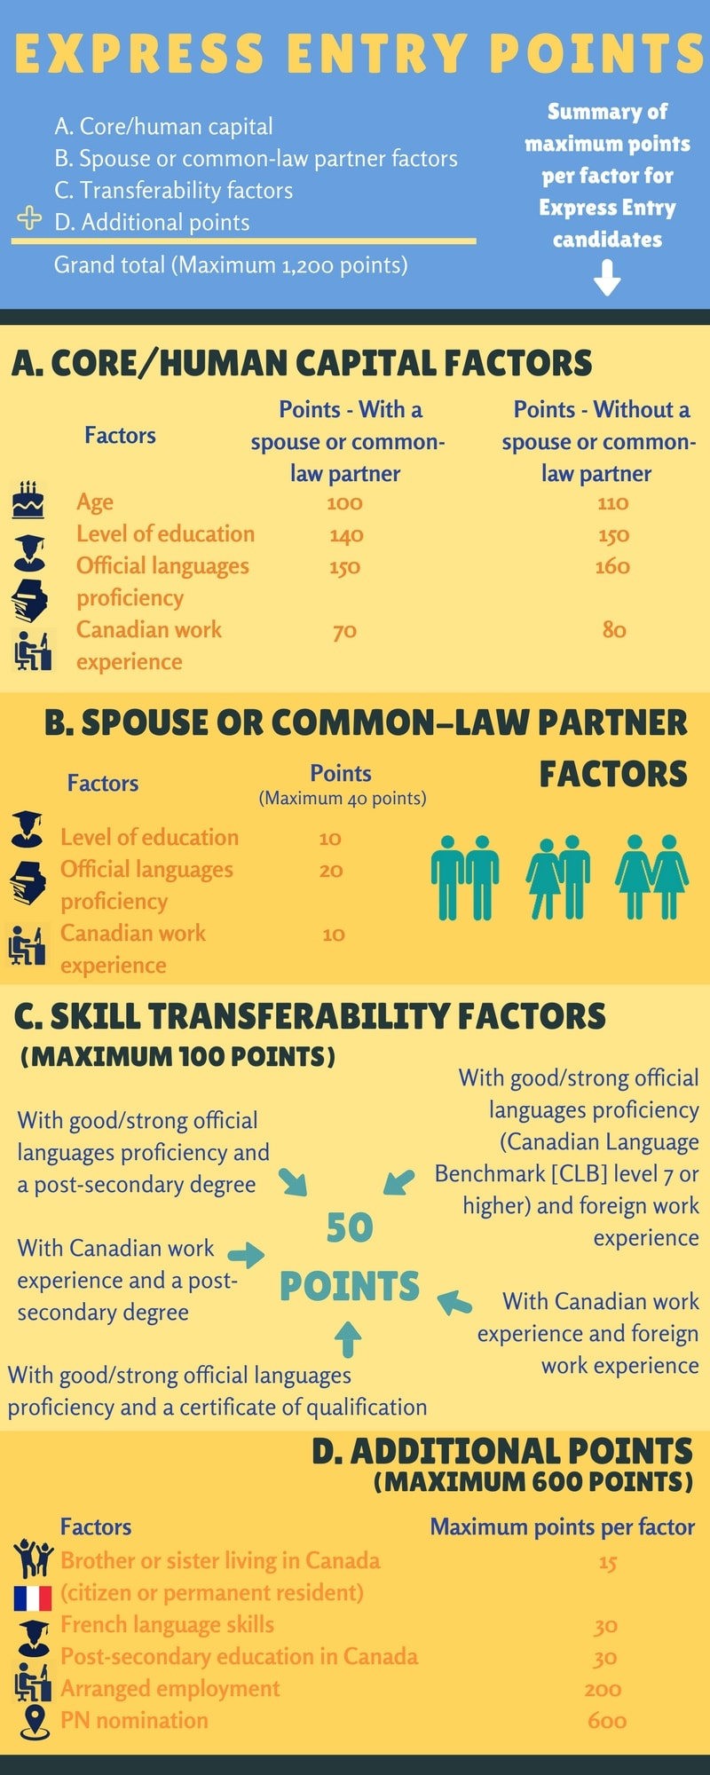
Immigration Today
Points System: English/French proficiency, education, work experience, age and pre – arranged employment.
1971 – Trudeau and multiculturalism as the recognition of diverse cultures in a plural society. Encouraging immigrants to retain their cultural practices.

Slide 9
Why Multiculturalism?
Assist cultural groups in retaining and fostering their identify.
1
Assist cultural groups in overcoming barriers to their full participation in Canadian society
2
Promote creative exchanges among all Canadian cultural groups.
3
Assist immigrants in acquiring at least 1 official language.
4

Slide 10
Racial Discrimination
Canada has experienced racial discrimination. Historically through John A Macdonald and Mackenzie King. Examples include the Chinese Head Tax of 1885 to 1923, WWII Canada refused to accept Jewish Immigrants from Europe, and the historical treatment of Indigenous Peoples.

Slide 11
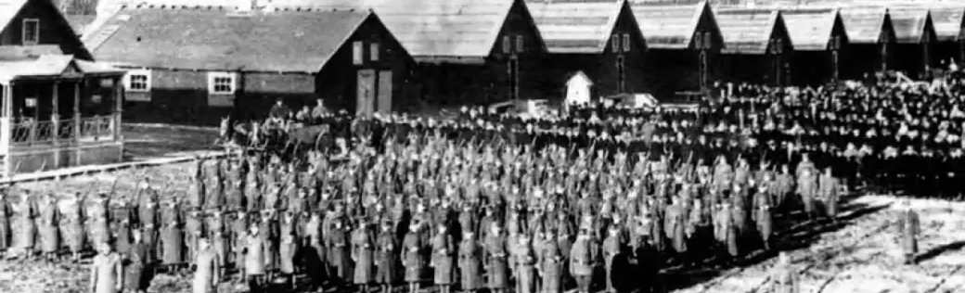
Discrimination
Immigrants are far more likely to face discrimination. During WWI Canadians of German and Austrian decent had their vote taken away and during WWII those of Asian decent, specifically Japanese faced discrimination and put into interment camps and 4000 were deported.
In BC Asians were not permitted to be hired for jobs to preserve them for white people
21 000$ was paid to survivors of interment camps in 1988
Together we will watch the video from David Suzuki on our website.

Slide 12
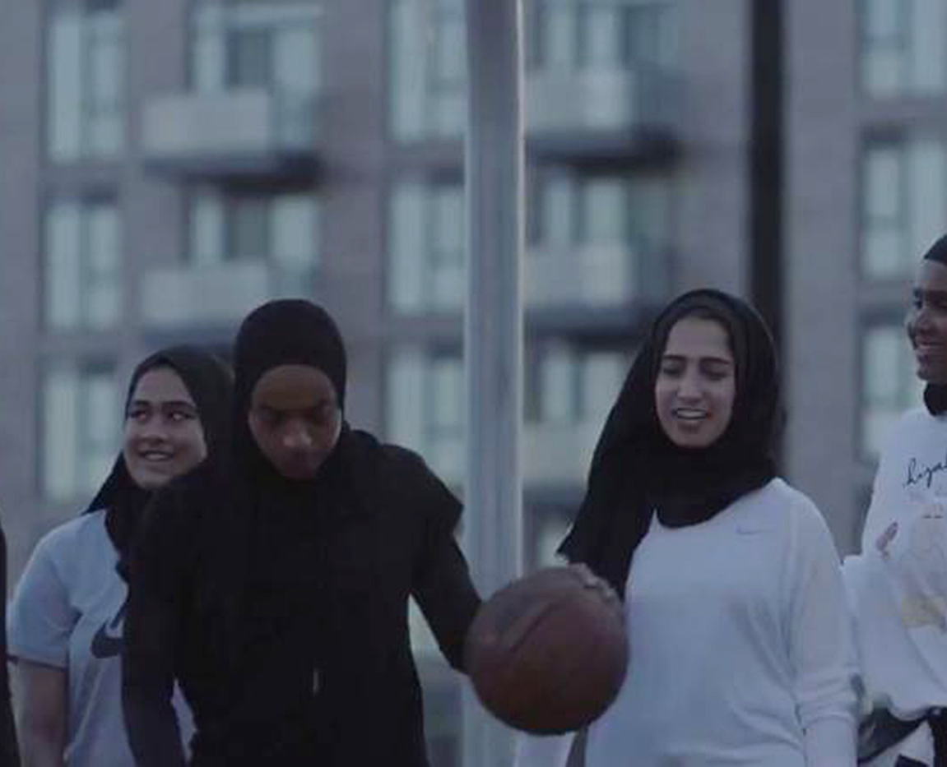
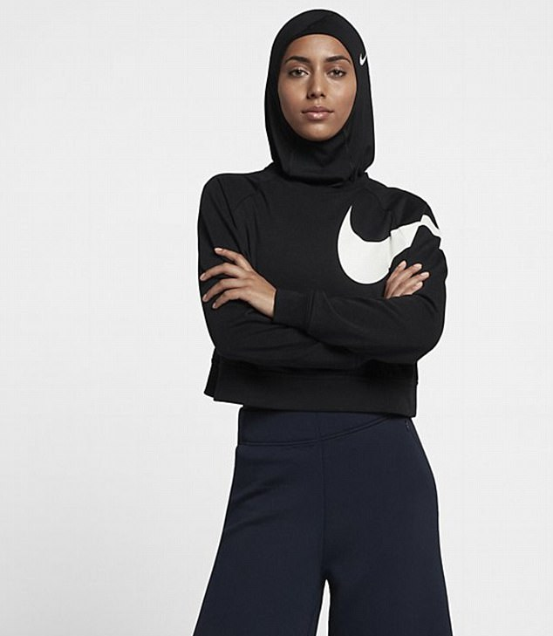
Current Ethnocultural Issues - Islam
Muslims are the fastest growing demographic groups and are expected to double in the next 15 years. Wearing of the hijab/niqab or burka by Muslim women has become a battle between secularism and religious visions of society.
Governments of Alberta and Quebec as well as the former Harper Conservatives have attempted in various ways and settings to ban the wearing of these religious articles of clothing.

Slide 13
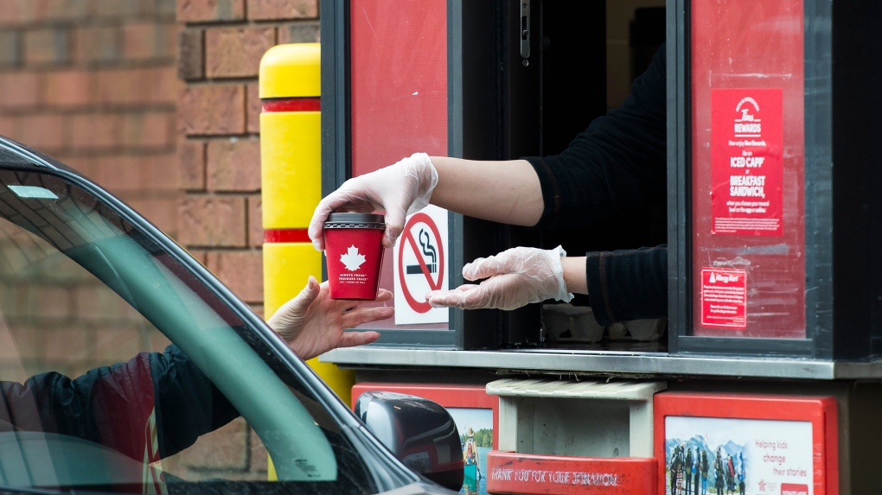
Current Ethnocultural Issues – Temporary Foreign Worker Program
180 000 entered in 2010.
Workers do not have the same rights as permanent residents or citizens. They often work in the service industry, agriculture, domestic caregivers and construction.
Some wonder why unemployed Canadians could not do such work or why companies should not pay higher salaries if they cannot attract workers the need from the Canadian population.

Slide 14
Current Ethnocultural Issues – Professional Credentials
Many immigrants live below the poverty line.
Their credentials from their home countries are often not recognized here or need expensive ‘upgrading’.
This disproportionately effects women newcomers.

Slide 15
Conclusions
Immigration has changed the traditional meaning of what it means to be Canadian.
Low birthrate and aging mean immigration is necessary for the expansion of the Canadian economy.
Many immigrants still face barriers often driven by racism and discrimination.

