Slide 1
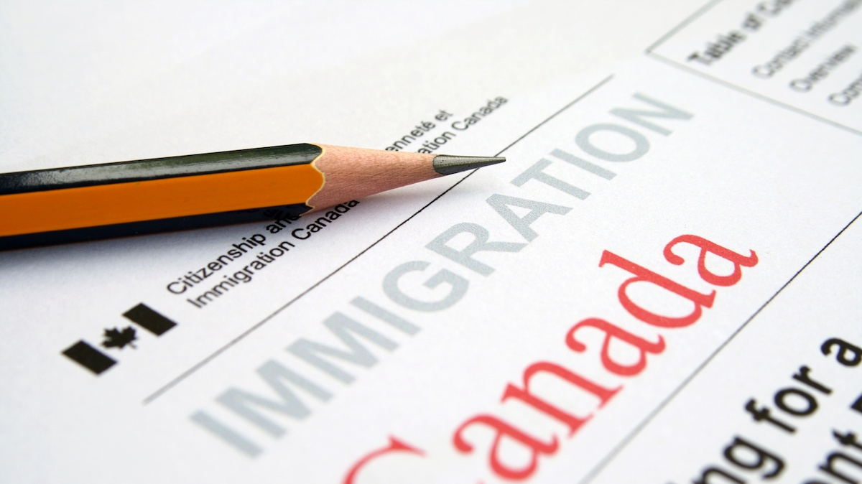
Immigration
A Short Introduction to the Rights of Newcomers

Slide 2
Multiculturalism Act 1988
Sought to protect the cultural heritage of Canadians, reduce discrimination and encourage the implementation of multicultural programs and activities within institutions and organizations
The act sought to remove any barriers preventing full participation in society and promised to assist individuals in eliminating and overcoming discrimination.
The new policy promoted inclusivity amongst Canada’s social, cultural, economic and political institutions (Canadian Museum of Immigration)

Slide 3
Immigration and Refugee Protection Act S.C. 2001: Immigration
“An Act respecting immigration to Canada and the granting of refugee protection to persons who are displaced, persecuted or in danger”
3 (1) The objectives of this Act with respect to immigration are
(a) to permit Canada to pursue the maximum social, cultural and economic benefits of immigration;
(b.1) to support and assist the development of minority official languages communities in Canada;
(d) to see that families are reunited in Canada;
(h) to protect public health and safety and to maintain the security of Canadian society; (Government of Canada)

Slide 4
Immigration and Refugee Protection Act S.C. 2001: Refugees
(2) The objectives of this Act with respect to refugees are
(a) to recognize that the refugee program is in the first instance about saving lives and offering protection to the displaced and persecuted;
(c) to grant, as a fundamental expression of Canada’s humanitarian ideals, fair consideration to those who come to Canada claiming persecution;
(d) to offer safe haven to persons with a well-founded fear of persecution based on race, religion, nationality, political opinion or membership in a particular social group, as well as those at risk of torture or cruel and unusual treatment or punishment;
(f) to support the self-sufficiency and the social and economic well-being of refugees by facilitating reunification with their family members in Canada; (Government of Canada)

Slide 5
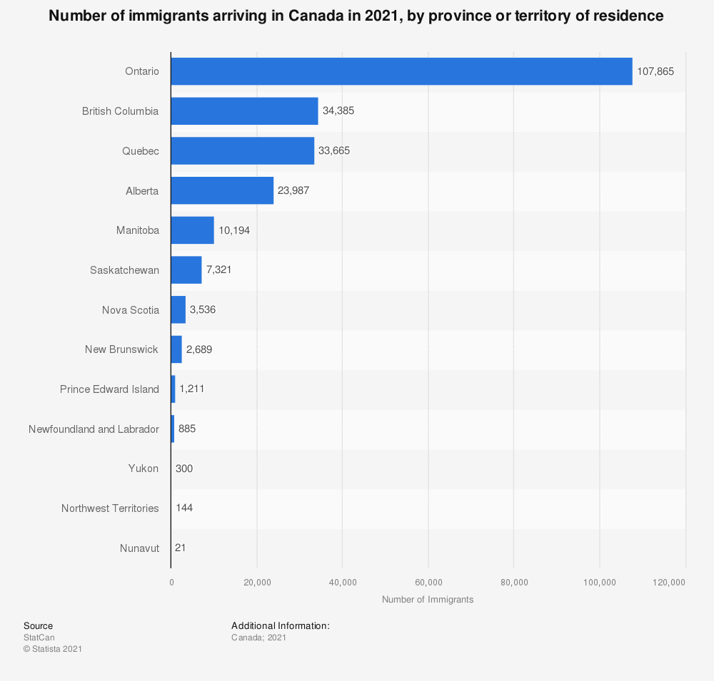
A Snapshot of Immigration to Canada Statistics Canada

Slide 6
Immigration: 2019 Statistics Canada

Slide 7
Immigrants To Canada Statistics Canada

Slide 8
Naheed Nenshi
36th mayor of Calgary, Alberta; served 3 terms as mayor
First Muslim Mayor in North America
He was educated at the University of Calgary, serving as President of the Students Union and receiving a Bachelor of Commerce in 1993, and completed a Master of Public Policy from the John F. Kennedy School of Government at Harvard University in 1998
Watch the short video on immigration in Canada on our website and answer the questions in your table groups.

