Slide 1
Development of the Legal System
Types of Law and their Origins

Slide 2
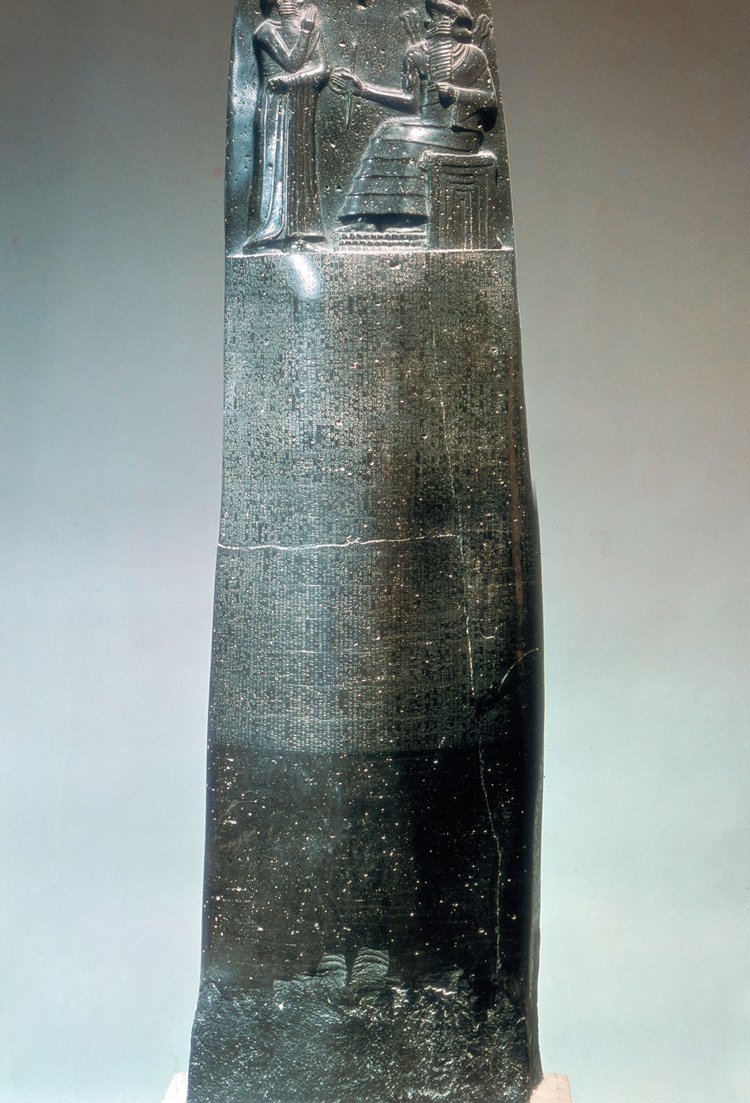
History
Begin on our website by looking at The Code of Hammurabi (1750 BCE)

Slide 3
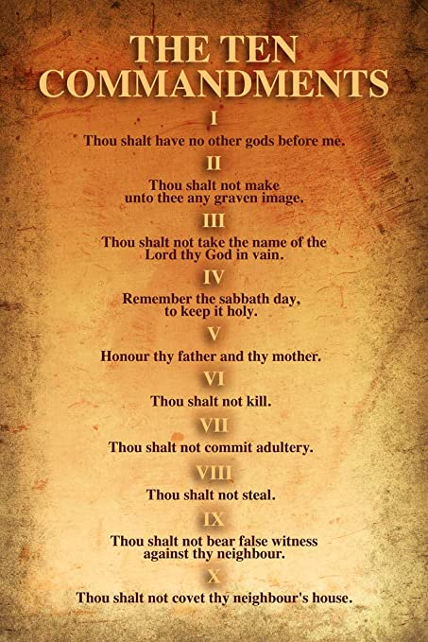
Mosaic Law & Justinian Code
Mosaic Law (1240 BCE)
- Laws of Moses that he gave to the Hebrew people. The 10 Commandments.
Justinian Code (550 CE)
- Byzantine emperor Justinian codified 1000 years of Roman Laws and opinions from legal experts emphasizing equality.

Slide 4
Indigenous Law Pre - Europeans
“The existence of social norms, the use of force and ostracism to enforce them, and the existence of a group—the elders—accustomed to asserting the integrity of such rules underlay the Aboriginal approach to justice before Europeans arrived in this part of the world. As we shall see, these customary practices survive to this day in the outlook of Aboriginal people.” (Aboriginal Justice Implementation Commission)
(More on this in later units)

Slide 5
Medieval Legal History
To get a picture of what life was like we will watch the Crash Course on Medieval History on the website.
Feudal System – King owns all the and and divided it among his lords and nobles. In return they served the King (loyalty and army)
The lord’s land was called his manor or estate and essentially he made all the laws. There were severe punishments and they varied from Lord to Lord. The King appointed judges to travel to try and stamp out these inconsistences.
13th Century laws and punishments were more standard as judges met and made punishments more ’consistent’ and developed Case Law
They became the basis for Common Law and Precedent Cases

Slide 6
Ancient Chinese Law
The word for law in classical Chinese was fǎ (法)
A term which preceded fǎ was xíng (刑), which originally probably referred to decapitation. The early history Shang Shu recorded the earliest forms of the "five penalties” : tattooing disfigurement , castration mutilation , and death.
Under Confucianism, the state should lead the people with virtue and thus create a sense of shame which will prevent bad conduct.
Under Legalism, law is to be publicly promulgated standards of conduct backed by state coercion. The tension between these two systems is that Confucianism relies on tradition to make the leader the head of household of all China, while Legalism makes standard law that even the emperor should be bound by.

Slide 7
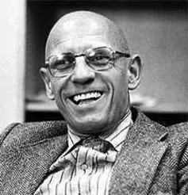
Magna Carta (1215)
A famous document that the English Nobility forced King John to Sign in 1215. Recognized the principle of the rule of law, which is the idea that all people – rulers and commoners – have to follow the same laws. (Legalism in China)
We will watch the video on Magna Carta on the website.
Read Foucault's detailing of punishment and how it has changed posted on our website and answer the questions.

Slide 8
Napoleonic Code (1804)
Gave post-revolutionary France its first coherent set of laws concerning property, colonial affairs, the family and individual rights.
Special commission, which met more than 80 times to discuss the revolutionary legal revisions,
It codified several branches of law, including commercial and criminal law, and divided civil law into categories of property and family.
(What the law meant: authority of men over their families stronger, deprived women of any individual rights, and reduced the rights of illegitimate children. All male citizens were also granted equal rights under the law and the right to religious dissent, colonial slavery was reintroduced.)

Slide 9
Evolution of Law Across Cultures
1. Based on custom
2. Meeting and culture to decide laws
3. Seeking widespread standardization

