Slide 1
Fundamental Freedoms
Section 2

Slide 2
Fundamental Freedoms
2 Everyone has the following fundamental freedoms:
(a) freedom of conscience and religion;
(b) freedom of thought, belief, opinion and expression, including freedom of the press and other media of communication;
(c) freedom of peaceful assembly; and
(d) freedom of association.

Slide 3
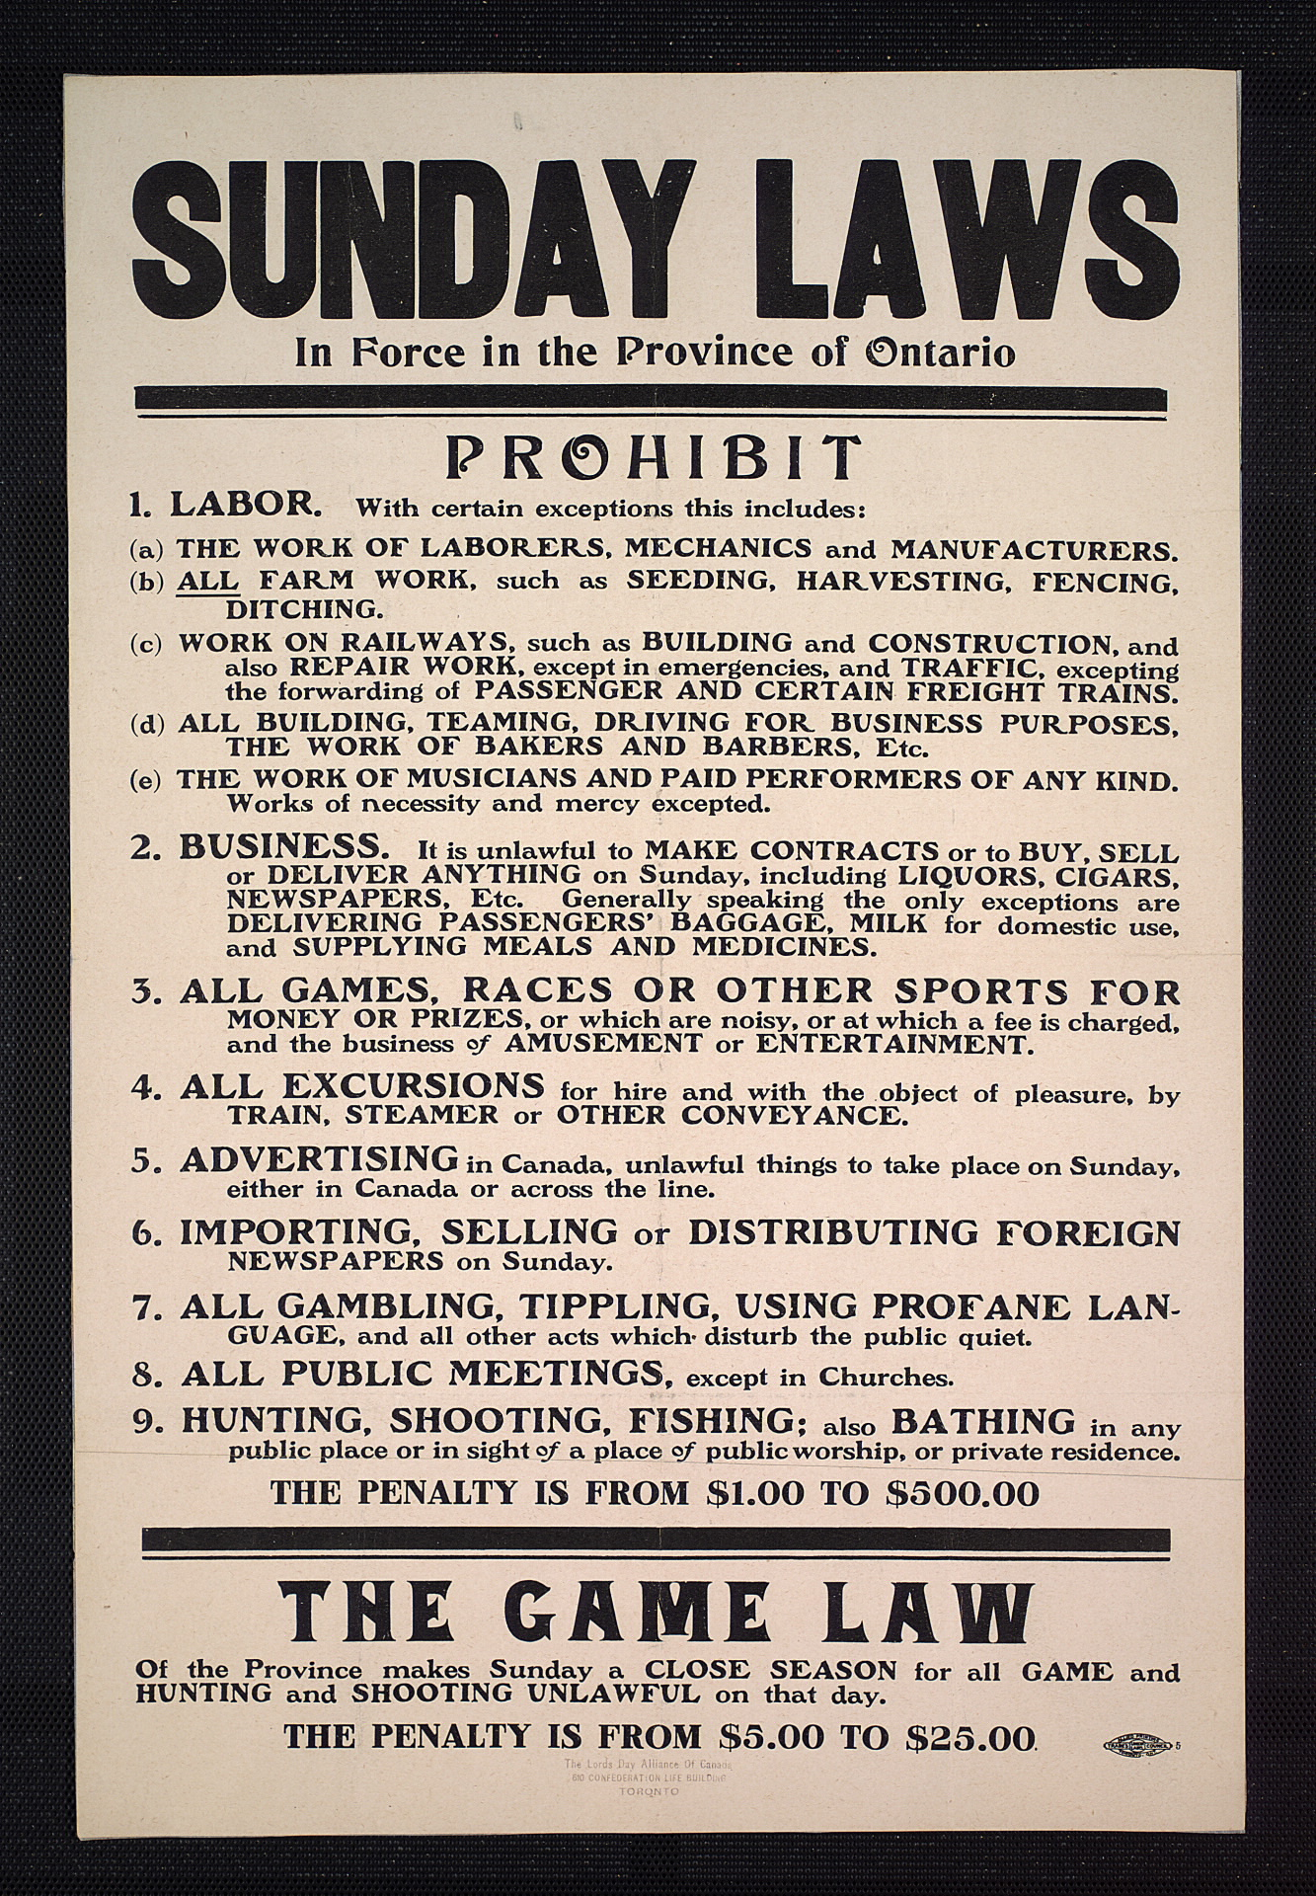
(a) Freedom of Conscience and Religion
In Canada you are free to practice you’re religion. You cannot be forced to act in a way that goes against your beliefs or conscience.
Lord’s Day Act

Slide 4
Lord’s Day Act
The federal Lord's Day Act made it an offence to transact business on Sunday. It was part of a legislative tradition which started in the 17th century in England. An "Act for punishing divers Abuses committed on the Lord's Day," called Sunday, was passed during the reign of Charles I.
On 24 April 1985 the Supreme Court of Canada in the BIG M DRUG MART case struck down the Lord's Day Act on the grounds that it contravened the freedom of religion and conscience provision in the Canadian Charter of Rights and Freedoms.

Slide 5
(b) Freedom of Thought, Belief, Opinion and Expression, including Freedom of the Press and Other Media of Communication;
The Charter covers all forms of communication and expression, including the mass media, writing, painting, sculpture and film. However there are limits on freedom of expression.
It is illegal to target groups because of their colour, race, religion or ethnic origin and to spread hate.

Slide 6
R v. Keegstra, 1990
What does it mean to promote hate?
James Keegstra was convicted of willfully promoting hate.
He taught his Alberta high school students that the Holocaust never happened.
His case went to the Supreme Court.
The majority ruled that while his Charter rights were infringed upon, this infringement was justified, upholding that spreading hate was against

Slide 7
Other Limits To Freedom
Read Canada (Attorney General) V. JTI-Macdonald Corp., 2007 SCC 30 posted on our website and answer the questions.

Slide 8
The Ruling
The ban on “false, misleading or deceptive” promotion, as well as promotion “likely to create an erroneous impression about the characteristics, health effects or health hazard of the tobacco product or its emissions”
Further, according to s. 22(2-4), both advertising appealing to young persons and “lifestyle advertising”, whereby a link between a tobacco product and a way of life (ie. glamour, recreation, excitement, vitality, risk, or daring) is constructed in a promotional material, are prohibited.

Slide 9
Social Media
Do you think social media needs restrictions?
Watch the video on our website then Read the Globe and Mail article on our website and be prepared to discuss.

Slide 10
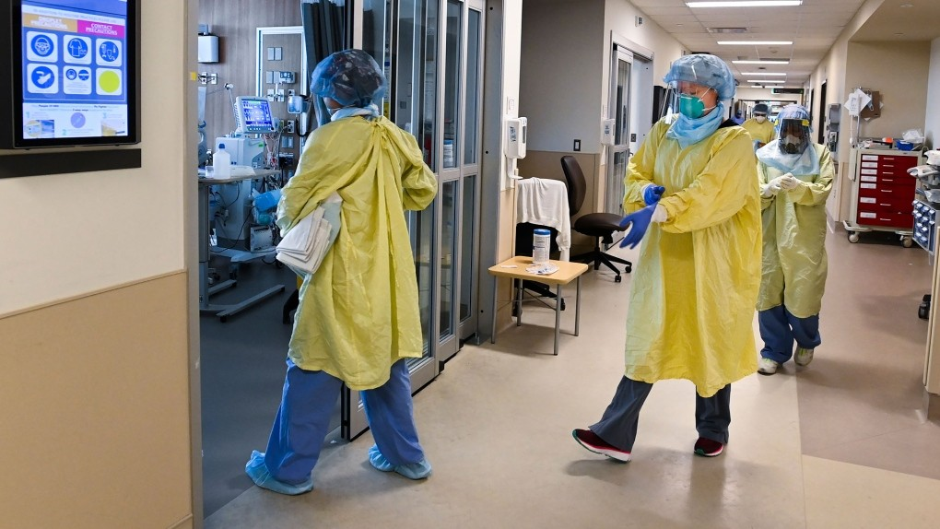
(c) Freedom of Peaceful Assembly;
The key word is ‘peaceful’. If a public display threatens to turn violent, the police may charge the participants with unlawful assembly. If things get disorderly or chaotic, police may charge participants with rioting.
View the videos about healthcare workers and protests/hate on our website then the laws the Federal Government are putting in place to curb these types of hateful protests.

Slide 11
(d) Freedom of Association.
Refers to the right of individuals to join together in groups. They can include sports clubs, cultural organizations, or trade unions.
It also recognizes worker’s rights to collectively bargain and to have the right to be represented by a union.
Freedom of associate can be limited: if a youth is charged with a crime they can be prevented from associating with other youth

