Slide 1
Parties and Elections In Canada

Slide 2
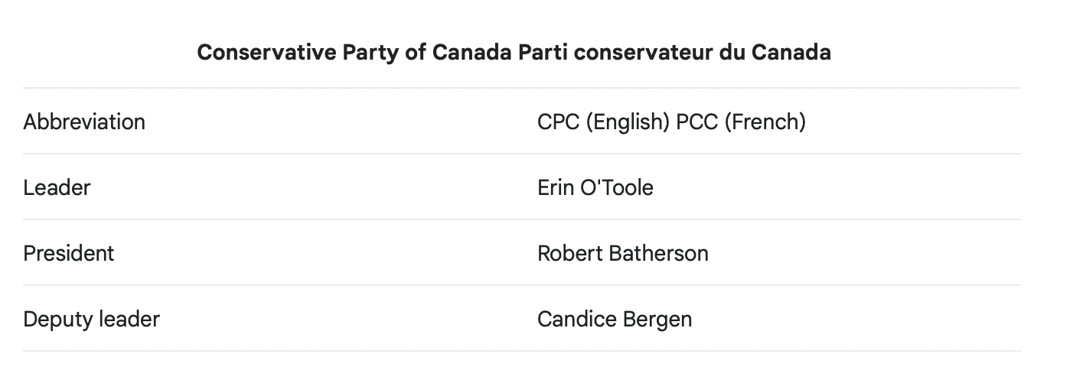
Party Policies
Policy - seeking vs. Office – seeking
At conventions parties outline objectives, structures, and procedures.
Parties vote in conventions on policies, but these votes are note binding.
Party leaders retain the right to determine official party policy (e.g. Conservatives on Climate Change)
Each party has: national executive including a president, vie presidents, treasurer and so forth. They establish executive committees.

Slide 3
Federal vs. Provincial Responsibilities
Federal Responsibilities
National Defense
Foreign Affairs
Federal Taxation
Banking
Provincial Responsibilities
Education
Healthcare
Some Natural Resources
Road Responsibilities
Federal Parties and Provincial Parties may have no link. For example in BC, Saskatchewan and Quebec there is not official Conservative Party, while if you are a member of the NDP Provincially, its assumed you are a member Federally. While the Liberals have some links provincially and some (BC for example, there is none at all).

Slide 4
https://www.nationalgeographic.org/maps/forms-government-2018/

Slide 5
Elections – Their Purpose
Decisions made by voters provide support for policies put forth by a part and choose how the country will be governed in the near future.
Elections allow citizens to choose who represents them in parliament.
Elections legitimize power.
Canada’s elections are ‘free’ in the sense that everyone can participate and you can start a political party, but there are advantages in terms of media coverage and finances for established ones.

Slide 6
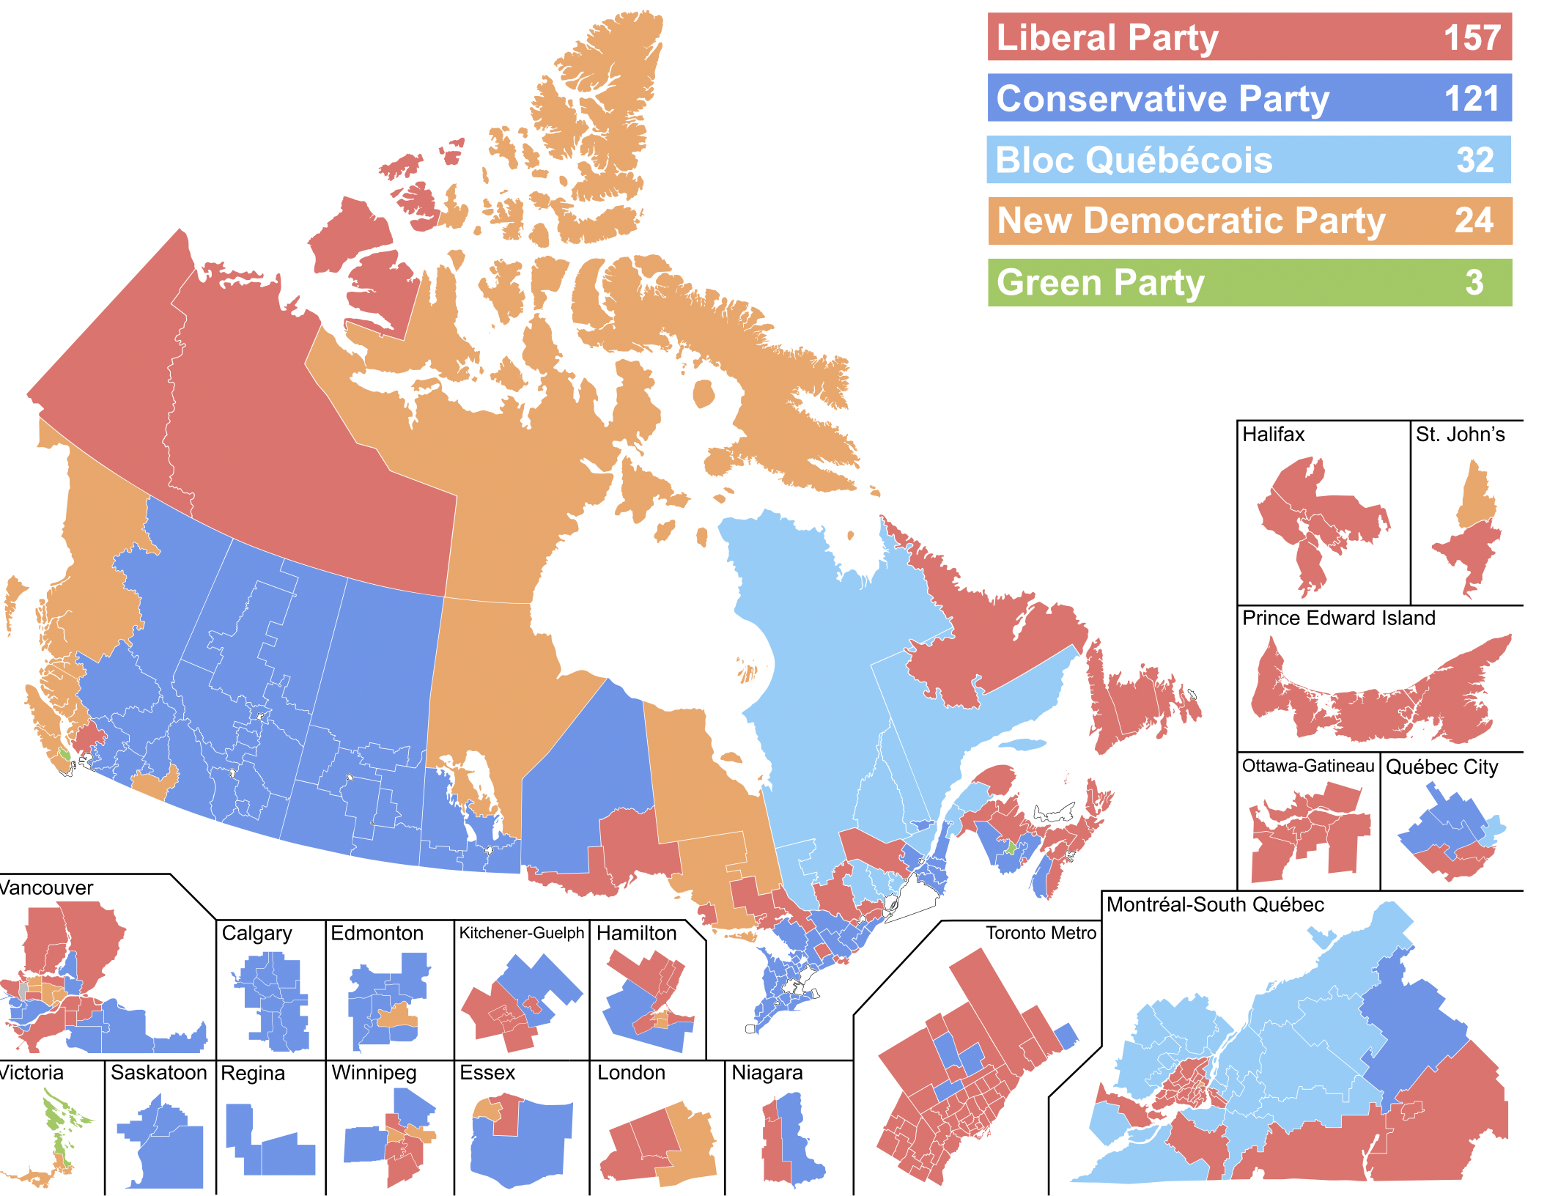
2019 Results
170 seats needed for majority government
How does this compare to 2021?
Winners and Losers?

Slide 7
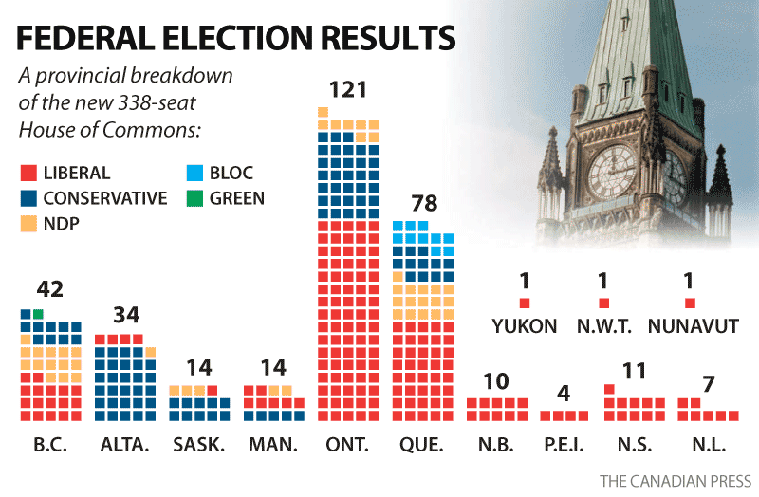
Division of Seats
The 3 territories are each given one seat automatically, while the population of each province is divided by the “electoral quotient” to provide the initial allocation of seats. That quotient was set at 111 166 for the post – 2011 redistribution.
Senatorial Clause – no province can have fewer MPs than it has senators
Grandfather Clause – No province can have fewer MPs that it had in 1985

Slide 8
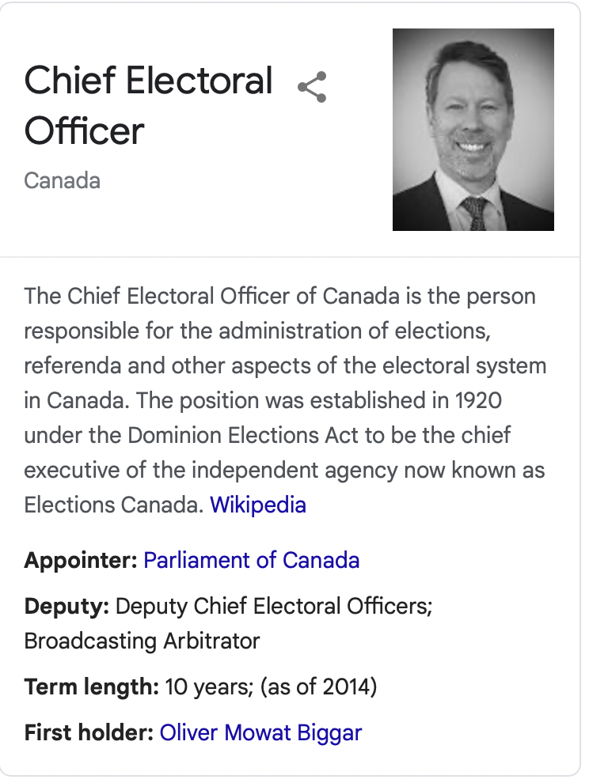
Some Election Facts
Dissolving Parliament: PM asks the Governor General to do so to trigger an election. This can also be done with a ‘nonconfidence vote.
The chief electoral officer (I absolutely had to Google that) is impartial and administers the election.
Voters lists come from income tax, Canada Post, citizenship and immigration, drivers licenses and vital statistics files.
Candidates are nominated (mostly) at a pollical party meeting
Canadian Federal Elections are held on Mondays (September 20th 2021)
Mail in voting is done in advance, but not opened until polls close on election day – this election might not be decided on the day as its estimated many more Canadians will mail in votes.
Voting in Australia is mandatory, fine is 55$

Slide 9
Voting
Dates of Extension of the Franchise in Federal Elections
1918 Women
1948 Asian Canadians
1950 Inuit
1960 Registered Indians
1970 Persons 18 years of age
1988 Federally appointed judges and people with mental disabilities
1999 Returning officers
2002 All prisoners
Secret ballot was introduced in 1874
20 Parties registered for the 2019 election
Application:
Political Approaches:
Political psychology and political behavior approaches are interested in voting behavior. For example, to what extent to people choose not to vote for their most favored candidate in order to vote for a lesser choice who has a greater chance of defeating their least favored option? (strategic voting). For example, NDP supporters who vote Liberal to defeat Conservatives. What do you think about this?

