Slide 1
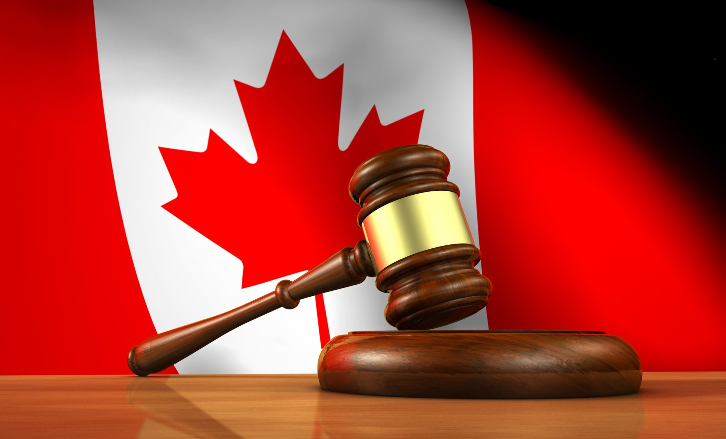
Evolution and Overview of The Canadian Legal System
A Lot of New Learning…

Slide 2
Part 1: Divisions of Law

Slide 3
Two Divisions
Substantive: Rules that outline your rights and obligations in society. In the Criminal Code outline activities or actions that are considering crimes in society.
Ex: Different types of assault in the Criminal Code.
Procedural: Outlines the steps involved in protecting our rights. Ex: The formal legal process that police must follow

Slide 4
Public & Private Law
Public: Controls the relationships between governments and the people who live in society.
Laws that apply to all individuals.
Main Types: Criminal, Constitutional and Administrative
Private: The legal relationships between private citizens and between citizens and organizations.
Purpose to manage behavior of persons and organizations in conflict with one another.
Also known as Civil Law

Slide 5
The 9 Divisions of Public and Private Law
Public: Criminal, Constitutional, Administrative.
Private: Tort, Family, Contract, Property Labour and Employment
Go to our website and choose a division of law. Each student can only do one and follow the instructions.

Slide 6
Part 2: Common Law

Slide 7
Common Law
A system of law based on past legal decisions; also known as Case Law.
Based on Precedent. A precedent is something that happened before and we rely on whatever decision was made in the past to influence our decisions for the future.

Slide 8
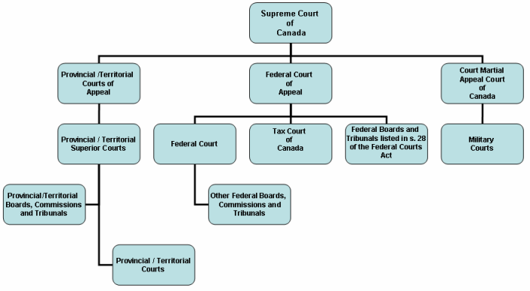
Appeals
Referring a case to a higher court to reconsider the lower court’s decision.
In Canada you can appeal to a higher court to review a decision of a lower court. Each province has a court of appeal and the highest court is the Supreme Court of Canada.

Slide 9
Precedents
Are still used today and are considered examples that should be followed. They are often brought up in cases and referred to during trials where they are often brought up to influence the persuade the judge to read a similar decisions.
It allows everyone including the accused to examine what the standard was.

Slide 10
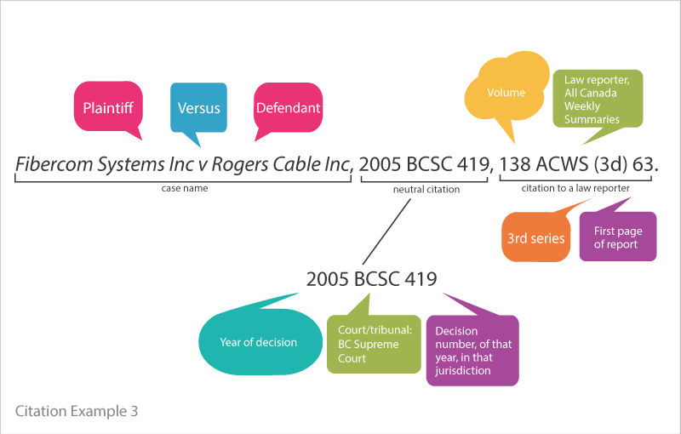
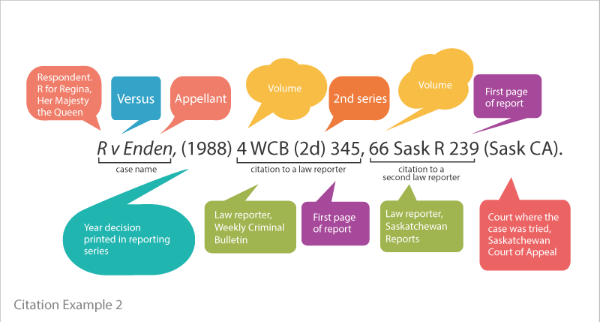
Elements of a Case Citation
Each recorded case is given a title or citation. Its basic information. Who is involved in the case, whether the case is public or private and the year the court decision was reached. It also identifies which court heard the case and the name of the published book where the court decision appears.

Slide 11
Case 1: Grant v. Dempsey.
Go to our website and view the case there and answer the questions .

Slide 12
Part 3: Development of Law in Canada

Slide 13
Statutes & Parliament
A statute is a law passed by a legislative body. Parliament fills gaps made by new laws and deals with new situations (changing culture and social norms for instance).
Here is an example of a legislative change made in early January.
When courts make decisions they must consider both Case Law and Statute Law.

Slide 14
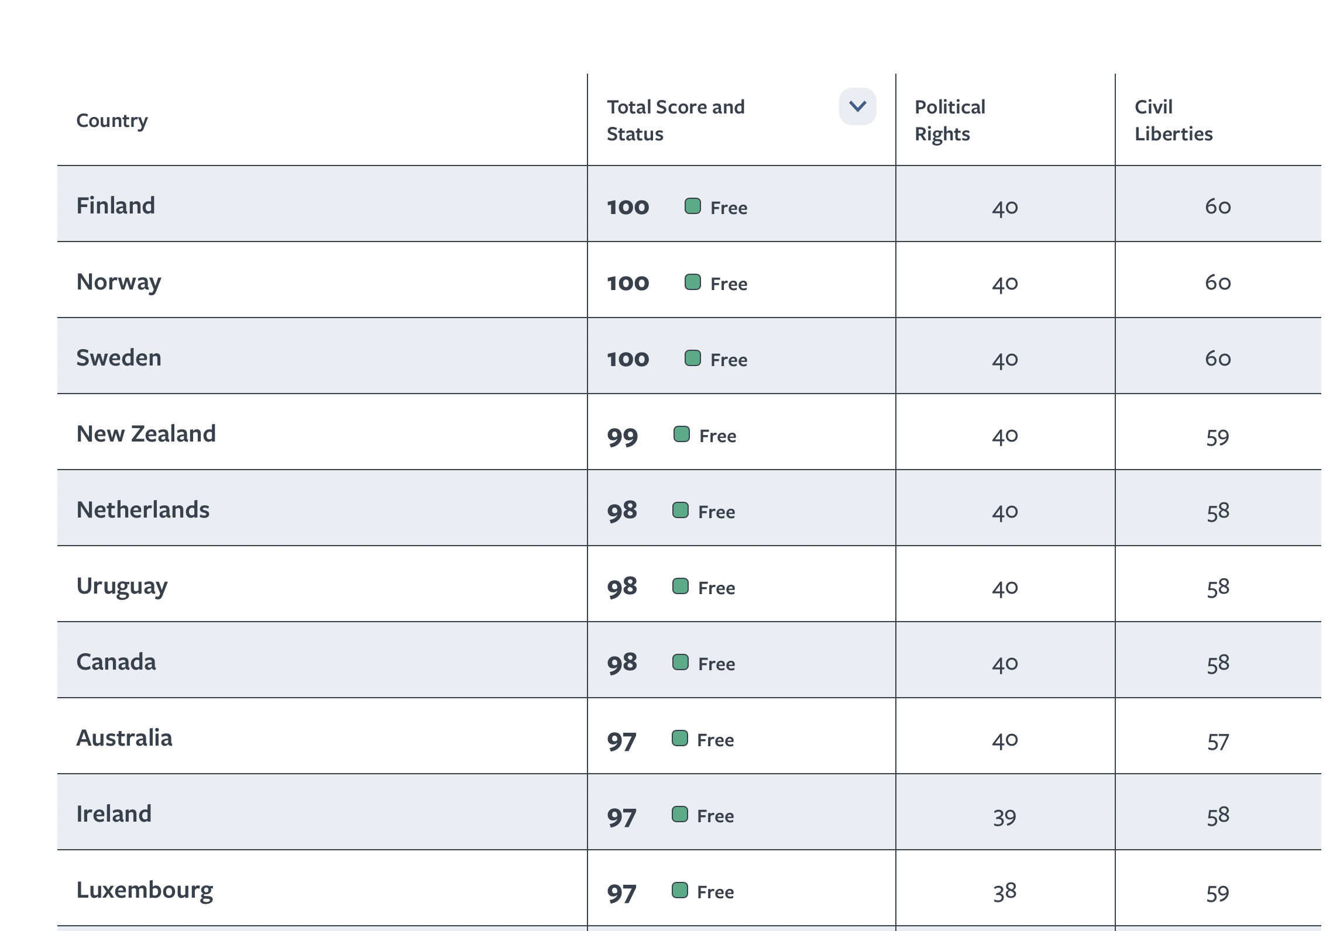
Freedom in Canada
Freedom House rates people’s access to political rights and civil liberties in 210 countries and territories through its annual Freedom in the World report. Individual freedoms—ranging from the right to vote to freedom of expression and equality before the law—can be affected by state or nonstate actors. Click on a country name below to access the full country narrative report. (Freedom House - https://freedomhouse.org/countries/freedom-world/scores?sort=desc&order=Total%20Score%20and%20Status)

Slide 15
Why The High Ranking?
Civil Rights – the rights of citizens that limit the power the government has over citizens.
Canada also respects human rights (banning conversion therapy for example).
While Canada has a long way to go with Truth and Reconciliation, Systemic Racism and Gender Equality, it is on its way to dealing with these issues, even if slowly at times. These fundamental freedoms are outlined in the Charter of Rights and Freedoms.

Slide 16
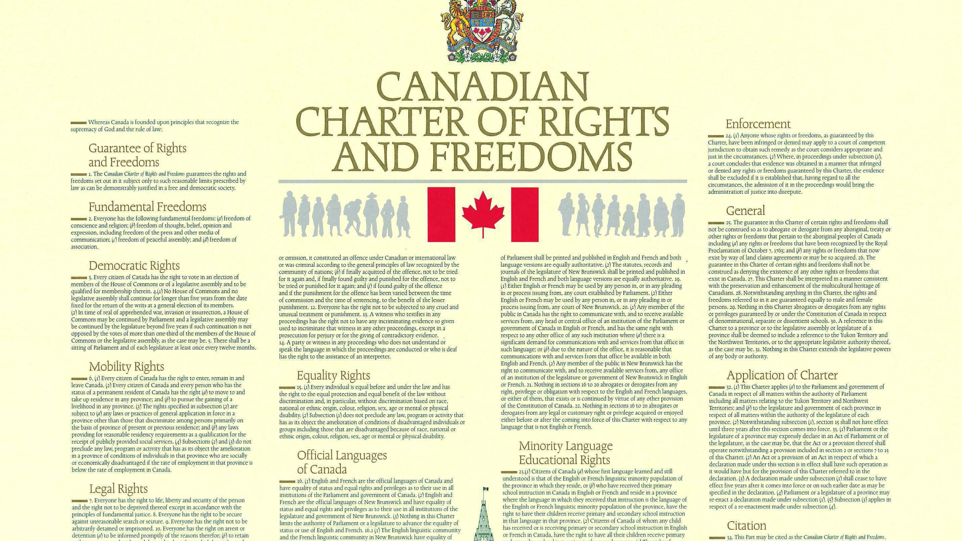
The Charter
The Charter of Rights and freedoms outlines how all Canadians should be treated and we will spend a great deal of time on this in the next unit.

Slide 17
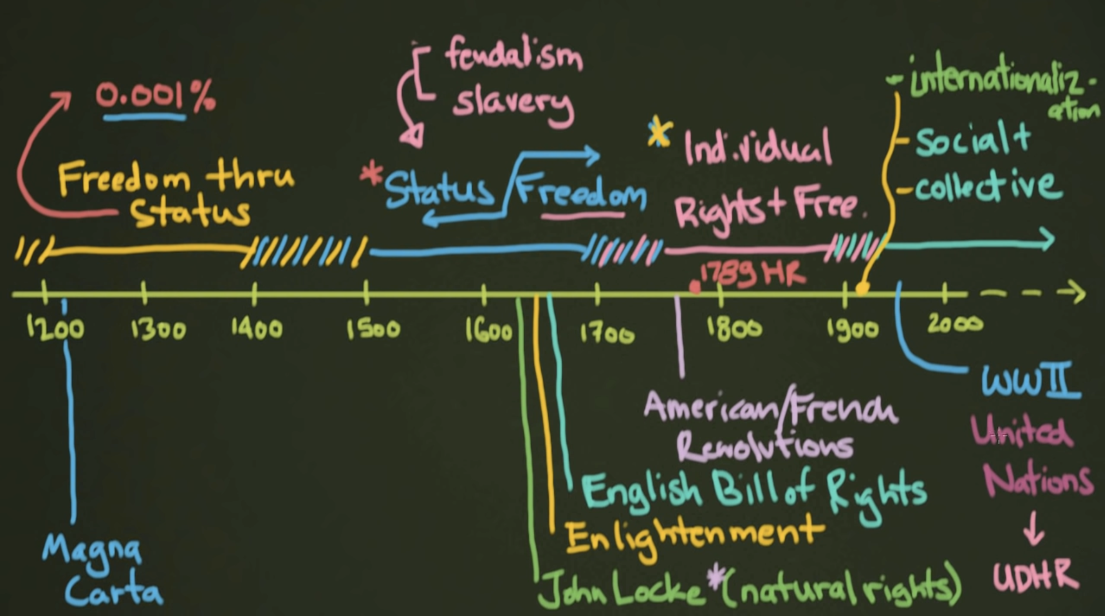
How We Got To The Charter
We will Watch 9 minutes

Slide 18
Universal Declaration of Human Rights (Dec. 10, 1948)
The United Nations was formed after World War II to resolve disputes around the world and address the many crimes committed in World War 2 against Jews, Gypsies, political enemies, gays and disabled people.
Visit the UN Declaration of Human Rights linked on our website. Choose 1 human right you think is important and be prepared to explain why you think so.

Slide 19
Canadian Bill of Rights (August 10, 1960)
On our website, review the Bill of Rights. How does it differ from the Declaration of Human Rights?

Slide 20
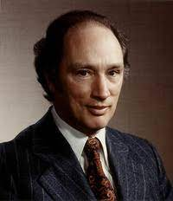
Pierre Elliott Trudeau
Passed the Constitution Act of 1982 which included the Canadian Charter of Rights and Freedoms. It lists civil rights and freedoms of all Canadians and guarantees them at ever level of government.
The Charter is Constitutional Law and therefore Parliament cannot vote to change it unless the federal government and at least 2/3^{rds.} of all provinces as well as 50% of the population agree to make any change.
Section 24 allows anyone to go to court to ‘seek remedy’ if their Charter Rights are violated.

Slide 21
Division Of Power
The Constitution Act of 1867 divides federal, provincial and territorial government powers and outlines what has jurisdiction or authority to make laws in different areas.
Federal and Provincial Government Powers
Federal Government Powers (Section 91) | Provincial Government Powers (Section 92)
peace, order, and good government Criminal Law Unemployment insurance Banking, currency, and coinage Federal penitentiaries Marriage and divorce Postal services Indigenous Peoples and their lands | Property and civil rights Marriage ceremonies Police forces and provincial courts Highways and roads Provincial jails Hospitals
Note: Laws that govern local municipalities include cities, towns, townships, villages and counties. They include: smoking in public places, zoning, parking by-laws, and property taxes

Slide 22
How Laws are Made
Bills are proposed laws to the government
Go to our website and view the PDF file on how Federal laws are passed. What do you think of the process? What are some benefits and what are some drawbacks?
Provincial & Territorial Laws are passed in a similar fashion, however they do not have Senates. Once bills pass through 3 readings, they go to the lieutenant – governor, the Queen’s representative, for signature.

