Slide 1
Contract Law

Slide 2
What is Contract Law?
Contract law is mainly private, judgemade common law. It developed over many years as coursts heard cases and decisions were recorded into case law.
Once a contract exists, each party has rights and responsibilities to carry out; when they are completed the contract is finished.
If one party does not live up to their end they are in breach of contract.

Slide 3
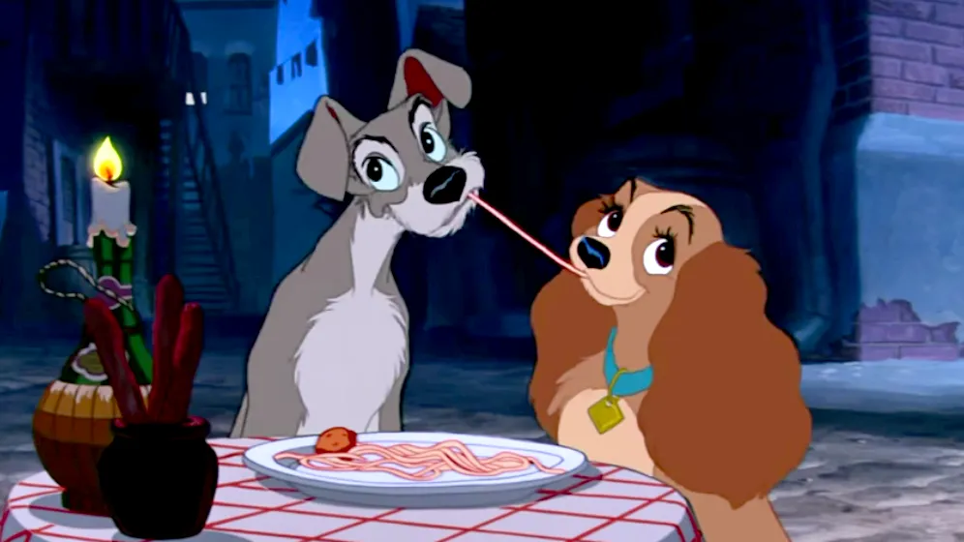
Agreement vs. Contract
Valid Contract – a legally binding document that imposes rights and responsibilities on all parties involved. Social and moral obligations (paying on your date) are not valid contracts.
All contracts involve agreements but not all agreements are contracts.
Agreeing to split dinner isn’t a contract.

Slide 4
Characteristics of a Valid Contract
Offer and Acceptance
Consideration
Capacity
Consent
Lawful Purpose

Slide 5
Offer and Acceptance
A proposal to a contract by the offeror that contains all essential terms, followed by an agreement to the proposal by the offeree.
Offers must be seriously intended and definitively accepted. Terms of an offer must be clearly defined. See Nike’s return policy here.
A retailer does not expect everyone who sees the advertisement to buy. As a buyer you make the offer when you purchase.
Jokes and offers out of anger are not valid.

Slide 6
Communicating the Offer
Offers are communicated a variety of ways: most common now are email or in person.
Offers can have a time limit. An offer lapses when it is not accepted within a certain time limit and it can be revoked or cancelled before it is accepted. Offers to buy or sell stocks can lapse in minutes, contracts for employment may have a 48hr deadline, buying a home might be 1hour or 24 hours.

Slide 7
Acceptance
Acceptance can be communicated verbally or written. Acceptance must be unconditional and made within a specific timeframe.
You may make a counteroffer in response to the original made. This happens often in real estate.

Slide 8
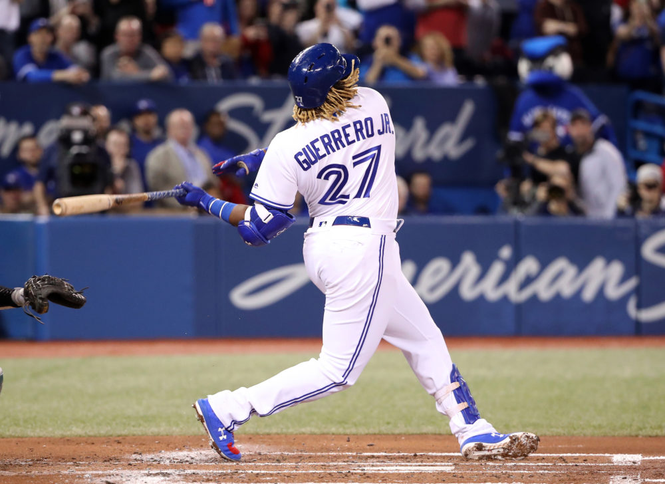
Consideration
Something of value exchanged between the parties to a contract.
Present Consideration: When the contract is formed.
Future Consideration: When one or both parties promise to do something in the future.
Good and Bad Deals: You can make a bad deal and lose money or make a bad trade.
In theory, when a player is acquired for future considerations, it means that, at the end of the season, the acquiring team will send another player of equivalent value to the team that traded the original player.

Slide 9
Capacity
You need to be sane and sober and an adult.
Minors: Anyone under 18 in Ontario. Minors can engage in contracts if they are necessaries (food, water, clothing, education, medical services) so businesses can sell to them. Unlike adults, they can only be offered and accept ‘reasonable prices. Contracts are void of minors lie about their ages and sometimes parents are liable.
In Ontario, you must be 18 years of age with valid, government-issued photo ID to get tattooed. Some exceptions may be made for customers as young as 16 years of age with signed parental consent.
(Toronto Star)

Slide 10
Consent
The seller is not legally obligated to discolose negative facts that might stop you from making a purchase. You are responsible for checking out the product. Google Reviews!
What are some ways that consent in a contract might be prevented?

Slide 11
Misrepresentation
Misrepresentation is a false or misleading statement that is important to the contract.
Examples:
Innocent Misrepresentation: made in good faithe by a person who believed it to be true.
Fraudulent Misrepresentation: made intentionally to deceive the other party.
Common Mistake: an error made by both parties about a fundamental component of the contract
Unilateral Mistake: an error made by one party to the contract
Clerical Mistake: an error caused by a store clerk or employee

Slide 12
Lawful Purpose
Any contract that is a crime under the Criminal Code or that breaks federal or provincial laws is illegal and void.
Gambling is regulated in Ontario and unless you are of age and using a legal website, app or in a lawful casino, all bets are void.

Slide 13
Discharging a Contract
Contracts can also be ended by mutual agreement, impossibility of performance and breach of contract.
Example: Harry Styles is performing in Toronto and the show sells out, he performs, and he gets paid. Contract has been performed. If he has issues at the boarder and cannot perform say he doesn’t meet Canada’s Covid restrictions, then the contract is void or if the Roger’s Centre has a roof leek, they have not fofilled their obligations. If not enough tickets sell there can be a mutual breaking of the contract. Say Styles is supposed to perform in Whistler, but there is a massive snow storm then a frustration of contract has occurred as it is not possible for him to perform. He can get out of the contract this way.

Slide 14
Breach of Contract
Failure to perform an obligation owed to another under a contract.
Breach of Condition: failure to perform an essential term of a contract, entitling the injured party to treat the contract as ended.
Breach of Warranty: failure to perform a term of a contract, entitling the injured party to damages.

Slide 15
Remedies for Breach of Contract
Damages: compensation for the injured party. Mean to place the injured party in the same position had the contract been fulfilled.
Mitigation of loss: the expectation that a person injured by a breach will take reasonable steps to reduce any losses that the breach caused.
Liquidated Damages: the sum of money stipulated in a contract to settle a potential breach.
Specific performance: a court orders a person to fufill the terms of a contract.
Injunctions: Stopping one party in the contract from doing something.
Rescission: Cancelling the contract.

