Slide 1
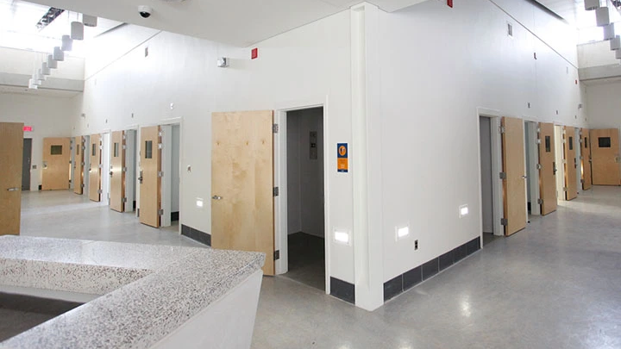
The Young Offender’s Act

Slide 2
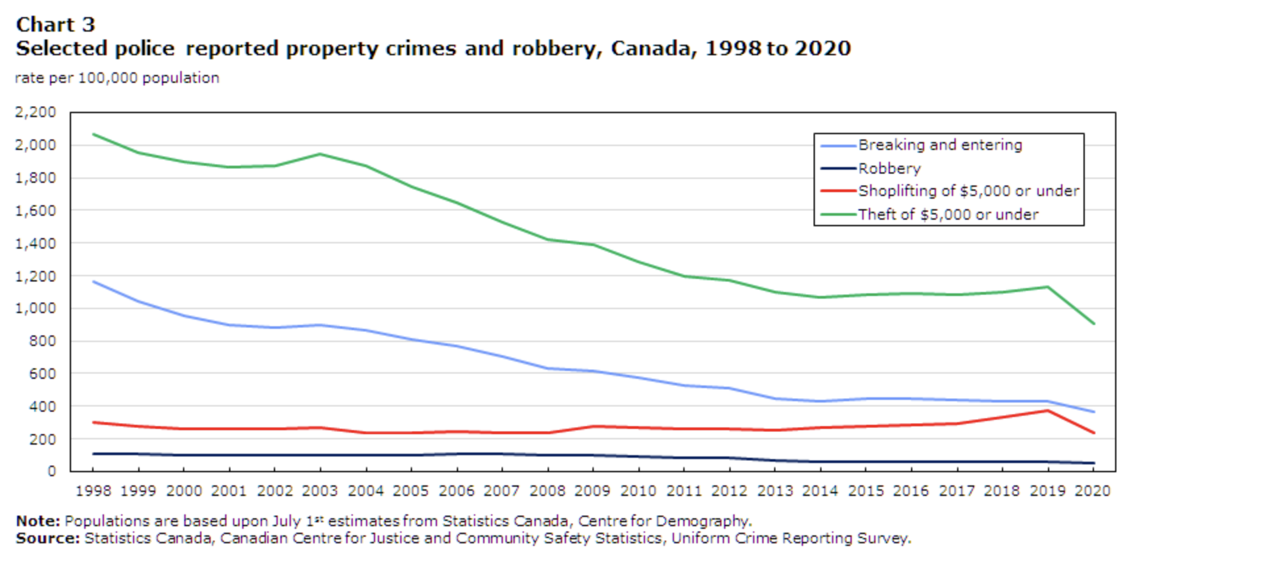
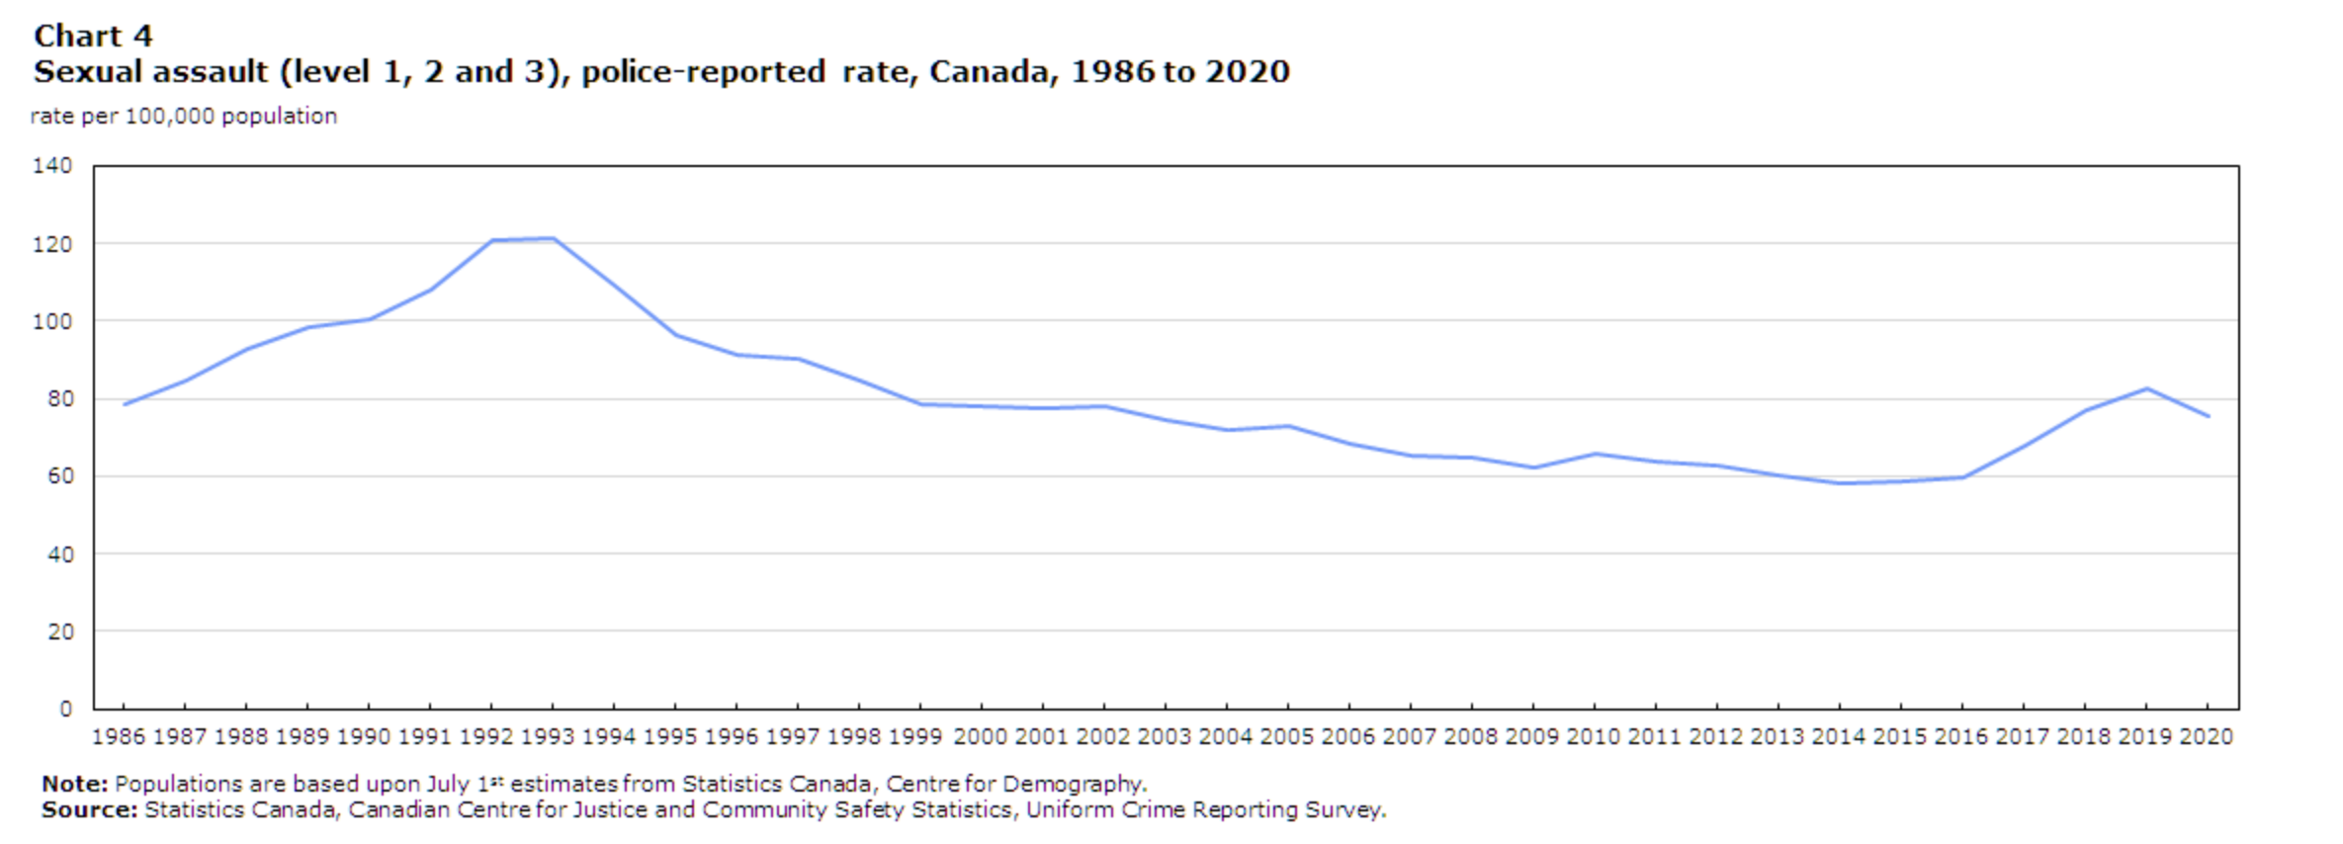
Youth Crime Statistics

Slide 3
What is a Young Offender?
Young Offenders are people who are aged 12 to 17 who break the law as defined under the Young Offender’s Act (linked on our website – use it for the mock trial).
A youth criminal is a person 12 - 17 who is charged with a crime under the YOA.
This reflects that young people and specifically those under 12 cannot form criminal intent or mens rea and that capacity is limited between the ages of 12 and 17.

Slide 4
Winnipeg
In 2008 Winnipeg police seized a 10 year old boy who was thought to have set nearly 36 fires. Police said the latest string of arsons began March 27 when a Molotov cocktail was thrown at a house. The boy could not be charged under the Youth Criminal Justice Act because of his age. He was turned over to a guardian and referred to a provincial education program designed for young children who run up against the law.
Do you think that child offenders should be dealt with more seriously? Why or why not?

Slide 5
YOA’s Purpose
To prevent crime by finding out what causes offending behavior, rehabilitate youths who commit offences, reintegrate them into society, ensure that they are subject to meaningful consequences and promote the long-term protection of the public.

Slide 6
Legal Rights
Extrajudicial Measures – Measures other than court proceedings for non-violent, first-time youth criminals.
Crimes that call for Extrajudicial Measures: | Common Extrajudicial Measures
Theft under 5000$ | Taking no further action against the youth or their parents
Possession of stolen property | Giving an informal warning
Breach of probation | Giving a formal police caution including the seriousness of the offence
Failure to appear in court | - Referring the youth to a community program such as recreation, mental health or child welfare
 | - Referring the youth to a extrajudicial sanctions program

Slide 7
Extrajudicial Sanctions:
A more serious punishment for youth criminals that does not create a criminal record. Apologies to victims, returning stolen goods, work for victims to repair damages, counselling, drug and alcohol treatment, specials school programs and community service.
Programs are designed to increase involvement of parents and to rehabilitate youth.
Youths who successfully complete these programs will have all charges against them stayed or dropped.

Slide 8
R.v. K (Cr.) and K. (Ct.), 2006
Two teenage sister were found guilty of first – degree murder in 2005 in the drowning death of their mother. The sisters supplied their mother with drugs and alcohol. The older sister held their mother’s head under water until the mother drowned. The sisters’ lawyer argued that the mother was an alcoholic who was in a self-induced state when she accidentally drowned in the tub. But the court also heard that one of the sisters described to a friend how they killed their mother and planned to make it look like an accident. The mother’s alcoholism caused her to be abusive. Because of the sister’s ages at the time of the murder, they could not be identified under the YOA.
What type of punishment should they receive?
Should youth’s names be released to the public when they commit a crime?

Slide 9
Arrest and Detention
For serious offenders, police must arrest youths as they would adults. However certain legal rights and protections are afforded to youth. The Charter applies to all youths. Youths must be advised of their rights in a manner to which they understand by police or a person of authority (principal, coach, teacher etc.)
Parents or guardians must be notified as soon as possible after arrest or detention.

Slide 10
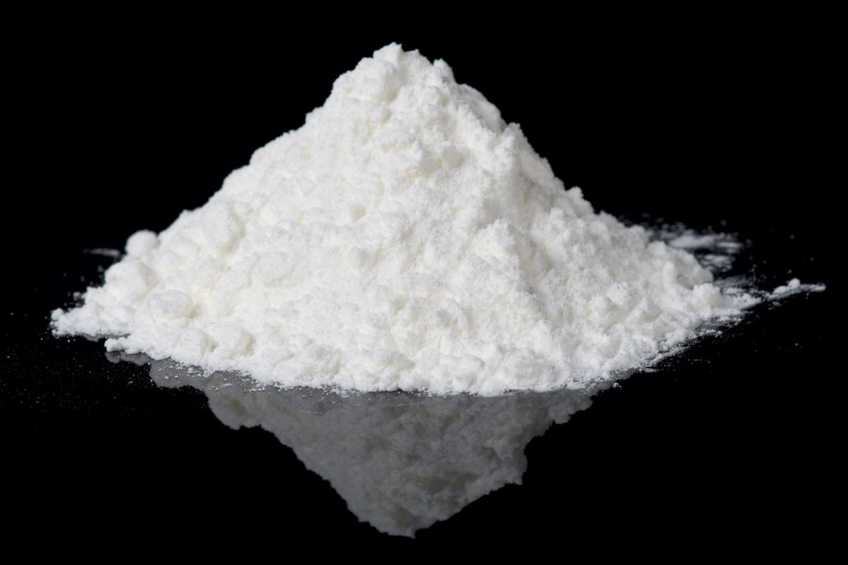
Searches
Principals can search students if reasonable grounds are given without a warrant. Examples of reasonable grounds include: teacher observations and information from credible students.

Slide 11
Trial Procedures
If youth are at risk of reoffending they may be placed in a foster home or under house arrest.
Youths 12 to 15 are tried in Family Court and 16 to 17 in Provincial Court. Trials are the same as they are for adults if the offence is serious enough.

Slide 12
Youth Court Sentences
Crime | Maximum Sentence
First – Degree Murder | 10 Years
Second – Degree Murder | 7 Years
All other offences where an adult would receive a life sentence | 3 Years
All other offences | 2 Years

Slide 13
Youth SENTENCING OPTIONS
Under the YOA the principals of sentencing are as follows:
To told offenders accountable for their criminal behaviour
To consider the victim's needs and concerns
To impose appropriate sanctions, with emphasis on rehabilitating youths, reintegrating them into society, and protecting society
Which do you think for young people is most important?

Slide 14
Sentencing Options
Choose 1 of the following sentencing options, search it on the internet (Canadian only) and be prepared to explain it to the class.
Absolute Discharge
Fine
Compensation
Personal and Community Service
Probation
Custody

