Slide 1
Women’s Rights
Issues in Women’s Rights

Slide 2
Some Background & History
Together we will watch the 2 videos on our website about different aspects of women’s rights. Each video has a couple questions you need to answer and that we will discuss.
Women were excluded from universities, professional schools, could not vote or run for political office.
Much has changed, but much change still needs to occur.

Slide 3
Social Stereotypes of Women
What are some stereotypes of women?
How are these dangerous and harmful?

Slide 4
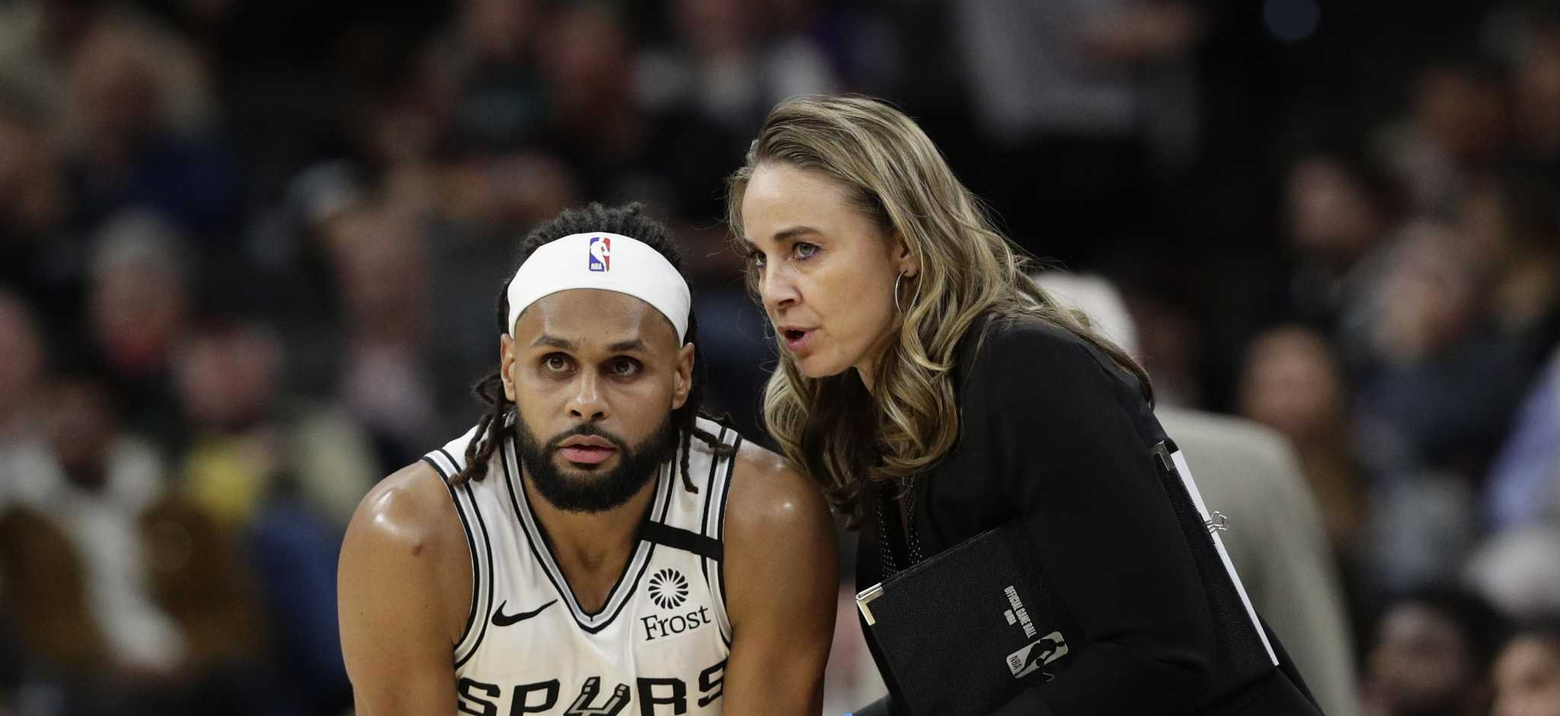
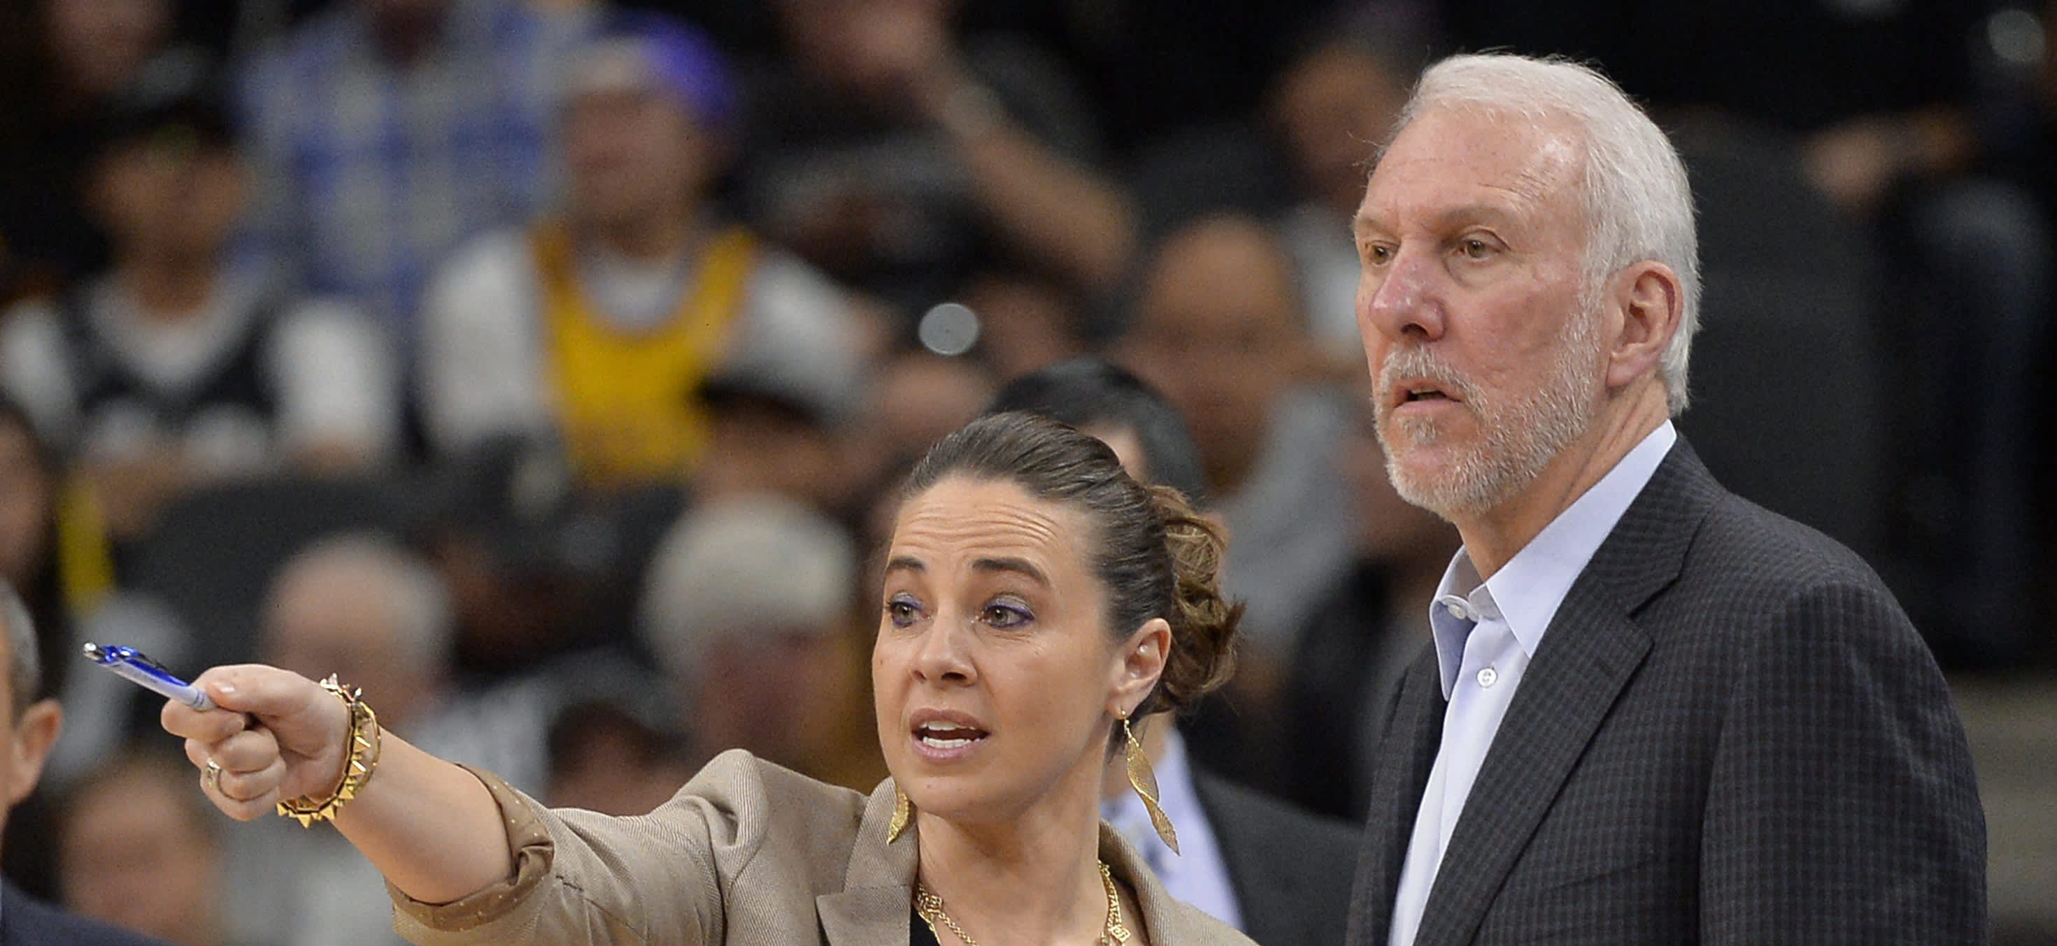
Prejudice
A Prejudiced towards women is pre-judging a women based stereotypes, not based on her actual character, skill, or personality.
For example: Women in sports leadership.
Example: Becky Hammon

Slide 5
Labeling
Labelling theory is a theory in sociology which ascribes labelling of people to control and identification of deviant behaviour.
How might this be an example that goes against labeling?

Slide 6
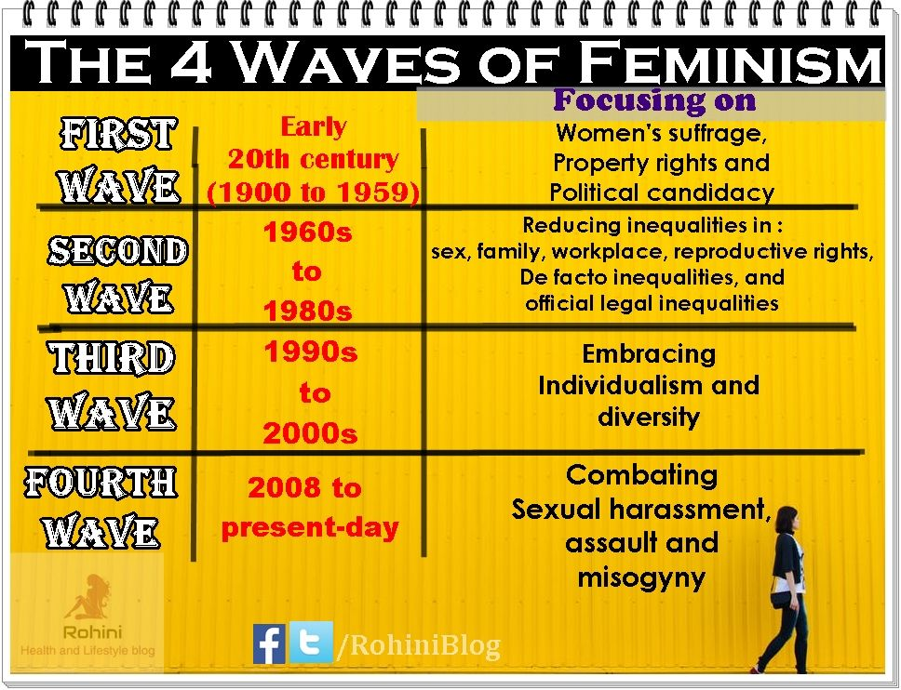
Feminism
The social, economic and political struggle for equality of the sexes
There are 4 Waves of Feminism. We are currently in Wave 4.
Read the article on 4th Wave Feminism on our website and answer the questions

Slide 7
Emma Watson
Graduate of Brown University
UN Women’s Goodwill Ambassador
Watch her video on our website.
1. What does she think the gaps are in data are?
2. What are her feelings on the word feminism and how it is perceived by men. What are your feelings on this?
3. What do you think she means by the normalization of prejudice and misogyny?

Slide 8
Issues in Women’s Rights Today
Pay Equity: equal payment for work evaluated as equal in worth.
Watch the Netflix Explained on our website and answer the questions there.
Employment Equity: all employees should be treated on their abilities and be fair and just and impartial.

Slide 9
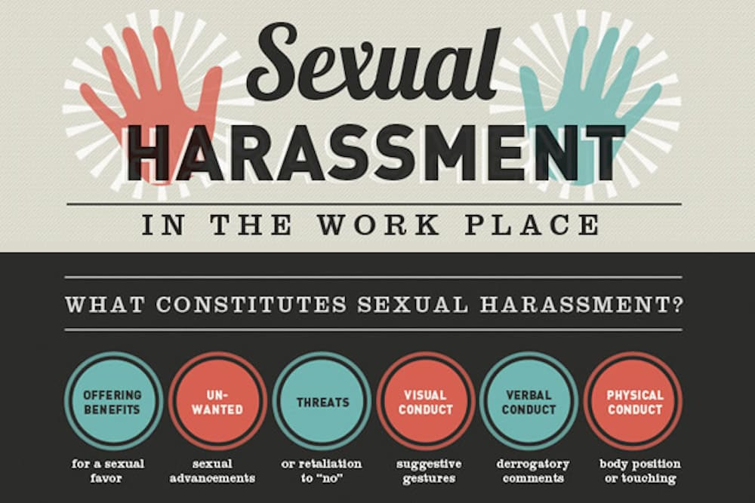
Issues in Women’s Rights Today
Sexual Harassment: unwelcome actions or conduct of a sexual nature towards another person.
Watson touches on this, how can we prevent this?

Slide 10
Issues in Women’s Rights Today: Title IX: United States
Title IX
“The U.S. Department of Education’s Office for Civil Rights (OCR) enforces, among other statutes, Title IX of the Education Amendments of 1972. Title IX protects people from discrimination based on sex in education programs or activities that receive federal financial assistance. Title IX states:
No person in the United States shall, on the basis of sex, be excluded from participation in, be denied the benefits of, or be subjected to discrimination under any education program or activity receiving Federal financial assistance.”
- What affects has Title XI had on you? How is it beneficial to both women and men?

