Slide 1
Laws of the Economic Jungle

Slide 2
The Production Possibilities Curve
Used to illustrate the fundamental problems of scarcity.
Since wants will always exceed available resources, people living in a given economy must make production choices.
The production possibilities curve provides a visual model of the production choices faced by people in a simple economy.

Slide 3
Cetris Paribus
Consumer Good (Bread) – products and services that directly satisfy human wants
Capital Good (Ploughs) – used in the production of other goods
In this economy: Consumer goods and Capital Goods are being used.
Only two products can be produced. (to make decision making simple we cannot have too many products being produced) Therefore the trade-off is very clear.
The economy has fixed technology and resources. (No technological advancements can be made as this decision is made over a very short period of time and no additional resources can be imported and only resources can be shifted)
The economy is at full employment. (resources are being used effectively and efficiently within the economy)

Slide 4
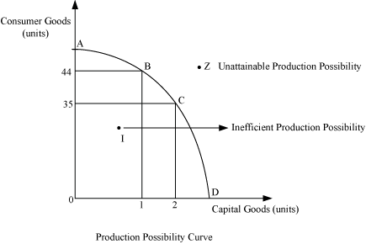
The Production Possibilities Curve
At Point C an equal number of bread and ploughs are produced.
At Point A great deal of bread is being produced therefore almost 0 Ploughs are being produced.
At Point B less bread is produced and thus more ploughs are produced.
At point D a great deal of ploughs are being produced and therefore almost 0 bread is produced.
Therefore as more of one good is produced, less of another is. It is an economist’s job to determine how much of one ought to be produced over another.

Slide 5
I and Z
Explain I and Z.

Slide 6
Law of Increasing Relative Cost
Plough | Bread
0 | 15000
1 | 14000
2 | 12000
3 | 9000
4 | 5000
5 | 0

Slide 7
Explained
When a society, in order to get greater amounts of one product is willing to sacrifice an ever increasing amount of the other product.
The Economic cost of 1 output relative to a 2nd output is given in terms of quantity of that 2nd output. Ex. The cost of 1 plough is 1000 loaves of bread.
Therefore the slope becomes steeper as a result of this ever increasing vertical change

Slide 8
The Law of Diminishing Returns
Outputs will increase when a particular input is increased, but only to a point. After that point, increasing inputs will not have an appreciable effect on outputs. This deals with labour and output.

Slide 9
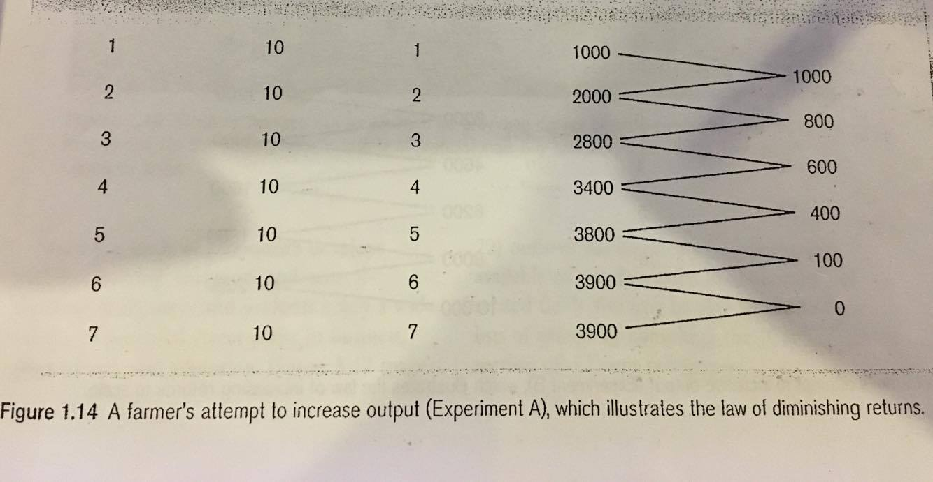
Example
If a farmer farms her own land without machinery or hired help there are two productive resources land and farmers own labour. The farmer can hire additional workers as needed, therefore as she hires workers there is an increase in crops yielded. However, this only occurs to a point as eventually the amount of workers added will produce diminished return

Slide 10
Law of Increasing Returns to Scale
By increasing the scale of the operation one can take advantage of teamwork and labour specialization thereby making the operation more efficient.

Slide 11
Explained
Every time the farmer increases the workface, she also increases her amount of land to farm therefore increasing overall production. Therefore if all productive resources are increased, output will increase.
 | Labour
1000 | 1
2000 | 2
3200 | 3
4600 | 4
6200 | 5
8000 | 6
10000 | 7

Slide 12
Check Your Understanding
1. How does the production possibilities curve illustrate scarcity?
2. Why do we not want to produce at I in the production possibilities curve?
3. Provide an example of a capital and consumer good not used in this presentation.
4. What is meant by the relative cost of a product? Explain how increased relative costs are related to opportunity costs and diminishing returns.

