Slide 1
Trial Procedures
Pre – Mock Trial Information

Slide 2
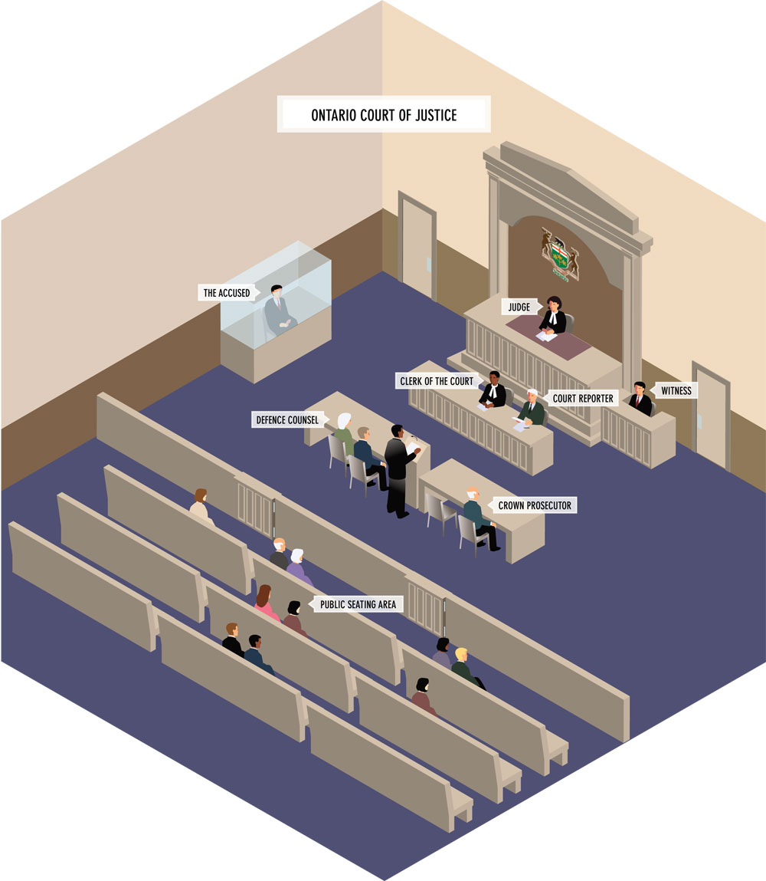
The Adversarial System
The system of law in which two or more opposing sides present their case in court. Note the diagram on the right of the Ontario Court.

Slide 3
Burden of Proof
The Burden of Proof is on The Crown. They need to prove that the accused is guilty beyond a reasonable doubt. They need to prove both actus reus (wrongful deed) and mens rea (guilty mind).
For our pruposes of our trial we will only have a judge with no jury. What type of offences would we be trying in our mock trial if there is no jury?

Slide 4
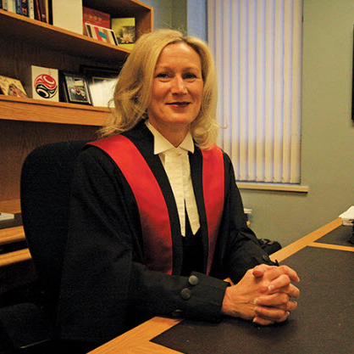
Judge
Judge Lowe ; BC Provincial Court
Often referred to as the ‘bench’ or the ‘court’.
The federal government appoints judges to federal and the Supreme Court; the lieutenant governor of each province appoints judges to provincial courts.
Judges must act impartially without bias. Judges have full control of the courtroom.
Judges decide what evidence is admissible.
Judge Trials: Judge rule on the credibility of witness statements, decided if the accused is guilty or not, and must give sentencing. (In our trial the judge will have to write and speak a rational for their ruling).

Slide 5
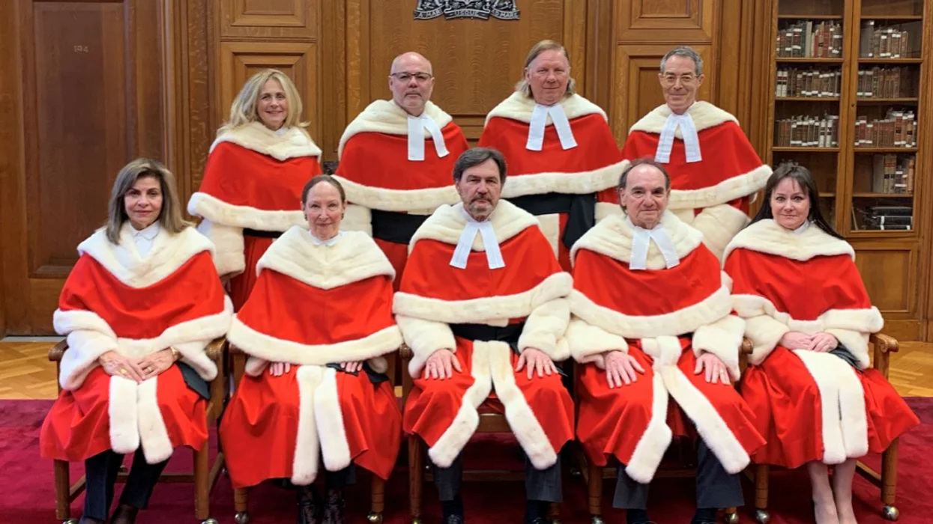
The Supreme Court of Canada
The Judges
The Rt. Hon. Richard Wagner, P.C., Chief Justice of Canada. (Learn about the functions of the court from this video from Wagner)
Michael J. Moldaver.
Andromache Karakatsanis.
Suzanne Côté
Russell Brown.
Malcolm Rowe.
Sheilah L. Martin.
Nicholas Kasirer.

Slide 6
The Crown
The lawyer who prosecutes on behalf of the government and society.
Prosecutors are responsible to see that justice is done.
Burden of proof is on the Crown and therefore must prove beyond a reasonable doubt that the accused is guilty.
Crown attorneys must disclose all evidence whether they plan to introduce it or not even if it makes their case weaker.
They must ensure that the accused is given a fair trial.

Slide 7
The Defense Counsel
The legal representative of an accused.
Duty to ensure the accused’s legal rights are protected.
They should know the law and advise their clients accordingly and how best to proceed.
Defense lawyers MUST represent their clients to the best of their ability not matter their personal beliefs.

Slide 8
The Court Clerk, Sheriff & Other Officals
Court Clerk – a person who keeps records and files, and processes documents for a court
Court Recorder – a person who documents court proceedings
Sheriff - a Crown - appointed official who acts as part of the justice administration system. They may find jurors for the court, ensure the accused appears and assists the judge in the courtroom. They also carry out court orders such as seizing and selling property to settle claims for damage (selling a car to pay for damages in theft for example).

Slide 9
Beginning Motions
At the beginning of a trial the Crown and Defense may present motions to the judge. Examples of these motions are:
Stay proceedings (if proceedings are delayed then it might go against Charter section 11, thus benefiting the defense if the motion is carried out)
You or the Crown may ask the trial judge to order all witnesses in the case to remain outside the courtroom until they testify.
Motion to Dismiss – an attempt to get the judge to dismiss a charge or the case. This may be done if there is not enough evidence, if the alleged facts do not amount to a crime.
Motion to Suppress – an attempt to keep certain statements or evidence from being introduced as evidence. For example, if police conducted a search without probable cause (Section 8 of The Charter), it may be possible to suppress the evidence found as a result of that search.
Motion for Change of Venue – may be made for various reasons including pre-trial publicity.

Slide 10
Trial Order
Read the 4 page trail document you have been given. No matter your role in the trial, you must know how the trail will proceed.
Answer the following questions. They will be a part of your assignment and must be handed in for evaluation.
What is a pre-trial motion?
What is an opening statement?
Who calls witnesses first?
Why are leading questions not permissible?
Explain what happens during cross – examination.
Can you re-examine your witness after cross – examination?
Can a police officer as a witness use his or her notes?
What is hearsay?
What are elements of a defense?
What is the role of the judge at trial?
Can witnesses lie?

Slide 11
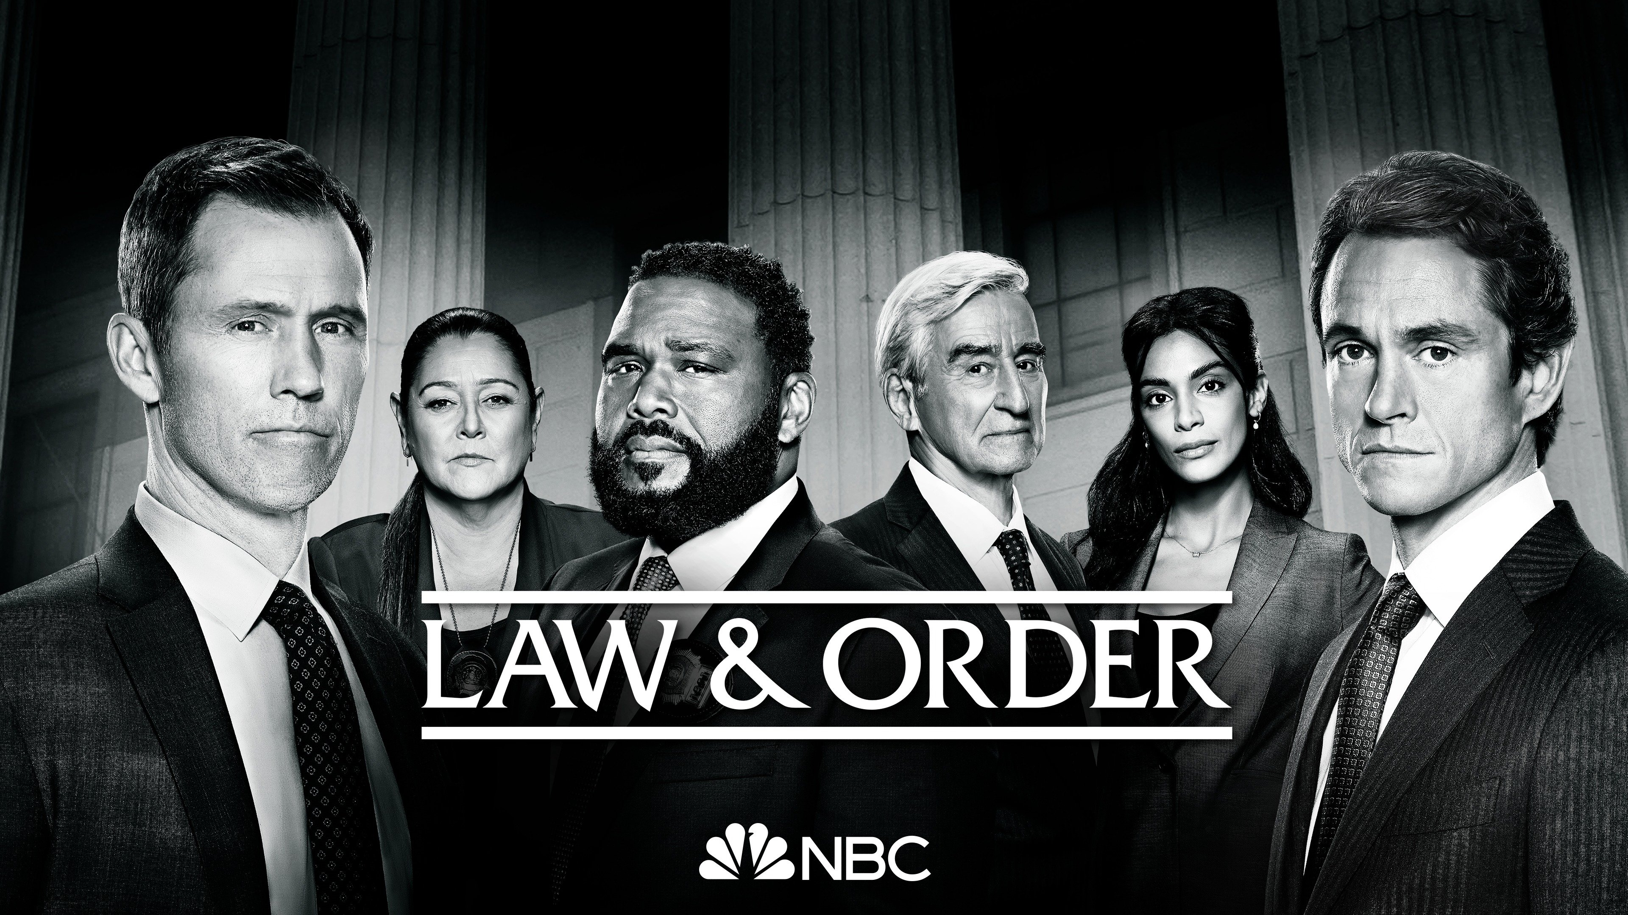
Law & Order
Together we will watch Law & Order and while this is a US Example with a jury, I would like you to pay attention to motions, the role of the Crown and Defense.
To complete the assignment, answer all questions on the website.

