Slide 1
Evidence
In Trial

Slide 2
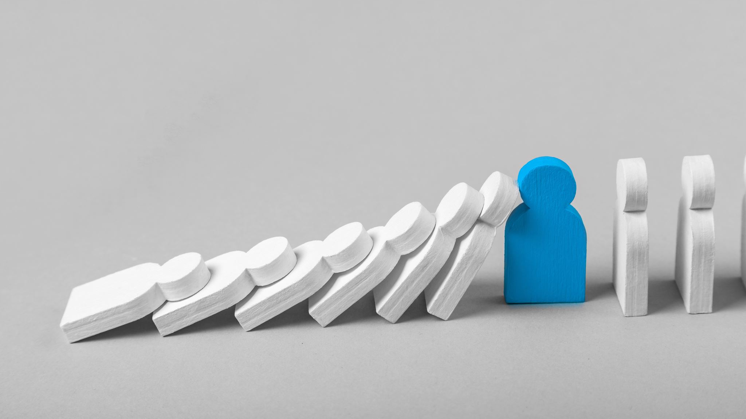
Arraignment
This is the first step at trial. It is when the charge is read to the accused and the plea is entered.
The Accused Enters a plea of guilty or not guilty.

Slide 3
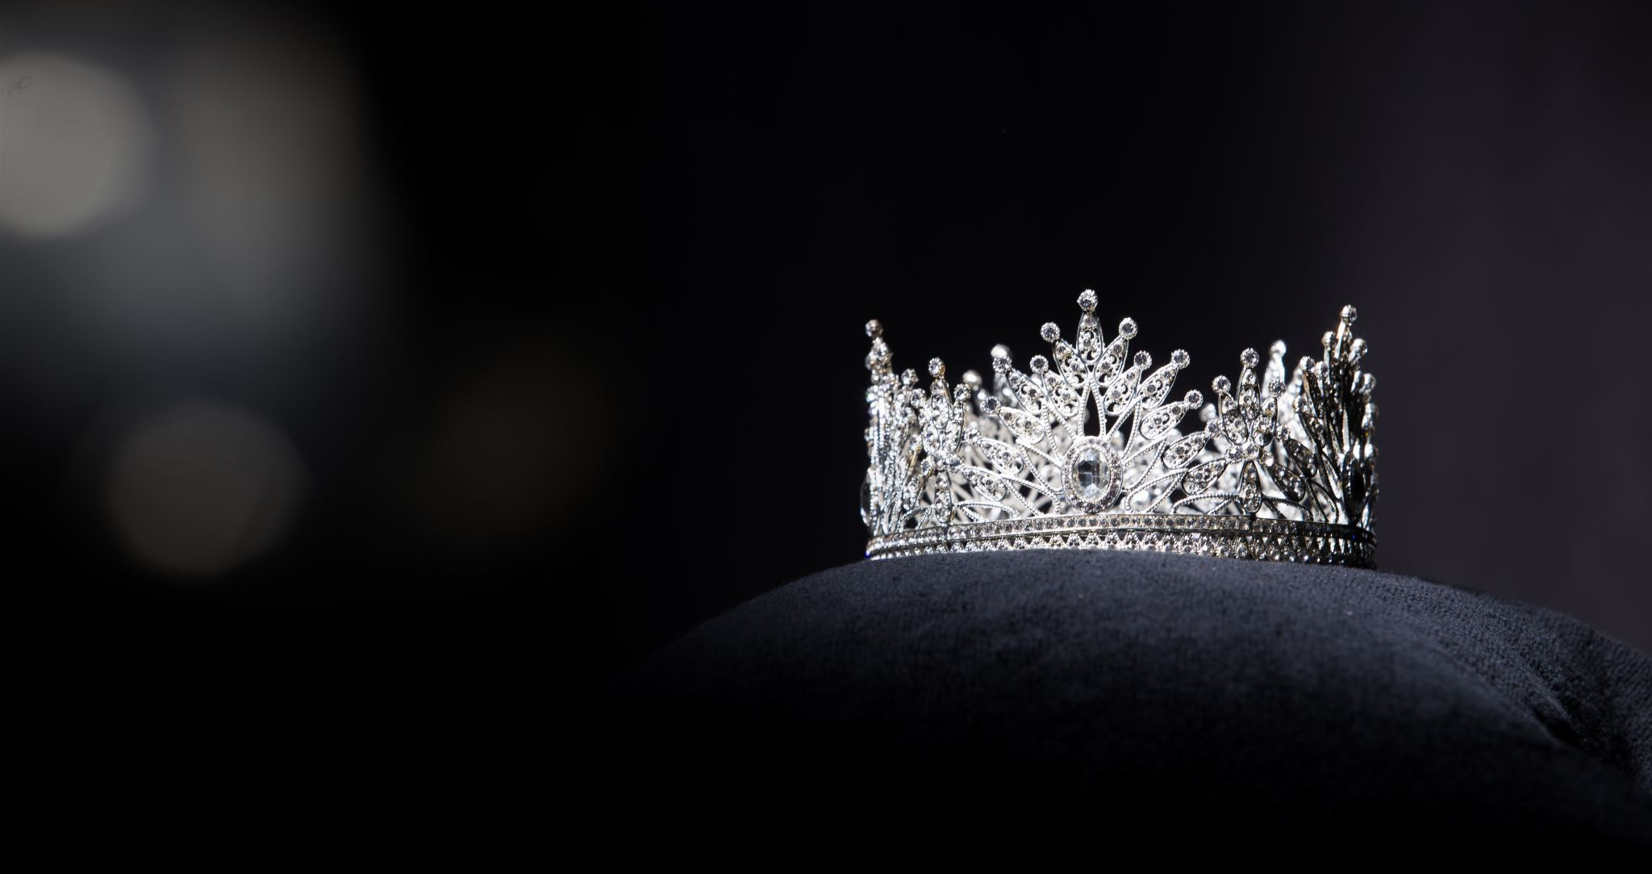
Crown Evidence
The Crown 1st Presents an opening statement, which summarizes its case against the accused.
It then calls evidence such as witnesses testimony and exabits. Exhibits may be presented as physical evidence such as drugs found at the scene.
It could also be a map of the crime scene.
Direct Evidence – information given by an eyewitness about the event in question.
Circumstantial Evidence – indirect evidence not based on personal knowledge a glove found at the crime scene is related to the crime.

Slide 4
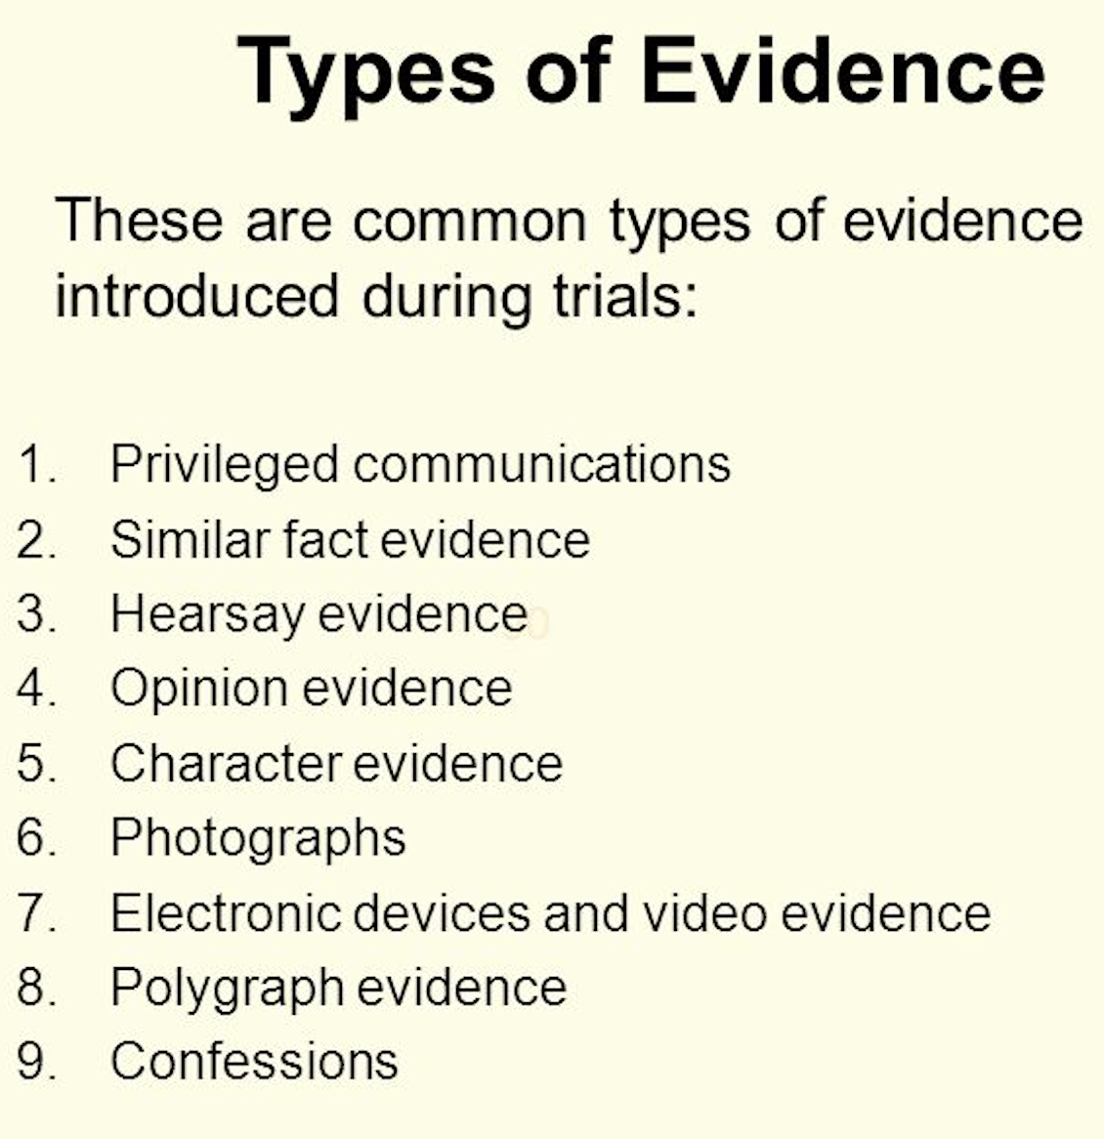
Types of Evidence
Privileged Communication – confidential communication that cannot be disclosed: Examples: Communication between spouses, lawyer and client, doctors, clergy.
There are exceptions including admissions of guilt to a lawyer.
Similar Fact Evidence: Evidence that shows the accused has committed similar offences in the past.

Slide 5
Evidence Examples
Hearsay – information not coming from the direct personal experience or knowledge of a witness. Not admissible, unless the person has died.
Opinion Evidence – information based on the thoughts of the witness, usually an expert; ex: forensic scientist
Character Evidence – information indicating the likelihood of an accused committing or not committing the crime. Sometimes the judge will not allow this line of questioning unless it is directly related.
Photographs – may be used but with technology they must be ensured to be authentic.
Electronic Devices and Video Evidence – a court must authorize the use of these devices to record video or conversations. However, depending on where you are your expectation of privacy might be limited.
Polygraphs – lie dictator. Are not admissible in court.
Confessions – a statement in wihc the accused admits that some or all of the charges laid are true. How confessions are obtained determine if they are inculpatory or exculpatory.

Slide 6
Steps in Presenting Evidence
Crown starts with examination in chief of witness.
Defense may cross examine witness
Crown my re-examine witness.
Defense may re-cross witness with judge’s permission.
For the Defense the procedure is the opposite.

Slide 7
Examination
Examination in chief – the questions a lawyer asks her or his own witness.
Cross examination – the questions a lawyer asks a witness called byt eh opposing side
Leading questions – a question that contains the desired answer “Was the accused wearing a red shirt?” vs. “What colour shirt was the accused wearing?”

Slide 8
Defense Evidence
Before the defense presents evidence they can call for a ‘Directed Verdict’ which asks the judge to acquit the accused because The Crown has not met its burden of proof.
If the Directed Verdict is rejected the Defense presents its case.
The Defense must only raise ”reasonable doubt” about whether the accused committed the offence. It DOES NOT need to prove innocence.
The Defense usually summarizes (opening statement) what it intends to prove and then presents evidence to prove it (witnesses/evidence)

Slide 9
Witnesses
Before the trial the crown gives the defense a list of Crown witnesses. Witnesses can be paid by either side, but those witnesses must be experts.
Subpoena – witnesses can be forced to testify if they do not want to. Witnesses can even be detained for up to 90 days.
Witnesses must take an oath before they testify.
Perjury – knowingly giving false evidence in a judicial proceeding
The accused does not have to take the witness stand

Slide 10
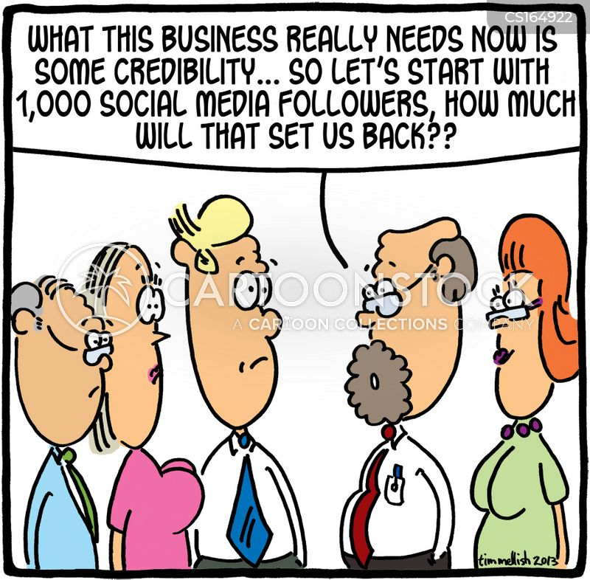
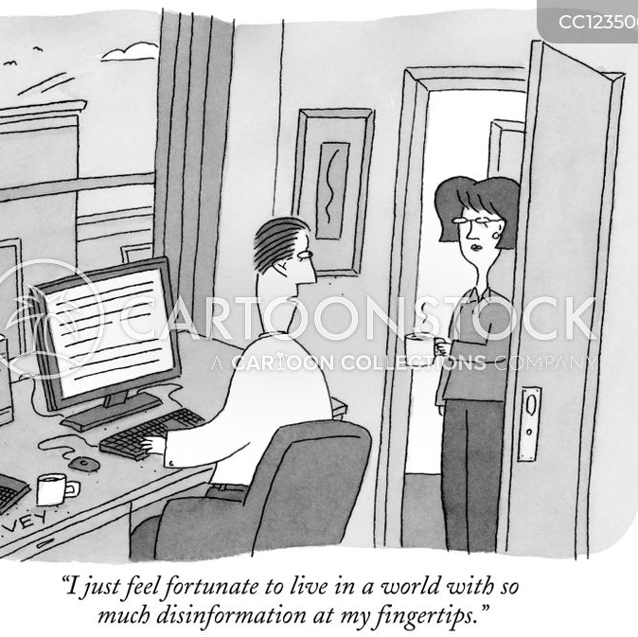
Credibility
What is credibility to you? What does it mean to be credible?
In our trial the judge will decide credibility but in a jury trial your peers decide. Which do you think is better?

Slide 11
Rules of Evidence
Voir dire – a mini trial that can be held within an actual trial to decide if certain evidence is admissible.
Self – incrimination – the act of implicating onself in a crime. In the US it is “taking the 5th” or 5th Amendment to the Constitution; in Canada it is covered under Section 13 of The Charter.
So: Yes. You can state as a witness that you were the murderer and that evidence cannot be used against you, but police can investigate as a result of that testimony and find other evidence to use against you.

Slide 12
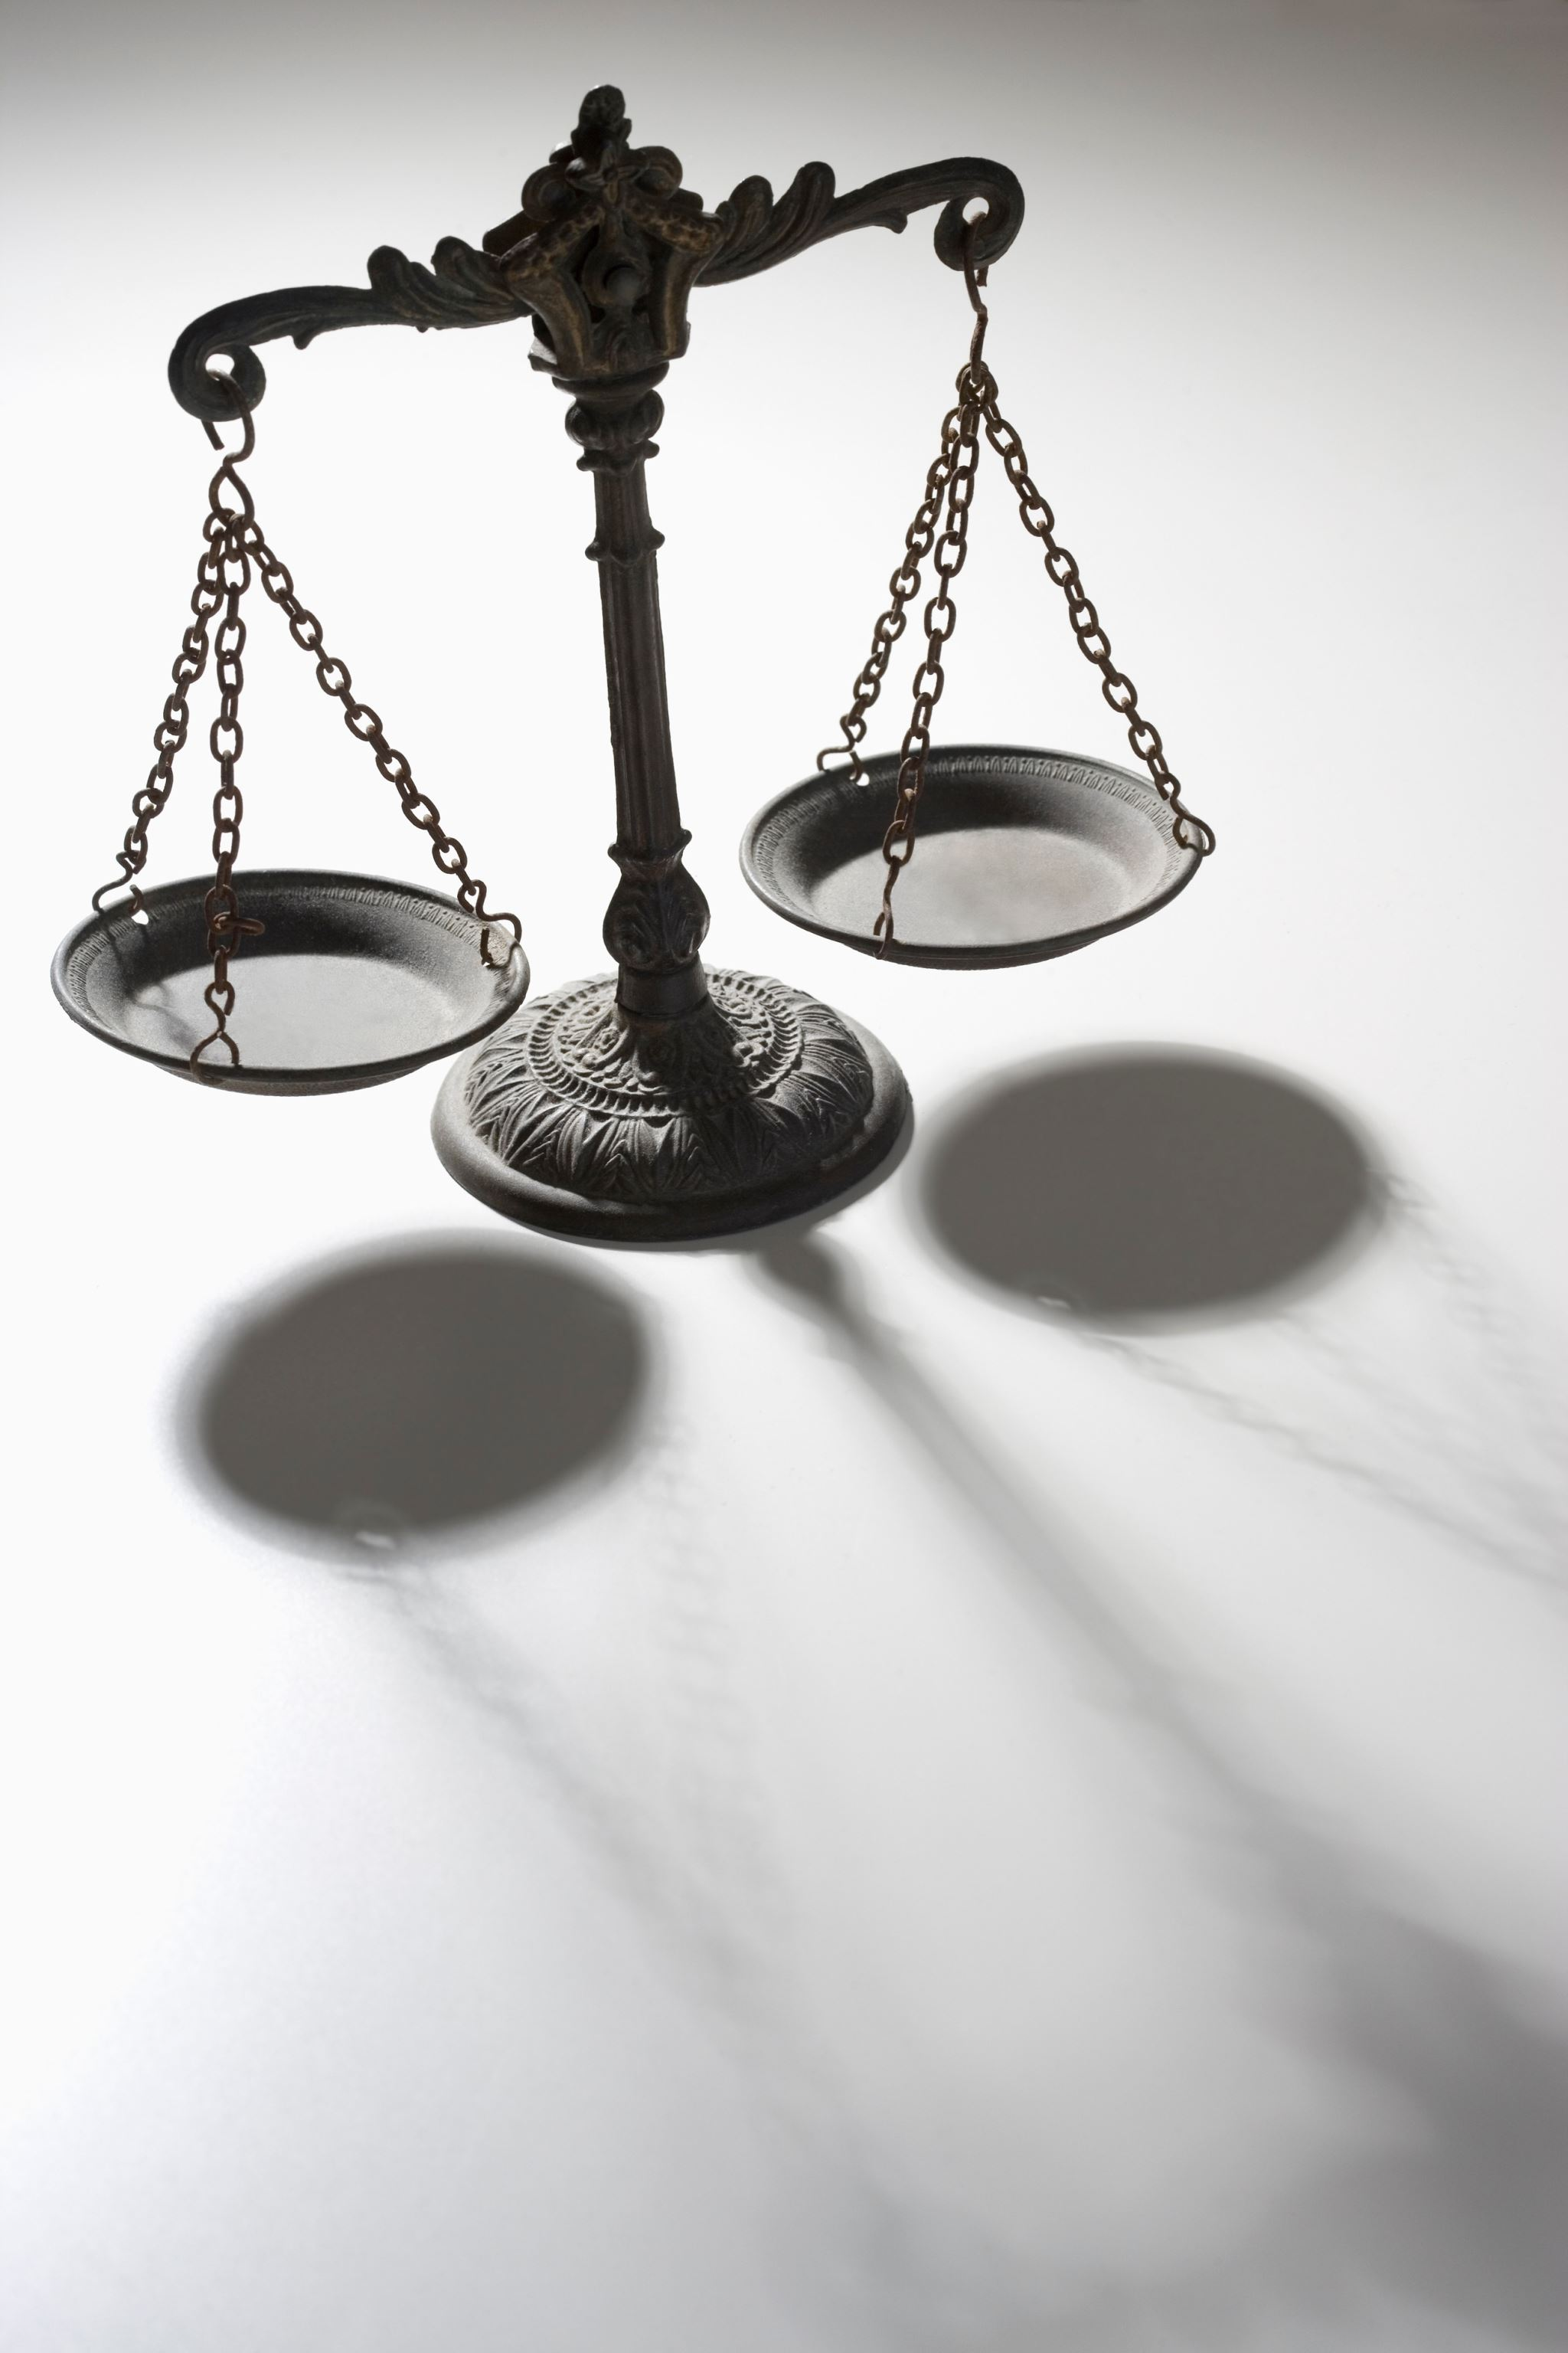
Illegally Obtained Evidence
Section 24 of The Charter allows the court to determine if the evidence is admissible or its collection has violated the Charter rights of the accused.
Continue the Law & Order Episode. What types of evidence are introduced? Are they all admissible? How does the defense and prosecution (Crown in Canada) present it?

