Slide 1
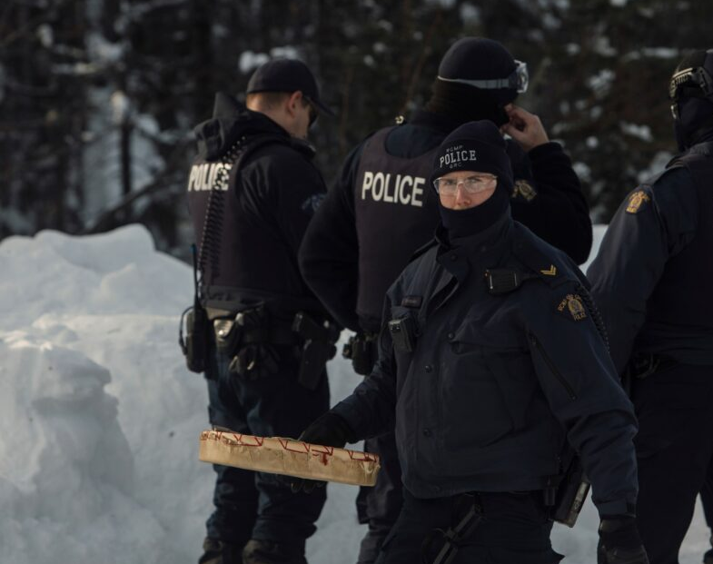
The Police

Slide 2
Duties of Police Officers
Crime prevention
Law enforcement
Assistance to victims of crime
Maintain public order
Emergency response
Investigation of crime

Slide 3
Back to The Charter
Sections 7 – 14 are Legal Rights. Visit The Charter so we can review some. https://laws-lois.justice.gc.ca/eng/const/page-12.html
These rights protect the accused as they move through the system from unfair treatment from police, judges and correctional officers.

Slide 4
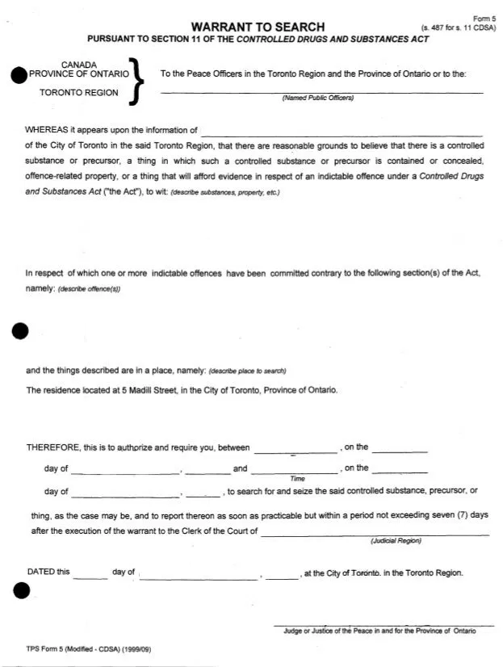
Search Warrants
Need to be obtained before conducting a search. Officers must apply to the Justice of the Peace or a judge and must have reasonable or probable grounds (facts that would cause an average person to believe beyond mere suspicion).
Extensive body searches must be conducted by a police officer of the same sex.
Example of Reasonable Grounds: When you are being arrested, when you consent, for safety reasons, and in public facilities.

Slide 5
Further Examples
they find you in a place where they are searching for drugs and they have reason to believe that you have drugs
they find you in a vehicle where people are transporting or consuming alcohol illegally and they have reason to believe that you have alcohol on you illegally
they have reason to believe that you have an illegal weapon or one that was used to commit an offence, and it might be removed or destroyed if they took the time to get a search warrant
they find you in a vehicle or a boat and have reasonable grounds to believe there is cannabis in the vehicle or boat, unless the cannabis is not readily available to anyone or is in its original unopened packaging

Slide 6
Judge vs. Justice of the Peace
Criminal Judges preside:
over virtually all adult criminal and youth criminal justice trials and sentencing hearings in Ontario – with the exception of jury trials and certain serious criminal offences, which are heard by the Superior Court of Justice
in preliminary hearings in criminal and youth criminal justice trials (a “preliminary hearing” is a court hearing to decide whether the Crown has sufficient evidence to hold a trial. At the end of the hearing, the accused will either be discharged or ordered to stand trial.)
in bail hearings (although, in Ontario, the vast majority of bail hearings are conducted by justices of the peace)
Justices of the peace preside:
over virtually all bail hearings in the province, and
in first appearance and remand courts (appearances that occur prior to a trial).
They also:
receive information (the documents that commence criminal proceedings)
issue process in the form of summonses or warrants
deal with applications for the issuance of search warrants and production orders under the Criminal Code
deal with applications for peace bonds
consider applications for warrants to seize weapons, and
conduct weapons disposition and prohibition hearings. (OntarioCourts.ca)

Slide 7
Arrests
Police must have reasonable and probable grounds that a person is involved in a crime prior to arresting (detain and charge) them. After this has been decided the police can:
Issue an appearance notice
Arrest the suspect
Obtain a warrant for arrest.

Slide 8
Adult Arrest
The officer must identify him or herself
If you are arrested or detained, you must be:
You must be told why you have been arrested or detained, and why the police are investigating you,
told immediately that you have the right to a lawyer,
told about Legal Aid and your right to free legal advice, and
allowed to speak, in private, to a lawyer of your choice, as soon as possible, if you ask to do so.

Slide 9
Under 18
If you are under the age of 18, the police have to treat you differently than an adult. This applies if you are arrested or detained or if they suspect that you have committed a crime.
The police should tell you that:
you do not have to say anything,
anything you say may be used as evidence against you,
you have the right to speak to a lawyer,
you have the right to contact your parents or guardian, and
you have the right to have your parents or guardian and a lawyer with you, if you want them there, when the police question you.

Slide 10
Citizen’s Arrest
“Under section 494(1) anyone may arrest a person whom they find committing an indictable offence or a person who, on reasonable grounds, they believe has committed a criminal offence and is escaping from and freshly pursued by persons who have lawful authority to arrest that person.” (Government of Canada)

Slide 11
R. v. Asante-Mensah, 2003 SCC 38 (CanLII)
In 1991, a taxi driver repeatedly “scooped” fares at Pearson International Airport in Toronto, contrary to regulations, He jumped the line in front of other taxis and picked up passengers ahead of his turn. An airport inspector approached the accused touched his sholder, and told him that he was under arrest for trespassing, and that he would be detained for police. The accused attempted to get into his taxi, but the inspector blocked his way. During the confrontation, the accuses shoved his car door into the inspector. The inspector backed off, and the accused fled. The driver was charged with resisting arrest. At trial, the judge acquitted the accused because the inspector as not authorized to make an arrest. The Ontario Court of Appeal disagreed, setting aside the acquittal and substituting a conviction. In a 9 – 0 judgment in July 2003 the Supreme Court of Canada upheld the conviction. Th court wrote that the word “arrest” is well understood in common law. It is initiated by words accompanied by physical touching or submission, and ends with the delivery to the police. As with all arrests, force may be employed if it is reasonable under the circumstances.
Do you think regular citizens should be allowed to make an arrest? Explain.

Slide 12
Rights on Being Detained vs. Being Arrested
Detained
Arrested
Section 9 of The Charter states that everyone has the right not tb arbitrarily detained or imprisoned.
You cannot be stopped, held for questioning, arrested or put in jail unless police have a good reason.
If you agree to talk to police you have not been unfairly detained.
You do not have to answer questions including giving your name. Say, “Sorry officer, I do not wish to answer any of your questions.”
If police proceed, ask to see a lawyer and write down the officer's badge number.
Must be able to see a lawyer immediately or legal aid. Police can give you phone numbers of a lawyer.
Only have to state your name, date of birth, address and occupation.
70% of people give statements when they do not have to.
Section 10 of The Charter says that everyone has:
- To be informed of why they are detained
- Retain and instruct counsel
- To be released if detention is not lawful

Slide 13
Video Case Study
Go to our website and together we will watch the video case.
After watching the case you must read the short article linked on the website.
Review the rubric and Assignment Success Criteria.
Then answer the 5 questions in 5 paragraphs on 1 – 1.5 pages single spaced.
Check your work and hand in the assignment.
You have 1 full class period tomorrow to work on it.

