Slide 1
The Nation State
More Recent Political Theory

Slide 2
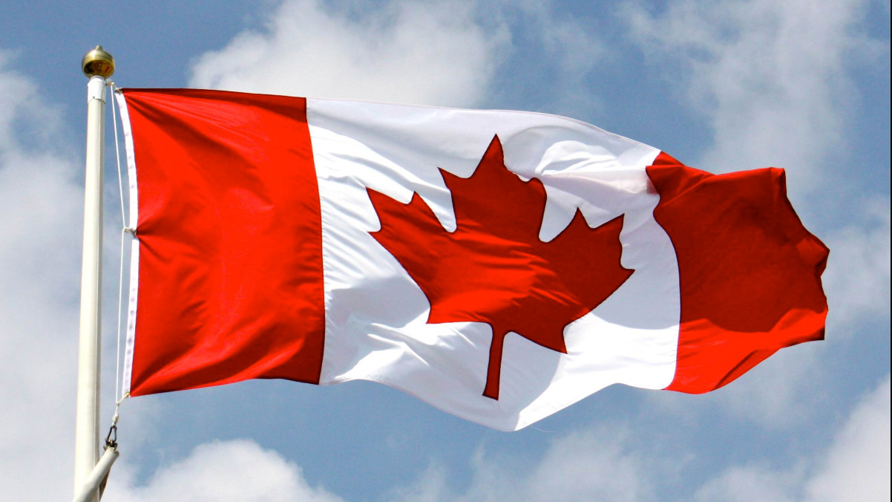
Canada
What are the characteristics of Canada? (What makes Canada, Canada?)
What does it mean to BE Canadian?

Slide 3
Nationalism
According to the Sandford Encyclopedia of Philosophy:
The term “nationalism” is generally used to describe two phenomena:
1. the attitude that the members of a nation have when they care about their national identity, and
2. the actions that the members of a nation take when seeking to achieve (or sustain) self-determination.

Slide 4
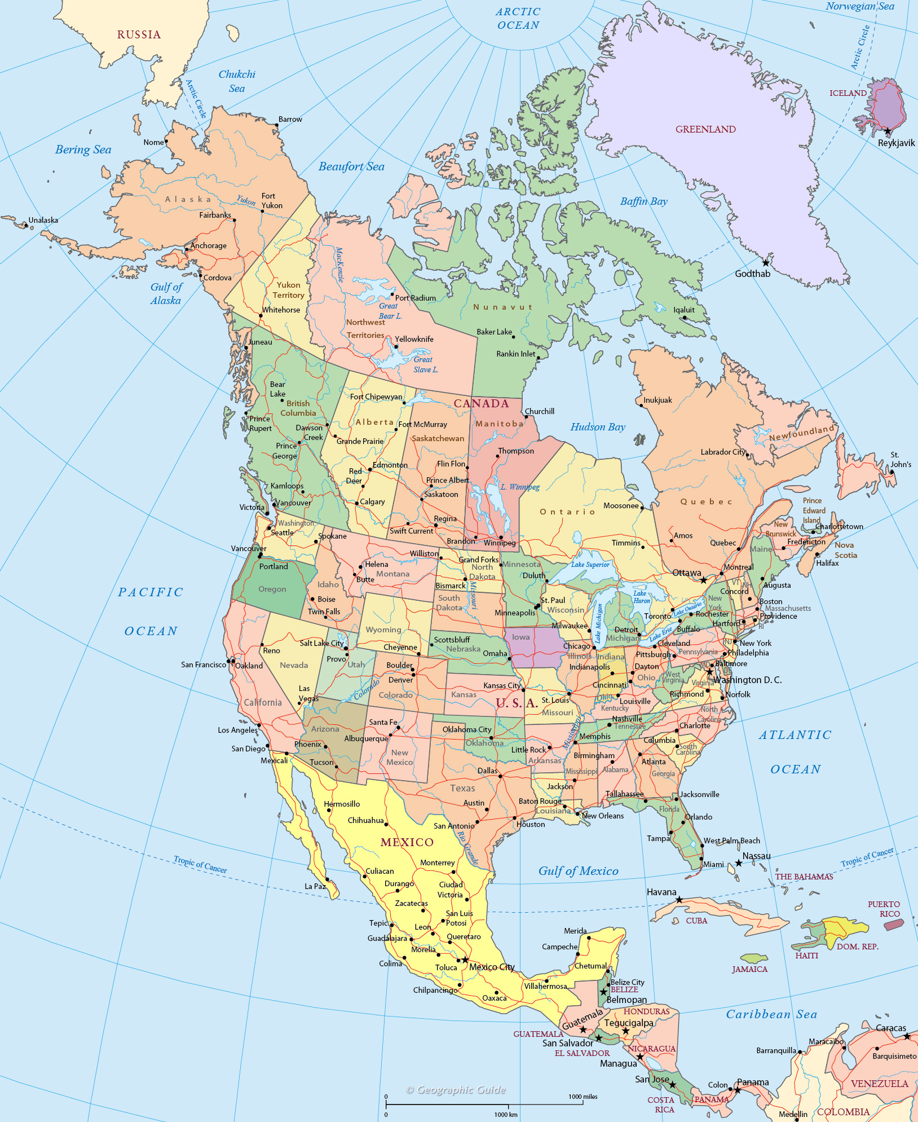
Starting with #2 – The Nation State
The mapping between the ethno-cultural domain (featuring ethno-cultural groups or “nations”) and the domain of political organization.
The nation state, the result of a complex division of labour and exchange relationships, is a political and territorial entity.
“Nation” implies that there is a common ethnicity and cultural characteristics, such as language, while “state” most often refers to the sovereign nature of the area in which a state has been formed.

Slide 5
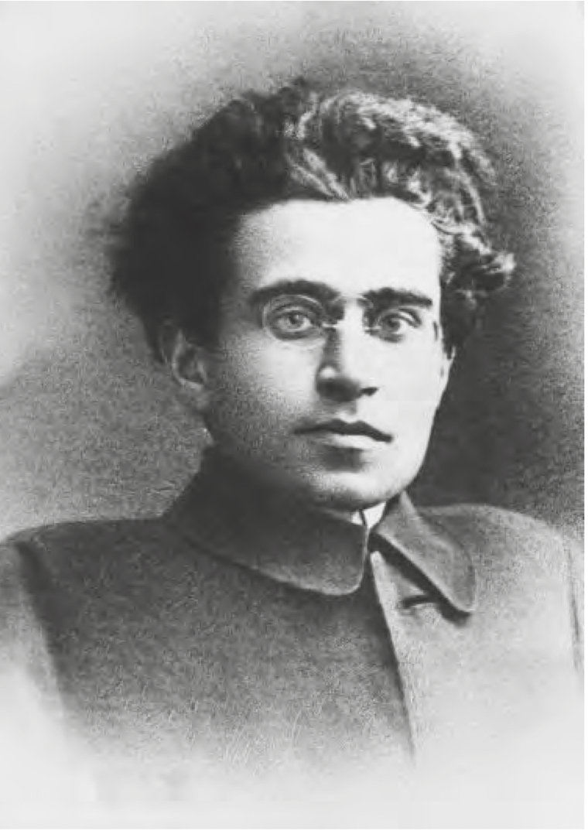
Now #1: Historic Nationalism
Nationalism has historically been a mechanism by which peoples are united under common characteristics with a sense of identity, generally backed by a government that defines a state.
Antonio Gramsci (1891–1937), in his Prison Notebooks, coined the term hegemony: the goal of harmony through the agreement of the peoples under state control and when the creation of hegemony becomes impossible, then the state often uses force.
Together we will watch the Crash Course on our website.
Thinking: What aspects of nationalism are dangerous? Who benefits from it?

Slide 6
Nationalism Power, & Systemic Racism/Violence
Elites that are the beneficiaries of state unity generate their own ideologies to justify their positions as managers and leaders, as well as rally the population for war when it is to the advantage of state organization or when the state is threatened by internal or external forces.
In order for power to be sustained, it must be justified, either by convincing people that existing forms of power are justified and good, or by force.
Structural violence, or the institutional mechanisms by which people are discriminated against or oppressed because of their particular ethnicity, race or gender.
What are some of these institutions. Let’s Name Some!

Slide 7
Ideologies
This justification of relationships of power is accomplished through the application of ideology, or “ideas in the service of power”.
In simple terms, ideology means a way of thinking about a situation, a context, or the world.
Wolf distinguishes between ideas and ideology, for, as he notes, the term “ideas” is intended to cover the entire range of mental constructs rendered manifest in public representations, populating all human domains...“ideology” needs to be used more restrictively, in that “ideologies” suggest unified schemes or configurations developed to underwrite or manifest power. (1999: 4)

Slide 9
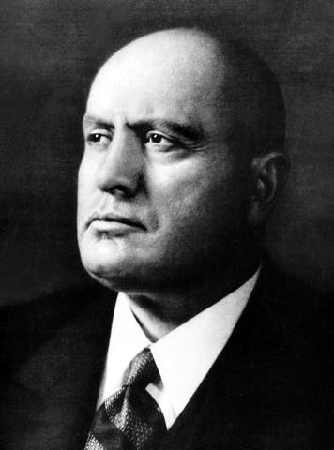
Dangers of Ideologies and Nation States
We are being presented with an ideology that hopes to direct our thinking and our action
The object of hegemony is to convince all within a society that the government is working towards their best interests, and this is accomplished in a number of ways, including education, the Church, military ideology, the penal system (Foucault, 1975) and the control over media and everyday cultural life
Where hegemony cannot be achieved through the incorporation or co-optation of competing ideologies, force is used, as we can see from the brutal actions of Mussolini in the 1930s.
Ideologies represent powerful agendas, providing a “social cement”

Slide 10
Some Conclusions and Further Questions
The sophistication of an ideology, then, is found in its ability to construct a convincing logic that includes the reservations and resistance of its critics, thereby creating the lack of conflict that leads to hegemony.
To exercise power, there must be mechanisms in place to keep it going, to keep social tensions from tearing the domination apart.
The successful implementation of hegemony creates a ”common sense” that all understand and share, it becomes an integral part of the culture. It is this “common sense” in a community that we look for to understand the mechanisms by which the interplay between power and its exercise takes place (Kirsch, 2001: 43).
Question: What common sense exists in Canada? How is this harmful to BIPOC people?

Slide 11
Making Connections
Would Locke, Plato and Aristotle agree with the concept of a Nation State? Why or why not?
Which approach to studying Politics would like the nation state ideologies the most?

