Slide 1
Society & The Environment
Problems and Legal Solutions

Slide 2
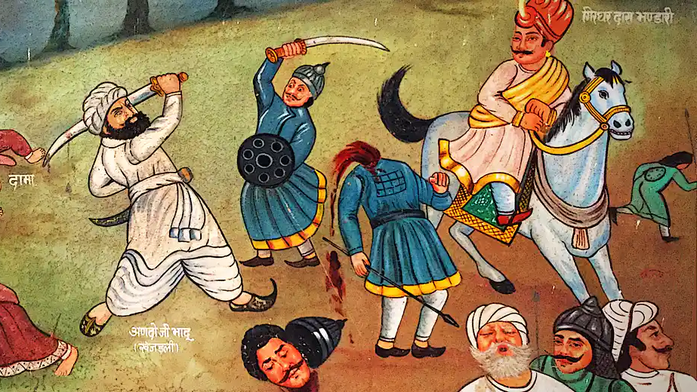
Early History of the Environmental Movement
First real environmental activists were the Bishnoi Hindus of Khejarli, who were slaughtered by the Maharaja of Jodhpur in 1720 for attempting to protect the forest that he intended to use build himself a palace.

Slide 3
Environmentalism & Law: A Timeline
18th Century witnessed the dawn of modern environmental rights. After a yellow fever epidemic in Philadelphia, Benjamin Franklin petitioned to manage waste.
1798: Thomas Malthus wrote An Essay on the Principle of Population warning that human overpopulation would lead to ecological destruction.
1835: Ralph Waldo Emerson, believed in Transcendentalism, a social and philosophical movement that held a deep respect for nature.
Go To our website and read Emerson’s Nature (an excerpt) and complete the questions. Be prepare to discuss.
End of the 19th Century, Germany, zoologist Ernst Haeckel wrote Generelle Morphologie der Organismen in which he discussed the relationships among species and ecology.

Slide 4
Early 20th Century
1900: Canadian Forestry Association Founded - Forest Reserves Act to maintain the supply of timber and conserve water through forest conservation
Early 20th Century, the chemist Alice Hamilton led a campaign against lead poisoning from leaded gasoline, accusing General Motors of willful murder.
1930: Canadian National Parks Act - excluded industrial activities from the parks, made their boundaries permanent, and formally recognized a category of Historical Parks.
1952: 4,000 people died in London’s infamous killer fog, and four years later the British Parliament passed the first Clean Air Act.
1962: Rachel Carson published Silent Spring, describing the impact of chemical pesticides on biodiversity. “For the first time in the history of the world, every human being is now subjected to contact with dangerous chemicals.”

Slide 5
Later 20th Century
1972: Pollution Prevention Act - prohibiting the deposit of “waste” in Arctic waters.
1987: Signing of The Montreal Protocol - active treaty that regulates the production and consumption of man-made ozone depleting substances
1995: The federal government and the provinces agreed that by the year 2001 all new cars sold in Canada must meet strict air pollution emission standards.
2000: The Species at Risk Act, new legislation aimed at protecting Canada's endangered wildlife; 233 species in four risk categories —extirpated, endangered, threatened and species of special concern.
2017: The Supreme Court of Canada ruled that Indigenous peoples do not have the power to veto resource development projects such as pipelines.
2019: RCMP Arrest 14 people at BC Pipeline Protest

Slide 6
Sustainable Development
An approach that seeks to preserve both a healthy economy and a healthy environment. UN defines it as ”development that meets the needs of the present generation without compromising the ability of future generations to meet their own needs.”
Go to our website and read:
The Nature Conservatory’s Response to Sustainable Development.
Science Directs Sustainable Development article.

Slide 7
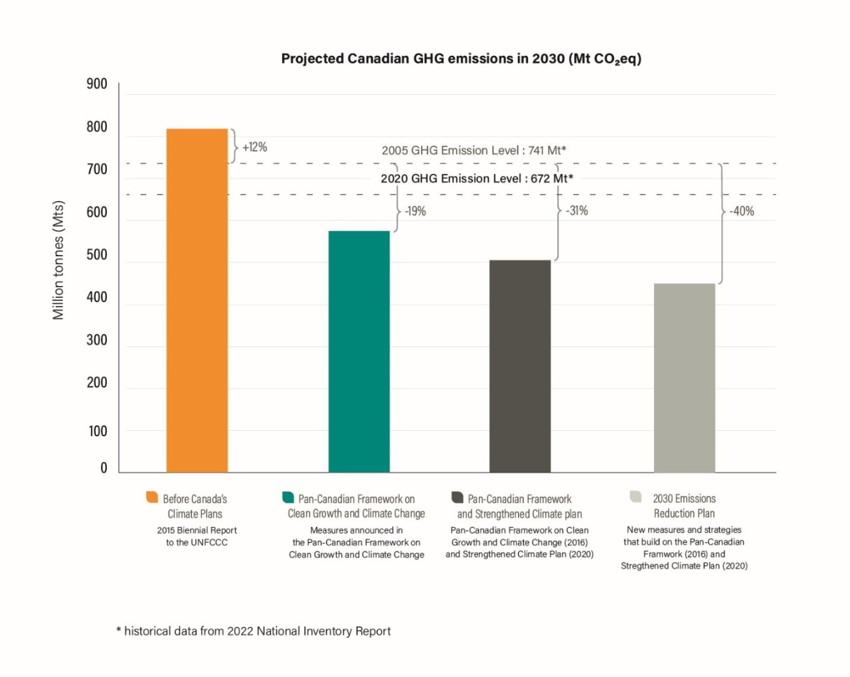
Net 0 Canada
Achieving net-zero emissions means our economy either emits no greenhouse gas emissions or offsets its emissions, for example, through actions such as tree planting or employing technologies that can capture carbon before it is released into the air.
Canada has joined over 120 countries in committing to be net-zero emissions by 2050, including all other G7 nations
The Canadian Net-Zero Emissions Accountability Act, which became law on June 29, 2021, enshrines in legislation Canada’s commitment to achieve net-zero emissions by 2050.
The Act requires public participation and independent advice to guide the Government of Canada’s efforts.
Reach Canada’s more ambitious climate target of 40-45% emissions reductions by 2030.
Go to the website and read about the litigation process currently happening in Canada over Net 0 Targets.

Slide 8
Carbon Pricing
In Canada, the federal government implemented a coordinated nation-wide carbon price, beginning at $20 per tonne of carbon dioxide and rising to $50 per tonne as of April 1, 2022.
Under the Greenhouse Gas Pollution Pricing Act (GGPPA), the federal pricing system has two parts: a regulatory charge on fossil fuels like gasoline and natural gas, the fuel charge, and a performance-based system for industries, the Output-Based Pricing System. The fuel charge applies in Ontario, Manitoba, Yukon, Alberta, Saskatchewan and Nunavut. The Output-Based Pricing System applies in Ontario, Manitoba, New Brunswick, Prince Edward Island, Yukon, Nunavut, and partially in Saskatchewan. Other provinces and territories are implementing their own pricing systems (it had to be forced on these provinces)
The Government of Canada uses approximately 90 per cent of fuel charge proceeds to directly support families through Climate Action Incentive payments, delivered through annual tax returns.
Canadian families receive more money back than they pay, with low-income Canadians benefitting the most.
The system also considers where people live, acknowledging the reality that Canadians who live in rural and smaller centres don’t necessarily have the same options, particularly when it comes to clean transportation. That’s why, for people in these communities, the Government applied an additional 10 per cent top-up to their Climate Action Incentive payment.
See the Next Slide For Details.

Slide 10
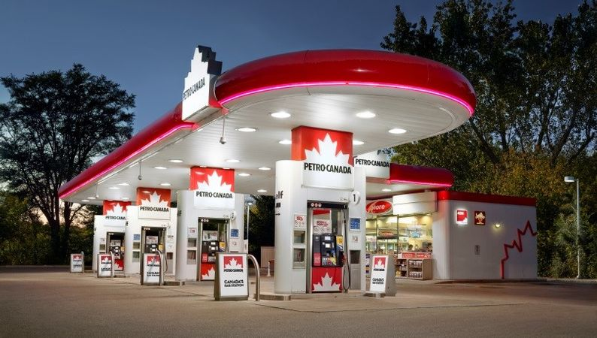
Gas Tax
The federal government charges an excise tax at a flat rate of 13 cents per litre on gasoline.
Ontario - 14.7¢ per litre Effective July 1 until December 31, 2022,
Was reduced from 14.7 cents per litre to 9.0 cents per litre, r a cut of 5.7 cents per litre.

Slide 11
Sustainable Development Debate - 2.5%
Debate Teams:
Emerson, Avery, & Savanah - Affirmative
Hamish, Amado, Zack, & Blake - Negative
Debate Resolution: The Government should regulate the envrionment.
You will have 2 days to prepare your debate. Follow the debate structure posted on our website, do research and ensure everyone has equal opportunity to speak.

