Slide 1
Rights and Freedoms

Slide 3
Analyzing a Charter Case: 4 Step Process
1. Does the Charter Apply?
2. Has a Charter Right or Freedom Been Infringed?
3. Does the Reasonable limits Clause Justify the Infringement?
4. If Not, Is there a Remedy under the Charter?

Slide 4
#1 Does the Charter Apply?
The Charter concerns only matters involving the government.
Can challenge a government law or question a government action (police illegal search & seizure).

Slide 5
#3 Does the Reasonable Limits Clause Justify the Infringement?
Charter rights are not absolute they can be limited if it can be justified in our free and democratic society.
You can’t say or do anything you want and claim it as a right of Free Speech (Section 2(b) of the Charter).
Section 1 states “(1) The Canadian Charter of Rights and Freedoms guarantees the rights and freedoms set out in it subject only to such reasonable limits prescribed by law as can be demonstrably justified in a free and democratic society.”
Writing racist or sexist comments that promote hate on an Internet blog is not against the law, but if it results in harm, it violates the Charter and you can be taken to court

Slide 6
The Notwithstanding Clause (Section 33)
33 (1) Parliament or the legislature of a province may expressly declare in an Act of Parliament or of the legislature, as the case may be, that the Act or a provision thereof shall operate notwithstanding a provision included in section 2 or sections 7 to 15 of this Charter.
The clause applies to Fundamental Freedoms (Section 2), Legal Rights (Sections 7 – 14), and Equality Rights (Section 15).
Allows provincial governments to create certain laws that contradict some Charter Rights.

Slide 7
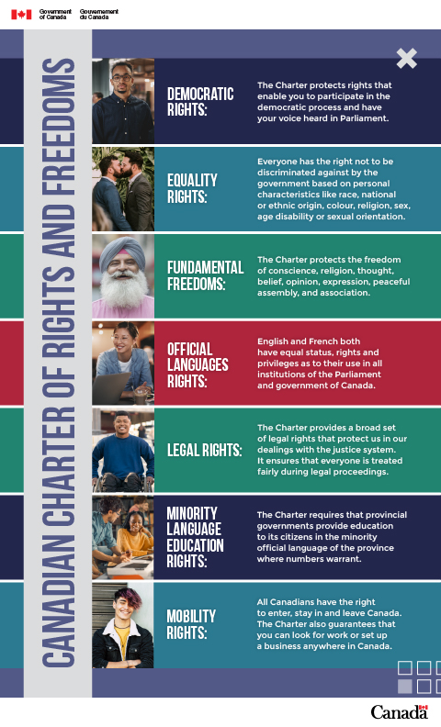
Fundamental Freedoms
2 Everyone has the following fundamental freedoms:
(a) freedom of conscience and religion;
(b) freedom of thought, belief, opinion and expression, including freedom of the press and other media of communication;
(c) freedom of peaceful assembly; and
(d) freedom of association.

Slide 8
Democratic and Mobility Rights (Sections 3, 4, & 5)
Democratic Rights of Citizens 3 Every citizen of Canada has the right to vote in an election of members of the House of Commons or of a legislative assembly and to be qualified for membership therein. Marginal note: Maximum duration of legislative bodies 4 (1) No House of Commons and no legislative assembly shall continue for longer than five years from the date fixed for the return of the writs of a general election of its members. Marginal note: Continuation in special circumstances ​ (2) In time of real or apprehended war, invasion or insurrection, a House of Commons may be continued by Parliament and a legislative assembly may be continued by the legislature beyond five years if such continuation is not opposed by the votes of more than one-third of the members of the House of Commons or the legislative assembly, as the case may be. Marginal note: Annual sitting of legislative bodies 5 There shall be a sitting of Parliament and of each legislature at least once every twelve months

Slide 9
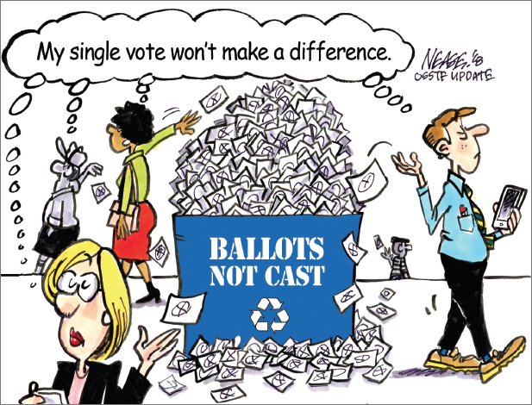
Should you be forced to vote?
Go to our website and read the articles on Australian and Ontario voting. Reflect by answering the questions there.

Slide 10
Life, Liberty and Security of Person
7 Everyone has the right to life, liberty and security of the person and the right not to be deprived thereof except in accordance with the principles of fundamental justice.
It is the duty of the Crown to disclose all relevant information it has in its possession before the case goes to trial.
The Crown cannot withhold any information from the defendant.

Slide 11
Case Study: Rodriguez v. British Columbia (Attorney General), 1993
Sue Rodriguez was a victim of a terminal disease that would soon leave her helpless. She was told that she had no more than three years to live. Once she was unable to enjoy life, she hoped that someone would be be able to help her end her life. In Canada, it is not illegal to commit suicide,. However, it is illegal for anyone to assist in a suicide.
Rodriguez argued that the law denying assisted suicide violated her right to life, liberty, and security of the person. The Supreme Court disagreed with Rodriguez. It kept the law on assisted suicide in the Criminal Code. The court commented that the objective of the law as to preserve life and protect the vulnerable in society.
On February 12, 1994, Rodriguez committed suicide with the help of an anonymous doctor.
Do you agree with the Supreme Court’s decision in this case?
Do you think assisted suicide law should still be in the Criminal Code? Explain

Slide 12
MAID
Go to our website and read the article on Medical Assistance In Dying. Be prepared to discuss.

Slide 13
March 17, 2021 MAID Update
Note: The law no longer requires a person’s natural death to be reasonably foreseeable as an eligibility criterion for MAID.
As of March 17, 2021, persons who wish to receive MAID must satisfy the following eligibility criteria:
be 18 years of age or older and have decision-making capacity
be eligible for publicly funded health care services
make a voluntary request that is not the result of external pressure
give informed consent to receive MAID, meaning that the person has consented to receiving MAID after they have received all information needed to make this decision
have a serious and incurable illness, disease or disability (excluding a mental illness until March 17, 2023)
be in an advanced state of irreversible decline in capability
have enduring and intolerable physical or psychological suffering that cannot be alleviated under conditions the person considers acceptable

Slide 14
Detention and Imprisonment
9 Everyone has the right not to be arbitrarily detained or imprisoned.
“Arbitrarily” means not having sufficient legal reason for stopping or restricting someone's movement or putting them in jail.
“Detained” does not just mean going to jail. Detained could become an arrest.
Should police be able to detain you without cause if they feel you could cause harm to the general public?

Slide 15
Treatment or Punishment
12 Everyone has the right not to be subjected to any cruel and unusual treatment or punishment
What is cruel and unusual punishment to you? Remember Foucault and crime and punishment?

Slide 16
Self - Crimination
13 A witness who testifies in any proceedings has the right not to have any incriminating evidence so given used to incriminate that witness in any other proceedings, except in a prosecution for perjury or for the giving of contradictory evidence.
You have likely heard of ‘Taking the 5th” in the US & and not presenting evidence that can be used to convict yourself later. This the equivalent to that.

