Slide 1
Supply and Demand
Labour Economics

Slide 2
What is Labour?
Labour is just like the market, it is based upon supply and demand for goods and services.
Households however are the suppliers and businesses are the consumers.
Price = Wage Rate

Slide 3
Demand
Direct Demand – Consumers determine it directly as the use their $ do indicate the value of the utility they receive from a good at various prices.
(yes this is the absolute conclusion to what you have learned to this point on demand!)

Slide 4
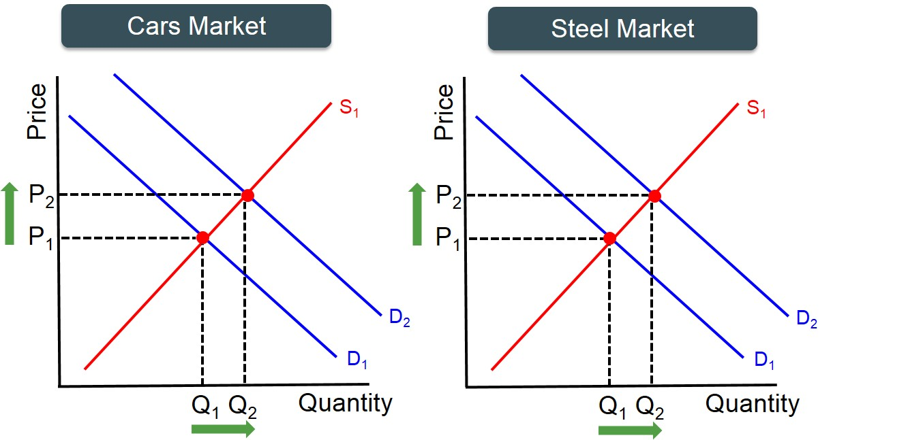
Derived Demand
This is dependent on or derived from consumer demand for the good or service produced.
For example if more cars are demanded then the demand for the resource (in this case steel) that is used to make cars also increases in demand.

Slide 5
Derived Demand For Labour
Labour is also a resource.
The greater demand for a product, the greater demanded for its production. Therefore, more workers are hired to produce it and wage increases (depending on factors).
One factor: Productivity – How much each worked can produce in a specified period of time.

Slide 6
Marginal Revenue Product of Labour
As an additional unit of labour is added to a firms productive process, the additional output that is created is the Marginal Product.
The marginal revenue product is the amount of of additional revenue that is generated from this marginal product.
MRPL = Price x MP

Slide 7
Labour Schedule
Unit of Labour | Total Product | Marginal Product | Revenue Product of Labour (MRPL)
4 | 180 | - | -
5 | 244
6 | 276
7 | 292
8 | 300
9 | 304
10 | 306
Calculate and graph the Labour Schedule
A pizza sells for 10$

Slide 8
Some Questions
What do you notice about the output as you increase workers?
If a worker’s wage rate is 40$ when would the firm stop hiring workers?
At what point would a firm stop hiring if the wage rate was 80$? 160$?
What does this tell us about the labour price?

Slide 9
Answers
1. The MRPL Decreases as you add workers.
Law of Diminishing Marginal Returns: each new worker contributes less marginal product and therefore less marginal revenue product.
2. A firm would hire up to and including the 9th worker as the worker still generates revenue = the wage rate.
3. 8 workers at 80$ and 7 workers at 160$
4. As price of labour increases, quantity demanded decreases.

Slide 10
Therefore
Firms hire additional workers as long as their marginal revenue product of labour is greater than the wage rate.
Market Demand: The quantity of labour demanded by all firms in a particular market.

Slide 11
Labour Supply
The amount of people in a market who are willing to offer their services to firms at given wage rates.
The opportunity cost of working is what earners could have earned doing something else or the value they place on ‘leisure time’

Slide 12
Wage
As wage rates increases over opportunity cost, more individuals are willing to offer their services.
At higher wage rates, the quantity of labour supplied is greater and as a result the market supply curve is upward sloping.

Slide 13
Factors Influence Supply and Demand
Demand
Supply
Change in demand for the product of labour (more demanded coffee at Thomas Hass = More workers hired)
Change in the price of other productive resources (Changes the price of materials increases the demand for labour will decrease)
A change in worker productivity (as workers ‘learn the job’ they become more productive and demand for labour will increase)
Change in Income Tax Rates: the more a government takes in tax, the less people want to work
Change in the size and composition of the population (if there is a decrease in population, there is less supply of workers and wages will increase)
Change in house hold technology: Technology allows people to have more time to work
Change in attitudes about work: Roles of women in the workforce for example

Slide 14
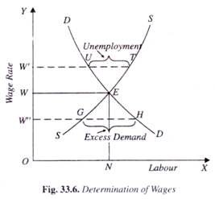
Wage Determination
When actual wage rate causes agreement between the amount of labor supplied and the quaintly demanded
If wage is too low, there is a shortage as people would not want to work for that amount of money
If wage is too high there is a surplus as many people want to work for that amount of money.

Slide 15
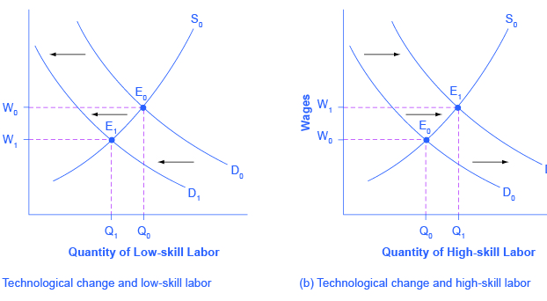
Questions:
Why does the wage for low skilled labour low?
Why is the wage for high skilled labour high?

Slide 16
Human Capital
Is the knowledge, skills, and talents that workers have.
Education is an investment. Education helps to improve efficiency and output. Its just like buying a new computer to help your business.
People invest in their own education, so to make themselves more marketable in the future.

