Slide 1
Criminal Code Offences
A Sample Level 4 Presentation

Slide 2
Consent – Criminal Code of Canada
Meaning of consent
273.1 (1) Subject to subsection (2) and subsection 265(3), consent means, for the purposes of sections 271, 272 and 273, the voluntary agreement of the complainant to engage in the sexual activity in question.
Consent
(1.1) Consent must be present at the time the sexual activity in question takes place.
Let's look at the following video on Consent.
(https://laws-lois.justice.gc.ca/eng/acts/c-46/section-273.1-20181213.html)

Slide 3
Age of Consent
Consent to sexual activity
The age of consent is the age at which a young person can legally agree to sexual activity. Age of consent laws apply to all forms of sexual activity, ranging from kissing and fondling to sexual intercourse.
All sexual activity without consent is a criminal offence, regardless of age.
These are serious offences that carry serious penalties, including mandatory minimum penalties.
Canada's age of consent
The age of consent to sexual activity is 16 years. In some cases, the age of consent is higher (for example, when there is a relationship of trust, authority or dependency).
In other words, a person must be at least 16 years old to be able to legally agree to sexual activity.
(https://www.justice.gc.ca/eng/rp-pr/other-autre/clp/faq.html)

Slide 4
Exploitation
Sexual exploitation
A 16 or 17 year old cannot consent to sexual activity if:
their sexual partner is in position of trust or authority towards them, for example their teacher or coach
the young person is dependent on their sexual partner, for example for care or support
the relationship between the young person and their sexual partner is exploitative (https://www.justice.gc.ca/eng/rp-pr/other-autre/clp/faq.html)

Slide 5
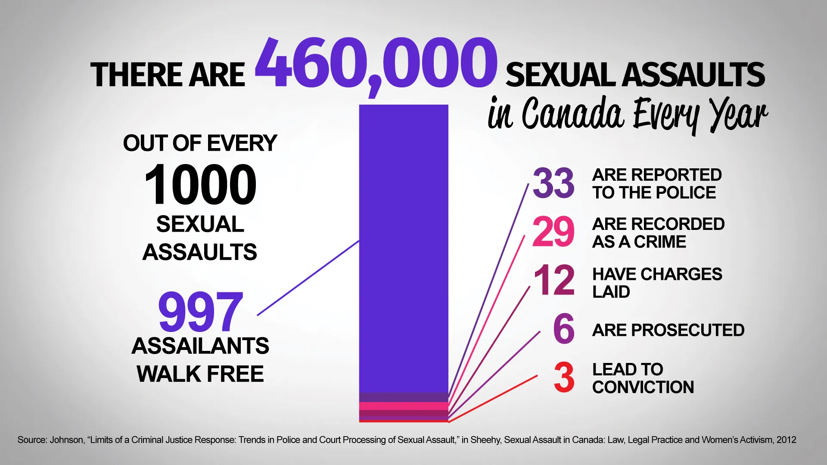
Sexual Assault
Sexual Assault is a specific form of assault that involves any form of unwanted sexual activity. A sexual assault occurs when consent is not given. There are 3 levels.

Slide 6
3 Levels of Sexual Assault
Level of Sexual Assault | Description | Example
Level 1 | 271 (1) Criminal Code: Occurs when the victim’s sexual integrity is violated. Maximum imprisonment of 10 years. | Forced physical sexual behavior
Level 2 | 272 (1) Criminal Code: Carries a maximum sentence of 14 years. | Involves sexual assault with a weapon or imitation of a weapon, threats, or causing bodily harm to the victim
Level 3 | Section 273 Criminal Code: most severe form, aggravated sexual assault. Maximum sentence of life in prison | A sexual attack so serious that the victim’s physical injuries may even be life threatening.

Slide 7
Rape Shield
Bill C – 49 (1992) Prohibits evidence of sexual reputation from being raised in court to challenge the credibility of the complainant. A judge may allow evidence if it will add to the value of fairness in the trail.
R. v. Darrach, 2000 the Supreme Court in a unanimous 9 – 0 decision confirmed the current Rape Shield Law.

Slide 8
R. v. Dyck, 2008 ONCA 309 (CanLII)
In 1988, 11 – year old Christopher Stephens was sexually assaulted and killed by Joseph Fredericks, a convicted child sex offender who was out on parole. He was to serve his sentence in the community. In 1993 a corner’s investigation indot the death recommended created a national registry for convicted sexual offenders. The registry requires them to register with local police when they move into a community.
April 25, 2008 the Ontario Supreme Court of Appeal dismissed the challenge saying that the public’s right to safety outweighs the offender’s freedoms.
Should all provinces pass this law?

