Slide 1
Search & Seizure

Slide 2
Section 8 of The Charter
8. Everyone has the right to be secure against unreasonable search or seizure.

Slide 3
Purpose
Section 8 protects people, not places, against unjustified intrusions on their privacy interests (Hunter v. Southam Inc., [1984] 2 S.C.R. 145 at 159; R. v. Gomboc, [2010] 3 S.C.R. 211 at paragraphs 17, 75).
The purpose of section 8 is to prevent unjustified searches before they happen, not simply to determine after the fact whether they ought to have occurred in the first place (Hunter v. Southam at page 160).
The values underlying the privacy interest protected by section 8 are dignity, integrity and autonomy (R. v. Plant, [1993] 3 S.C.R. 281 at page 292).

Slide 4
What is Permitted
Section 8 permits reasonable searches and seizures in recognition that the state’s legitimate interest in advancing its goals or enforcing its laws will sometimes require a degree of intrusion into the private sphere (Goodwin v. British Columbia (Superintendent of Motor Vehicles), [2015] 3 S.C.R. 250 at paragraph 55).

Slide 5
Section 8 Analysis
An inspection is a search, and a taking is a seizure, where a person has a reasonable privacy interest in the object or subject matter of the state action and the information to which it gives access (R. v. Tessling, [2004] 3 S.C.R. 432 at paragraph 18; R. v. Evans, [1996] 1 S.C.R. 8 at paragraph 11).
A search or seizure will be reasonable where it is (1) authorized by law; (2) the law itself is reasonable; and (3) the manner in which the search is carried out is reasonable
In general terms, determining the constitutional reasonableness of a search and seizure is “a function of both the importance of the state objective and the degree of impact on the individual’s privacy interest” (R. v. Rodgers, [2006] 1 S.C.R. 554; S.A.B.at paragraph 38; Hunter v. Southam at pages 159-60).
Reasonable can include tangible (a gun) or intangible things (words or text messages).

Slide 6
What is a Seizure?
A “seizure” for section 8 purposes is the “taking of a thing from a person by a public authority without that person’s consent” (R. v. Dyment, [1988] 2 S.C.R. 417 at 431; R. v. Colarusso, [1994] 1 S.C.R. 20 at 58; R. v. Law, [2002] 1 S.C.R. 227 at paragraph 15).
Example: Where what the police are “really after” is ultimately to access the data on a personal computer, the taking of the computer constitutes a seizure because it deprives individuals of control over highly private information.

Slide 7
Types of Privacy
The Supreme Court has identified three broad privacy interests protected by section 8: personal privacy, territorial privacy and informational privacy.

Slide 8
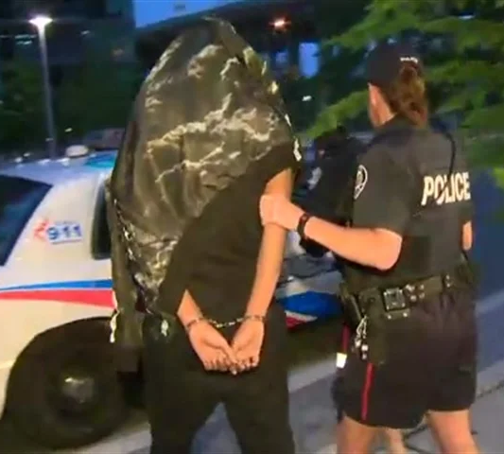
Personal
The right of individuals not to have their bodies touched or explored to disclose objects or matters they wish to conceal and takes into account body privacy and “human dignity”

Slide 9
Territorial/Spatial Privacy
Territorial privacy has its origins in the notion that “the house of everyone is to him as his castle and fortress” (Semayne’s Case, [1558-1774] All E.R. Rep. 62 (1604), at 63). in the home, being the place where our most intimate and private activities are most likely to take place:
The perimeter space around the home
Commercial space
Private cars
In a school

Slide 10
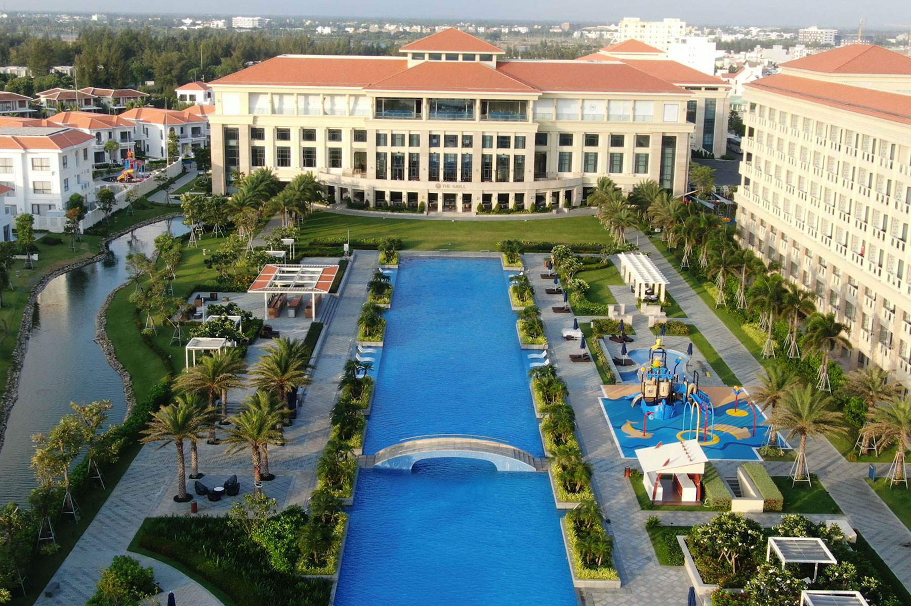
Examples
Hotel, public locker, or wherever there is a ‘master key’ - limited but significant expectation of privacy
Car – decreased expectation of privacy as public roads are highly regulated

Slide 11
School
“Student’s reasonable expectation in the school environment is significantly diminished. Students know that their teachers and other school authorities are responsible for providing a safe environment and maintaining order and discipline in the school, which may sometimes require searches of students and their personal effects and the seizure of prohibited items. Nevertheless, a personal search of a student (i.e., a search of their person or items carried on their person) interferes with a reasonable expectation of privacy (M. (M.R.) at paragraphs 32-33). Students also have a reasonable expectation of the contents of their backpacks on school premises (A.M.).”

Slide 12
Informational Privacy
Informational privacy has been defined as
protect a biographical core of personal in “the claim of individuals, groups, or institutions to determine for themselves when, how, and to what extent information about them is communicated to others” formation which individuals in a free and democratic society would wish to maintain and control from dissemination to the state.
Information which tends to reveal intimate details of the lifestyle and personal choices of the individual

Slide 13
The Internet
The Internet has exponentially increased both the quality and quantity of information that is stored about Internet users, and because users cannot fully control or even be fully aware of who may observe a pattern of online activity, it is by remaining anonymous that the user can in large measure be assured that the activity remains private (Spencer at paragraph 46).
Therefore, there can be no reasonable expectation of privacy in something that is knowingly exposed to the public, or to a section of the public, or abandoned in a public place

Slide 14
R. v. Shankar, 2007 ONCA 280 (CanLII)
Go to the website and read and complete the case.

