Slide 1
Critical Reflection

Slide 2
What is Critical Reflection
Critical reflection analyzes experience by exploring social, political, educational and cultural contexts, and working to reveal conventional wisdom or commonly held falsehoods.

Slide 3
Why Critical Reflection?
Allows us to:
Engage transformative learning by engaging both reason and emotion (Taylor, 2001)
Understand were we as people are in society
Allows us to understand our own as well as other’s values, beliefs and biases more effectively
Allows us to be able to understand cultural confrontations we might have and how to work though those
It also informs our learning so that we can improve

Slide 4
Critical Reflection Involves
Brookfield 1988
Assumption analysis – challenging our beliefs and social structures in order to determine their impact on our practice
Contextual awareness – determining the social and cultural contexts that influence our assumptions
Imaginative speculation – imagining alternative ways of thinking in order to challenge our current ways of thinking
Reflective skepticism – questioning universal claims or unexamined interactions by suspending or temporarily rejecting previous knowledge
Of these, which one best reflects beliefs surrounding the understanding of learning styles?

Slide 5
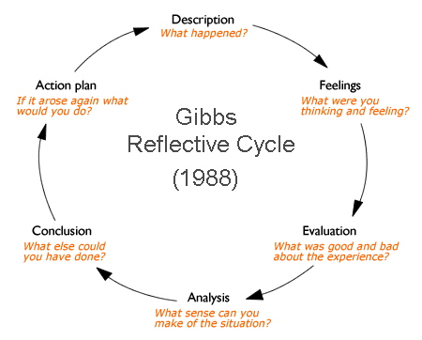
Self Reflection
What is self – efficacy and why is it important?
What is collective – efficacy and why is it important?

Slide 6
Critical and Self - Reflection
How are critical and self – reflection related?
Why is it important to have self – efficacy?

Slide 7
Making Connections and Self Reflection
Look at the following images, choose 1 and reflect on what it means to you in 1 paragraph that meets the paragraph success criteria. What situation does it remind you of? What happened? What role did you play? What did you learn?

Slide 8
Critical Reflection
Look at Slide 4 again and think of one social issue that means something to you (women’s rights, the environment, animal rights, abortion whatever you can think of) and choose 1 of the 4 critically reflective disciplines and write a 1 paragraph critical self reflection on that topic.

