Slide 1
Quebec Nationalism
French – English Tensions

Slide 2
English – French Tensions
English – French tensions are an enduring feature of Canadian political history, often reflecting rival conceptions of Canadian identity.
Some have tried to ensure a single Anglo – Canadian identity, while others aimed to preserve the cultural and linguistic distincivness of French Canada.

Slide 3
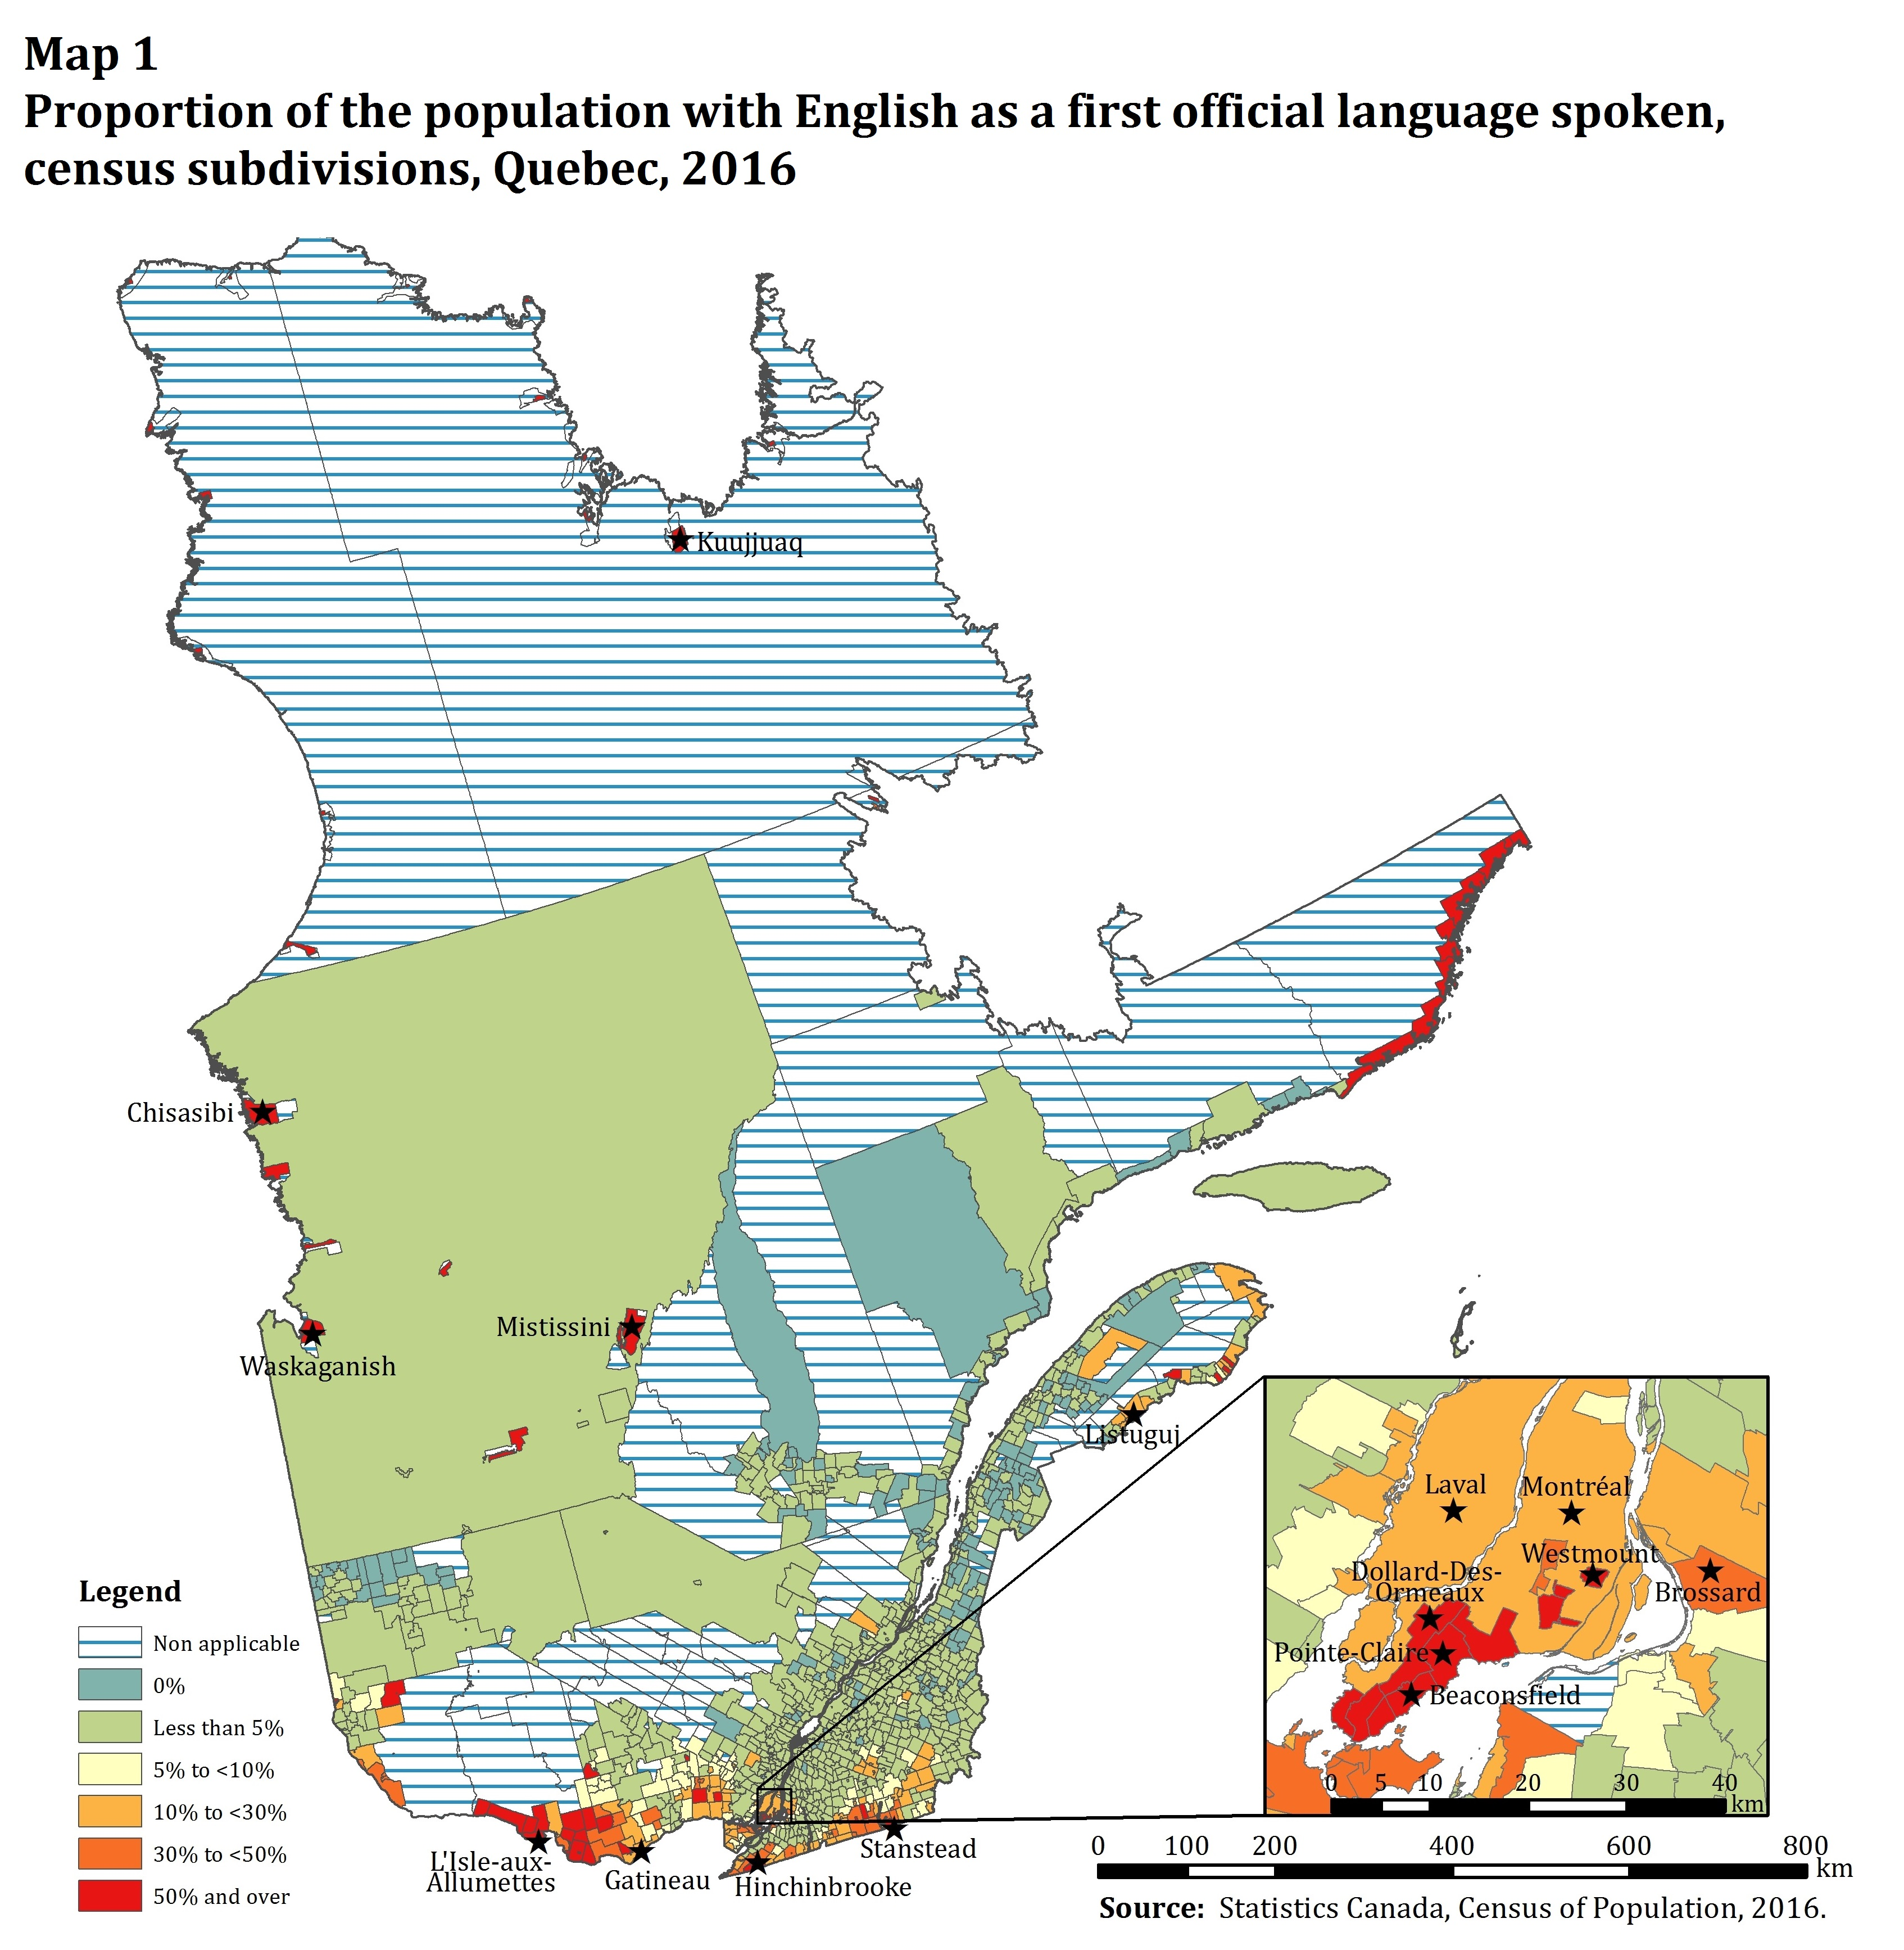
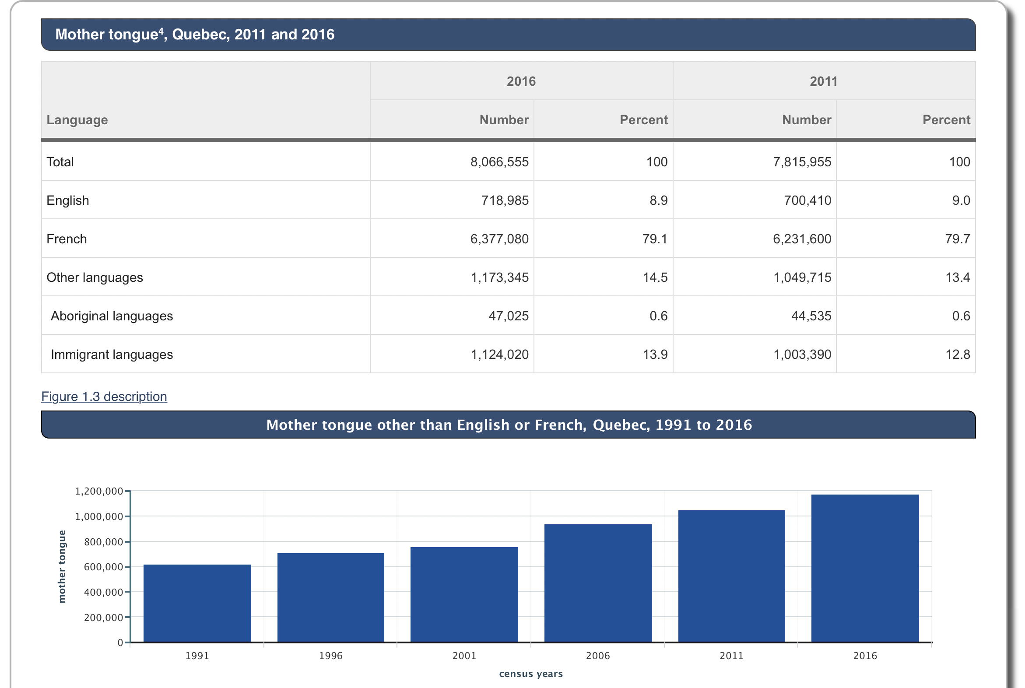
Important Statistics
Number of people in Canada as having English as their mother tongue was 19 460 855 (2016) 56%
French was 7 166 705 (2016) 20.6%
Number of Canadians with another mother tongue rose to 7 321 060 (2016) 21.1%

Slide 4
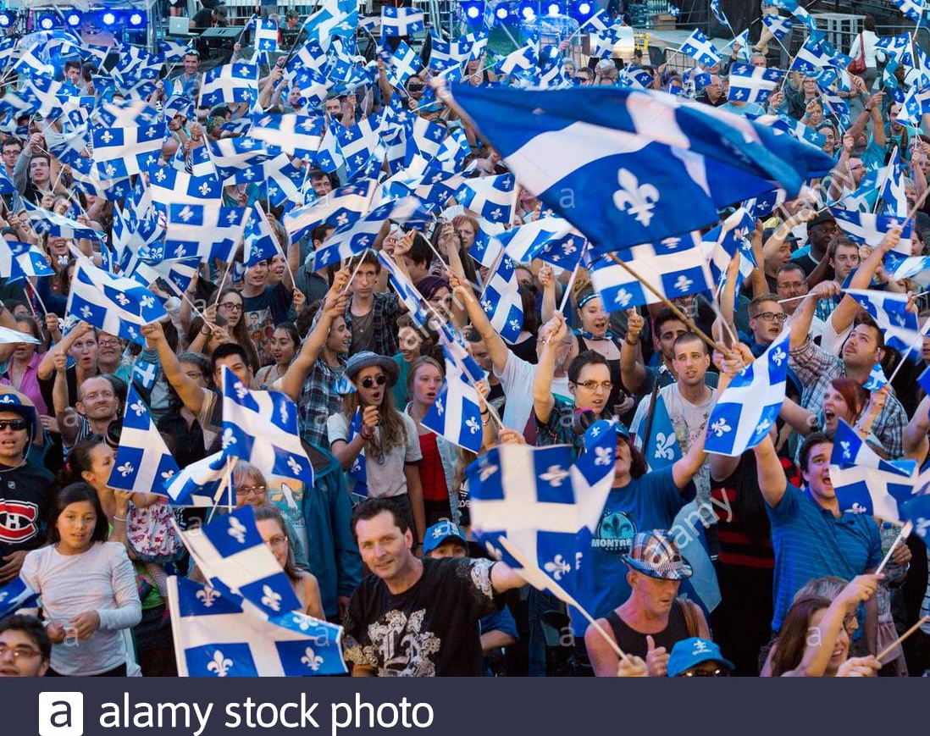
Quebec Nationalism
Usually defined as: a feeling of primary loyalty to Quebec emanating from the widely held notion that it is home to a distinctive French – Canadian nation, centered on language, ethnicity, culture, history, territory and religion.

Slide 5
Quebecois History
1960’s Quiet Revolution francophone Quebeckers sought more control over all aspects of Quebec life including language and economy.
Saw themselves as majority in Quebec as opposed to minority in Canada
Changes in values, attitudes and behavior, expanded role of the provincial state and became outward looking, aggressive and focused on expansion and growth.
Official Languages Act 1969 – Canada has 2 official languages, Canadian public service is bilingual and support for French Immersion programs in other provinces
1988 Supreme Court declared French only outdoor signage unconstitutional, but the province invoked the notwithstanding clause
1993 French signage must be prominent, but English is included
Bloc Quebecois 1991 – Lucien Bouchard after Manitoba and Newfoundland defeated the Meech Lake Accord, which would have given Quebec ‘distinct society’ status among other benefits. PC & Liberals defected.

Slide 6
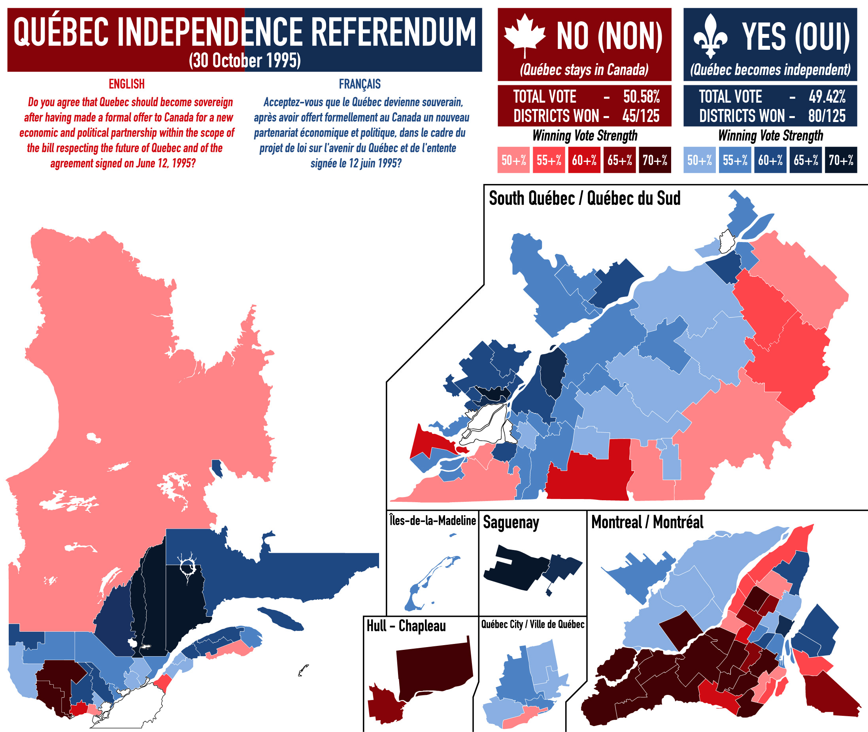
October 1995
The PQ Quebec Government under Jacque Parizeau proposed a referendum on Quebec Sovereignty which would have had Quebeckers retain Canadian Passports, use of the Canadian Dollar and citizenship.
It failed as 50.6% voted against it.

Slide 7
Contemporary Quebec
Quebec’s political institutions are distinctive in terms of civil law, language regulations etc.
Quebec has many different policies than other provinces and is more social democratic including labour friendly laws, childcare and pharmaceutical plans, and clinics that combine health and social services
Quebec is distinct in its news and entertainment and its civil society
“for most Quebec francophones, anything less than distinct society would not do justice to the reality of contemporary Quebec as they understand it.” (Kenneth McRoberts)
What is nation state criteria again?

Slide 8
Quebec Nationalism Today
Interculturalism - moving beyond mere passive acceptance of a multicultural fact of multiple cultures effectively existing in a society and instead promotes dialogue and interaction between cultures. The use of French by new immigrants, while still maintaining cultural practices.
Differences between “civic” and “ethnic” nationalism with increased allophones.
Cultural “threats” through immigration, but a government committee found none and instead recommended all be treated equal.

Slide 9
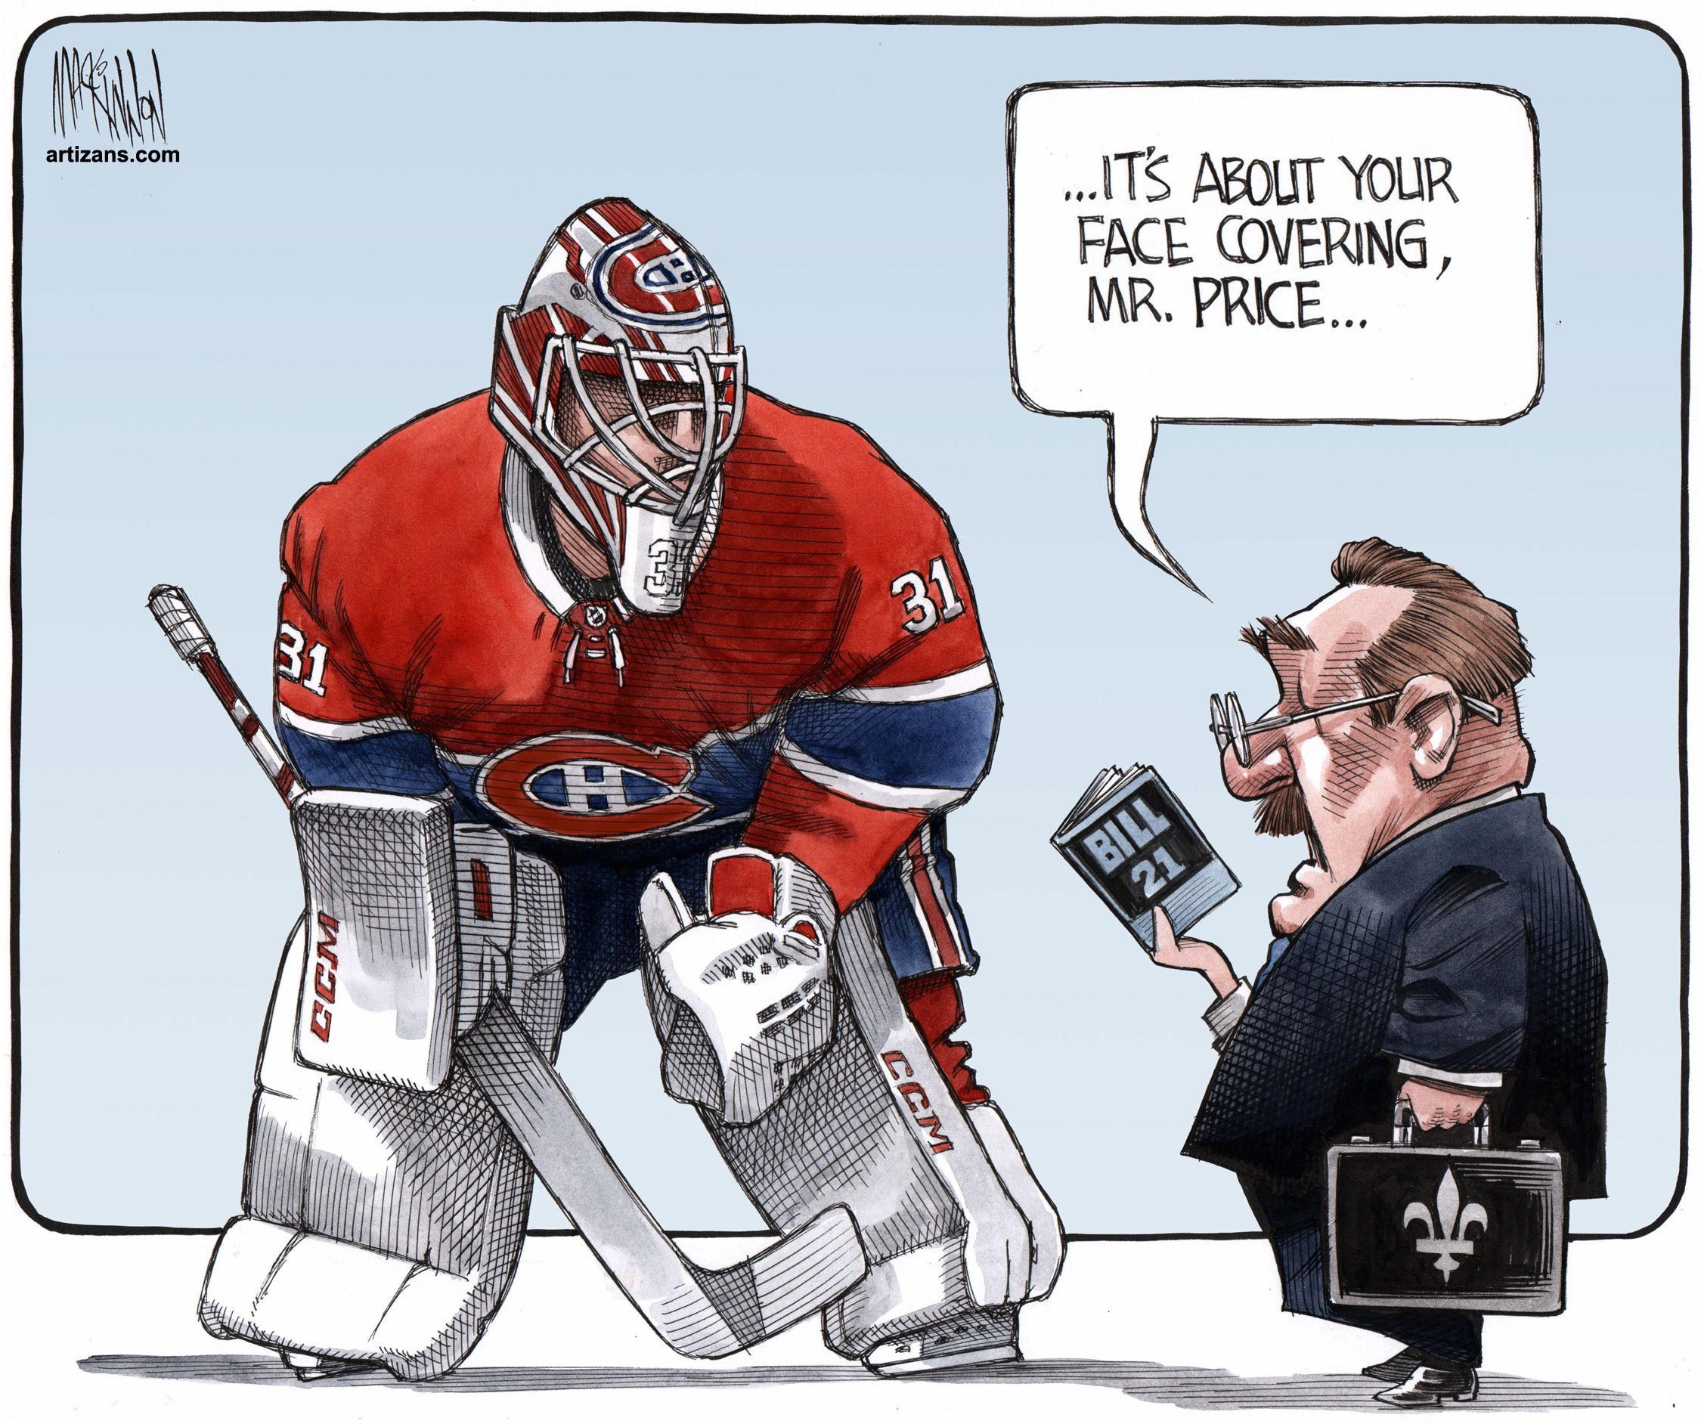
Bill 21
In 2013 the PQ Provincial government introduced the “secular charter”, which prohibits public service employees from wearing religious symbols.
The Bill was passed in 2018 after the Right leaning BQ Government led by Francois Legault formed government.

Slide 10
Further Discussion Questions
Do you think Quebec should get special status aside from other provinces?
What problems exist with Bill 21?
How does Bill 21 reflect Quebeckers nationalism?
Do you think that Quebeckers face discrimination and stereotyping from English - Canada? Why? How do you think this affects their participation in politics?

