Slide 1
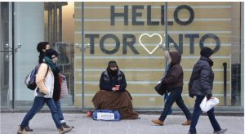
Poverty
A Social and Political Issue

Slide 2
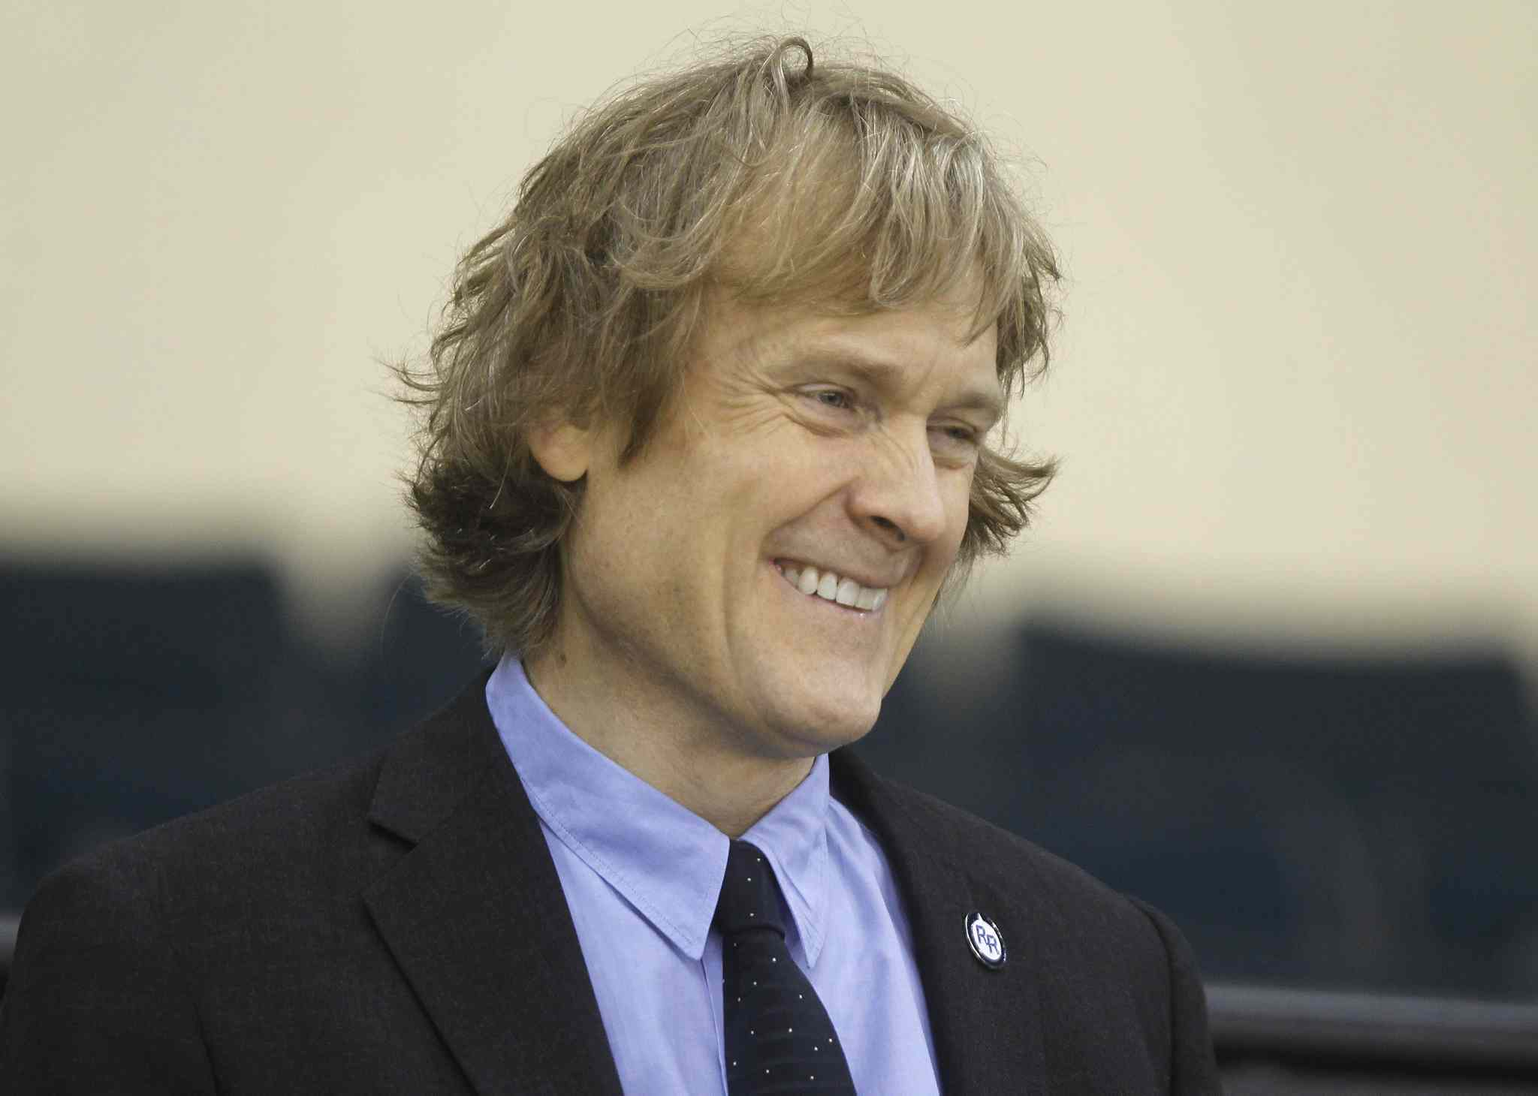
The Rich - David Thompson
Richest Canadian worth more than 40 Billion.
Owns Thompson Corp., a company with numerous holdings in science, research and information including some familiar holdings.
Thompson could stop earning money tomorrow and could spending an amount equal or twice the average of the annual income of a Canadian household every hour of his life (70k) for 20 years and still have billions.

Slide 3
The Poor
We use the word poor because… Follow the Link to find out what the NGO Oxfam says about it. Then visit the link and find out what Oxfam Canada is and what they do.

Slide 4
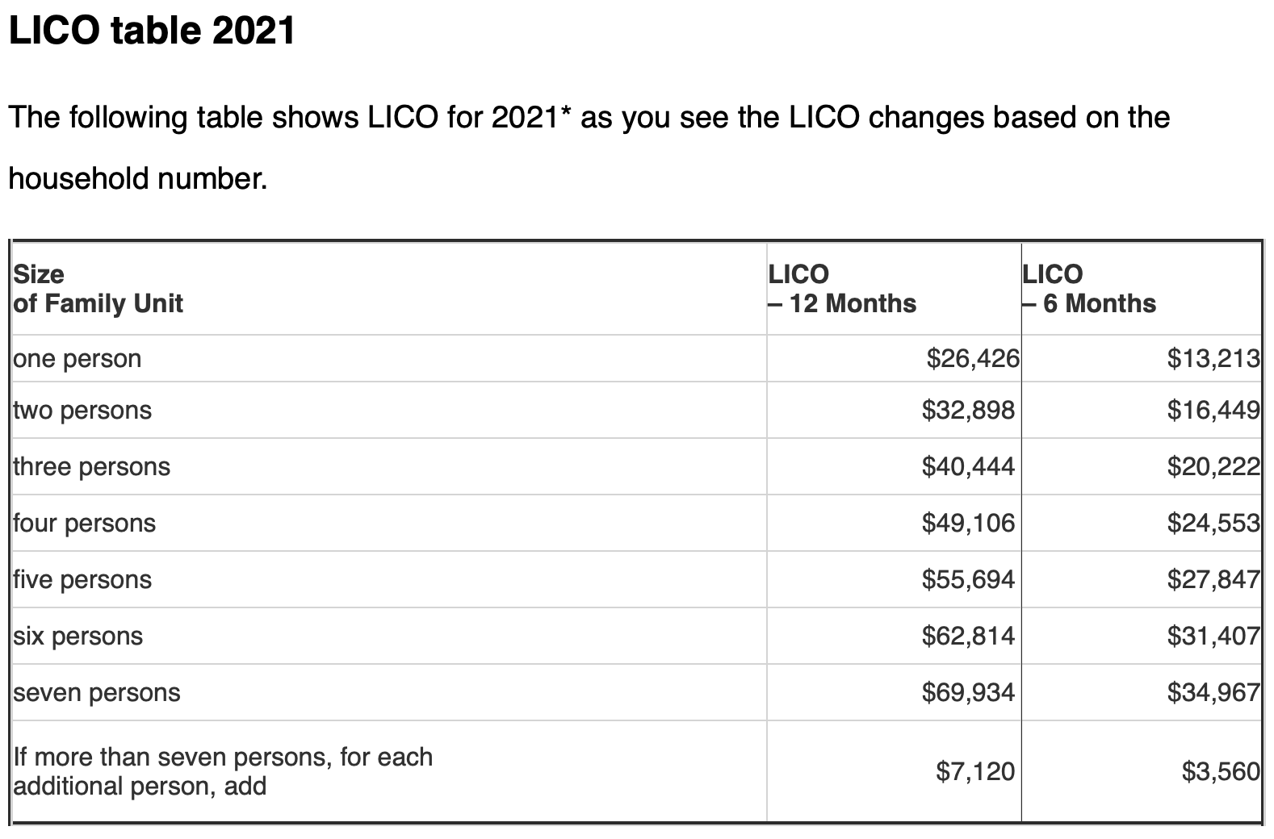
Who Are The Poor
The Poor in Canada are those living below the poverty line or Low Income Cutoffs.
The Amount of money needed to purchase necessities of life (food, clothing, shelter) in a community.
Source: Immigration Services

Slide 5
Link Party
The next 3 slides have a variety of statistics regarding poverty in Canada. They come from Canada Without Poverty and after the 3 slides, I would like you choose 2 pieces of information you find the most interesting and view the links where the information comes from to expand your knowledge.

Slide 6
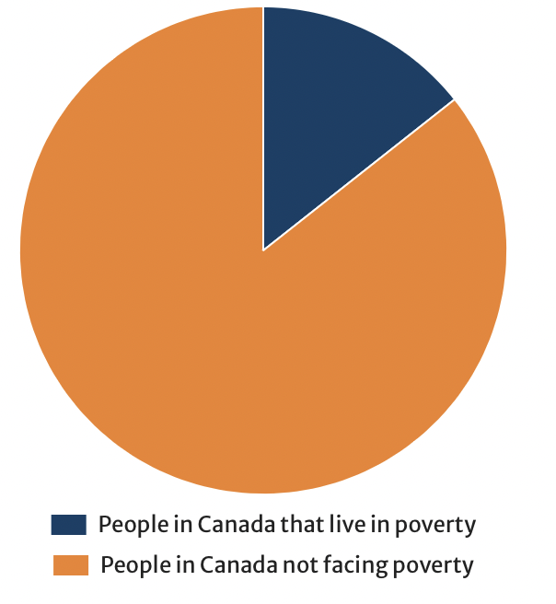
Basic Statistics about Poverty In Canada
The following are statistics about the current reality of poverty in Canada.
1 in 7 (or 4.9 million) people in Canada live in poverty.
In Edmonton, 1 in 8 individuals is currently living in poverty.
Poverty costs Canada billions of dollars annually.
Precarious employment has increased by nearly 50% over the past two decades.
Between 1980 and 2005, the average earnings among the least wealthy Canadians fell by 20%.
Over the past 25 years, Canada’s population has increased by 30% and yet annual national investment in housing has decreased by 46%.
From: Canada Without Poverty

Slide 7
Marginalized Communities
People living with disabilities (both mental and physical) are twice as likely to live below the poverty line.
Nearly 15% of people with disabilities live in poverty, 59% of whom are women.
Estimates place the number of homeless individuals living with a disability or mental illness as high as 45% of the overall homeless population.
Children with disabilities are twice as likely to live in households relying on social assistance
Indigenous Peoples (including First Nations, Métis, and Inuit peoples) are overrepresented among the homeless population in virtually all urban centres in Canada.
28%-34% of shelter users are Indigenous.
1 in 5 racialized families lives in poverty in Canada, as opposed to 1 in 20 non-racialized families.
Nearly 15% of elderly single individuals live in poverty.
Nearly 2 million seniors receive the Guaranteed Income Supplement and live on about $17,000 per year. However, the most basic standard of living in Canada is calculated at $18,000 per year for a single person.
From: Canada Without Poverty

Slide 8
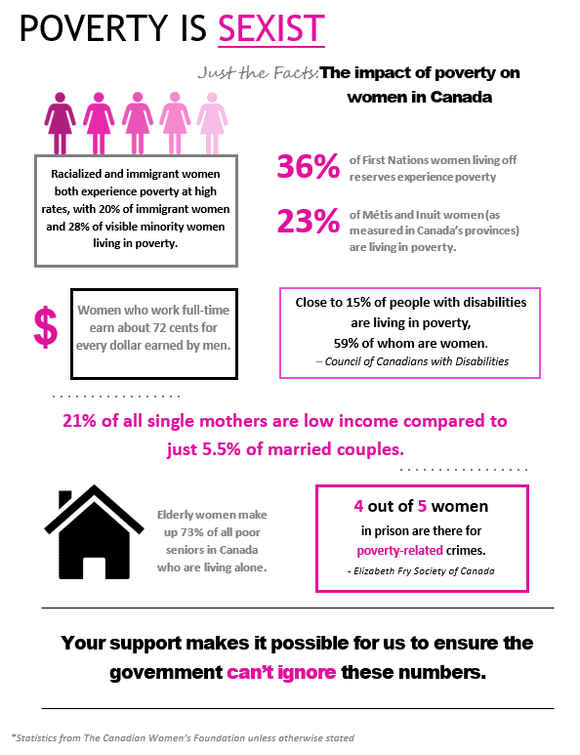
Poverty is Sexist
21% of single mothers in Canada raise their children while living in poverty (7% of single fathers raise their children in poverty).
Women parenting on their own enter shelters at twice the rate of two-parent families.
Racialized women living in poverty were almost twice as likely to work in manufacturing jobs than other women living in poverty.
Overall, racialized women earn 32% less at work.
From: Canada Without Poverty

Slide 9
Expanded Knowledge
After visiting your links, choose one piece of information to add to our PowerPoint. Come up and type it here.

Slide 10
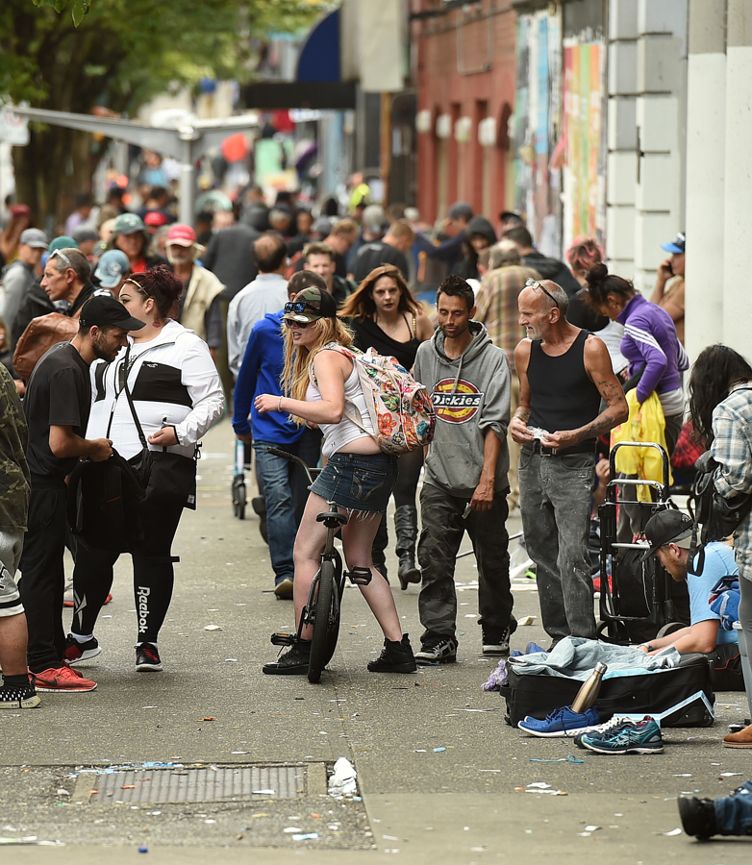
Covid – 19 (UBC Report on Poverty 2021)
People living close to or at the poverty line prior to the COVID-19 suffer the hardest during this crisis, this will worsen due to the unprecedented economic downturn in the long-term.
People in poverty are more likely to work in front-line and service industry, live in inadequate housing, access limited healthcare resources, struggle in food insecure and chronic disease, all of these will further depress their productivity and raise living costs, leading to deeper poverty. (Read Linked Article)
Impoverished people are more likely to work low-wage jobs without benefits, more likely to work in retail or service, which means either risking exposure to a potentially deadly virus or being laid off.
East Hastings Vancouver

Slide 11
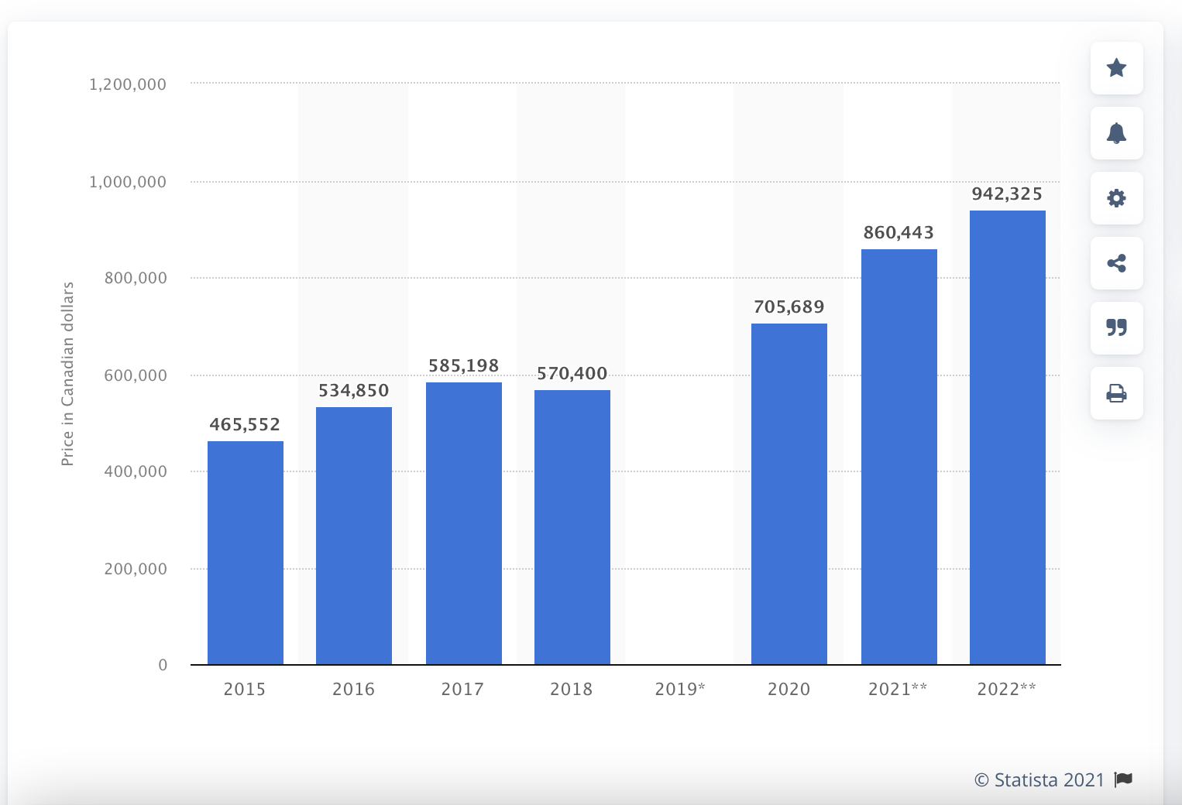
Housing
Average Cost of Housing in Ontario 2015 – 2020 (Projections for 2021/2022)
The high cost of housing as a proportion of income is forcing the poor to reduce their spending on other necessities, such as food.

Slide 12
The Working Poor
Many poor people work full – time and others part – time. Circumstances such as children may limit how much a person can work.
Minimum wage in Ontario is 14.35/hour (21, 840 / year after tax) Is this enough to live in Toronto?

Slide 13
Being Poor & Apolitical
The Poor often lack education, money or time to be politically active.
Canadian Council on Social Development represents middle-class, bureaucratic and some corporate concerns.
National Council of Welfare speaks on behalf of welfare clients.
National Anti – Poverty Organization or Canada Without Poverty represents 700 local anti – poverty groups and individuals living below the poverty line.

Slide 14
Government Social Programs
Choose 1 of the 6 Social Programs below. Research it. Tomorrow you are going to contribute 1 slide to the PowerPoint on your topic.
1.Social Welfare Program
2.Employment Insurance
3. 10$ / Day Daycare
4. Canada Child Benefit
5. Public Pensions
6. National Housing Strategy

Slide 15
Look at Jesse’s Centre On Our Website.
Why do you think I chose this? What poor population do they target? Why are they important?

