Slide 1
Media in Canada

Slide 2
What We Know & Why We Don’t Know It
What do we know about politics? People are not really politically active. Why? Because they have: jobs, school, family, and friends.
Do we often talk politics with any of these groups? No.
So what do people actually know about the parties they are being asked to vote for?

Slide 3
Quiz! Ontario Provincial Election in June 2022
Kahoot! Time. Together let’s see what we know today about Ontario’s upcoming election.
How will you find out about the upcoming election issues?

Slide 4
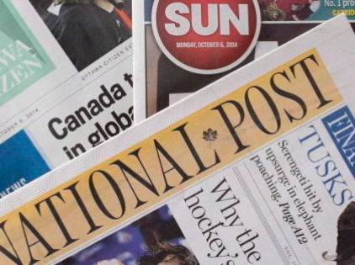
Media Influence
Mass media has, “considerable influence on the beliefs and perspectives presented to Canadians. These choices help to determine available role models, images of reality, definitions of what is political, concepts of community and other elements of our political culture.”
Look at the sample headlines from the newspapers you have been given and try to determine the political bis of each newspaper outlet.
Then look up which media company owns that outlet.

Slide 5
Reflect:
Question: Does the media influence or are people already influenced and then choose their form of media. Example: Does a person working on Bay Street choose the National Post or the Wall Street Journal?
IF this is true, then media is more effective at reinforcing the views of people not generating new views. Conformation Bias?

Slide 6
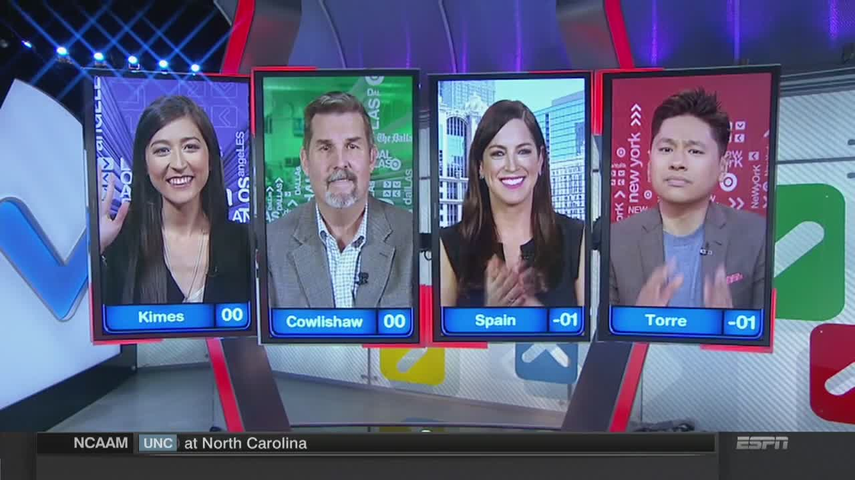
Agenda - Setting
The media tell people what to think about, what the important issues are, and which political personalities are significant. Stories that lead a news broadcast for example.
Mina Kimes, Tim Cowlishaw, Sarah Spain and Pablo Torre are pictured here on ESPN’s Around The Horn. By putting these pundits on TV, ESPN is telling you the viewer that their opinions are ones that matter, ones you should pay attention to and that they, ESPN have them and thus can and should be the network YOU trust for sports news and information.

Slide 7
Framing
Framing deals with the manner in which information about an issue is presented. It occurs when, in the process of covering an issue, the media draw attention to some considerations rather than others. An election could be framed as race between 2 leaders, a contest between ideolgoies, or in many other ways.
This can be obvious or not subtle. Look at the newspapers again and find stories about the same topic and determine if they are framed differently.

Slide 8
Mass Media
Television (you don’t watch), newspapers (you don’t read), radio (you don’t listen), The Internet (that’s you!)
According to the Public Fund's sociological data, only 16% of people aged 13–19 years old are watching TV and are going to continue doing so, 46% do not watch television, and 38% admitted that they are watching less and less. (CyberWise.com)

Slide 9
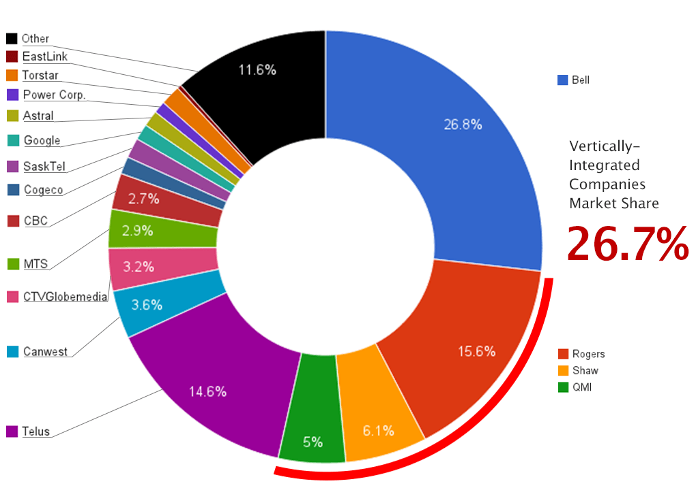
Purpose of Media
Privately owned Media’s goal is profit.
If profits are threated by delivering comprehensive political coverage, they will not provide it.
Look at the Media Ownership in Canada.

Slide 10
Newsprint Media Ownership
Owner | Number | Examples
Postmedia Network Inc./Sun Media | 35 | National Post, Ottawa Citizen, Calgary Herald, Toronto Sun
Torstar | 7 | Toronto Star, Hamilton Spectator, Metro
Saltwire Network | 7 | St. John’s Telegram, Cape Breton Post, Halifax Chronicle-Herald
Groupe Capitales Medias | 6 | La Tribune (Sherbrooke), Le Soleil (Quebec)
Black Press | 3 | Red Deer Advocate, Trail Times
Quebecor | 3 | Le Journal De Montreal, Le Journal De Quebec
Alta Newspaper Group/Glacier | 5 | Lethbridge Herald, Medicine Hat News
Brunswick News | 3 | Saint John Telegrpah-Journal, Moncton Times & Transcript
Continental Newspapers | 3 | Kelowna Daily Courier, Thunder Bay Chronicle Journal
FP Canadian Newspapers | 2 | Winnipeg Free Press, Brandon Sun
Smaller Chains & Independents | 10 | The Globe and Mail, Le Devoir (Montreal), Epoch Times (Vancouver/Toronto)

Slide 11
Broadcasting
Canadians listen to 2 hours less radio per week (2017), but stream 7 hours more (2017) – Podcasts?
In 2017 Canada had 322 public or community radio stations and 725 private radio stations. Most are owned in the same manner as newsprint. Example: BCE (Bell) bought CHUM in 2007 and Astral in 2012.
The average Canadian also watches about 15 hours of TV per week.
CBC is public programming on both radio and TV (CBC News Channel). Both broadcast a great deal of political content.
Example: CityNews (TV) recently merged with 680 News (Radio) both owned by Rogers.

Slide 12
Privately Owned Television
CTV was acquired by BCE (BELL) in 2011 consists of more than 24 stations including a 24hr News Channel.
Global, Toronto based was purchased by Shaw Communications out of Calgary and is the 3rd largest English Network.
Rogers owns CityTv, Sportsnet, OMNI and others.
Pierre Peladeau established a right – win television version of his Sun Newspapers in 2011, but it failed as of 2015.
Read the link of what is going on in Rogers right now and be prepared to discuss the effects of communications corporations merging.

Slide 13
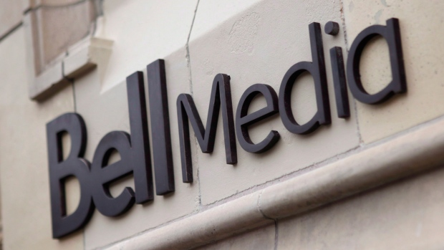
Media Conglomerates
As you have seen already most media is owned by a few corporations. And you have seen these corporations are seeking to get larger and obtain more control over content.
Media is also changing. Media convergence is the ‘bundling’ or ‘folding’ of services together. Media giants seek to have TV, Internet, Radio and newsprint holdings together.
Question: Why might they do this? Is this positive or negative for the average Canadian?

Slide 14
Changing of the Narrative
“Since reliance on television in English Canada usually means exposure to American television, this tendency detracts from public knowledge in a second way. The increased concentration of ownership of newspapers, radio and television is not a health development in any democracy that values the maximum diversity of opinions. Such ownership only enhances the predominance of the right – wing opinion already amply supplied by radio talk-show hosts, think tanks, columnists, and pendants.” (Cochrane et. al. 2021)

Slide 15
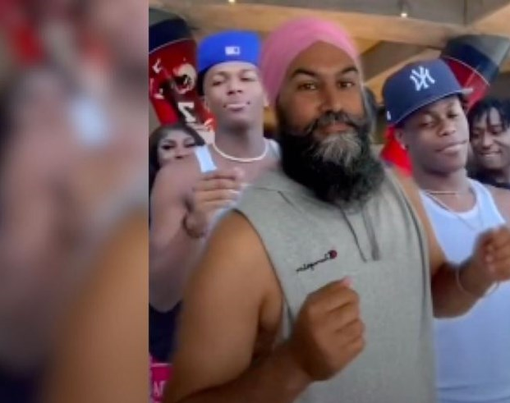
The Internet
Television subscriptions in Canada sunk to 75% in 2016 while 87% of households had the internet. These numbers are likely more divergent today.
The Internet provides access to newsprint media, Television, and radio.
The Internet also provides access to political parties, their campaigns and platforms.

Slide 16
Social Media
Twitter, TikTok, Facebook, Instagram and YouTube have become increasingly important in politics and political campaigns.
Politicians use social media reach a wider and often younger demographic.
Also, these media cites have been known to “push a given viewpoint rather than accurately provide information.” This has “increased substantially due to the internet an social media.”
How has this happened? How does social media and the Internet influence politics and elections? Watch the PPS Doc. The Art of Selling Lies to find out.

