Slide 1
Marxist Literary analysis
Criticism # 3

Slide 2
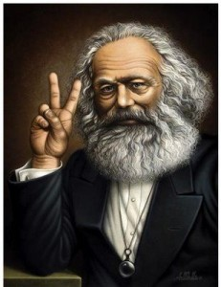
Karl Marx
Karl Marx (1818–1883) is best known not as a philosopher but as a revolutionary communist, whose works inspired the foundation of many communist regimes in the twentieth century. It is hard to think of many who have had as much influence in the creation of the modern world.

Slide 3
Marx’s Theories
Historical materialism — Marx's theory of history — is centered around the idea that forms of society rise and fall as they further and then impede the development of human productive power.
Marx sees the historical process as proceeding through a necessary series of modes of production, characterized by class struggle, culminating in communism.
Surplus value of human labour = the profits that good workers make for the company is taken in the form of profit for the owner and thus workers are not paid or treated fairly.
How Does this relate to Brave New World and the Deltas/Epsilons?

Slide 4
Marx
Based on the theories of Karl Marx this school concerns itself with class differences, economic and otherwise, as well as the implications and complications of the capitalist system: "Marxism attempts to reveal the ways in which our socioeconomic system is the ultimate source of our experience” - Tyson

Slide 5
Goals of Marxist Criticism
Theorists working in the Marxist tradition, therefore, are interested in answering the overarching question, whom does it [the work, the effort, the policy, the road, etc.] benefit? The elite? The middle class?

Slide 6
Marxist Analysis
Whom does it benefit if the work or effort is accepted/successful/believed, etc.?
What is the social class (background )of the author?
Which class does the work claim to represent?
What values does it reinforce?
What values does it subvert?
What conflict can be seen between the values the work champions and those it portrays?
What social classes do the characters represent?
How do characters from different classes interact or conflict?
The highlighted ones will help you!!!!!

Slide 7
Performing an Analysis
Take out your short story that you did at the beginning of the course, Jubilee.
In your groups choose 2 or 3 of the questions from the previous slide and perform a Marxist critique of Jubilee!
Use a Google Doc and do it together and be prepared to share your questions and analysis with the class.

Slide 8
Personal Reflection
To this point, what how has Brave New World demonstrated differences in classes?
Think of examples and note them down.

