Slide 1
Management Overview
Issues in the Workplace

Slide 2
Management Today
The world is changing. Look around you. Getting to know yourself will help you adapt to a diverse and technological world.
You must be able to adapt.
Reflect: How does one’s ability to adapt help their ability to lead?

Slide 3
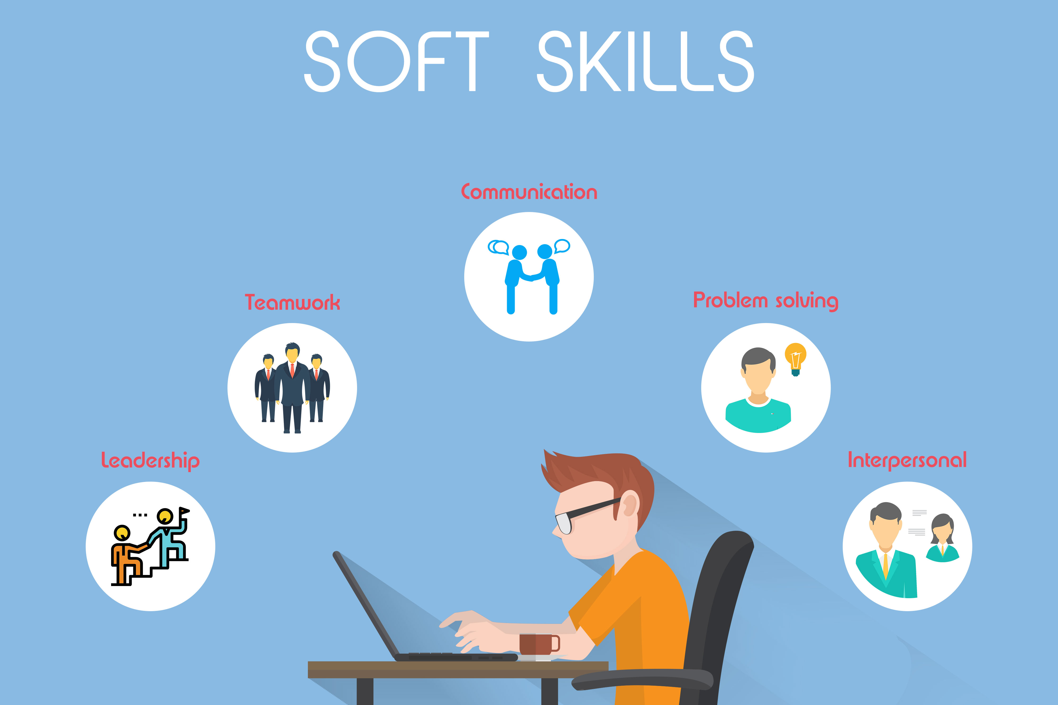
Look at the Soft – Skills. Why do you think they are important today? Do you think they are more important that course content? Which is the most important? Why?

Slide 4
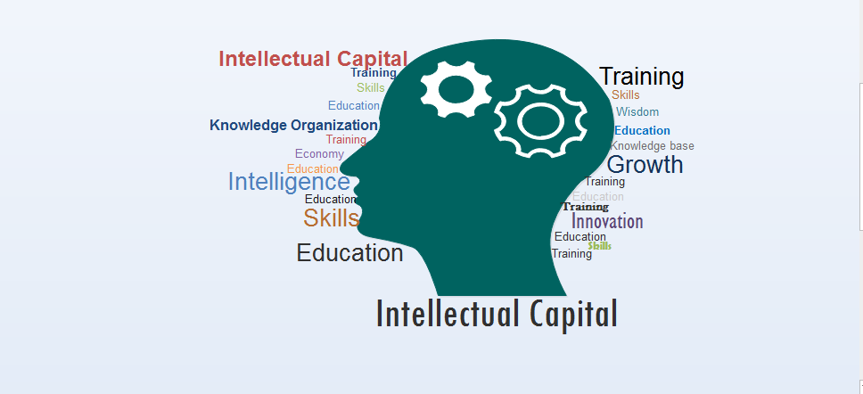
Talent
Intellectual Capital: The collective brainpower or shared knowledge of a workforce.
How do soft – skills contribute to Intellectual Capital?
Intellectual capital = competency x commitment
You want to be a Knowledge Worker: Someone whose mind is a critical asset to employers.

Slide 5
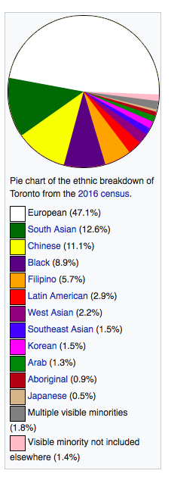
Workplace Diversity
Facts about Toronto: Toronto was named the most diverse city in the world in 2016 by BBC Radio.
Workforce Diversity describes differences among workers in gender, race, age, ethnicity, religion, sexual orientation, and able-bodiedness.
Statistics Canada: by 2031 3/10 Canadians in the workforce will be visible minority groups

Slide 6
Prejudice in The Work Force
Prejudice is the holding of negative, irrational opinions and attitudes regarding members of diverse populations.
This unfortunately happens too often in the workplace. Discrimination is when some groups in society are unfairly treated and denied the full benefits of organization membership.
Example: Names. Names on resumes can cause discrimination/racism: prejudice, discrimination or antagonism directed against someone of a different race based on the belief that one’s own race is superior.

Slide 7
Gender Discrimination
The Glass ceiling effect is an invisible barrier limited career advancement of women and minorities.
Follow the link on our website to read one woman’s experience in the workforce.

Slide 8
Globalization
The worldwide interdependence of resource flows, product markets, and business competition.
Together we will watch the globalization video on our website. Think about:
Where do you fit in the global world.
Is globalization positive or negative and for who?

Slide 9
Technology and Globalization
Discuss and answer these questions in your group.
1. What technology do you have? (Devices, Applications)
2. How has technology contributed to globalization?
3. Is technology good or bad for our world?
Be prepared to share with the class.

Slide 10
Ethics
The business world is full of contradictions. Ethics tell us what decisions we ought to make. There are 2 branches of ethics:
Consequential: Perform the act that produces the best consequences
Non-Consequential: Perform the act because it is the right act to perform.
Reflect: Which do you prefer? Why? How should we decide?

Slide 11
Ethical Dilemma #1
Read the short case you have been given. What do you think should happen and why. Be prepared to discuss in your groups.
1. Do you think your choice of what you would do would differ if you were consequentialist or non – consequentialist?

Slide 12
Ethical Dilemma #2
2. Read the second case. What do you think she should do? Why?

