Slide 1
Organizations
Management Structures

Slide 2
Organizations
An organization is a collection of people working together to achieve a common purpose.
Self - Efficacy – the ability to produce a desired or indented result.
Collective Efficacy: What do you think that is?
In business, what do you think an organization’s purpose is?

Slide 3
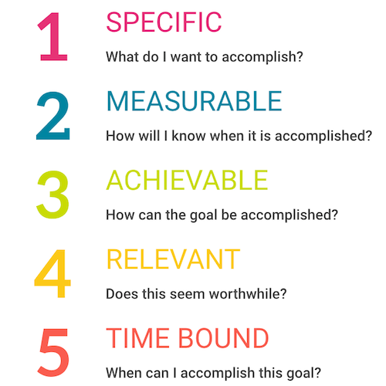
Goal Setting: SMART Goals
Do you have a SMART Goal?

Slide 4
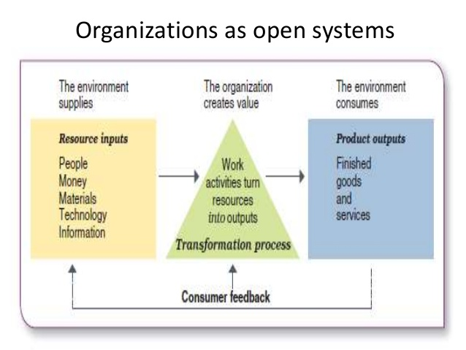
Organizations as Systems
Organizations transform resources that the environment supplies into outputs or finished goods and services for their customers.
Can you think of an example of a product that has been transformed?

Slide 5
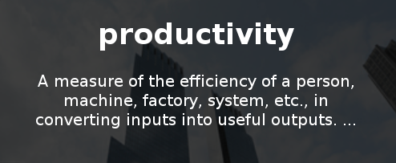
Goals of Organizations
Profit (adding wealth to shareholders or owners)
Non – Profit (adding wealth to society)
Productivity (the quantity and quality of work performance) is one measure of success. Money raised or profited and improvement in quality of life is another (accomplishing a pre-set goal)

Slide 6
How Organizations are Changing
Renewed belief in employees
Disappearance of ‘command and control’
Emphasis on Teamwork
Prominence of technology
Embrace of networking
New workforce expectations
Concern for work – life balance
Focus on speed
Which do you think are the most important? Rank them in your groups in order of what you feel is most important.

Slide 7
Management
Organizations have various management structures. There are different types of managers as well.
- A manager is a person who supports, activates and is responsible for the work of others. Do you think this definition is missing something? Evaluate it.

Slide 8
Henry Mintzberg
“No job is more vital to our society than that of the manager. It is the manager who determines whether our social institutions serve us well or whether they squander our talents and resources.” Do you agree?

Slide 10
Managers and Administrators
Line Managers: directly produce goods
Staff Managers: use special expertise to advise workers
Functional Managers: Responsible for one specific area like Marketing
General Managers: Are responsible for complex multifunctional units
Administrators: Manager in a public or non-profit organization
At what level of our pyramid do you think each would be placed?

Slide 11
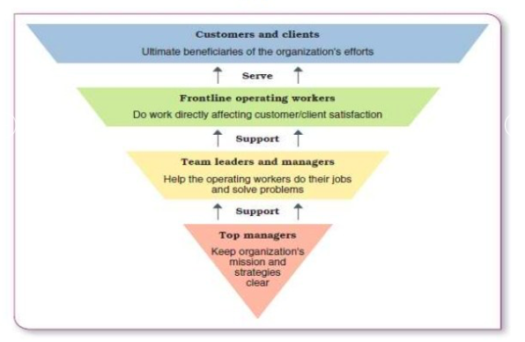
Upside-down Managerial Pyramid
What differences do you see between this and the previous pyramid?
Which pyramid do you prefer? Why?

Slide 12
Managerial Characteristics
What characteristics do you think make a good manager? In pairs I want you to create a brief mind map of characteristics that you think make a good manager of an organization. No Googling.

Slide 13
Managers
1. Go to our class website and watch the video about the functions of management and complete the activity.
2. After you have completed the video and activity move on to the next activity posted and visit the link to read about managerial roles.

Slide 14
Managerial Characteristics Poster
I would like you to CREATIVELY create a visual representation of the perfect manager. Use only the characteristics you brainstormed and the information from the video and link you visited, but still NO GOOGLING.
Draw, use color, be creative and yes of course you can add words. You will present your poster to the class in 2 days.
- I would like it hand drawn, but if you MUST use the computer you can. Both people must work on this and the best ones will be posted around the room.

