Slide 1
Legal Philosophy
some OTHER people you need TO know

Slide 2
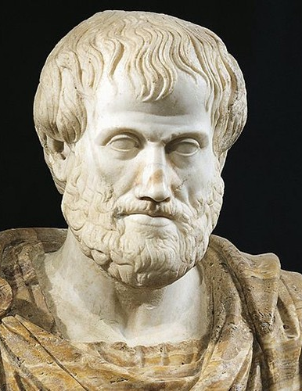
Aristotle (384 – 322 BCE)
Agreed with Plato that humans are political animals like other animals that live in colonies with social organization. Reason sets humans apart, which allows them to tell the difference between good and bad; this is Rationalism.
People fall into 3 classes. Some are born good, some can be made good through education but the majority of people are ruled by their passions and education alone will not make them good. That is law’s job.
Fear and punishment controls people.
Citizens should train to legislate in order to regulate behavior.
Law has a moral purpose. It forces people to live according to reason rather than passion.
Law is to help citizens use their reason to achieve their highest potential.

Slide 3
Justice in the Nicomachean Ethics
[W]e allow only reason, not a human being, to be ruler. For a human being awards himself too many goods and becomes a tyrant; a ruler, however, is a guardian of the just, and hence of the equal [and so must not award himself too many goods].
[T]he law looks only at differences in the harm [inflicted], and treats the people involved as equals, if one does injustice while the other suffers it, and one has done the harm while the other suffered it. And so the judge tries to restore this unjust situation to equality, since it is unequal.

Slide 4
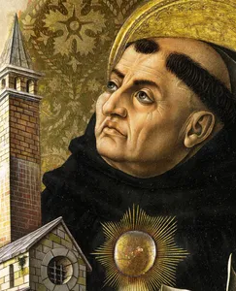
St. Thomas Aquinas (1224 – 1274)
A Dominican friar who taught for several years at the University of Paris. Lived in the Middle Ages.
Adapted Aristotle’s thought to Christianity.
Believed that humans develop their greatest potential led by the church not the state. The state should be subordinate then to the church.
People are under no obligation to obey unjust laws or laws that conflict with divine laws.
He identified 4 kinds of law:
Eternal Law
Natural Law
Divine Positive Law
Human Positive Law.

Slide 5
THE 4 Types
1. Eternal: Body of laws by which ‘God’ created the universe and kept it in operation. Exists outside time and will never change.
2. Natural: Is the eternal law as it operates in humans and can be known. Faculty of reason. Examples:
Parents should care for their children
Each person should try to preserve his or her own life.
People should do no harm to others.
We should all assist the poor, the sick, and the elderly.
3. Divine Positive: Part of the eternal law that has been revealed in scriptures. Laws that were written in the bible for instance.
4. Human Positive: “Law is nothing else than an ordinance of reason for the common good, promulgated by him has the care of the community.
Law is the product of human reason.
It is made for the common good.
It is made by the ruler who must care about the community.
It is promulgated or published so everyone knows it.

Slide 6
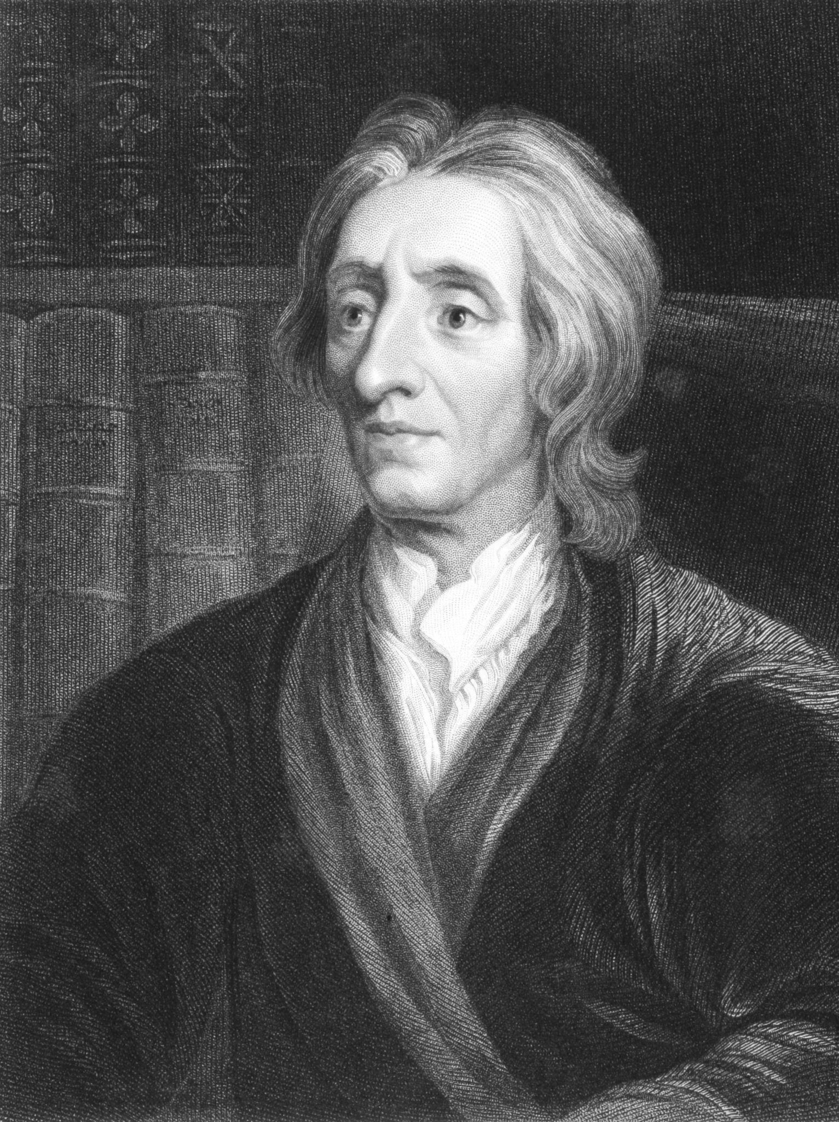
Locke 1632 – 1704)
Response to Hobbes.
Two Treatises of Government 1690: “All men are created equal; that they are endowed by their Creator with certain unalienable [inviolable] rights; that among these are life, liberty and the pursuit of happiness; that to secure these rights, governments are instituted among men, deriving their just powers from the consent of the governed; that whenever any form of government becomes destructed of these ends, it has the right of the people to alter or to abolish it and to institute new government, laying its foundation on such principles, and organizing, its powers in such form, as to them shall seem most likely to effect their safety and happiness.”
Analyze the above quote.

Slide 7
Locke Reflection
One can only become a full member of society by an act of express consent (Two Treatises 2.122).
The literature on Locke’s theory of consent tends to focus on how Locke does or does not successfully answer the following objection: few people have actually consented to their governments so no, or almost no, governments are actually legitimate. How do you consent to a government? Who should consent? How should consent for a government be?

Slide 8
Some Solutions
Tacit (is this good enough?) consent. Simply by walking along the highways of a country a person gives tacit consent to the government and agrees to obey it while living in its territory. (There are issues with this. Is this really consent?)
Explains why resident aliens have an obligation to obey the laws of the state where they reside, though only while they live there.
Inheriting property (which Locke sees as a right…should it be?) creates an even stronger bond, since the original owner of the property permanently put the property under the jurisdiction of the commonwealth.
Children, when they accept the property of their parents, consent to the jurisdiction of the commonwealth over that property (Two Treatises 2.120).

Slide 9
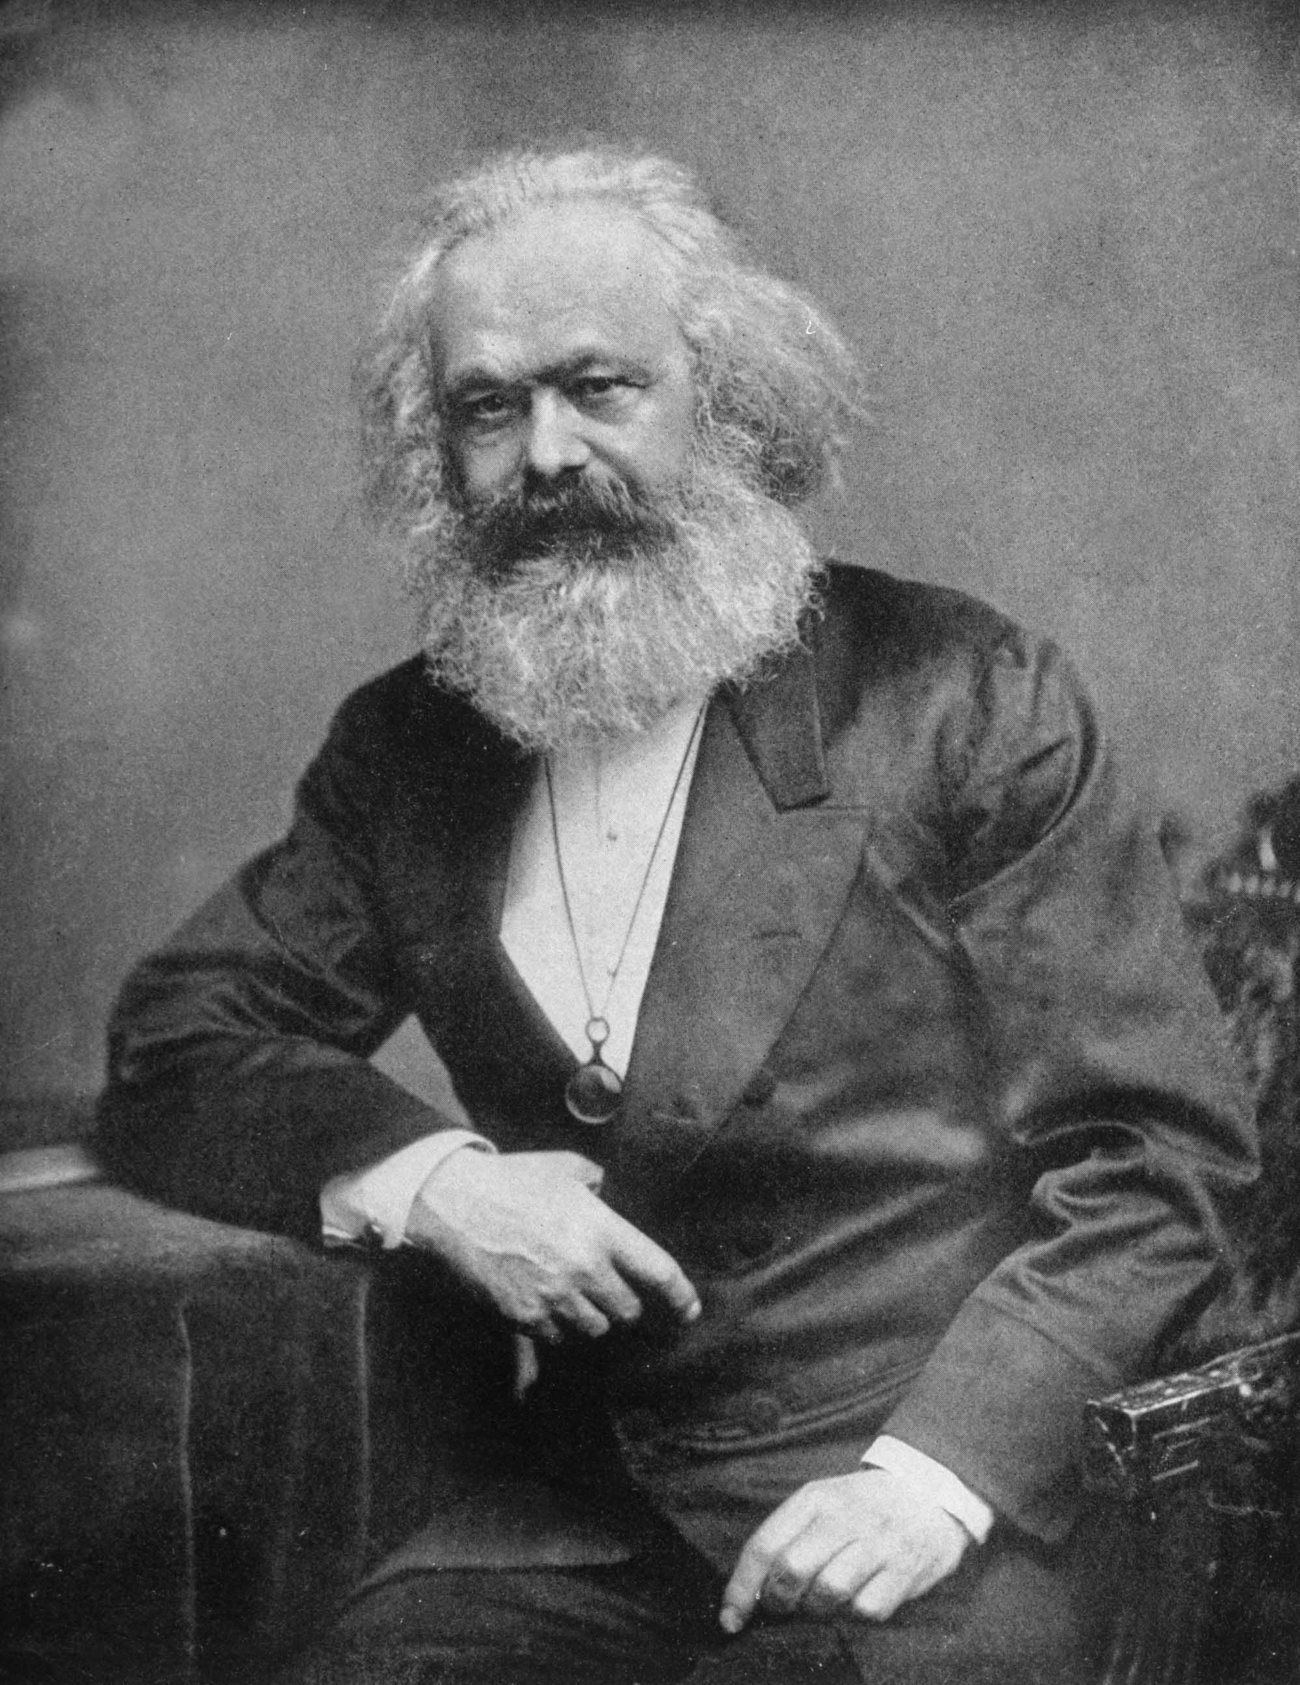
Marx (1818– 1883)
German attended university and studied law, history and philosophy.
Marxism: an economic and political theory that states that law is an instrument of oppression and control that the ruling classes use against the working class.
Was concerned with worker treatment he witnessed living in England during the Industrial Revolution. Concerned with how capitalist bourgeois were controlling these means of production.
British Law favors this “capitalist class" by strengthening its power over the working class. Anti – union laws for example.
Are there examples of this today?

Slide 10
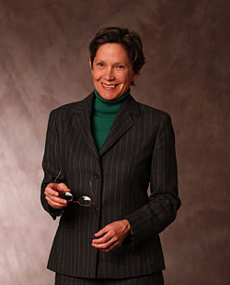
Ann Scales (1952 – 2012)
American lawyer, activist, graduate of Harvard Law and was a law professor at the University of Denver Sturm College of Law
She was a founder of the legal field of feminist jurisprudence, and coined the term feminist jurisprudence in 1977
Feminist Jurisprudence states that the law has been fundamental in women's historical subordination. Plays off of Marxism where the law is used to oppress workers or the ‘middle class’.
“the fourteenth amendment … cannot be relied on to meet the real challenge raised by the issues of pregnancy and childrearing. “ (Scales, Ann C. (1981) "Towards a Feminist Jurisprudence," Indiana Law Journal: Vol. 56 : Iss. 3 , Article 1.)
Go to our website and view the latest on law restricting women’s rights.

Slide 11
Michel Foucault (1926 – 1984) & Noam Chomsky (1928 – Present)
Together we will go to our website and watch a portion (15 minutes) of Foucault (French Philosopher, Activist and Professor at University of Tunis) & Chomsky (MIT Professor and often termed the ‘Father of Linguistics’ debating Justice and Power in our society) (1971).
What are they arguing? Where are they similar? Where are they different?

Slide 12
Philip Selzinck (1919 – 2010)
Sandford Law Professor
Law’s essence does not lie in the “exercise of power and control, but in the predictable restraint on those using the power.” In other words, a country will have the best laws and justice will be achieved only when there is an independent boy or branch of government that can challenge, review and limit the laws made by the ruling power.
Dictators are powerful as there is no one to challenge their authority.
At what point should a nation challenge its leader’s authority? What would Foucault & Chomsky say about this?

