Slide 1
Introduction to Criminal Law

Slide 2
Review: Why do Laws Exist?
Provide a System of Enforcement
01
Establish Rules of Conduct
02
Protect Rights and Freedoms
03
Resolve Disputes
04
Protect Society
05
Which do you think Criminal Law focuses on the most? Pick 2.

Slide 3
The Criminal Code
The Criminal Code is the main source of criminal law in Canada, which is the body of publish law that defines crimes and prescribes punishments. It is linked on the website.
A criminal offence is an action, omission, or state of being that is considered a crime, as defined int eh Criminal Code or other criminal statute.

Slide 4
What is a Crime?
The Law Reform Commission of Canada states 4 conditions that must exist for an act to be considered a crime:
The actions or behavior of the person must be considered immoral (wrong) by most Canadians (watch the video on Metaethics on our Website).
The person’s actions must cause harm to society and any individual victims.
The harm caused by the person’s actions must be serious.
The person must be punished by the criminal justice system for his or her actions.

Slide 5
Immorality – How do we decide what is moral?
What is the issue with having the majority of Canadians determine what is moral or immoral behavior?
“What is moral is not necessarily legal and what is legal is not necessarily moral.”
What is something that is legal and not moral?
What is something that is moral and not legal?

Slide 6
Criminalizing, Decriminalizing, Legalizing
Term | Explanation
Criminalization | To make a behavior a criminal offence in the Criminal Code
Decriminalization | To make a behavior that was illegal punishable only by fines
Legalization | To make an act completely legal by removing it from the Criminal Code or other criminal statutes
What do you think is the difference between criminalization and decriminalization? Why is this difference so important?

Slide 7
Examples of Legal, Illegal and Criminal behavior
Legal | Illegal | Criminal
Dying your hair pink Wearing religious clothing Drinking alcohol over the age of 19 Using a cellphone in a movie theater Protesting by walking out of work or class | Purchasing marijuana under the age of 19 Speeding Drinking alcohol in a public place Cutting down certain trees Burning leaves | Theft Assault Kidnapping Trespassing
Behavior that some people consider immoral, such as smoking is not necessarily illegal (though purchasing of cigarettes for a minor (under 19) is criminal )while smoking under the age of 19 is illegal.

Slide 8
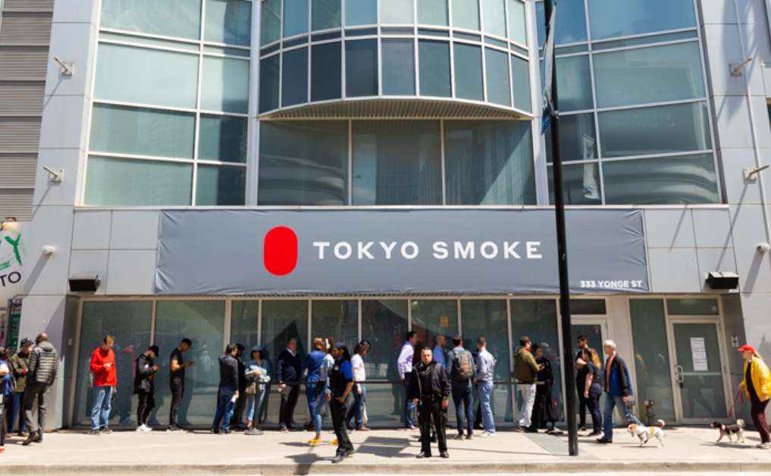
The Federal Government
The Federal Government creates laws that are in the Criminal Code and are supposed to represent what Canadians want.
On October 17th 2018 Cannabis Laws Changed. Visit the link on our website to examine the changes. What are your opinions on these laws?

Slide 9
Core Values of our Justice system
Fairness, Efficiency, Clarity, Restraint, Accountability, Participation, Protection.
The rule of law guarantees freedom and security in that it allows no one to be above the law; every individual is subject to the law regardless of his or her power or importance. Thus, we strive to be impartial in that decisions are based upon objective criteria and free from bias or conflicts of interest.
Is this always true? Read the two articles on our website and reflect in 2 – 5 sentences how you feel we can achieve greater impartiality by our police.

