Slide 1
Individuals and The Environment

Slide 2
Individual Legal Action to Protect the Environment
Common Law allows individuals to take action against someone who interferes with their own enjoyment of their own property.
Tort Law: the area of the law that covers most civil suits. In general, any claim that arises in civil court falls under tort law. standards of the “reasonable person.”
The concept of tort law is to redress a wrong done to a person and provide relief from the wrongful acts of others, usually by awarding monetary damages as compensation.
Tort law requires those who are found to be at fault for harming others to compensate the victims.

Slide 3
Remedies for Torts
Typical harms include the loss of past or future income, payment of medical expenses, and payment for pain and suffering. There may also be additional punitive damages that are meant to punish the plaintiff in excess of full compensation.

Slide 4
Negligence
Trespass: the direct interference with land that is owned or occupied by another person.
Negligence: an act committed without intention to cause harm, but which a reasonable person would anticipate might cause harm.
Negligent torts are harms done to people through the failure of another to exercise a certain level of care, usually defined as a reasonable standard of care. Accidents are a standard example of negligent torts.
Example: Someone pollutes a water source that people are using by having a boat race. They demonstrating negligence towards the water source.
Go to our website and watch the two videos posted about Toronto and Canada. Answer the questions

Slide 5
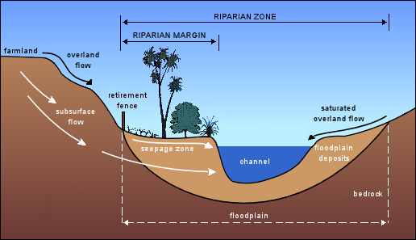
Riparian Rights
The right of an owner of land bordering on a lake, river, or stream to sue another person who interferes with the quantity or quality of the water.
Legislative authority: the power conferred on a public person to do something that would otherwise be prohibited by the common law.

Slide 6
Nuisance
Private: an indirect interference with the use and enjoyment of land due to the actions or conduct of someone nearby. Ex: noise, air, water, and soil pollution.
Public: an interference with a public right to fish or the right of navigation.
Read the case on our website and answer the questions.

