Slide 1
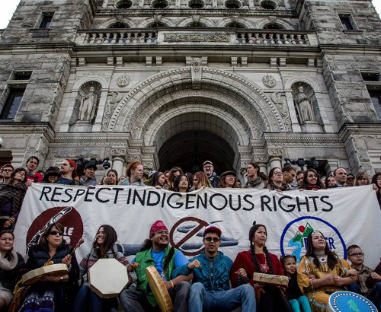
Indigenous Rights in Canada

Slide 2
Indigenous Rights
Collective Rights: The rights of the group, rather than the rights of the individual.
Indigenous People's have occupied Canada for thousands of years. This is one of the reasons rights have been collective; as a group since Europeans came to North America, they have been oppressed.

Slide 3
Cultural Genocide
”Acts and measures undertaken to destroy nations' or ethnic groups' culture through spiritual, national, and cultural destruction.” (American Genocide Museum)
Canada has committed cultural genocide to Indigenous Peoples. View the video on our website that explains a small portion of our history.

Slide 4
Indian Act - 1868
By Confederation, European immigrants had flooded to Canada and had used their power to remove Indigenous Peoples from their lands and force them onto reserve lands.
Indian Act of 1868 defined who was “Indian” and essentially removing any self governing of Indigenous Peoples.
It restricted Indigenous freedoms and allowed officials to determine Indigenous rights and benefits based on “good moral character.” (Canadian Encyclopedia)

Slide 5
How the Indian Act Systematically Destroyed Indigenous Culture
First Nations peoples and communities from expressing their identities through governance and culture.
Hereditary chiefs — leaders who acquire power through descent rather than election — are not recognized by the Indian Act.
Women were excluded from band council politics
Made it illegal for First Nations peoples to practice religious ceremonies and various cultural gatherings.
1895, “any Indian festival, dance or other ceremony,” which would include powwows and the sun dance, were banned.
Illegal for First Nations peoples and communities to hire lawyers or bring about land claims against the government without the government’s consent.
Residential schools were put into affect (1894 and 1920)
19th and early 20th centuries, the Indian Act was used to support the pass system (restricted the movement of First Nations peoples off reserves) and the sale of goods on and off reserves

Slide 6
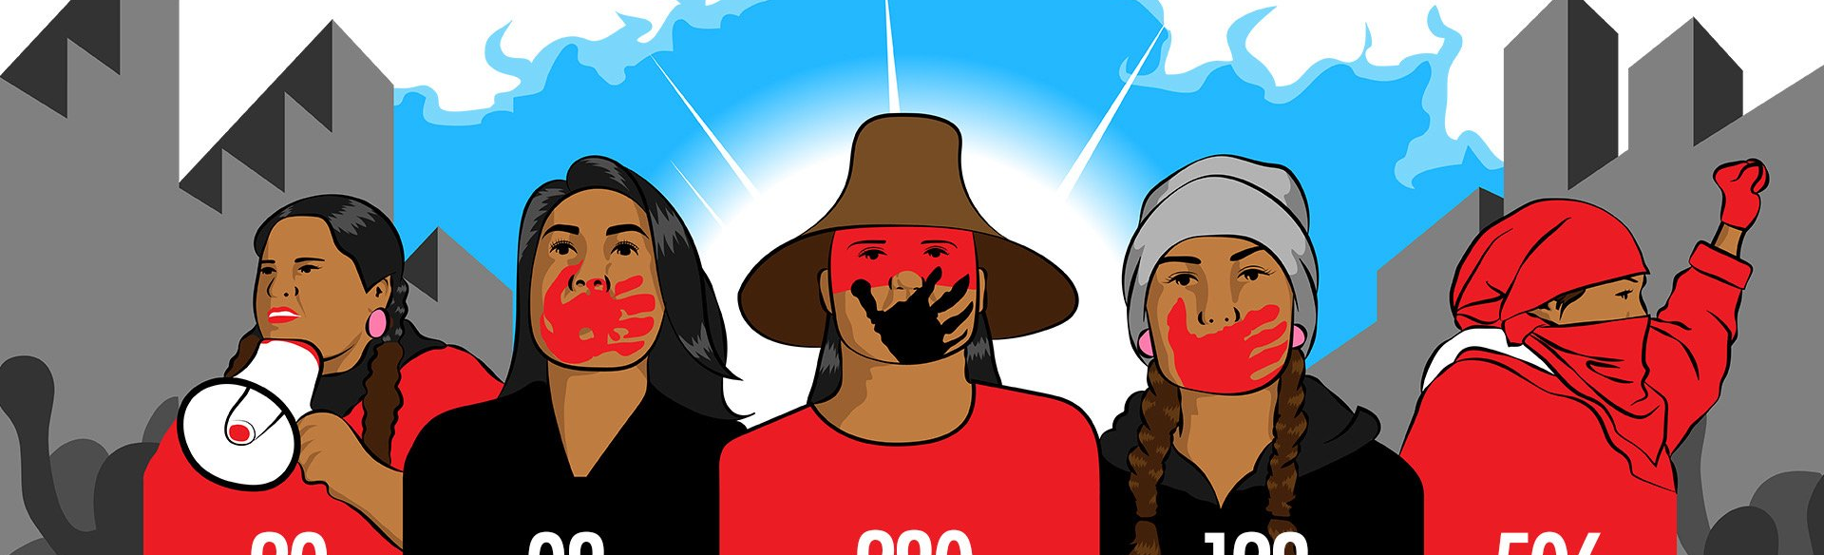
Missing and Murdered Indigenous Women
Watch the video on Missing and Murdered Indigenous Women from Al Jazeera on our website.
Why is it a failure that private citizens have to look in the river for bodies?
Why do you think Indigenous Peoples do not trust the RCMP?
Why are children being put in foster care? How is this a failure of the entirety of Canada?
How are residential schools related to missing and murdered indigenous women?
What do you think it means that there is a “harmful power dynamic in which indigenous girls are at the bottom”?

Slide 7
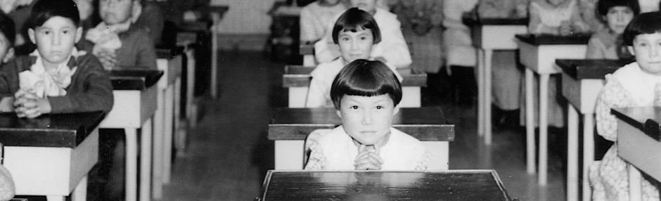
Murdered Residential School Children
Watch the short video on abused and murdered indigenous school children.
What are the lasting effects of the trauma on survivors?
Why might nuns and priests not share their diaries?

Slide 8
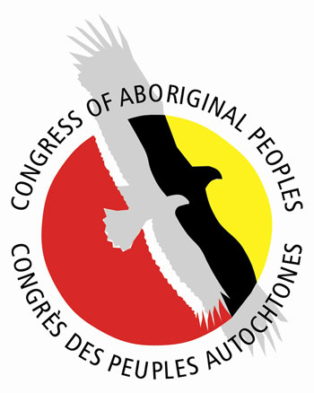
Indigenous Rights Groups
Assembly of First Nations (AFN)
Congress of Aboriginal Peoples (CAP)
Inuit Tapiriit Kanatami (ITK)
Métis National Council (MNC)
Native Women's Association of Canada (NWAC)

Slide 9
Important Indigenous Human Rights Events
Visit the link on our website and choose 1 event that occurred Post 1984 and be prepared to explain why you chose it to the class.

