Slide 1
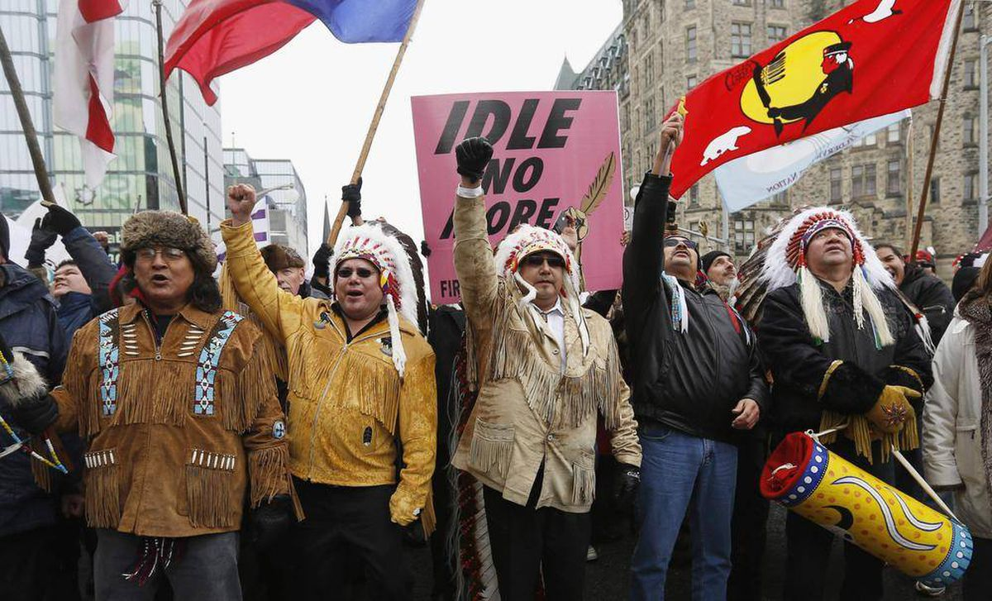
A History of Nationalism In Canada
Who is Canada?

Slide 2
Origins of Canada
Land Bridge Theory
Canada like the United States, Australia, and much of South America, is a settler colonial country. It was originally founded by people who moved to this part of the world from somewhere else.
Indigenous Peoples settled in the Americas many thousands of years ago.

Slide 3
First Peoples
Most archaeological and genetic analysis seem to agree that there were permeant settlements in North America at least 20 000 years ago.
So Canada 150, really wasn’t Canada 150.
There is more human history in The New World than in the histories of Hinduism, Judaism, Buddhism, Christianity and Islam combined.

Slide 4
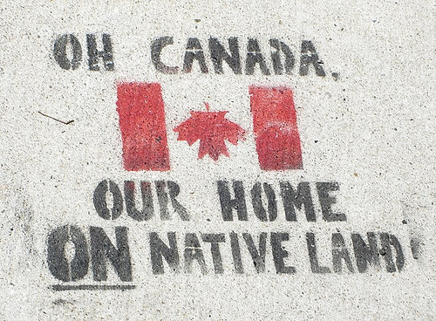
What is Nationalism?
Common language, common cultural practices, religion, ethnicity, activities, history.
Territorial Ownership and Boundaries
- 95 percent of history in North America was played out before Europeans arrived. Language, culture, belief systems were created before Europeans arrived. Was there nationalism before Europeans?

Slide 5
Colonialism & Imperialism
Colonialism is establishing, acquiring and maintaining colonies.
Any discussion of Indigenous Peoples in the context of Canada or the political entity that is the Canadian government must be framed by the concept of colonialism.
A colony is under the control of a government from some other part of the globe.
Imperialism is state policy, practice, or advocacy of extending power and dominion, especially by direct territorial acquisition or by gaining political and economic control of other areas.

Slide 6
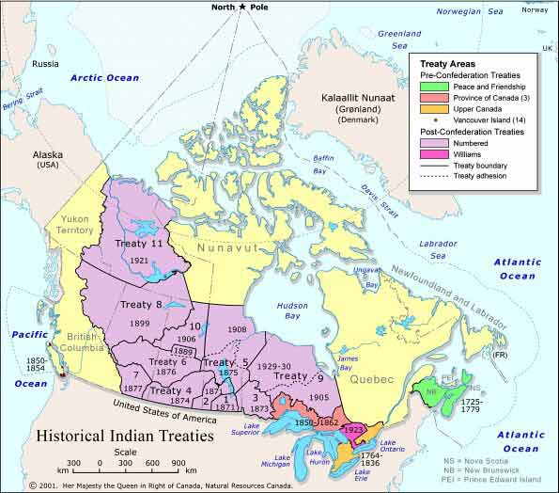
Timeline of The Canadian Government and Indigenous Peoples
1763 – Royal Proclamation acknowledged Indigenous rights to land (was ignored - ”Indian Territory” land could not be settled without Crown approval.
1830 – Previously Indigenous Peoples received lump some payments and later annuities, reserves instead were instituted from this point.
1850 – First treaties of this kind were instituted.
Post Confederation – Treaties to the right were created for the transcontinental railway, contained extinguishment clause, which removed previous treaty rights for new ones.
1867 – Indigenous Peoples were ignored in the creation of Canada except the Constitution Act gave jurisdiction over their lands to the Federal Government without their consent

Slide 7
The Indian Act of 1876
Consequences:
Discrimination and indignities that reflect a colonial mentality
Indigenous forms of government and medicine were banned
Voting rights denied until 1960
Between 1927 and 1951 it was illegal to hire a lawyer to bring a claim
Indigenous babies were frequently removed from reserves and moved to non – indigenous parents
150 000 indigenous children were forced into residential schools forced renounce their identity, punished, assaulted for speaking in their mother tongue and practicing cultural traditions
Hundreds maybe thousands were murdered.
The basic aim was to assimilate indigenous people into the new white majority. Genocide.
The act provided the Federal government with control over almost every aspect of indigenous life and encouraged “enfranchisement” which encouraged Indigenous People to give up their status as “Indians”

Slide 8
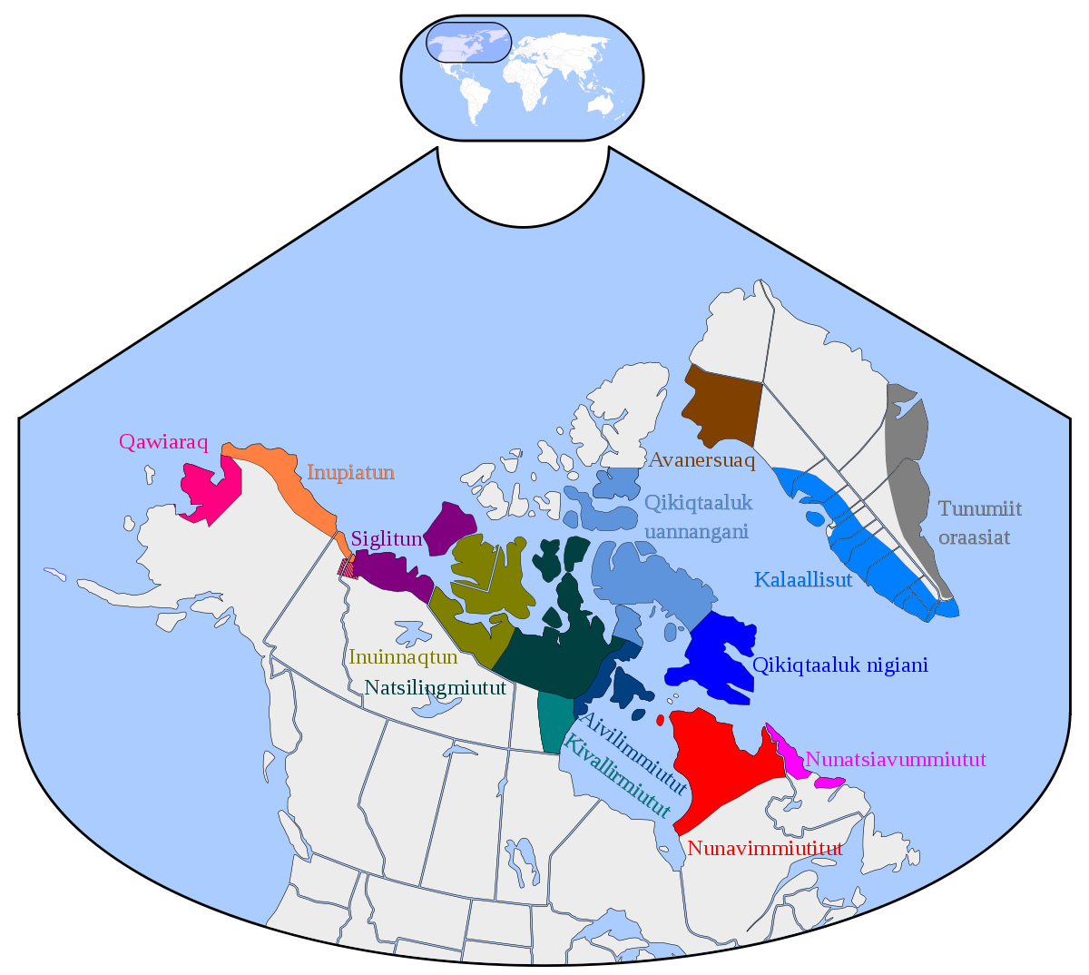
The Inuit
1939 – Supreme Court ruling declared the Inuit came within the meaning of “Indians” in the 1867 Constitution Act, but not Indian Act
1950s - Government provides health and education services
Government later relocated Inuit communities into about 50 permanent settlements on the coast of the Arctic mainland, Hudson Bay, Northern Quebec
- This disrupted hunting and trapping and caused an increased dependance on the Government

Slide 9
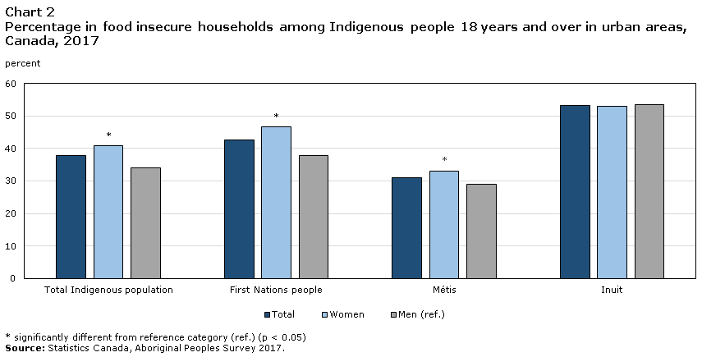
Consequences of Imperialism for Indigenous Peoples - Poverty
The legacy of colonialism and forced assimilation continues today.
- Many indigenous families have incomes far below the poverty line.

Slide 10
Social Exclusion
Social exclusion means a lack of belonging, acceptance and recognition. People who are socially excluded are more economically and socially vulnerable, and hence they tend to have diminished life experiences
Poverty is one of the key factors in exclusion.
The CCSD report, The Progress of Canada's Children 2002, found that children living in poor families are:
- less likely to have positive experiences at school
less likely to participate in recreation
twice as likely to live in a "dysfunctional" family
twice as likely to live with violence
three times as likely to live with a depressed parent
All risk factors for social exclusion

Slide 11
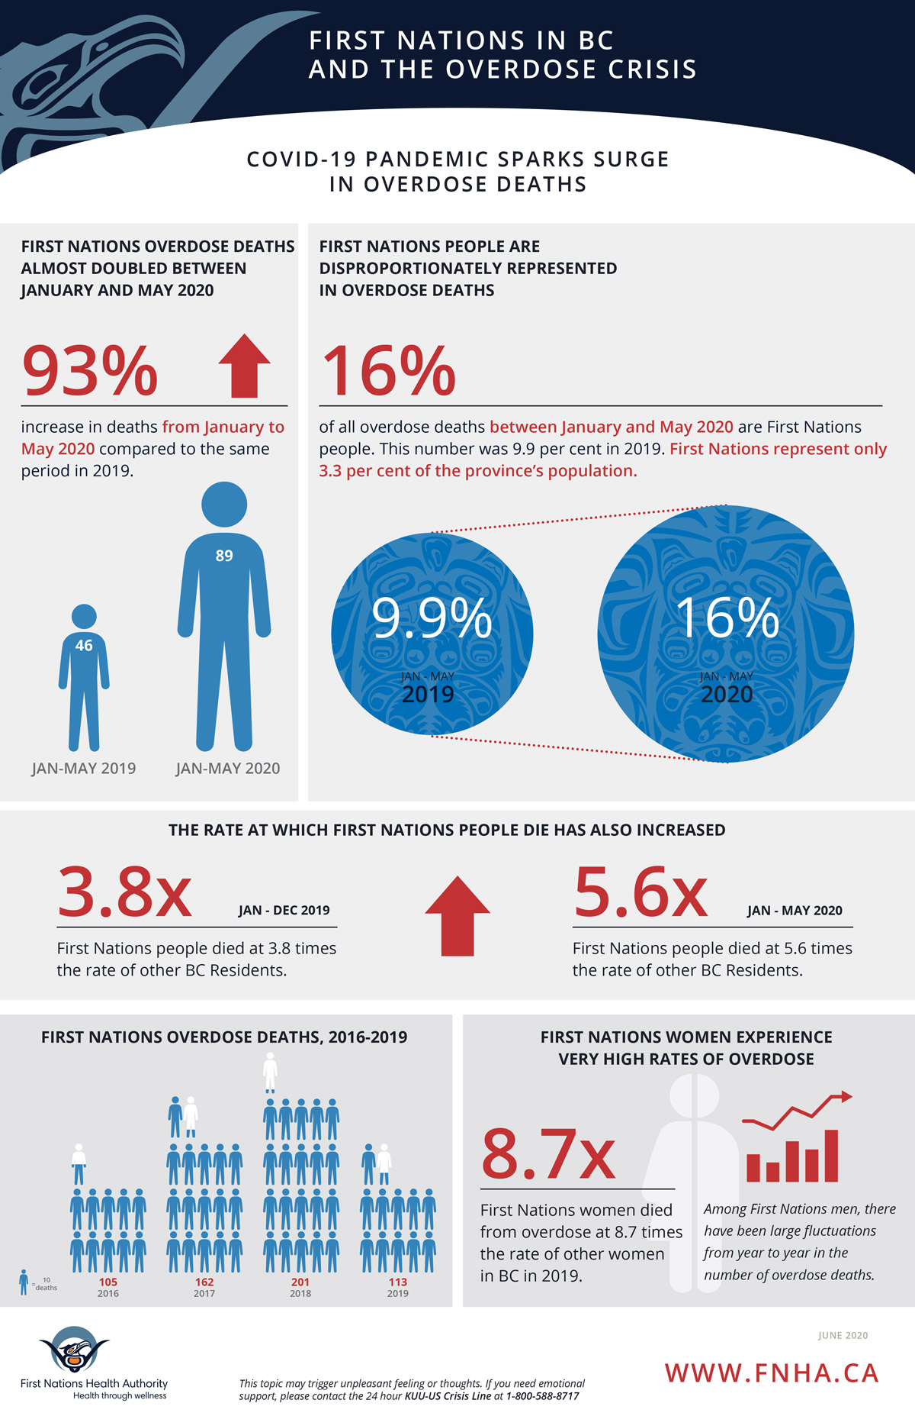
Further Consequences of Imperialism for Indigenous Peoples
Related to their poverty level are alarming rates of indigenous alcoholism, violence, mortality, low educational attainment, and high unemployment.
Ages 25 – 64 9.8% of Indigenous Peoples had a university degree compared to non – Indigenous peoples at 26.5%

Slide 12
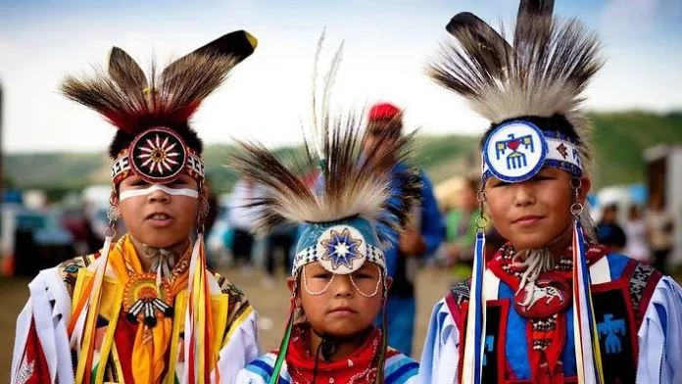
Reflection
I asked you before what makes Canada, Canada and what makes one Canadian? If Canada’s history dates back 20 000 years, does anyone who’s family immigrated here in the last 100, 200, 300 years, really know what it is to be from here?
Watch the short Indigenous history on our website.
Watch the Residential Schools Video on our website.
Read the Historical Approaches Reading on our website and answer the 3 questions for reflection.

