Slide 1
Economic Systems
Types of Economies and Politics

Slide 2
Economic Systems
What a country produces and in what quantities?
How should scarce resources like land, labour and capital be allocated?
How should goods and services be distributed throughout the country?
What should be the price of goods and services?

Slide 3
A Market Economy
“The statesman who should attempt to direct private people in what manner they ought to employ their capitals, would not only load himself with a most unnecessary attention, but assume an authority which could safely be trusted, not only to no single person, but to no council or senate whatever, and which would nowhere be so dangerous as in the hands of a man who had folly and presumption enough to fancy himself fit to exercise it.” – Adam Smith
In your groups read and then be prepared to explain this quote.

Slide 4
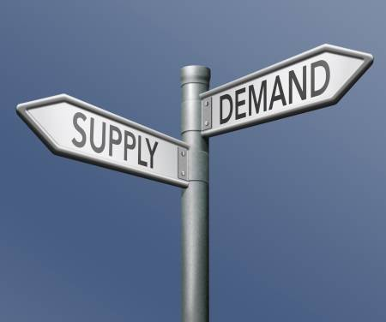
Characteristics
Private Property – private ownership of property
Profit – self interest, economic gain,
Competition – companies compete on quality, services, price, reputation and other areas. The result is to is in theory greater selection of goods and services and only ones demanded by the market (people)
Look At The Example: USA
How do supply and demand illustrate a Market Economy?
Watch the video and read the handout. How is the USA / New York Portrayed? How does this illustrate the characteristics of a Market Economy?

Slide 5
Centrally Planned/Command Economy
Private Property: restricted, mostly owned by the government. People may own small houses or plots of land.
Profit: All profit in some way belongs to the government. The government is in control of revenue.
Competition: limited, The government determines price, quality, style, amount of goods and services made/sold.
Cuba?
Singapore?

Slide 6
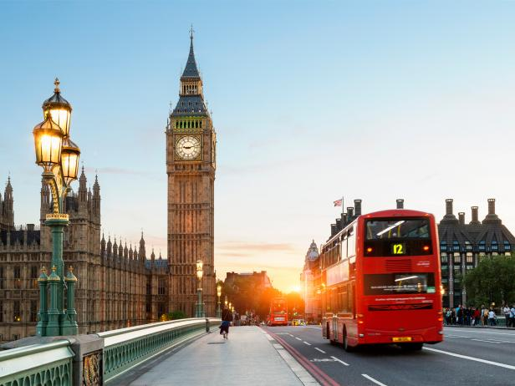
Mixed Economy
Private Property: owned by individuals, corporations and government. The government owns schools, parks, real estate and other essential services
Profit: encouraged, but taxed to support government projects
Competition: strong competition exists but the government may also compete
Denmark
England

Slide 7
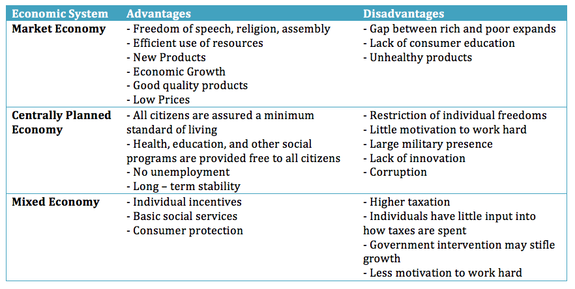
Advantages and Disadvantages
Read the textbooks advantages and disadvantages. Do you sense a bias from the text towards one area or another? Do you agree with the textbook’s evaluation?

Slide 8
Reflect
Which economic system do you like most? Why?
Can you match the economic system with the type of government it will most likely go with?
Look at the videos on Lobbyists on our website. Do you think they are more positive or negative for society?

