Slide 1
Human Rights

Slide 2
Important Terminology
Discrimination – Treating a person differently or adversely for no valid reason.
Stereotyping – Judging one person of a group and applying that judgment to all members of that group.
- Ex: You see your neighbour hit a pole with their car and you then say all women are bad drivers.
Prejudice – An opinion or judgement, especially an unfavorable one, based on irrelevant considerations or inadequate knowledge.
Ex: All women are bad drivers therefore your attitude towards all women is negative.
Go to our website and read about ethnocentrism and white saviorism.

Slide 3
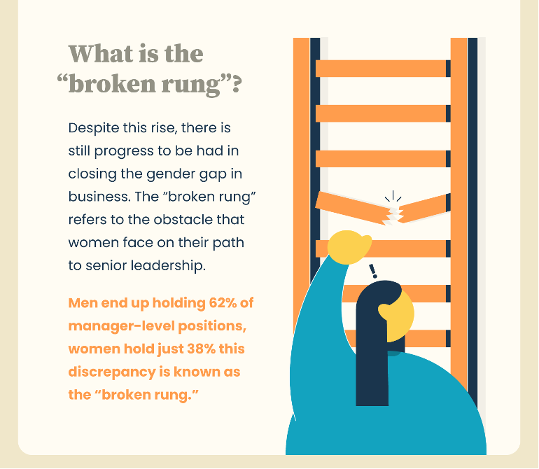
Discrimination in Action
So the owner of a taxi company thinks all women are bad drivers and therefore refuses to hire women for his company.
Macro Example: The CEO of a fortune 500 company (say Walmart) thinks all women are too emotional and therefore cannot make important rational decisions; therefore, he refuses to let them climb the corporate ladder in his company and they never get higher management positions. Extend this further, if large numbers of women don’t get this experience it makes the ladder broken and impossible to climb for everyone.

Slide 4
Human Rights
The rights of an individual that are considered basic to life in any human society, including the right to religious freedom and equal opportunity; when such rights require protection, intervention by the government is necessary.
Human Rights legislation’s goal is to prevent discrimination in society by providing deterrents to offenders and ensure everyone has adequate access to basic needs such as food, water and shelter.
Most importantly human rights involve respecting one another and not discriminating against others.

Slide 5
History of Human Rights
Go to our website and watch the short video on the history of human rights. Then visit the Universal Declaration of Human Rights and complete the activity.

Slide 6
Canadian Human Rights Act
The CHRA came into force in 1978.
Applies to federal departments and businesses that fall under government control
Function is to investigate complaints concerning possible human rights violations, to provide legal procedures to hear the complaints and try to find solutions.
Each province and territory has its own human rights law usually called a code.
Ontario Human Rights Commission founded in 1961
The complainant must prove there was undue hardship that the change effected the economic viability of the employer. They do this through balance of probabilities whereby the complainant must show a “greater likelihood” as opposed to beyond a reasonable doubt.

Slide 7
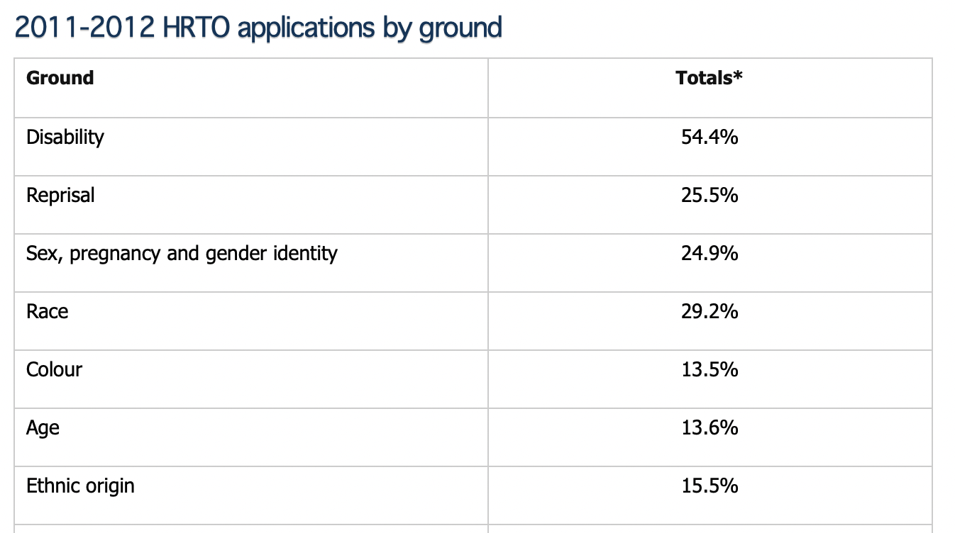
Discrimination in Ontario
The OHRC reviewed all applications (formerly known as “complaints”) filed with the Human Rights Tribunal of Ontario (HRTO) citing creed as a ground of discrimination in the 2010-11 fiscal year
Relative to their population size, members of the Jewish (15 or 10.7%), Hindu (10 or 7.1%), Traditional Aboriginal (4 or 2.9%) and Sikh (3 or 2.1%) faiths accounted for a disproportionate number of 2011-2012 HRTO creed applications
Go to our website and read the case of Blainey v. Ontario Hockey Association and OHRC (1986)

Slide 8
Human Rights Issues in Canada
Japanese Internment Camps
1941: Canada began seizing some 12,000 fishing boats belonging to Japanese Canadians and selling them off to mostly white fishermen
1942: B.C.'s Japanese population of approximately 22,000 were forced into internment camps throughout the interior.
Federal government confiscated their agricultural property and personal possessions and allowed them to be auctioned off or sold at low prices.
1988: the Government of Canada ​formally apologized and offered compensation
Together we will hear Japanese Canadian David Suzuki discuss Japanese Interment Camps

Slide 9
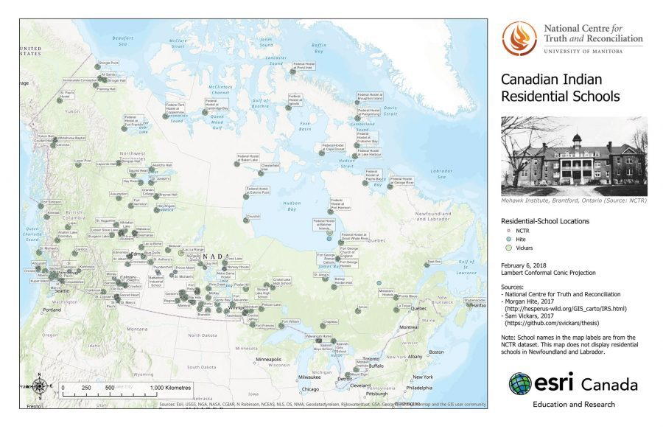
Human Rights Issues in Canada
Residential Schools
Residential School system operated across Canada between the 1870s and the 1990s
-More than 150,000 First Nations, Inuit and Métis children from across the country were forced to attend Indian Residential Schools
Go to our website and visit the link and learn about Residential Schools in Canada.

Slide 10
Human Rights Issues in Canada
Water on Indigenous Lands
20+ years Some of the advisories date as far back as 1995 – like Neskantaga First Nation.
A single drinking water advisory can mean as many at 5,000 people lack access to safe, clean drinking water.
73 per cent of First Nations’ water systems are at high or medium risk of contamination.
The lack of clean, safe drinking water in First Nations is one of the greatest violations of the UN-recognized human rights to water and sanitation.
still 34 long term drinking water advisories
There is also a deficit in funding for the maintenance and operation of drinking water systems on reserves, which the Parliamentary Budget Officer identified as amounting to $138 million per year.

Slide 11
International Human Rights Awareness Assignment – 10%
Go to our website and visit the link to the United Nations Human Rights Commission. Choose 1 human right you are passionate about and would like to create awareness about here at our school. Only one person may choose each topic.
Note: Exception – If one person would like to choose Indigenous Access To Clean Water in Canada you may.

