Slide 1
Healthcare
Issues in Canada

Slide 2
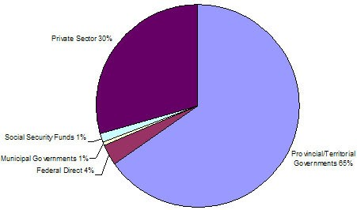
Healthcare in Canada
Total Health Expenditures 2010
Is Publicly funded for Everyone
“Medically necessary health care services provided on the basis of need, rather than the ability to pay.” (Government of Canada)
Demonstrates Canadian Values
“Basic values of fairness and equity that are demonstrated by the willingness of Canadians to share resources and responsibility are displayed in Canada's health care system.”

Slide 3
Canadian Health Care Act
The five Canada Health Act principles provide for:
Public Administration: The provincial and territorial plans must be administered and operated on a non profit basis by a public authority accountable to the provincial or territorial government.
Comprehensiveness: The provincial and territorial plans must insure all medically necessary services provided by hospitals, medical practitioners and dentists working within a hospital setting.
Universality: The provincial and territorial plans must entitle all insured persons to health insurance coverage on uniform terms and conditions.
Accessibility: The provincial and territorial plans must provide all insured persons reasonable access to medically necessary hospital and physician services without financial or other barriers.
Portability: The provincial and territorial plans must cover all insured persons when they move to another province or territory within Canada and when they travel abroad. The provinces and territories have some limits on coverage for services provided outside Canada, and may require prior approval for non-emergency services delivered outside their jurisdiction.

Slide 4
Who is Responsible for What?
Federal
Setting and administering national principles for the system under the Canada Health Act
Financial support to the provinces and territories through cash and tax transfers to the provinces and territories in support of health through the Canada Health Transfer
Funding and/or delivery of primary and supplementary services to First Nations people living on reserves; Inuit; serving members of the Canadian Armed Forces; eligible veterans; inmates in federal penitentiaries; and some groups of refugee claimants
Provincial
The roles of the provincial and territorial governments in health care include:
administration of their health insurance plans;
planning and funding of care in hospitals and other health facilities;
services provided by doctors and other health professionals;
planning and implementation of health promotion and public health initiatives; and
negotiation of fee schedules with health professionals.

Slide 5
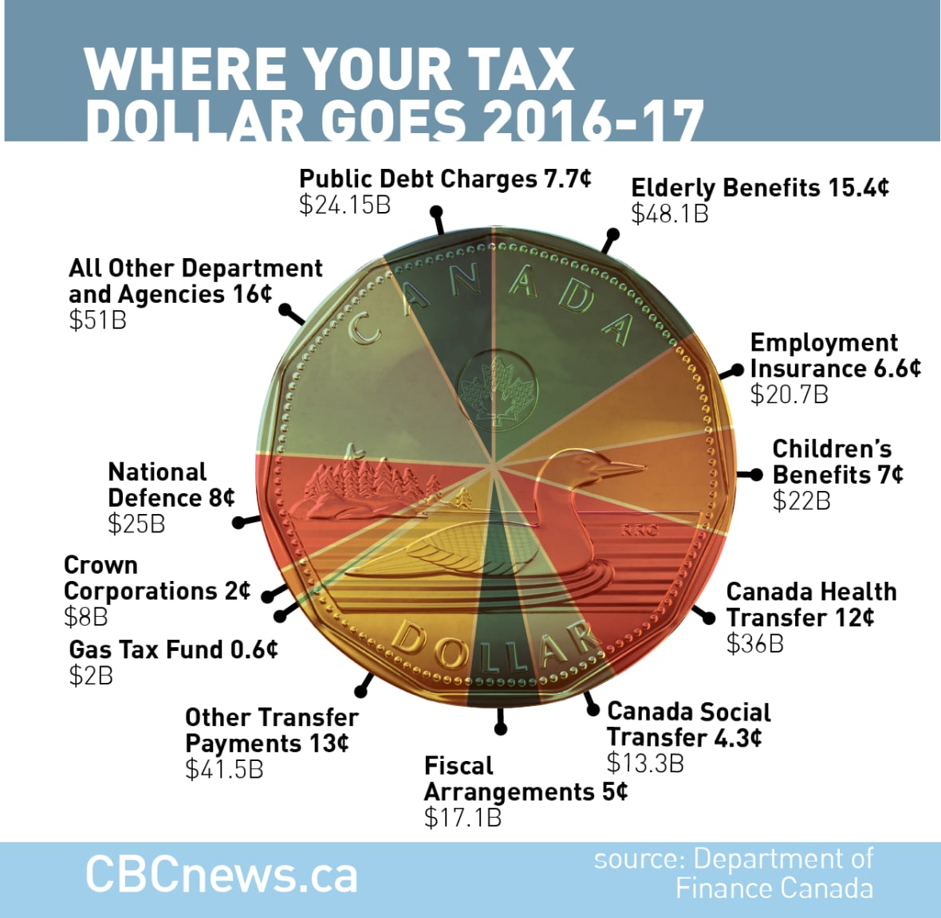
How Its Paid For
The universal health-care system is paid for through taxes.
Publicly funded health care is financed with general revenue raised through federal, provincial and territorial taxation, such as personal and corporate taxes, sales taxes, payroll levies and other revenue.
Each province and territory has their own health insurance plan
All provinces and territories will provide free emergency medical services, even if you don’t have a government health card.

Slide 6
Issue #1 – What is Paid For and What is Not
Government health insurance plans give you access to basic medical services. You may also need private insurance to pay for things that government plans don’t fully cover.
The most common types of plans are extended health plans. These cover costs for:
prescription medications
dental care
physiotherapy
ambulance services
prescription eyeglasses
What if any do you think should be covered? How would we pay for it?

Slide 7
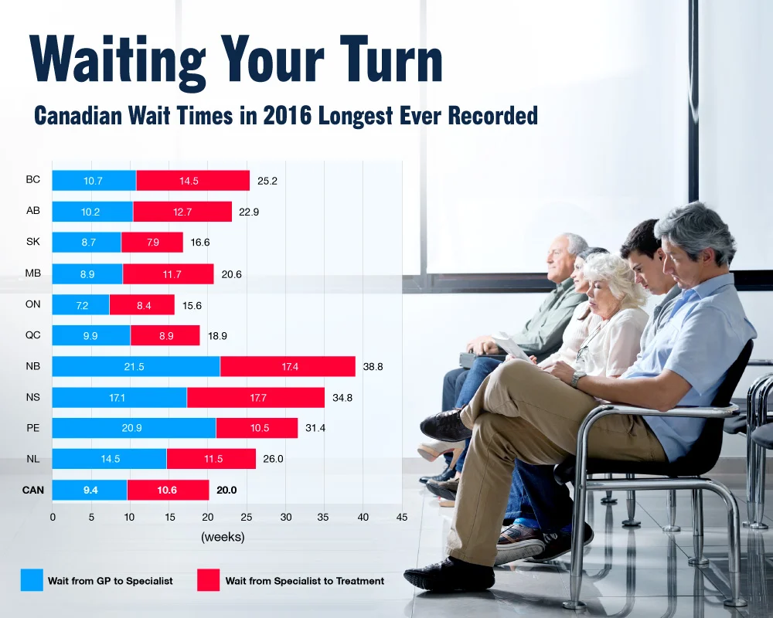
Issue #2– Freedom and Wait Times
Read the article linked on our website about wait times. How can wait times be solved?

Slide 8
Issue #3 – Covid 19
Watch the videos on our website and reflect.
- Should healthcare workers be mandated to be vaccinated?
- Does it violate Charter Rights?
- What is more important, individual freedom or the collective health and safety of society?
- Should the notwithstanding clause be used?

