Slide 1
Gender
Women’s & LGTBQ+ Rights

Slide 2
Feminist Movement
Together believed that gender consciousness is important.
Traditional male definitions of politics are too narrow (did not take into account women’s participation in community groups, charities, and other informal local networks)
In certain situations women need to be treated differently than men to obtain equality.
Visit the link on our website to a timeline of Women in Canadian History. Choose one you think is most important and be prepared to tell the class about her.

Slide 3
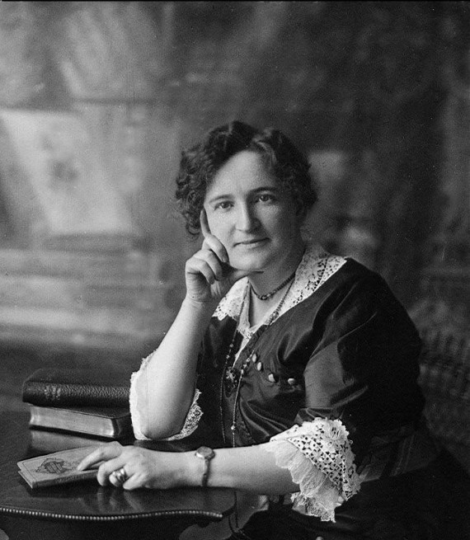
Some Important Moments Pre - 1970
On January 28, 1916, Manitoba became the first province in Canada to extend the franchise to women voters.
Nellie McClung - asked the members of the legislature: "Have we not the brains to think? Hands to work? Hearts to feel? And lives to live?" "Do we not bear our part in citizenship? Do we not help build the Empire? Give us our due!”
It would be another 10 years before the Famous Five won the Persons Case Victory, and it was not until 1940 that Quebec women won the right to vote in provincial elections. In 1960 First Nations were allowed to vote without giving up treaty rights.
1921 Agnes Macphail became the first woman elected to the House of Commons.
1940 Quebec franchised women to vote.
1960 Birth Control Pill was invented and in 1969 advertisement of birth control devices in Canada and the Divorce Act was introduced that same year.

Slide 4
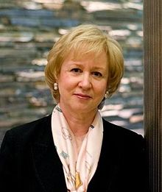
Kim Campbell
First Female PM 1993
Progressive Conservative
Linda Trimble described a media that made it palatable for her to lose the election to Jean Chretien.

Slide 5
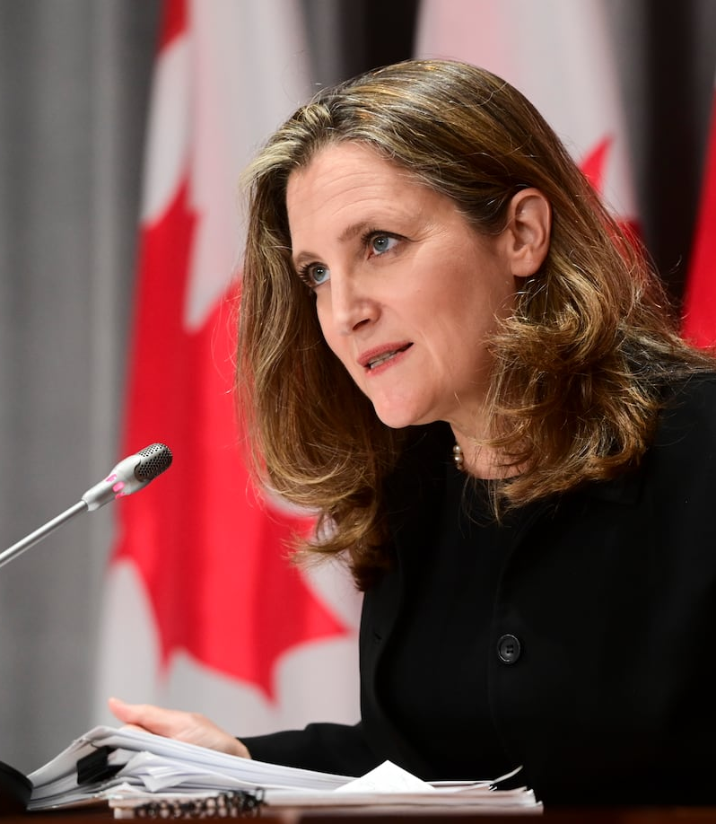
Women in the House of Commons
Representatives By Year
Year - 1972 Women Representatives– 4
Year – 1997 Women Representatives – 62
Year - 2019 Women Representatives – 98
Trudeau’s Appointments 2021
Anita Anand as defence minister
Chrystia Freeland deputy Prime Minister and Minister of Finance
Mélanie Joly Minister of Foreign Affairs

Slide 6
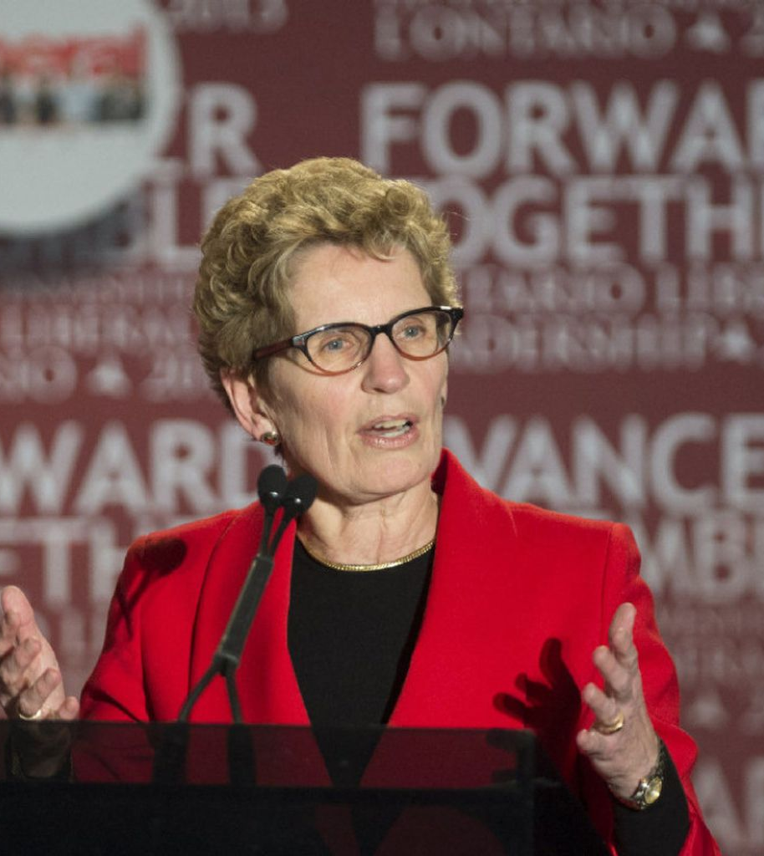
Kathleen Wynne
First was the first female premier of Ontario and also a lesbian – the first LGBTQ+ person to lead a federal or provincial government in Canada.

Slide 7
How Women Respond In Politics
Women are slightly more likely than men to prefer Liberals and NDP over the Conservative party.
Women are less supportive of individualism and market forces
Women are more supportive of social programs to help those in need
Women are more tolerant of new lifestyles and changing values
(Sevi, 2018)

Slide 8
Issues Surrounding Gender in Politics

Slide 9
#1 - Employment
Women constitute 48% of the labour force
Women have traditionally been paid less than men, underreported in managerial positions and discouraged from undertaking nontraditional occupations.
Pay Equity: 1997 women women’s full time earning shad rising to an average of about 70% of men’s.
In 2017 females 15 years of age and older earned 87% of what males earned.
2018 The Supreme Court of Canada Ruled on 2 cases. The court recognized pay equity as a fundamental human right and that restrictions are a violation of Charter Right 15” Every individual is equal before and under the law”

Slide 10
Where Are Women Employed?
Traditional Workplaces
Healthcare and Social Assistance (74.1%)
Accommodation and Food Services (59.1%)
Educational Services (52.1%)
Non – Traditional Advancements
STEM (Science, Technology Engineering and Math) up 7% to 38.8%
Self - Employment 18.5% (up from 17.7%)
Part – Time Work
18.5% compared to 5.5% of men
Unpaid Work
Women are estimated to do 50% more unpaid work than men
The value economically is difficult to calculate and monetarize, but that does not make it any less important

Slide 11
Senior Management
The percentage of women CEOs, is up from 15% in 2019 to 26% in 2021(while the percentage of women HR Directors is down to 38% in 2021 from 43% in 2019).
Canada’s Top 100 Companies only 10% of EOs are women.
In Canada, 36% of senior management positions are held by women in 2021
2018 Trudeau passed Bill C-25 that requires companies to disclose their hiring policies on diversity
Brenda Rideout

Slide 12
#2 - Murdered Indigenous Women
NWAC has gathered information about 582 cases of missing and murdered Aboriginal women and girls. Of these:
67% are murder cases (death as the result of homicide or negligence);
20% are cases of missing women or girls;
4% are cases of suspicious death—deaths regarded as natural or accidental by police, but considered suspicious by family or community members;
9% are cases where the nature of the case is unknown—unclear whether the woman was murdered, is missing or died in suspicious circumstances.
Aboriginal women and girls represented approximately 10% of all female homicides in Canada. However, Aboriginal women make up only 3% of the female population. (Native Women’s Association of Canada)
Watch the video on our website that details what is being done about this tragedy. What more should be done do you think?

Slide 13
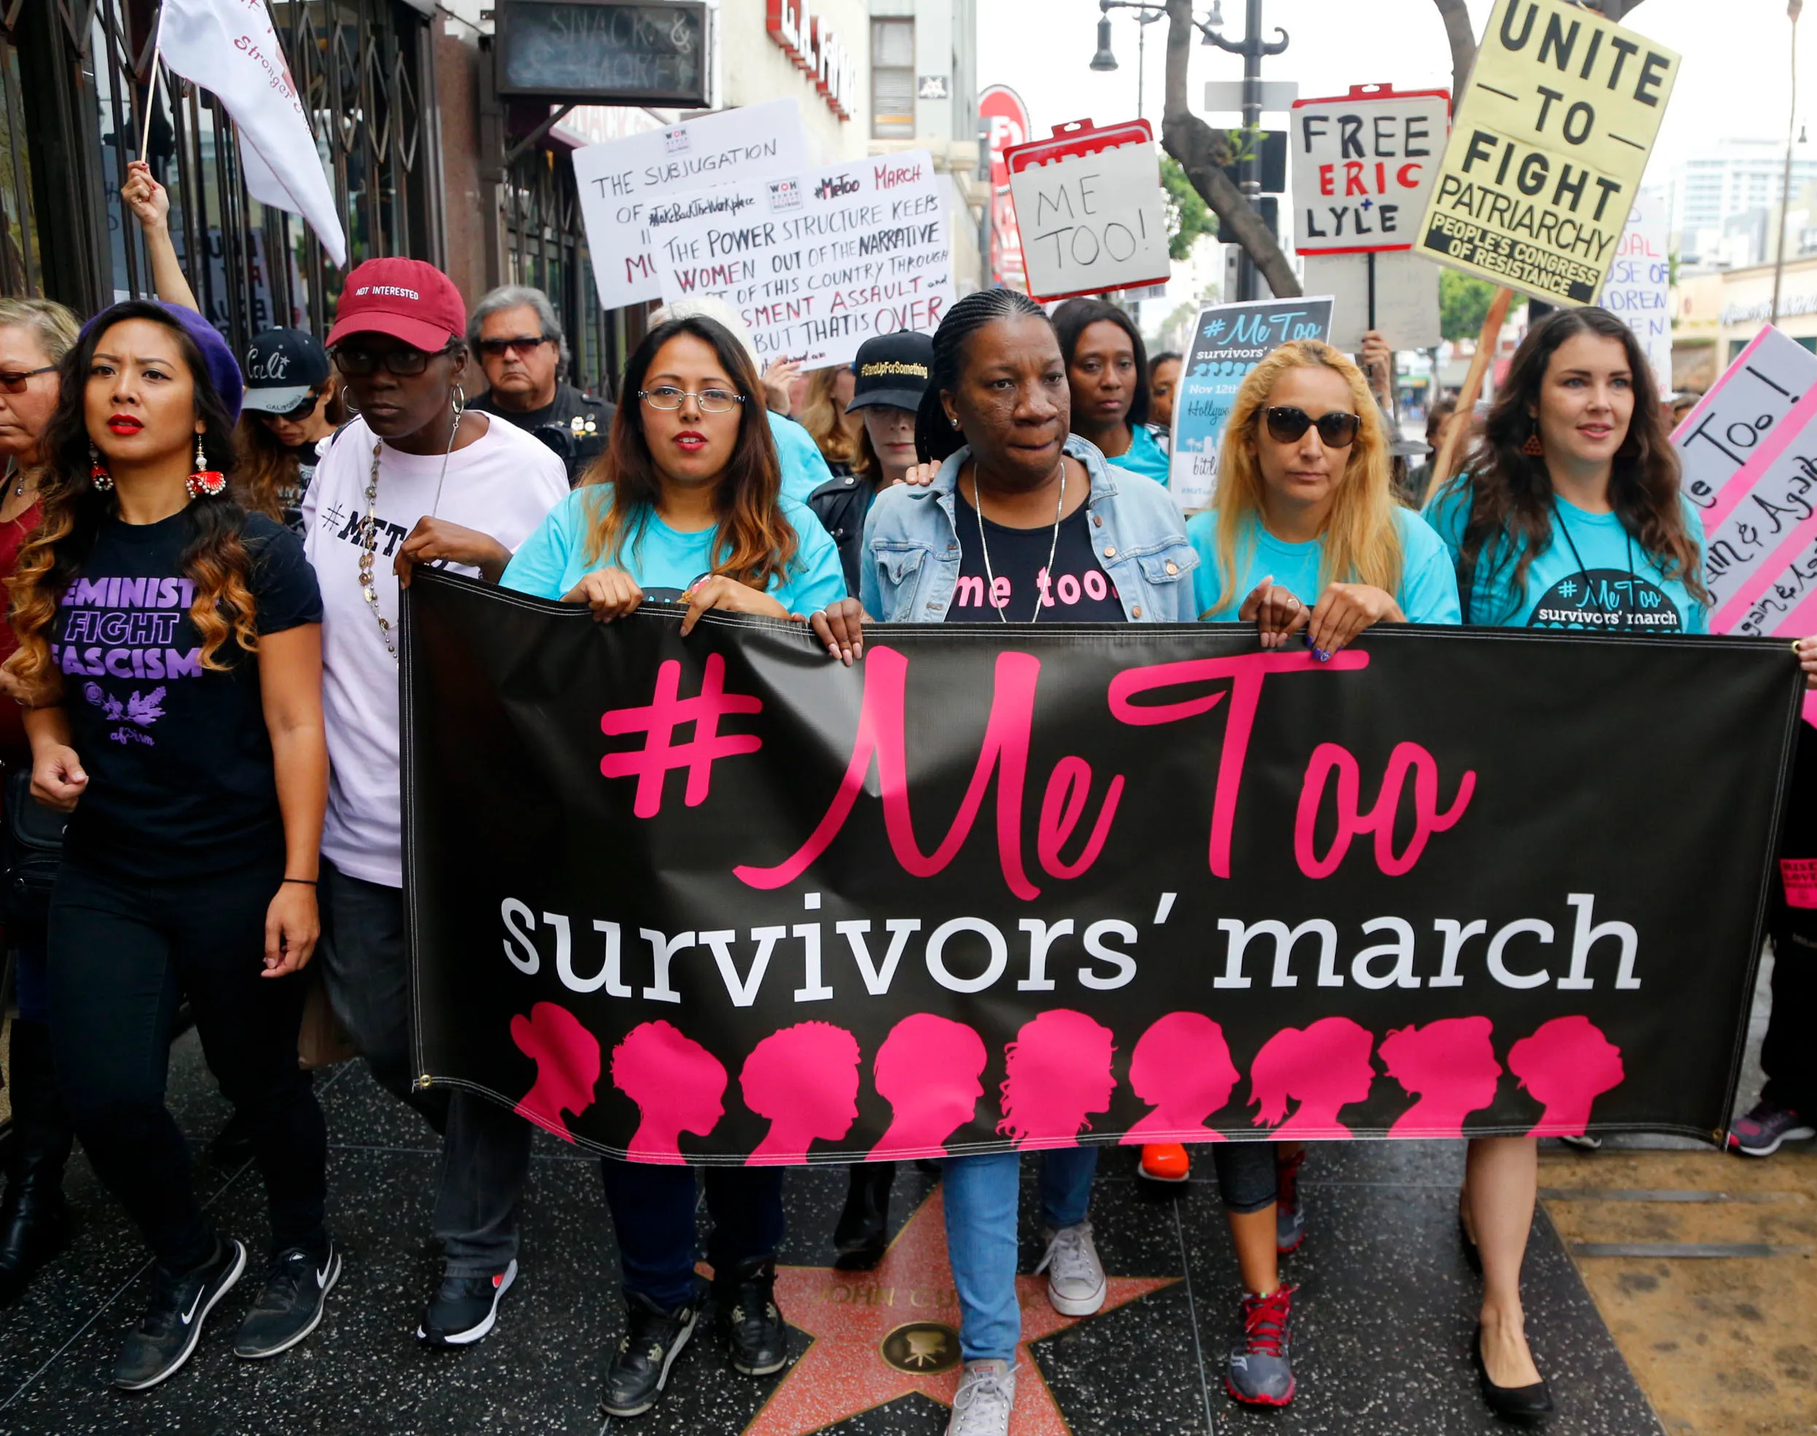
#3 - #MeeToo Movement
What is #MeeToo? Watch the following videos on our website to get a greater understanding of this important movement. After watching the video, visit the website and be prepared to share why this is so important.

Slide 14
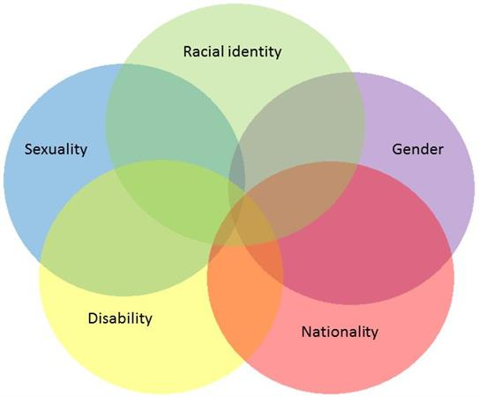
#4 - Intersectionality
First coined by Professor Kimberlé Crenshaw back in 1989
Put simply, intersectionality is the concept that all oppression is linked. More explicitly, “the interconnected nature of social categorisations such as race, class, and gender, regarded as creating overlapping and interdependent systems of discrimination or disadvantage”. (Taylor)
Intersectionality is the acknowledgement that everyone has their own unique experiences of discrimination and oppression and we must consider everything and anything that can marginalise people – gender, race, class, sexual orientation, physical ability etc.

Slide 15
Sex & Gender
Sex refers to biological differences
Gender refers to behavioral, cultural or psychological traits typically associated with one’s sex, but not necessary dependent on it. Gender is usually socially and politically constructed.
Social structures – traditions, customs, practices and intuitions are important determining how individual members of society see themselves and behave.
Gender then is an identity that is formed by social structures.

Slide 16
LGTBQ2+ & Politics
Pierre Trudeau 1970’s struck down laws against ‘sex acts in private between consenting adults’
Quebec was the first province to enact legislation prohibiting discrimination on the grounds of sexual orientation.
Federal Government took until 1996 to do this.
Section 15 of the Charter Debate: Prohibits discrimination by government or in law on the basis of ‘sex’ but not until 1995 did the Supreme Court of Canada say that also includes sexual orientation.
1998 Ontario Court of Appeals recognized same-sex survivor benefits
1999 Common Law same – sex spouses could apply for financial support from former spouses
2002 Quebec extends full parental rights to same – sex couples
2003 Ontario Court of Appeal rules that a ban on same – sex marriage was discriminatory and unconstitutional as a violation of equity rights and ordered the immediate recognition of such marriages
2004 – 2005 Minister Chretien referred the issue to the Supreme Court in the Reference re Same Sex Marriage and judges generally agreed with lower courts, Bill – C38 was passed in 2005, but Parliament debate was bitter
2011 Canadian Citizenship Guide “Canada’s diversity includes gay and lesbian Canadians, who enjoy the full protection of and equal treatment under the law, including access to civil marriage.”

Slide 17
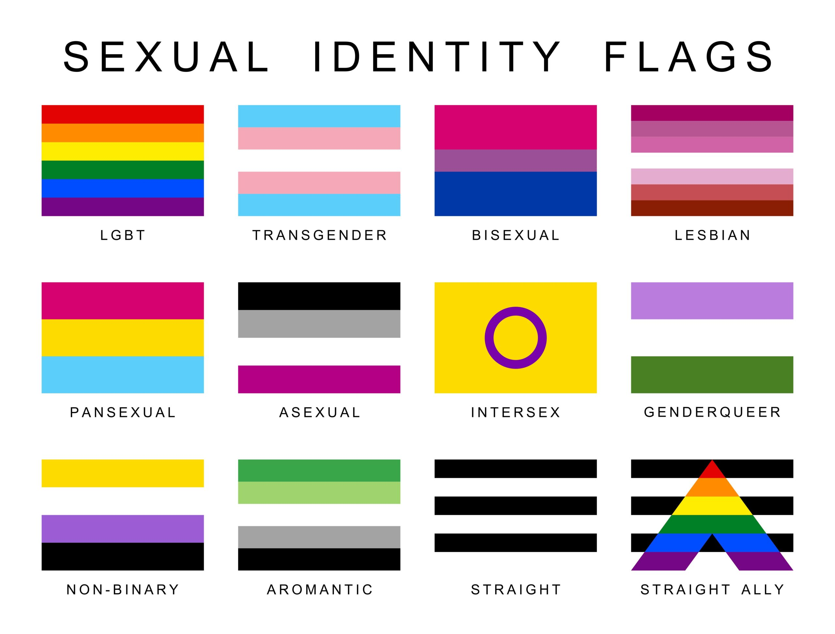
LGTBQ+ Issues
First go to our website and view the results of a 2019 poll conducted by Research Co. Look at the questions and responses.
What do you think this says about Canadians and their attitudes towards the LGTBQ2+ Community? Does anything surprise you or stand out?
- After we are going to look at a couple videos on our website that detail some of the successes and struggles the LTGBQ2+ Community face

Slide 18
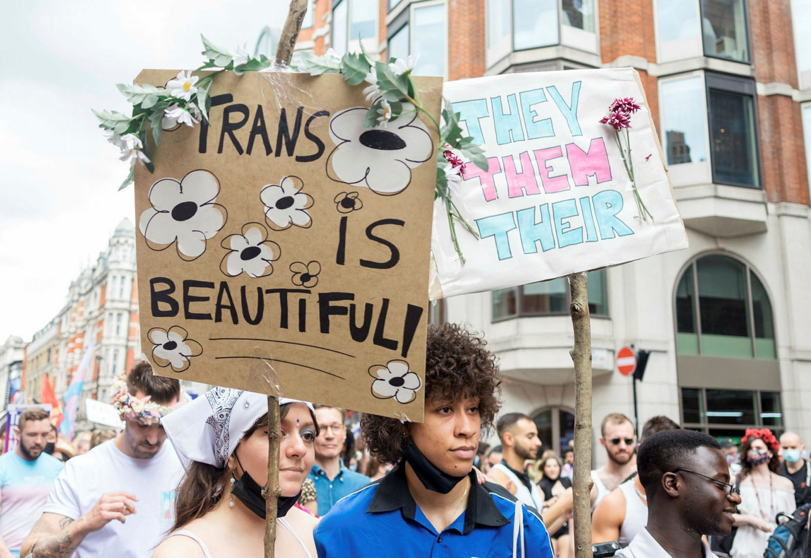
Being Transgender
Bullying, discrimination and police treatment of trans persons still are all too frequent.
2017 Parliament passed a bill to prohibit discrimination based on gender identity or gender expression.
2017 Prime Minister Trudeau apologizes to the LGTBQ2+ Community (we can watch this on our website)
2018 Parliament passes legislation to clear past convictions who where involved in consensual relations and made all such relations equal under law in 2019

