Slide 1
Brave New World
Freedom

Slide 2
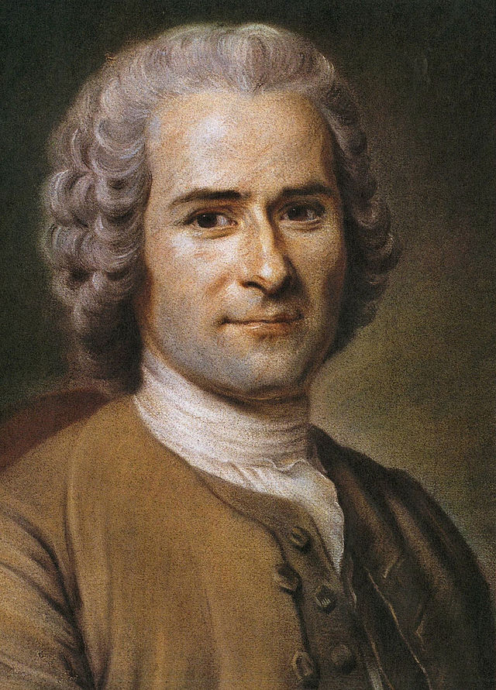
What is Freedom?
“Man is born free, but everywhere in chains.” – Jean Jacques Rousseau

Slide 3
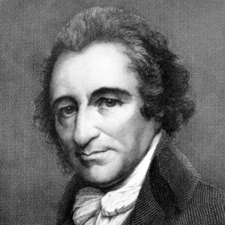
Thomas Paine
“MANKIND being originally equals in the order of creation, the equality could only be destroyed by some subsequent circumstance; the distinctions of rich, and poor, may in a great measure be accounted for, and that without having recourse to the harsh, ill-sounding names of oppression and avarice. Oppression is often the consequence, but seldom or never the means of riches; and though avarice will preserve a man from being necessitously poor, it generally makes him too timorous to be wealthy.” – Common Sense
Reflect: To yourself think about this quotation from Thomas Paine in and around 1776 and write in a short couple sentences what it means to you. There are no wrong answers here. Just write down some of your initial feelings.

Slide 4
Freedom in Brave New World
The Controller: the most powerful person in the novel. He dictates policy for the World State. He allows Bernard to bring John Back from the Reservation.
Discusses history and how people could not control their emotions because of, “obscene relationships’” pg 31 between family members. He details how the World State did away with these relationships because of mothers, “brooded over them [her children] like a cat over its kittens.” pg 32
“What with mothers and lovers, what with the prohibitions they were not conditioned to obey, what with the temptations and the lonely remorse, what with the diseases and the endless isolating pain, with the uncertainties and the poverty – they were forced to feel strongly. And feeling strongly (and strongly, what was more, in solitude, in hopelessly individual isolation), how could they be stable?” pg 35 Here Mond discusses in more detail the states desire to keep emotions calm so they, not the family, can control the people. He further discusses the importance of community and lack of individuality to control the people.

Slide 5
Chapter 16
“Sometimes a thousand twangling instruments will hum about my ears, and sometimes voice.” pg 192 – The Tempest Mond is able to quote the Shakespearean play because he can break the rules; because he is in power. In fact we learn that Mond gave up ironically science to become a Controller. He was and is a free thinker. The state needs a free thinker to control it.
“He laughed. ‘Expecting Deltas to know what liberty is!’” pg 194

Slide 6
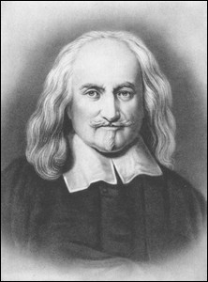
Obedience
“They that have already Instituted a Commonwealth, being thereby bound by Covenant . . . cannot lawfully make a new Covenant, amongst themselves, to be obedient to any other, in anything whatsoever, without his permission. And therefore, they that are subjects to a Monarch cannot, without his leave, cast off Monarchy and return to the confusion of a disunited Multitude; nor transfer their Person from him that beareth it to another Man, or other Assembly of men” – Thomas Hobbes, Leviathan
“We don’t want to change. Every change is a menace to stability.” – The Controller Pg 198

Slide 7
Bernard Marx
Philosopher Karl Marx: Forms of society rise and fall as they further and then impede the development of human productive power. Marx sees the historical process as proceeding through a necessary series of modes of production, characterized by class struggle, culminating in communism. - The Stanford Encyclopedia of Philosophy
Bernard Marx: Lacks any sort of control. Is angry and critical of the New World government in the beginning of the book stating, “‘How can I?’ He repeated meditatively. ‘No, the real problem is: How is it that I can’t, or rather because after all I know quite well why I can’t – what would it be like if I could, if I were free – not enslaved by my conditioning.” pg 78
Later in the novel when he improves his status he is quite happy to take soma, sleep with many women, and participate in the New World’s society. However, when he again falls from grace and his reputation suffers, he criticizes the state further the state by going with Helmholz to John when he riots. Marx is very much a social malcontent, but reflects well Karl Marx’s idea that society is in a constant transition to communism.

Slide 8
New World vs. Reservation
New World: Absolute control by the government of society through the use of science, technology in order to manipulate social structure (though ironically produces malcontents like The Controller, Marx, Helmholz, even the Director AND many more who are sent to Islands).

Slide 9
The Reservation
Fenced in by the New World. Religion, monogamy, democratic anarchy in small communities, no clean water, no consumerism, violence, rituals est.
People are free to do what they please and have formed customs and norms that are left unchecked by the New World.

